Slide 1

Face recognition using CNN
Desai Divyeswar reddy(200050033)
Kethavath Sai Yaswanth(200050061)
Reddy Bhavana(200050117)
Varre Suman Chaitanya(200050153)

Slide 2
Problem Statement
The main objective of the project is to build a custom CNN model that can recognize the faces
This feature is further used to post the appropriate attendance into the database along with timeline

Slide 3
Data Processing
It takes the video frame as input through the camera using open computer vision (OpenCV) library
whenever a new person is added in data it captures 50 images using cv2 module and it stores them in a folder called image_data.
The location of the face is identified by the automated script and a new resized image fit for the input size of the model is formed.
The images dimensions are 100*100.
All this dataset is further stored into a csv file where the image data is mapped to respective class(student id)

Slide 4
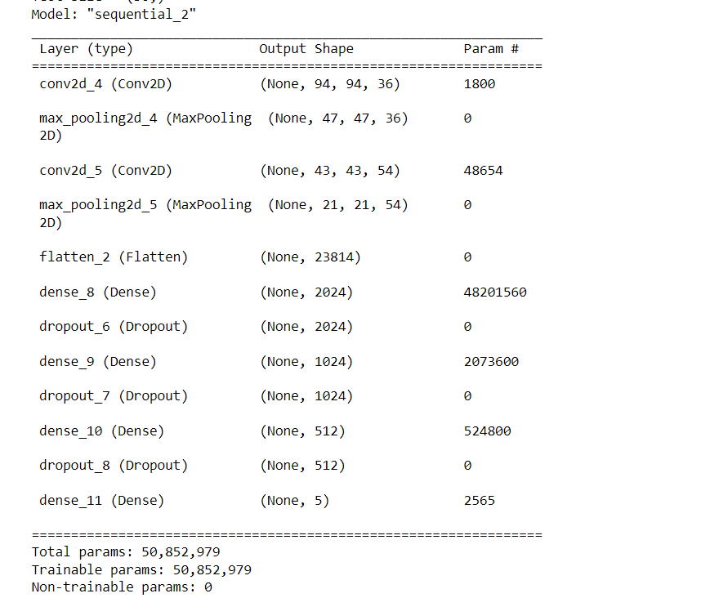
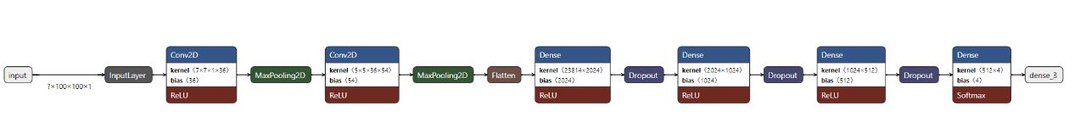
Architecture

Slide 5

Architecture
The proposed CNN model contains of 12 layers, which are Two-Dimensional Convolutional Layer(Conv2D),Max Pooling Layer, Dense Layer.
The architecture takes a image of grey scale with shape (100,100,1) and results the class label of the image as prediction

Slide 6
Attendance Marking
Whenever a user wants to mark his attendance, the program captures the image of his face and predicts his name using the pretrained cnn which was already saved in the pickle file.
After the prediction, the user will be asked to confirm his identity(to prevent false attendance markings).
If confirmed, it marks his attendance in the attendance.txt file along with the timestamp of attendance
If not confirmed, the program starts predicting again.

Slide 7
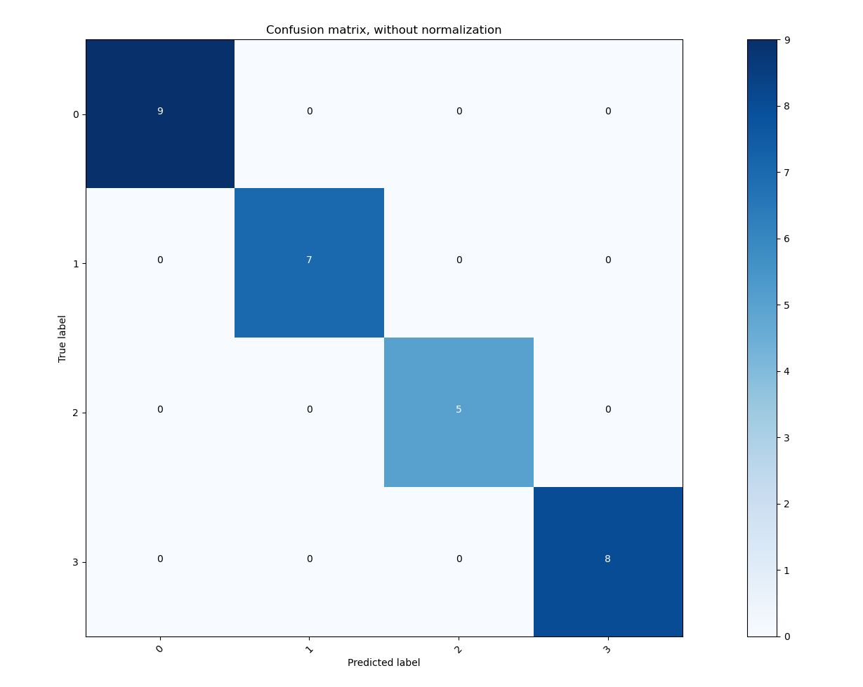
Confusion matrix

Slide 8
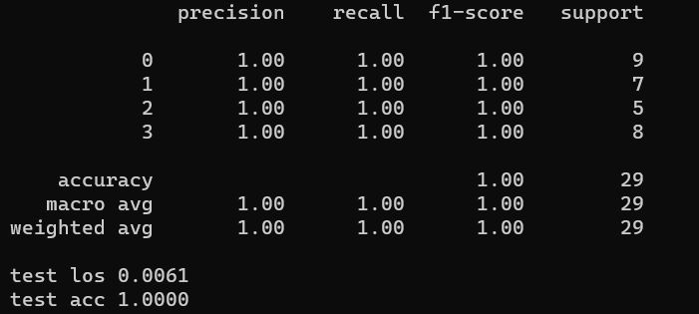
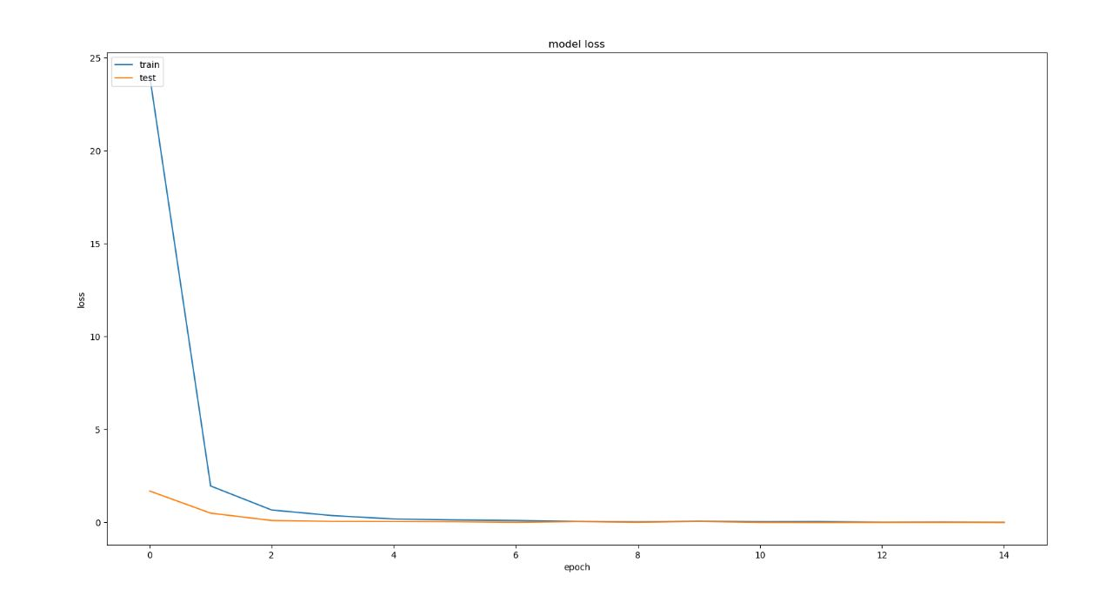
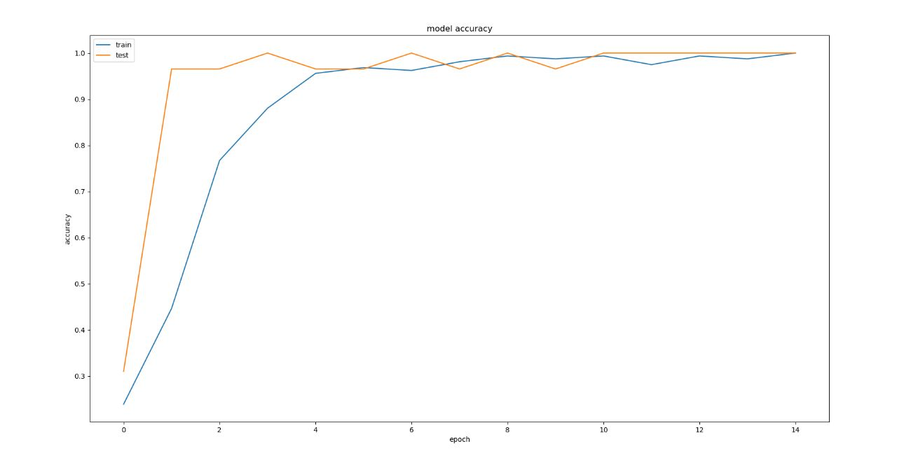
Metrics

Slide 9
Data Augmentation
While predicting the faces, If there is some change in camera angles or lighting we experienced some variations in the predictions.
We solved these using data augmentation.
We used RandomRotation, RandomContrast, RandomBrightness to increase randomness of trained dataset.(from keras.layers)
This helps in more accurate predictions since the data is more generic.

