Slide 1
Applications of Polynomial Interpolation
Name: SUMAN MITRA
Roll No: 2020202018
Course: Linear Algebra
Department: CSIS (PG1-2020)
Project Group: 8

Slide 2
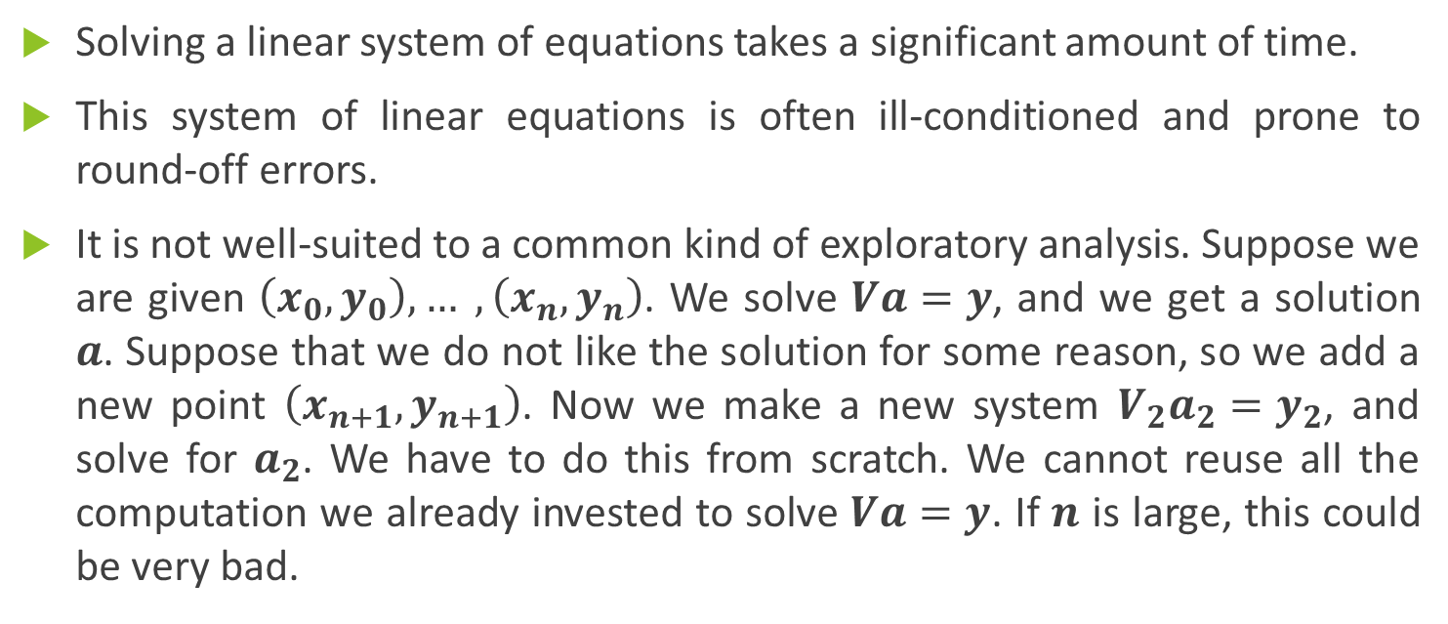
Drawbacks of Vandermonde Method
Solving a linear system of equations takes a significant amount of time.
This system of linear equations is often ill-conditioned and prone to round-off errors.
It is not well-suited to a common kind of exploratory analysis. Suppose we are given $\left(x_{0}, y_{0}\right), … ,\left(x_{n}, y_{n}\right)$. We solve $Va=y$, and we get a solution $a$. Suppose that we do not like the solution for some reason, so we add a new point $\left(x_{n+1}, y_{n+1}\right)$. Now we make a new system $V_{2}a_{2}=y_{2}$, and solve for $a_{2}$. We have to do this from scratch. We cannot reuse all the computation we already invested to solve $Va=y$. If $n$ is large, this could be very bad.

Slide 3
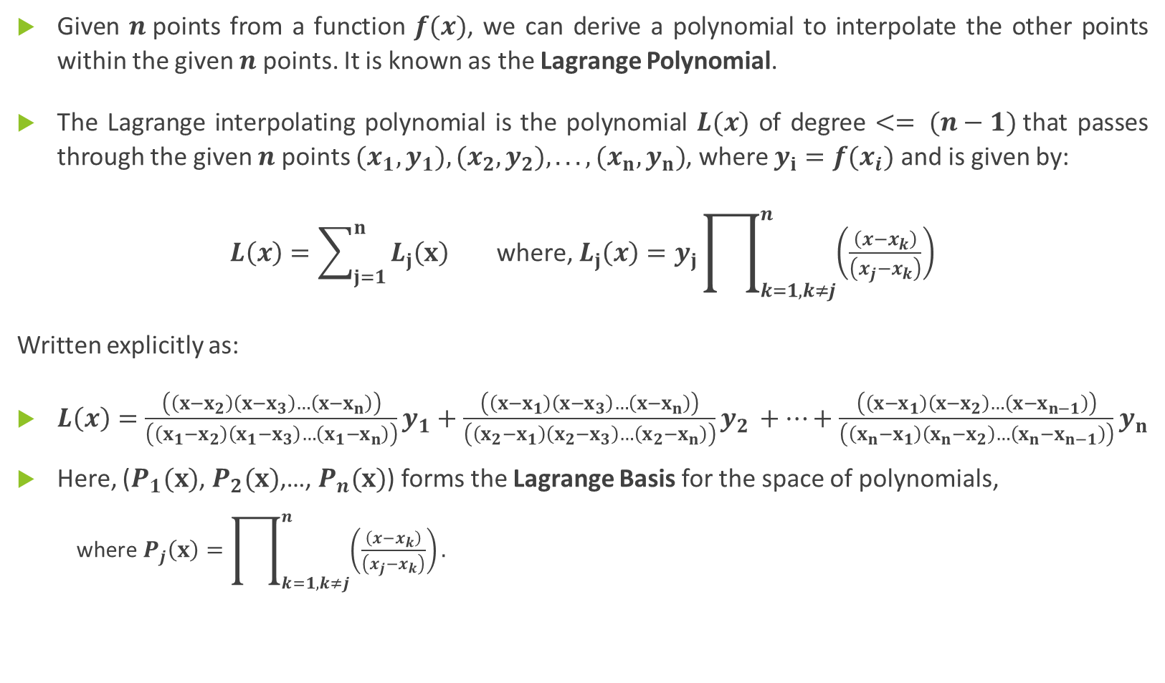
Lagrange Polynomials
Given $n$points from a function $f(x)$, we can derive a polynomial to interpolate the other points within the given $n$ points. It is known as the Lagrange Polynomial.
The Lagrange interpolating polynomial is the polynomial $L(x)$ of degree $<= (n−1)$that passes through the given $n$ points $(x_{1},y_{1}),(x_{2},y_{2}),...,(x_{n},y_{n})$, where $y_{i}=f(x_{i})$ and is given by:
$L\left(x\right)=\sum_{j=1}^{n}{L_{j}\left(x\right)}$where, $L_{j}\left(x\right)=y_{j}\prod_{k=1, k≠j}^{n}{\left(\frac{\left(x−x_{k}\right)}{\left(x_{j}−x_{k}\right)}\right)}$
Written explicitly as:
$L\left(x\right)=\frac{\left(\left(x−x_{2}\right)\left(x−x_{3}\right)…\left(x−x_{n}\right)\right)}{\left(\left(x_{1}−x_{2}\right)\left(x_{1}−x_{3}\right)…\left(x_{1}−x_{n}\right)\right)}y_{1}+\frac{\left(\left(x−x_{1}\right)\left(x−x_{3}\right)…\left(x−x_{n}\right)\right)}{\left(\left(x_{2}−x_{1}\right)\left(x_{2}−x_{3}\right)…\left(x_{2}−x_{n}\right)\right)}y_{2 }+…+\frac{\left(\left(x−x_{1}\right)\left(x−x_{2}\right)…\left(x−x_{n−1}\right)\right)}{\left(\left(x_{n}−x_{1}\right)\left(x_{n}−x_{2}\right)…\left(x_{n}−x_{n−1}\right)\right)}y_{n}$
Here, ($P_{1}(x)$, $P_{2}(x)$,…, $P_{n}(x)$) forms the Lagrange Basis for the space of polynomials,
where $P_{j}\left(x\right)=\prod_{k=1, k≠j}^{n}{\left(\frac{\left(x−x_{k}\right)}{\left(x_{j}−x_{k}\right)}\right)}.$

Slide 4
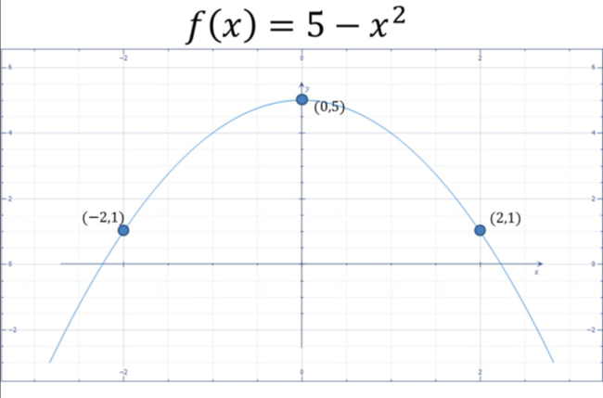
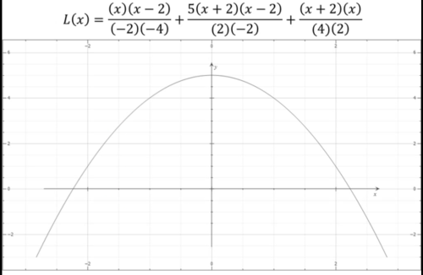
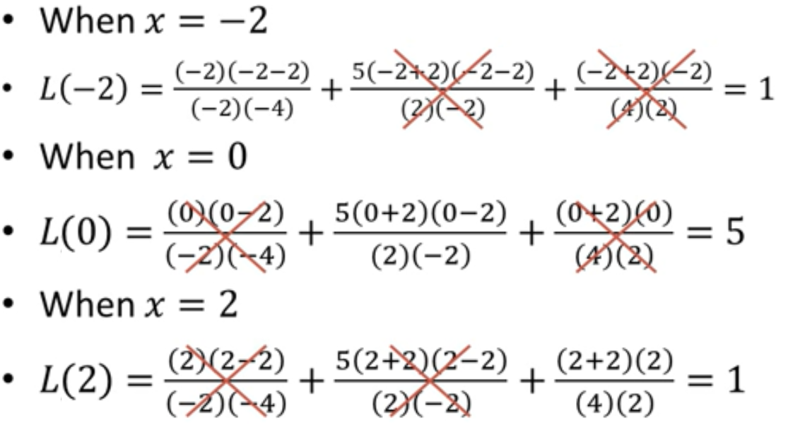
How does it work?
Example:

Slide 5

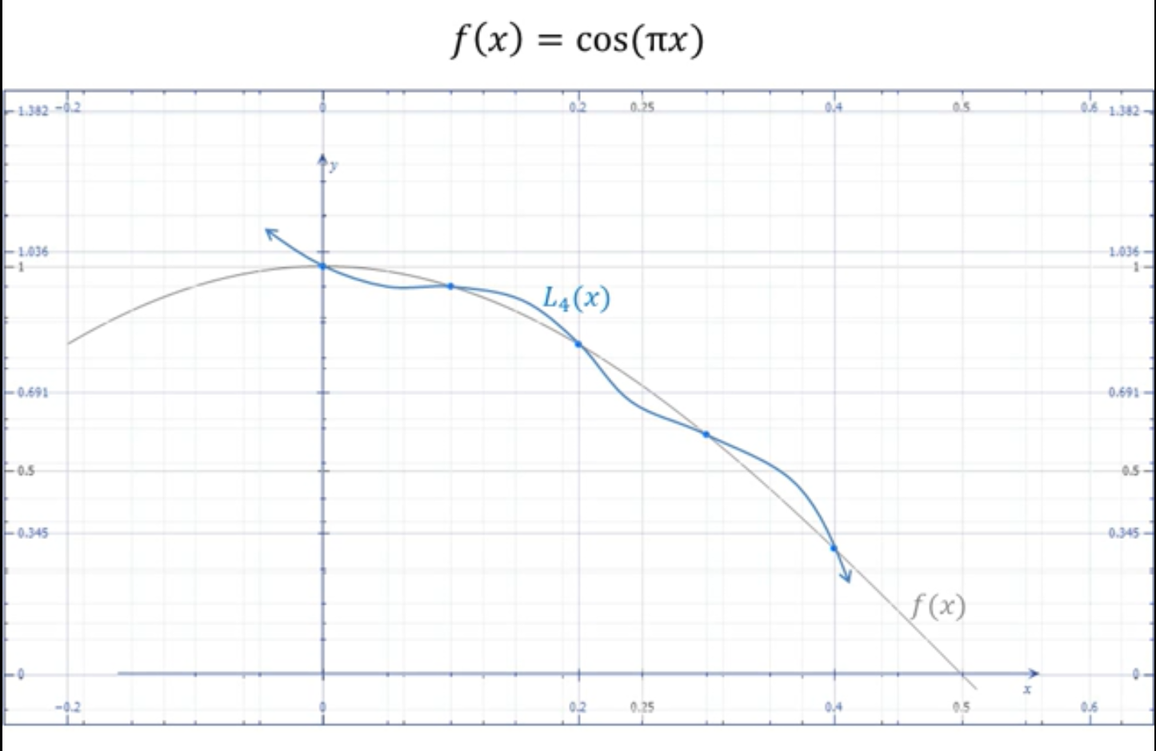
What’s the error?
Error:
If the Lagrange polynomial is of Higher Order OR if the points are far away from each other, poor results can occur on some points.
So, use Piecewise Lagrange or Splines for better result.

