Slide 1
Analytical CRM Development for a Bank
Suman Sariga M S
10/07/2024

Slide 2
You are an analytical CRM (Customer Relationship Management) specialist hired by a bank to extract meaningful insights from various customer-related datasets.
The bank aims to reduce customer churn, improve service delivery, and enhance customer satisfaction. They have provided you with datasets including customer demographics, transaction details, customer exit information, and active customer profiles.
Problem Statement

Slide 3
Key Metrics
Distribution of Balances Across Different Regions
Customer Growth Trends by Year
Geographic Market Trends
Customer Exit Analysis by Products
Customer Exit Analysis by Average Balance
Exited Customers by Credit Score Segment
Average Tenure by Year and Age Bucket
Customer Behavior Analysis
Product Affinity Study
Customer Exit Reasons
Recommendations
Reports
Agenda

Slide 4
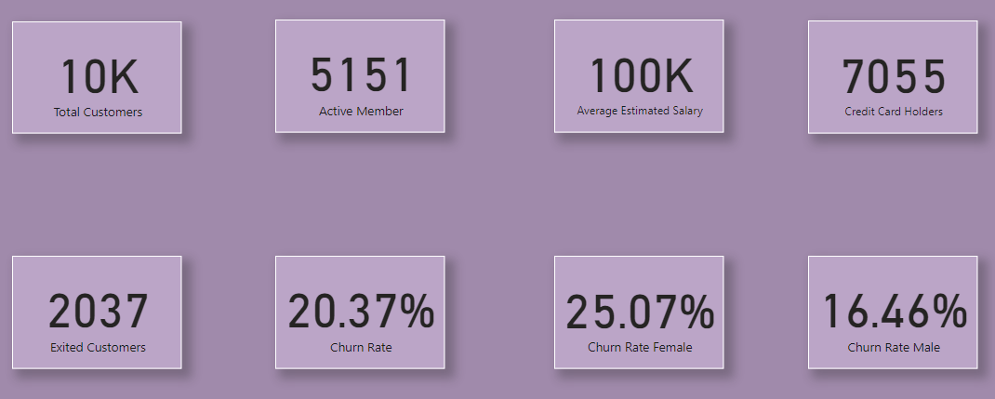
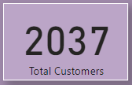
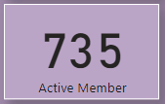
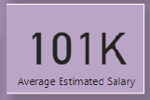
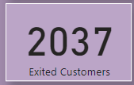
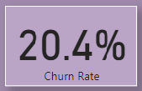
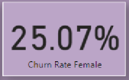
Key Metrics

Slide 5
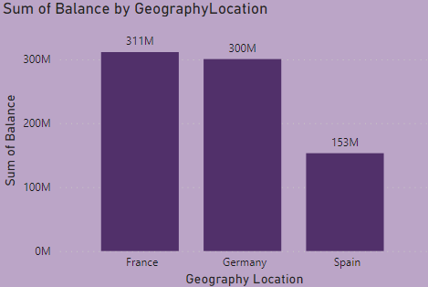
Distribution of Balances Across Different Regions
France exhibits the highest account balance among the regions at 311M, indicating a trend towards higher balances compared to Germany and Spain.
Germany exhibits the second highest account balance of 300M .
Spain has account balances of 153M, suggesting the lowest balances among these regions.

Slide 6
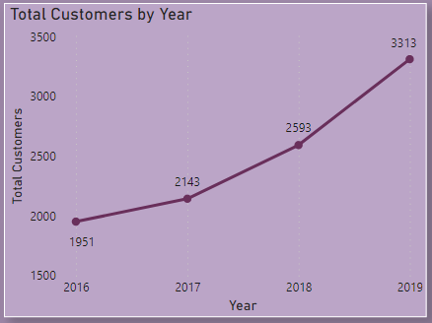
Customer Growth Trends by Year
The data shows the number of customers who joined each month from 2016 to 2019.
There is an observable trend of increasing customer joins from 2016 to 2019.

Slide 7
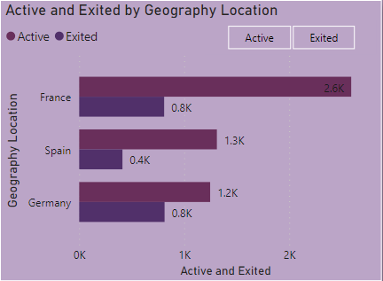
Geographic Market Trends
Despite having the highest number of active accounts (2,591), France also has a high churn rate with 810 customers exiting.
Germany has fewer active members (1,248) compared to France but has the highest churn rate (814).
Spain has the lowest number of active members (1,312) and the lowest churn rate (413). While the churn rate is lower, it is still relatively high compared to the number of active accounts.

Slide 8
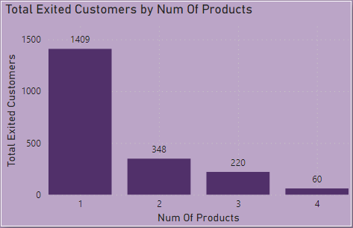
Customer Exit Analysis by Products
The most common number of products used by customers who have exited is 1, with 1409 customers.
The least number of products used by customers is 4

Slide 9
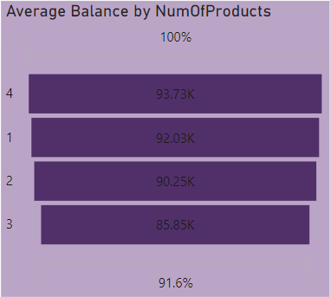
Customer Exit Analysis by Average Balance
There is an observable trend where customers who have exited tend to have higher average account balances when they have fewer products.
Decreasing Trend: There is a slight decrease in average balance as the number of products increases from 1 to 3, followed by an increase when using 4 products.
This suggests that customers who exit may initially maintain higher balances with fewer products, possibly due to a preference for simpler banking relationships.

Slide 10
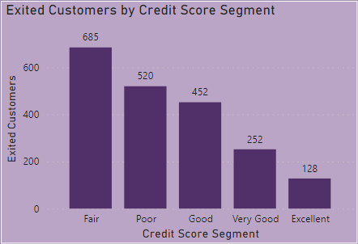
Fair: 685 customers have exited.
Poor: 520 customers have exited.
Good: 452 customers have exited.
Very Good: 252 customers have exited.
Excellent: 128 customers have exited.
Exited Customers by Credit Score Segment

Slide 11
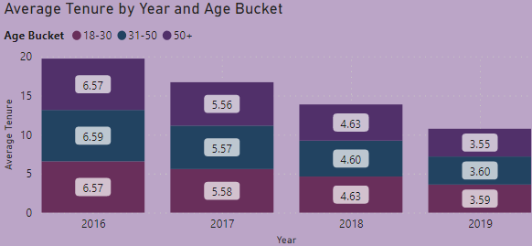
There is a clear trend of declining average tenure from 2016 to 2019 across all age groups (18-30, 31-50, 50+). This suggests that customers are staying with the bank for shorter durations over the years, indicating potential challenges in customer retention.
Younger age groups (18-30) consistently show shorter average tenure compared to older age groups (31-50, 50+).
Average Tenure by Year and Age Bucket

Slide 12
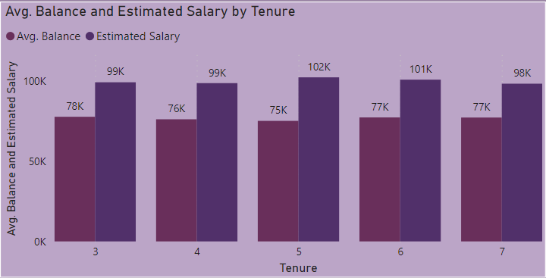
Long-term customers (7 years) tend to maintain slightly higher average balances compared to new and medium-term customers (3-6 years).
There is variation in average estimated salaries across tenure groups, with medium-term customers showing the highest average salary.
Higher average balances among long-term customers indicate potentially deeper financial relationships and stronger loyalty.
Customer Behavior Analysis

Slide 13
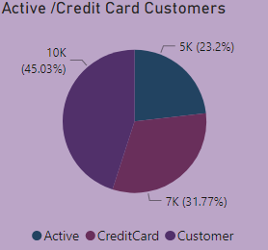
There are 5,151 active customers and 7,055 credit card holders. This indicates that a significant portion of active customers are also credit card holders.
Since a large number of customers hold credit cards, there is potential to cross-sell other banking products to these customers. For example, promoting loan products, savings accounts, or investment services to credit card holders could be beneficial.
Product Affinity Study

Slide 14
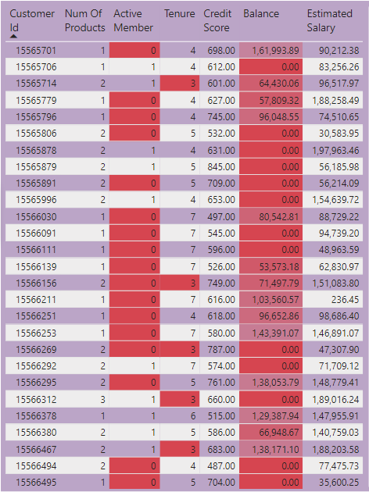
Customer Exit Reasons
Customers with shorter tenure duration might also indicate higher churn risk, especially if combined with other factors like low balance or fewer products used.
Customers who have exited typically have lower average tenures compared to those who haven't exited.
Customers who are marked as inactive (IsActiveMember = 0) may be at higher risk of churn.
The average credit scores, Average balance and estimated salary among customers who exited vary widely,indicating that financial metrics alone may not directly correlate with churn.

Slide 15
Recommendations
Personalized Loyalty Programs for Older Customers (Germany)
Implement personalized loyalty programs or exclusive offers tailored to the needs and preferences of older customers in Germany.
Enhanced Engagement for Medium-Aged Female Customers in France and Germany:
Develop targeted marketing campaigns that highlight personalized financial advice or investment opportunities for medium-aged female customers (31-50 age group) in both France and Germany.
Improved Value Propositions for Younger Customers in Spain and France:
Introduce innovative digital banking solutions and mobile app features that cater to the preferences and tech-savvy behaviors of younger customers (18-30 age group) in Spain and France.
Cross-Functional Collaboration and Training:
Foster collaboration between marketing, customer service, and product development teams to ensure cohesive strategies that align with customer retention goals.

Slide 16
Reports

Slide 17
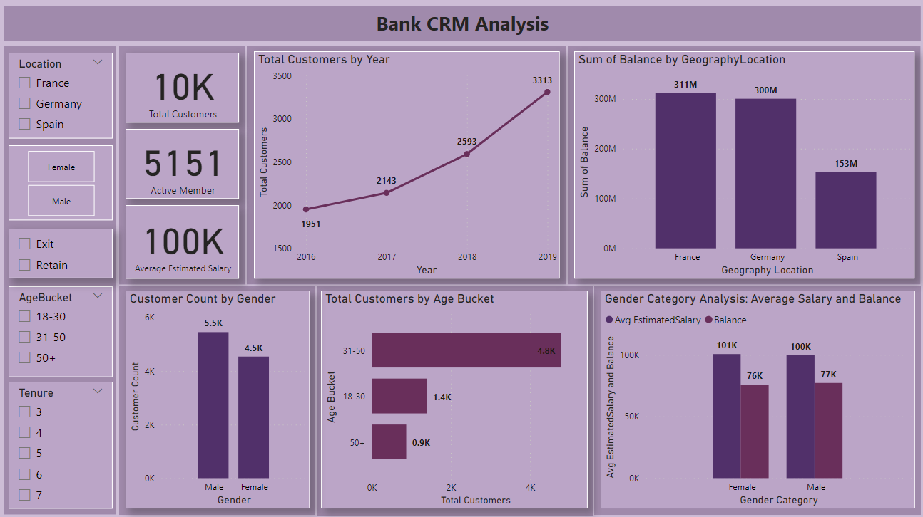

Slide 18
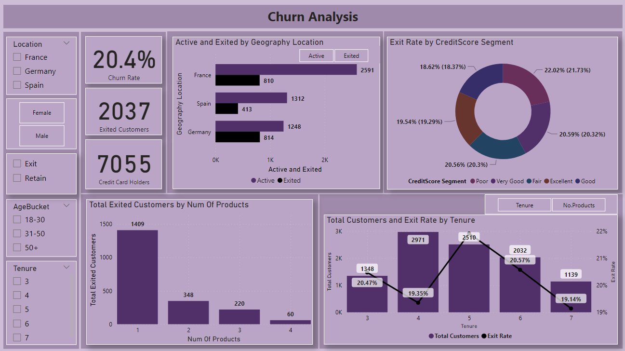

Slide 19
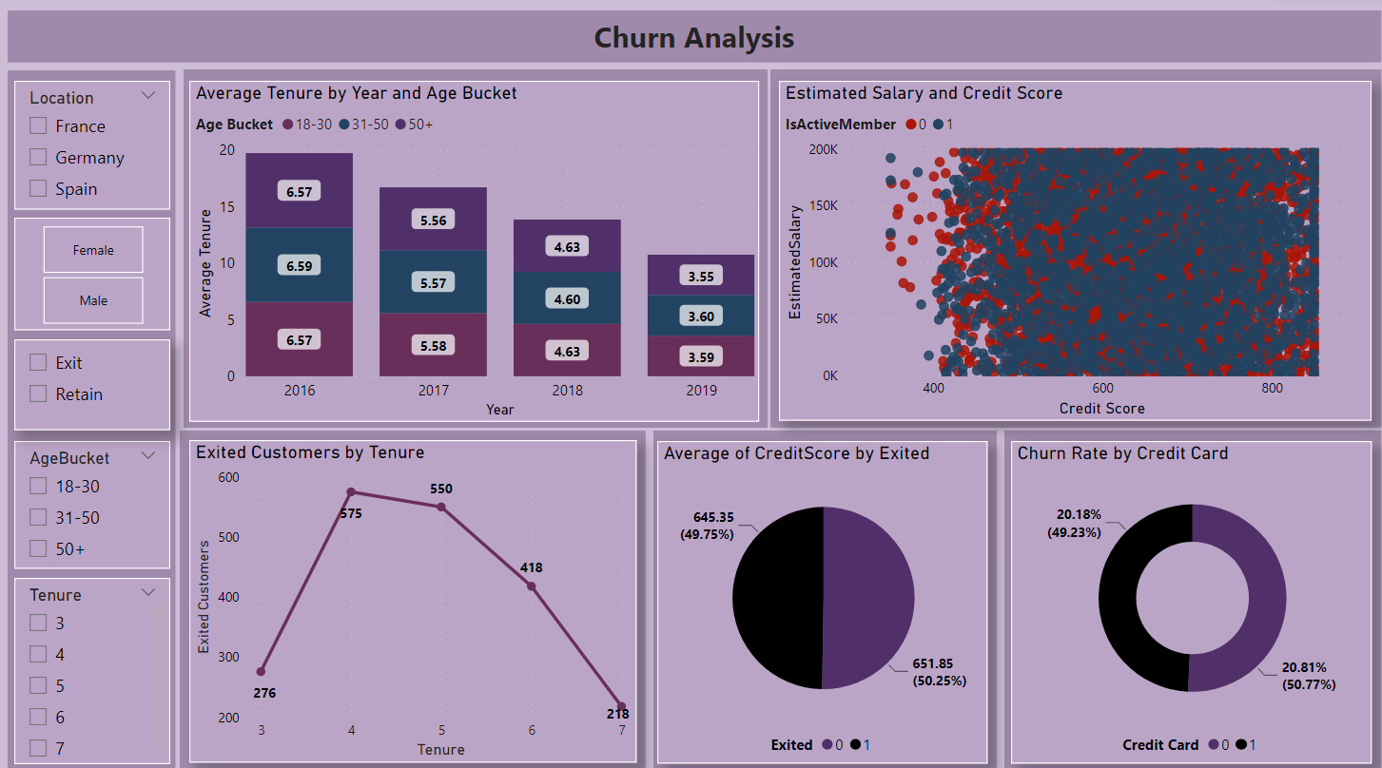

Slide 20
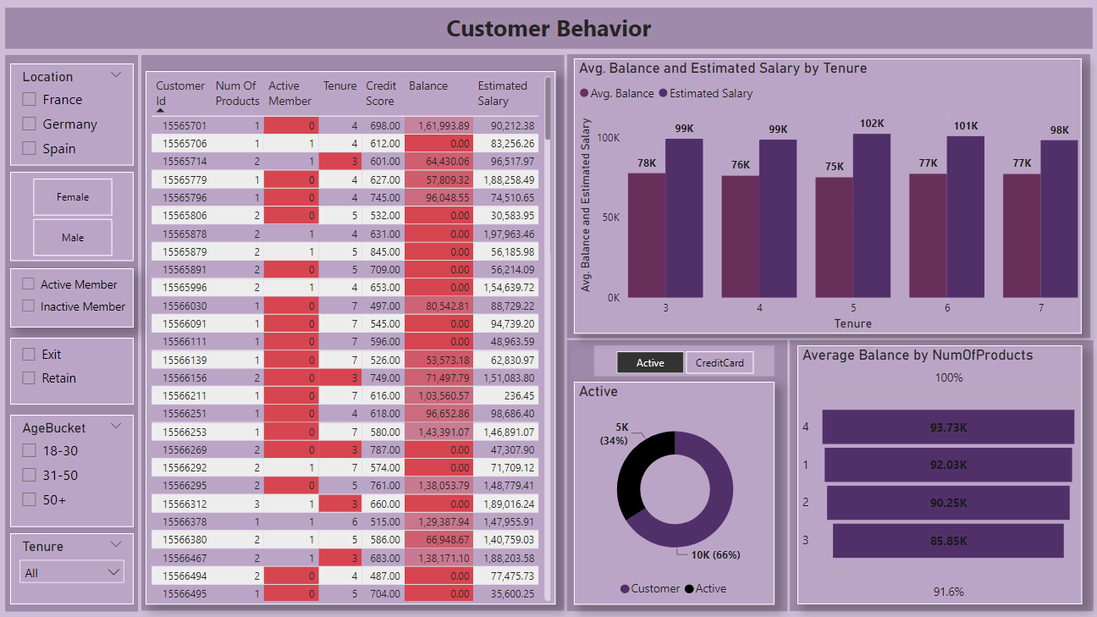

Slide 21
Thank You

