Slide 1

Zomato Restaurant Analysis
Suman Sariga M S
07/05/2024

Slide 2
Agenda
Countries for Restaurant Expansion
Cities for Restaurant Openings
Country-wise Restaurant Openings
Food Expenditure
Cuisines
Delivery Analysis
Dashboard

Slide 3
Problem Statement
You are hired as a consultant data analyst by zomato where the team is looking for expansion and opening restaurants. Your task is to come up with strategies/suggestions about opening newer restaurants.

Slide 4






Potential Countries for Restaurant Expansion
● Philippines: With an average rating of 4.47, the Philippines emerges as the top-performing country in terms of restaurant ratings. Its high average rating suggests a favorable market reception for restaurant ventures, indicating potential for success despite existing competition.
● Turkey and Indonesia: Both Turkey and Indonesia have average ratings of 4.30. While competition may be present in these countries, their relatively high average ratings indicate opportunities for successful restaurant ventures.
● New Zealand, UAE and South Africa: New Zealand,UAE and South Africa exhibit average ratings of 4.26, 4.23 and 4.21, respectively.

Slide 5
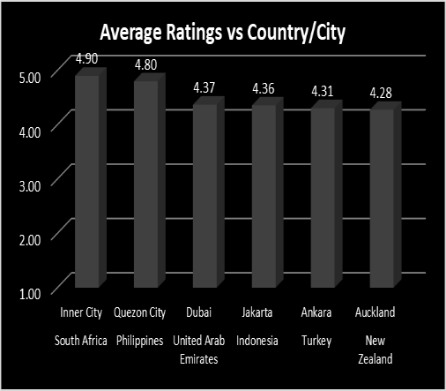
Suggested Cities for Restaurant Openings in Selected Countries
➔South Africa
Inner City
➔Philippines
Quezon City
➔United Arab Emirates
Dubai
➔ Turkey
Ankara
➔New Zealand
Auckland
➔Indonesia
Jakarta

Slide 6
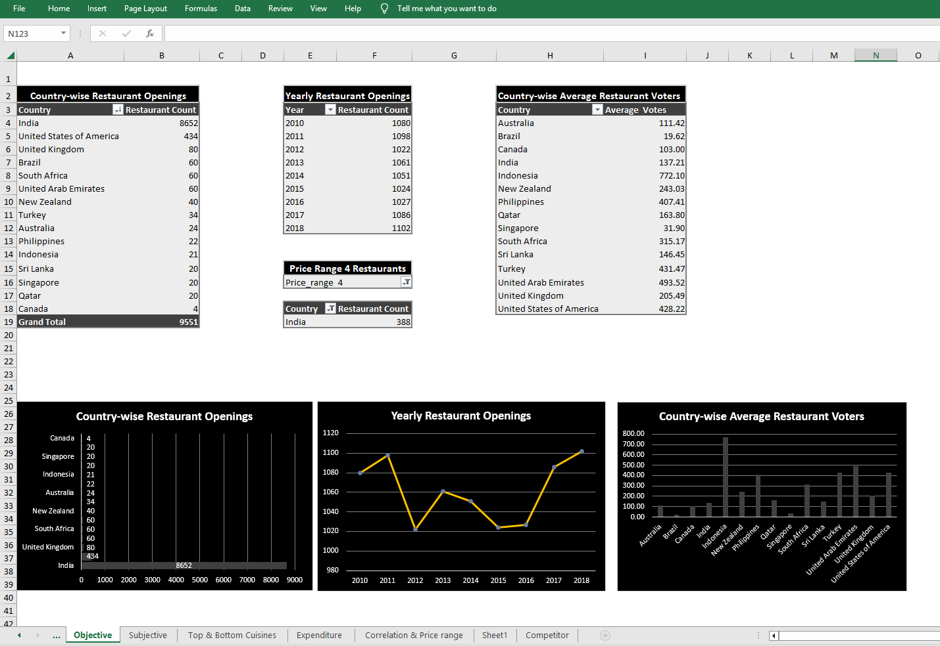
Country-wise Restaurant Openings

Slide 7
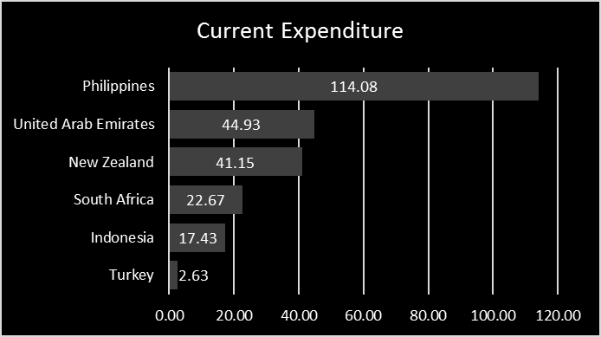
Expenditure on Food
The data reveals a significant variation in total expenditure across the listed countries.
● While Turkey has the lowest total expenditure of $2.63, the Philippines stands out with the highest expenditure of $114.08.
● This suggests diverse economic landscapes and consumer spending behaviors among the countries.

Slide 8
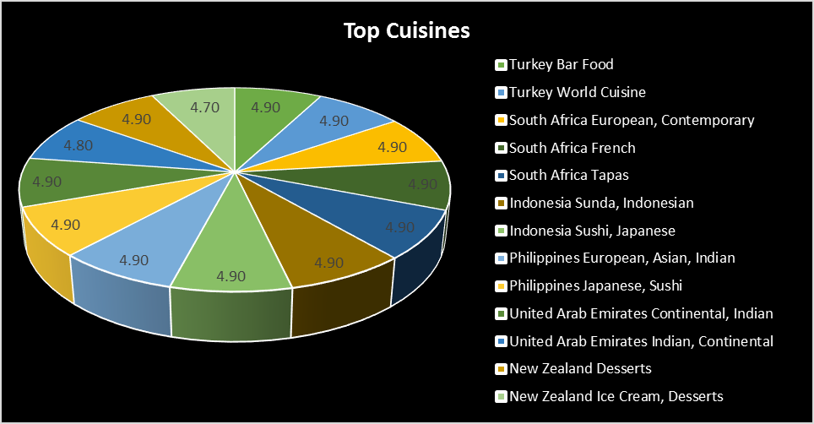
Top Cuisines
● Cuisines with higher ratings ranging from 4.8 - 4.9
● The data reveals exceptionally high average ratings of 4.9 for restaurants in Turkey, South Africa, Indonesia, and the Philippines, spanning various cuisines such as Bar Food, World Cuisine, European, Contemporary, French, Tapas, Sunda, Indonesian, Sushi, Japanese, and European.

Slide 9
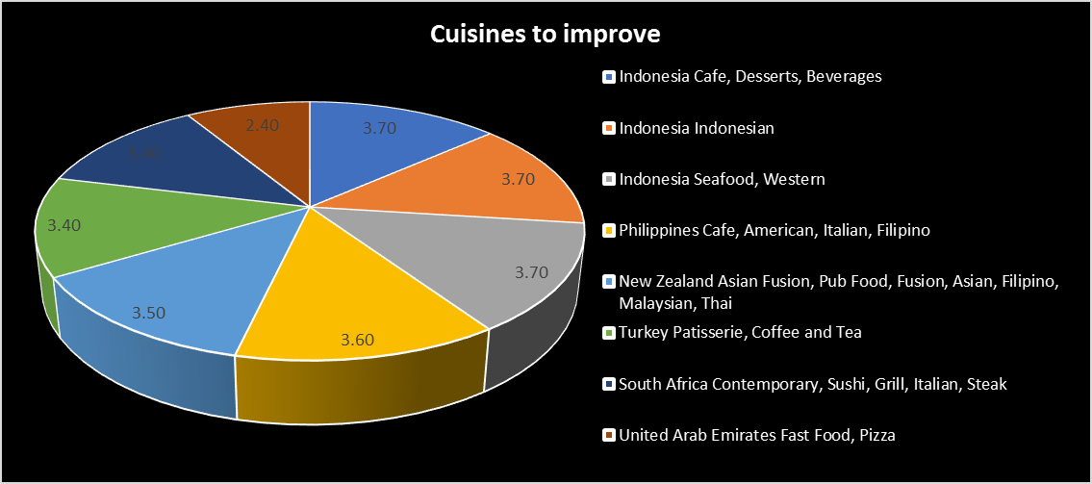
Refining Culinary Offerings: Areas for Improvement
● Focus on offering a diverse range of cuisines, as seen in countries like Indonesia and the Philippines, to cater to a broader range of customer preferences and potentially receive better feedback.

Slide 10
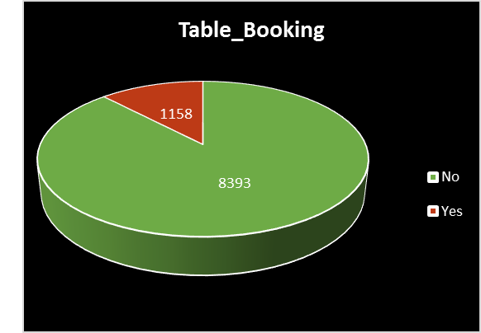
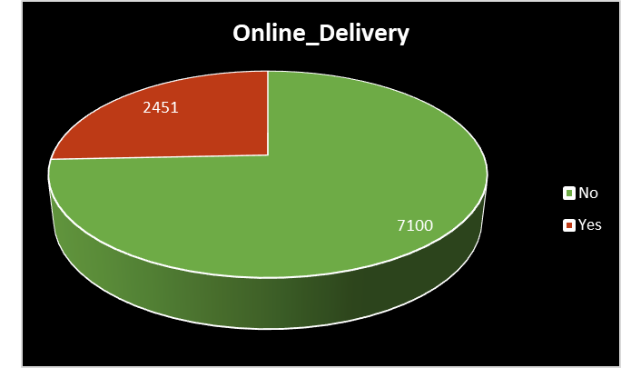
Delivery Analysis
Table Bookings
Table_Booking | Restaurant Count | Average of Rating
No | 8393 | 2.81
Yes | 1158 | 3.48
Online Bookings
Online_Delivery | Restaurant Count | Average of Rating
No | 7100 | 2.75
Yes | 2451 | 3.29

Slide 11
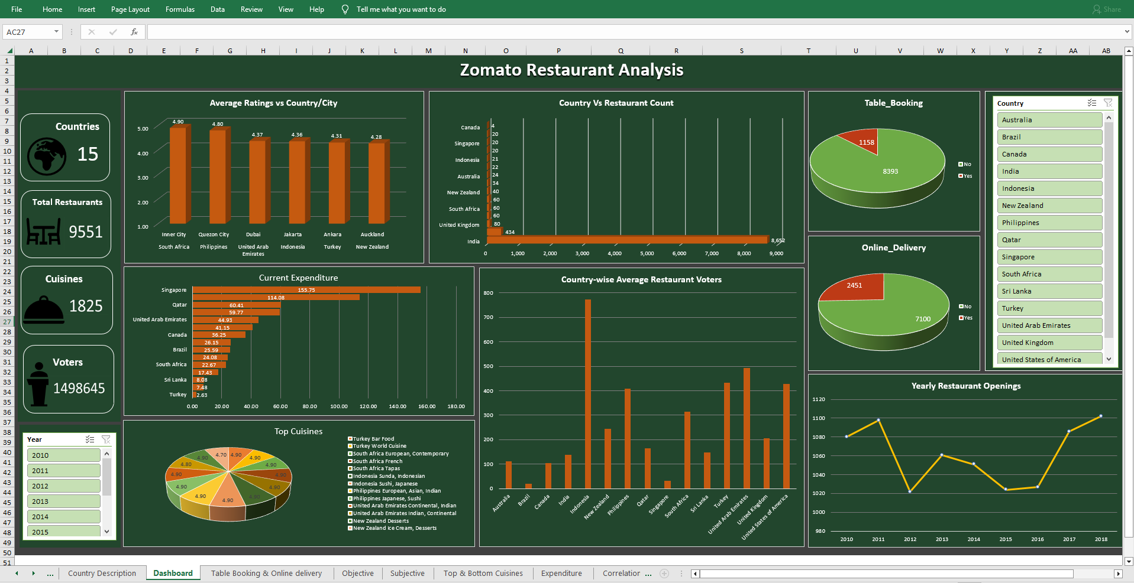
Dashboard

Slide 12
Thank You

