Slide 1

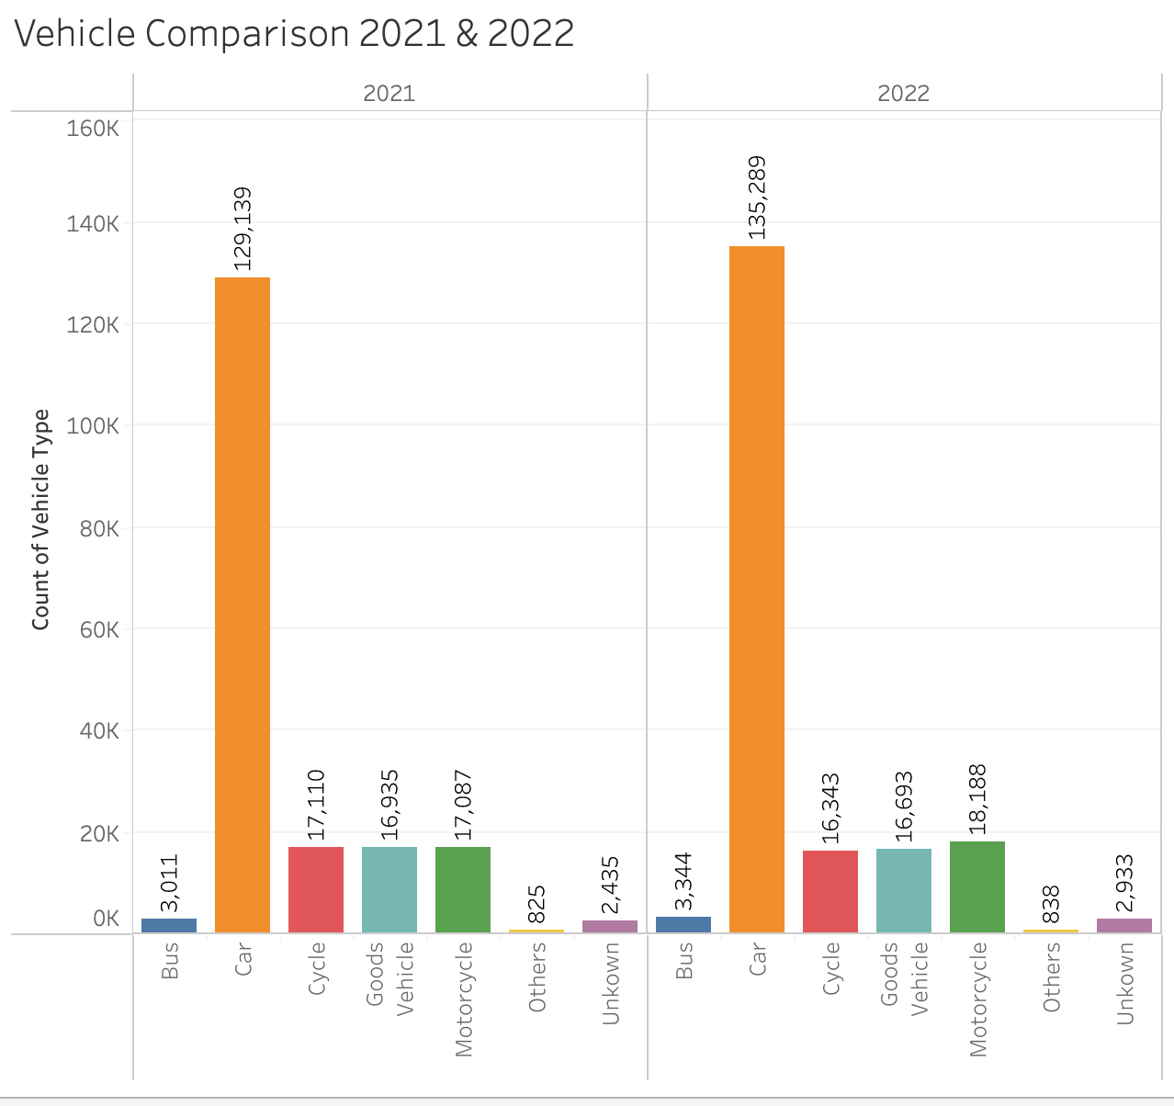
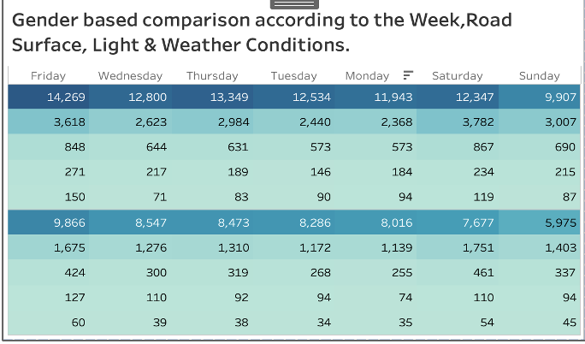
Visualisation of Road Traffic Accidents in the UK
Name: Suman Muthukumaran
SCHOOL OF BUILT ENVIRONMENT, ENGINEERING AND COMPUTING
MSc Data Science
Supervisor: Mark Dixon
OVERVIEW
LITERATURE REVIEW
RESEARCH OUTCOME AND DISCUSSION
ETHICAL CONSIDERATIONS
Due to their wide availability on roads, cars have been found to be involved in a disproportionately greater number of accidents when compared to other vehicle types.
Sameen and Pradhan, 2017 provides a deep learning model that uses a Recurrent Neural Network (RNN) and 1130 accident records from 2009 to 2015 to forecast Accident Severity Data.
Shaadan et al. (2021) investigated traffic incidents in Shah Alam, Malaysia and found that accidents happening more frequently in Selangor, and they happen most often during rush hour.
Jia et al. (2018) through spatial clustering technique found that whereas crowded places with public facilities may make driving more dangerous and cause more accidents.
According to Sakib et al. (2019), driving beyond the speed limit, age, location, environmental variables, and road types are some of the elements that contribute to traffic accidents and casualties and most incidents happened on dry, single-carrier ways, metropolitan locations, pleasant weather, and speed restrictions of less than 30 mph
Young drivers (usually between the ages of 20 and 29) can be more likely to be involved in accidents.
Men were engaged in more casualties in both daytime and dark settings with streetlights present and illuminated environments.
20s and 30s are disproportionately impacted more casualties and there are frequently a lot of fatalities from these incidents in both years.
Men were involved in more accidents than females in both dry and wet road conditions
The study complies with strict ethical guidelines and only uses data from publicly accessible databases on the UK Government website.
Because of this, there are no in-person encounters during the study procedure, guaranteeing ethical compliance. Moreover, complete ethical permission was gained from Leeds Beckett University, under which the study is carried out.
The integrity of the research process is protected, and the study complies with ethical guidelines thanks to this institutional control.
AIM AND OBJECTIVES
ACKNOWLEDGEMENTS
Aim: Analysing several contributing variables to road accidents in the UK in 2021 and 2022 is the goal of this research.
Objectives:
To carry out a critical review of literature on current studies in the field and to develop an in-depth knowledge of it.
To gather and clean up UK accident data for the 2021 and 2022 financial years.
To look for any clear patterns or connections between the severity of traffic events and related demographic traits.
I would like to express my sincere thanks to the distinguished administration, Computer Science department faculty members and professors at Leeds Beckett University for their outstanding facilities, cutting edge labs, and consistent assistance, all of which were essential to the successful completion of this dissertation.
The sincerest thanks go to Mark Dixon, who has been an inspiration to me throughout this project with his priceless advice and steady backing.
Special thanks go out to Thalita Vergilio and Kiran Voderhobli, whose knowledgeable advice and steadfast support were crucial in helping me overcome challenges and complete the dissertation successfully.
CONCLUSION
METHODOLOGY
the observation that most accidents happened on Fridays. disproportionately high number of fatal accidents were reported on Saturdays male drivers responsible for most of the incidents.
It is interesting to note that environmental elements like illumination, weather, and road surface quality did not seem to have a major impact on the frequency of accidents.
Most accidents happened in situations that were considered safe for driving, either in the daytime or at night when lamps were on.
Targeted initiatives aiming at lowering alcohol-related accidents and encouraging safer driving practices can be informed by an understanding of these trends.
Raw Information (From the Official Website) -> Data Pre-processing (Removing Unnecessary Information) -> Visualisation (Dashboard, Graph, and Charts).
Collecting and Preparing Data – Casualty, Accident and Vehicle data are collected.
Visualization Methodology: Advanced Techniques and Tools - to richness of the data is captured in an intricate collection of graphs, charts, and tables
Detailed Overview of Dashboard Metrics: Group and Calculation done is explained. Advantages of the Applied Method: created extensive dashboards that provide a deep knowledge of the causes that lead to accidents.
Drawbacks - visualisation similarities could reveal correlations between factors, they do not always indicate cause.
RATIONALE
REFERENCES
Road accidents have a wide range of effects on society and to reduce the likelihood of accidents and lessen their effect, a careful investigation is required to determine the financial and societal costs associated with them.
Even if the most current validated data relates to events that occurred in 2022, it is crucial to place this information in the perspective of larger historical trends and patterns. Over time, there are variations in accident rates due to a variety of factors, including changes in driving behaviours, infrastructural advancements, and economic swings.
Sameen, M.I. and Pradhan, B., 2017. Severity prediction of traffic accidents with recurrent neural networks.
Applied Sciences, 7(6), p.476.
Shaadan, N., Suhaimi, M.A., Hazmir, M.I. and Hamzah, E.N., 2021, July. Road accidents analytics with data visualization: a case study in Shah Alam Malaysia. In Journal of Physics: Conference Series (Vol. 1988, No. 1, p. 012043). IOP Publishing.
Jia, R., Khadka, A. and Kim, I., 2018. Traffic crash analysis with point-of-interest spatial clustering. Accident Analysis & Prevention, 121, pp.223-230.
Sakib, A., Ismail, S.A., Sarkan, H., Azmi, A. and Mohd Yusop, O., 2019. Analyzing traffic accident and casualty trend using data visualization. In Recent Trends in Data Science and Soft Computing: Proceedings of the 3rd International Conference of Reliable Information and Communication Technology (IRICT 2018) (pp. 84-94). Springer International Publishing.

Slide 2
Presentation Link :
Product Link : 77338335_tableau.twb
Data : Data
Video : 77338335.mp4

