Slide 1


AttendanceGuru
Minor Project Mid-term Defense
Under the Supervision of:
Rishi K.Marseni
Rikesh Silwal Khatri
Arun Bikram Khatri
Suman KC

Slide 2
Introduction
Face recognition is used for surveillance
Efficient methods for face detection and recognition
Real-time attendance system in classrooms
Reliable technology for accurate attendance tracking.
Eliminates the need for manual record-keeping
Enhances security and reduces administrative burden

Slide 3
Problem Statement
Flawed manual attendance system with inefficiencies
No centralized database for easy management
Security risks: tampering and record loss
Paper-based process prone to errors
Inconvenience for students across different classes
Need for automated and secure solution

Slide 4
Problem Objectives
To develop web based attendance system
To eliminate manual process , reduce errors

Slide 5
Literature Review
Safepro AI Video Research Labs Pvt Ltd : - provides smart security & video analytics solutions for smart cities
NeoFaces :- quickly and accurately identifies people, even in difficult situations.
Amazon Rekognition:- offers facial search , facial analysis

Slide 6
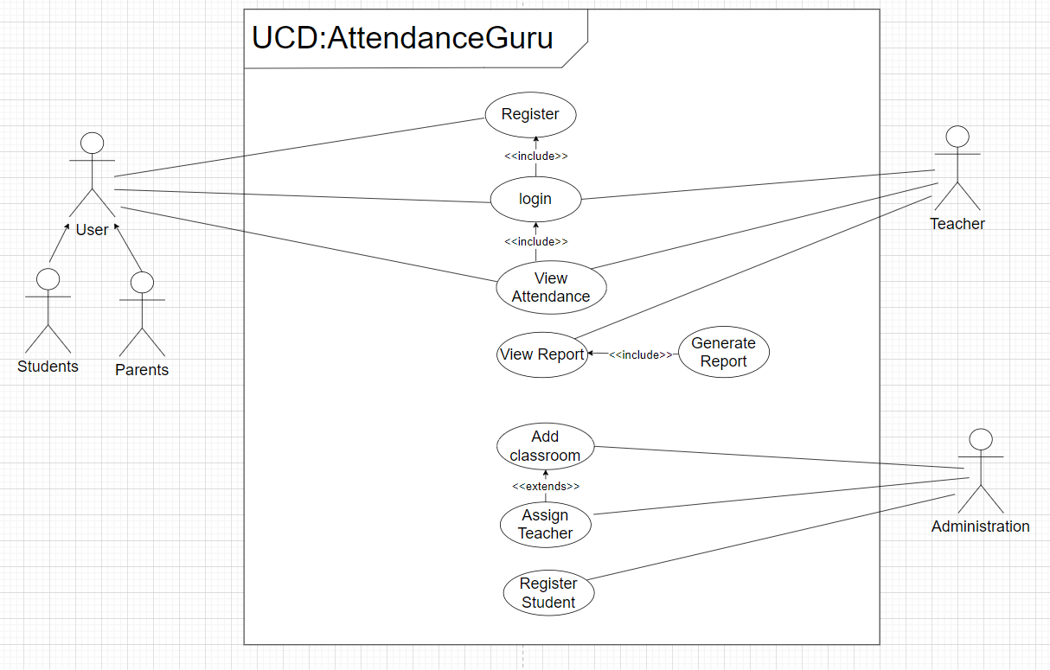
Methodology

Slide 7
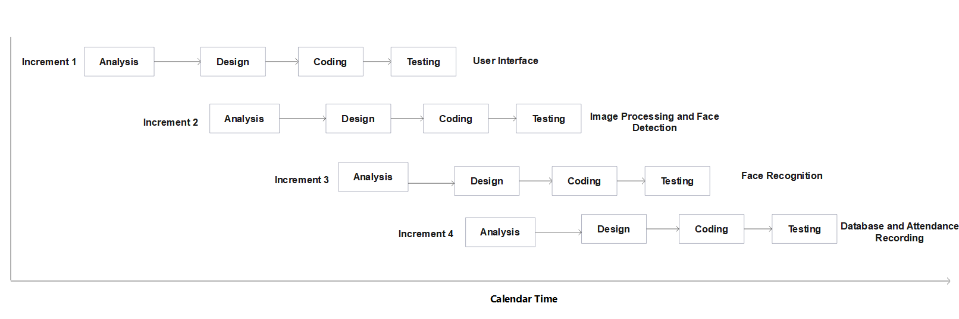
Methodology

Slide 8










Tools and Technology

Slide 9
Tasks Done so far
User Interface for students and teachers have been developed.
Pre-trained face detection model has been selected and implemented .
Integration of database and UI has been implemented .
Domain registration and hosting has been done successfully.

Slide 10
Task Remaining
Selection of Pre-Trained facial recognition model.
Face recognition model implementation and testing.
Attendance database design and implementation.
Real time attendance recording integration

Slide 11
Deliverable
User-friendly desktop app for administrator.
Step-by-step instructions for managing attendance
Web based application for parents , teachers and students
Secure login and personalized attendance records
Easy browsing and compatibility with various devices for accessibility

Slide 12
Limitations
Limitations in hardware and software capacity
Face recognition technology may require more data
Compliance with regulations for privacy and data
System effectiveness affected by lighting and masks
System requires periodic upkeep and enhancements

Slide 13
THANKYOU!!!

