Slide 1
Hackathon Presentation Topic- Display Bookshelves
TEAM 7

Slide 2
Team Members
NAME | COHORT ID
SUMAN SAHOO | QEA21QE032
SHWETA VERMA | QEA21QE032
ANCHAL SATPATHY | QEA21QE032
PHANI PAWAN KUMAR | QEA21QE032
AKHILESH IYENGAR | QEA21QE032

Slide 3
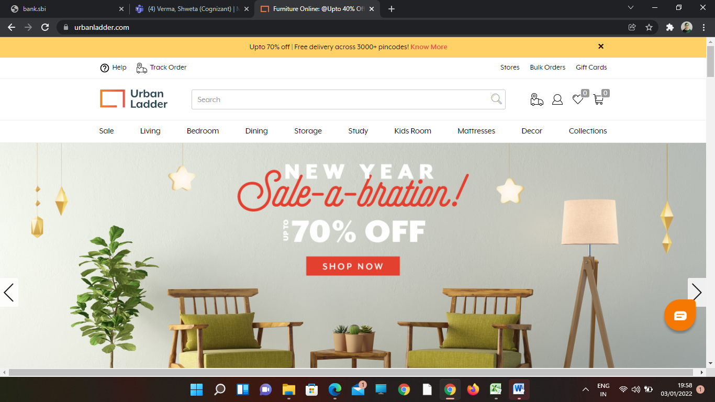
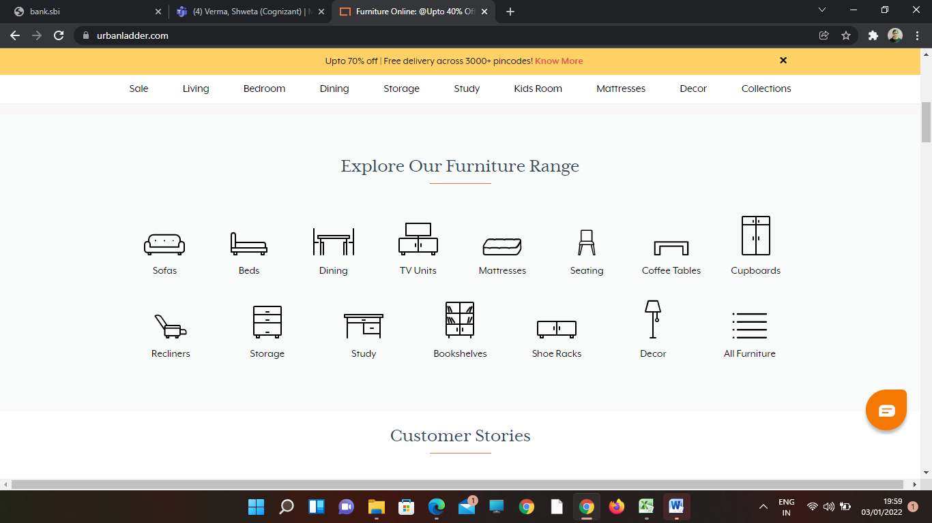
Website:
https://www.urbanladders.com/

Slide 4
TOOLS & TECHNOLOGY USED:
01. Selenium with Java in Eclipse
02. TestNG
. Selenium is a portable framework for testing web applications. Selenium provides a playback tool for authoring functional tests
TestNG is a testing framework for the Java programming language created by Cédric Beust and inspired by JUnit and NUnit.
03. Maven
04. POM with POI
05. Jenkins
Maven is a build automation tool used primarily for Java projects.
A Project Object Model or POM is the fundamental unit of work in Maven. It is an XML file that contains information about the project.
Jenkins – an open source automation server which enables developers around the world to reliably build, test, and deploy their software.

Slide 5
Work Done:
1. The Code is written in JAVA and is automated in different browsers with the help of Selenium. The project and dependencies are managed with the help of Maven.
3. Input data is obtained from properties file and from excel sheet with the help of Apache POI.
2. POM is used to create classes for each page therefore reducing usage of same code for various objects.
4. Jenkins is used for continuous integration of various versions of the code.

Slide 6
Requirements and Execution steps
STEP -1:-
STEP – 2 : -
Display the name & price of first 3 Bookshelves below Rs. 15000, with Storage type as open & exclude out of stock
From Collections, retrieve all sub-menu items under Being-At-home and store in a List; Display the same
STEP -3 :-
.Gift cards - choose "Birthday/Anniversary"; fill customize the gift card; fill from to details with any one input invalid (example: email); Capture & display the error message
STEP – 4 :-
Check all the steps are properly working or not

Slide 7
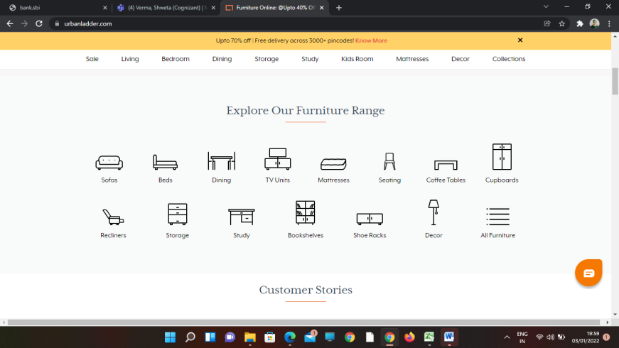
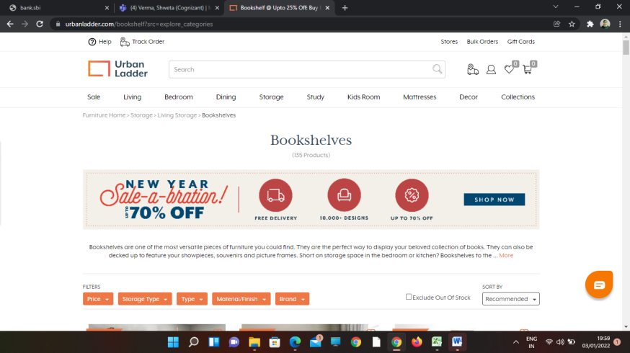

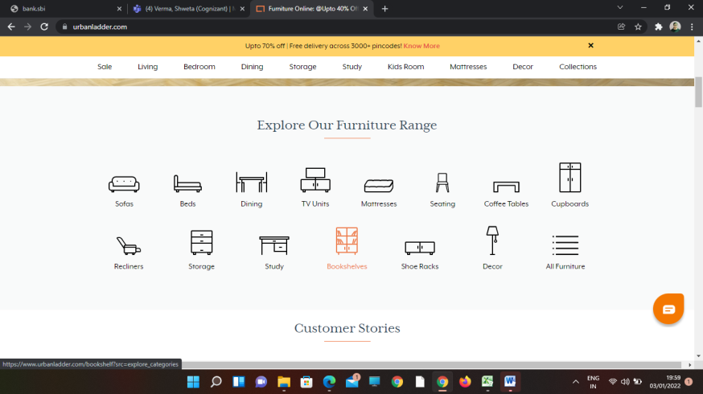
Screenshots:

Slide 8
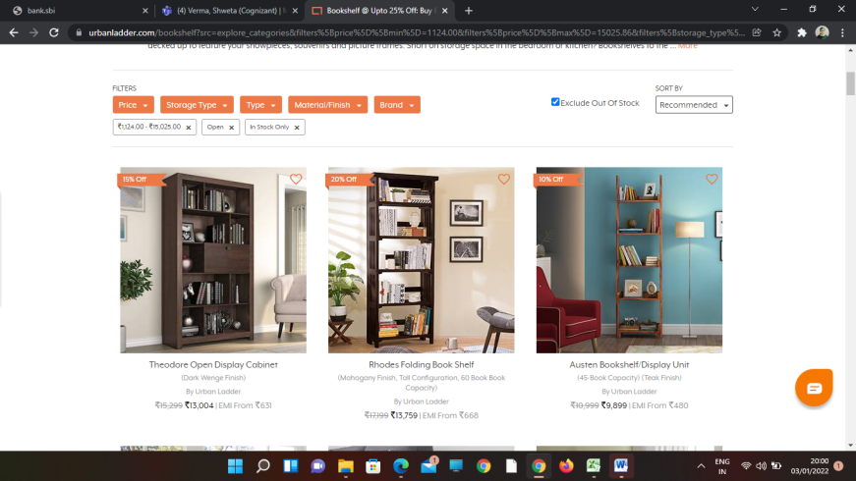
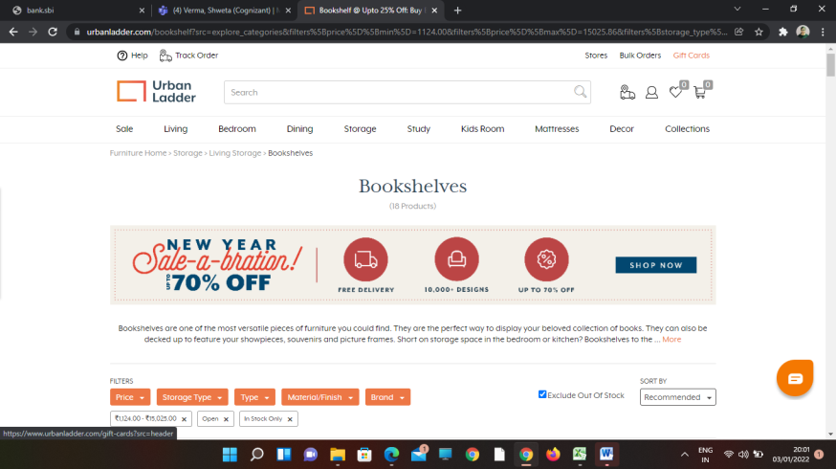
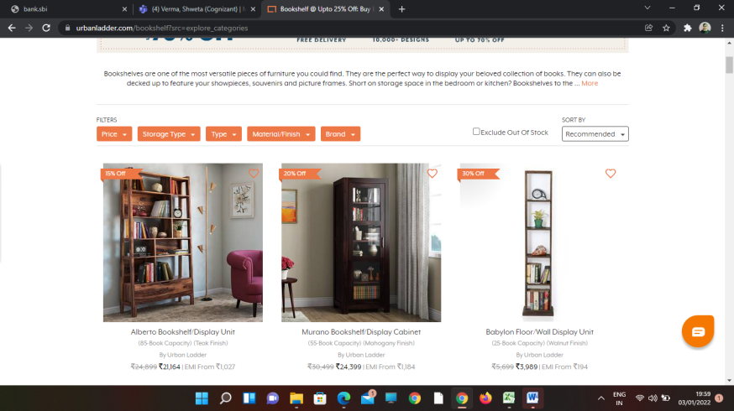
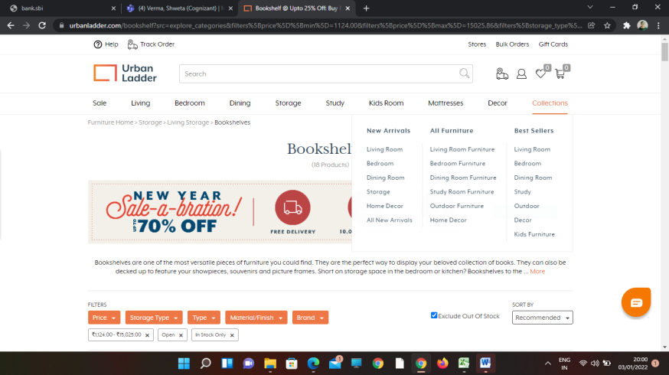
Screenshots:

Slide 9
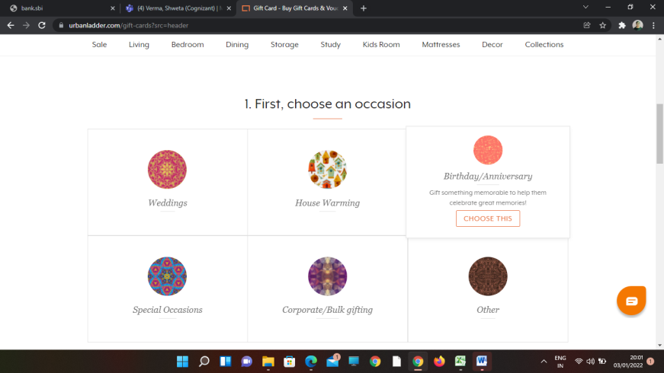
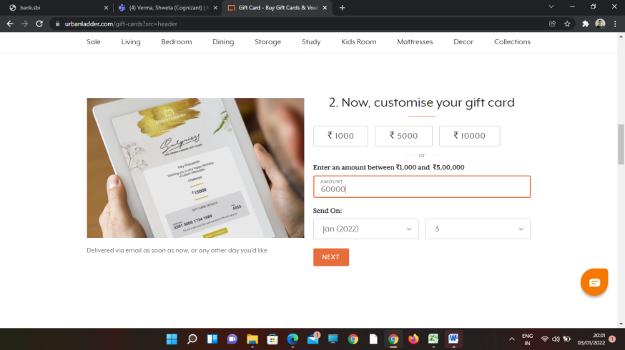
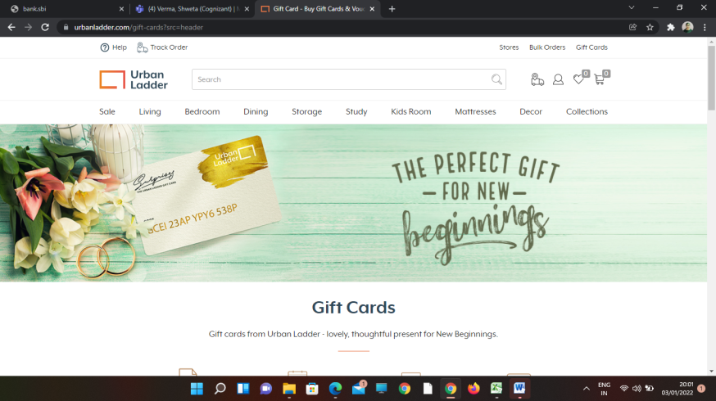

Screenshots:

Slide 10
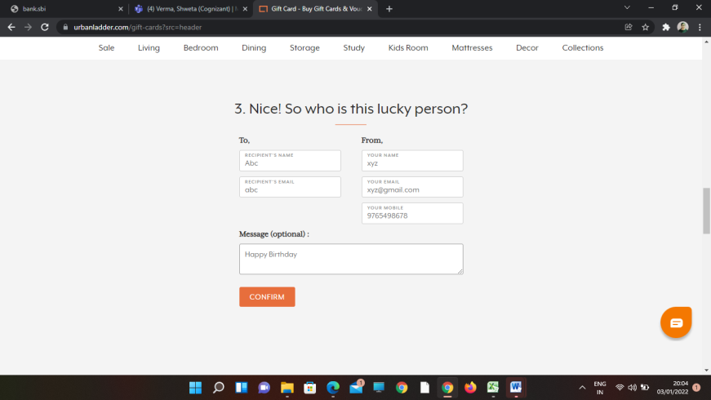
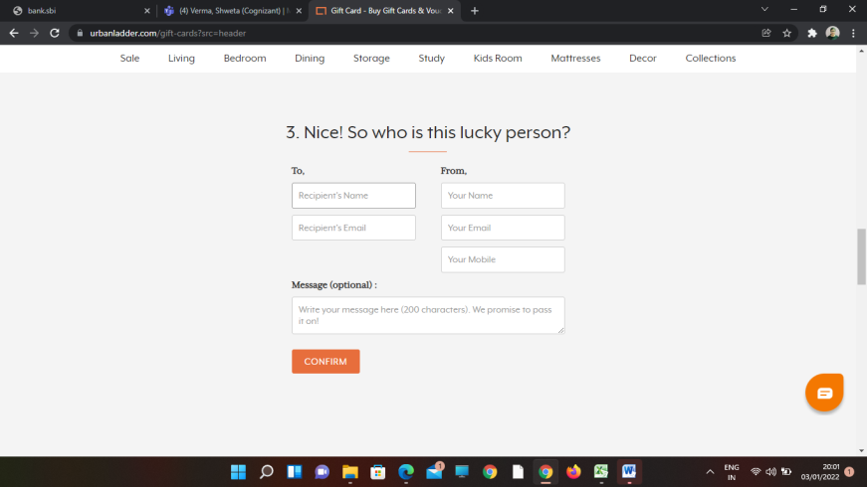

Screenshots:

Slide 11
Thank You
TEAM 7

