Slide 1
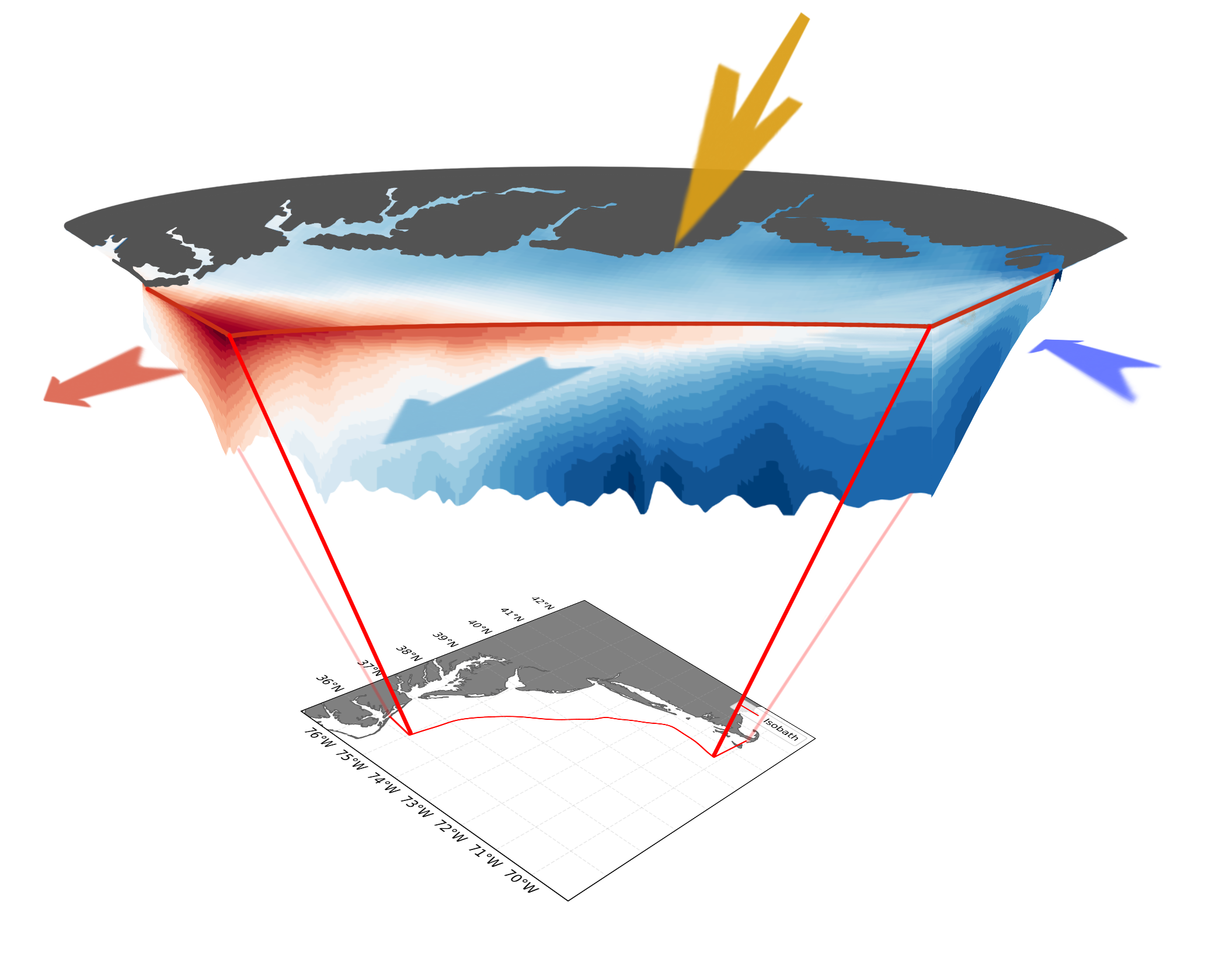
Heat Flux Mechanisms in the Mid-Atlantic Bight: Air-Sea Flux vs. Circulation Induced Flux
- Suman Shekhar
PhD student, Rutgers University
Advisor: Professor John Wilkin

