Slide 1
What Developers Use and Want
DA
Stack Overflow Developer Survey 2024 and 27,005 job postings
Sumant Chakravarty
github.com/Sumant-crty/IBM-Data-Analyst-Capstone-Project

Slide 2
Three data sources, four questions
65,437
1
Which technologies do developers use today?
survey responses (Stack Overflow 2024)
2
Which do they want to use next, and where is the gap biggest?
185
countries represented
3
Who are the respondents?
27,005
4
Which skills appear most in job postings?
job postings from a JSON API

Slide 3
From raw survey and API data to a dashboard
1
2
3
4
Collect
Clean
Explore
Visualize
Survey CSV, jobs JSON API, salary table scraped from a web page
Removed duplicates, imputed missing values, normalized compensation
Split multi-select answers; distributions, outliers, correlations
Three-tab dashboard: current tech, future tech, demographics
requests, BeautifulSoup
pandas
pandas, Seaborn
IBM Cognos Analytics

Slide 4
JavaScript is used most; Python is wanted most
Python is the only top language that more developers want than JavaScript.
SQL is used by half of all respondents who answered: it is the most common data skill.
Counts are respondents; each person could pick several languages.

Slide 5
Rust and Go are wanted far more than they are used
17,232
want Rust, but only 7,559 use it
13,837
want Go, against 8,103 who use it
Rust and Go users also report the highest median pay in the survey (about $76K).

Slide 6
PostgreSQL leads both today and next year
PostgreSQL keeps almost all its users' interest (24,005 want it vs 25,536 using it).
Redis is the only major database more developers want than use.
MySQL and SQL Server lose the most interest.

Slide 7
AWS and the React/Node.js stack dominate
AWS is used by almost as many respondents as Azure and Google Cloud combined. React, Node.js and Next.js also lead future interest.

Slide 8
Who answered the survey
58%
72%
7 yrs
are aged 18–34
hold a bachelor's degree or higher
median professional coding experience
$65K
6.9 / 10
US · DE · IN
median yearly pay (23,435 who reported it)
average job satisfaction
most responses: 11,095 · 4,947 · 4,231

Slide 9
JavaScript, Java and Python lead job postings
Data-quality catch
The first count matched skills by substring, so "C" matched any skill containing the letter c.
C: 25,114 → 817
Java: 3,428 → 1,209
Matching whole skill names fixed the ranking.

Slide 10
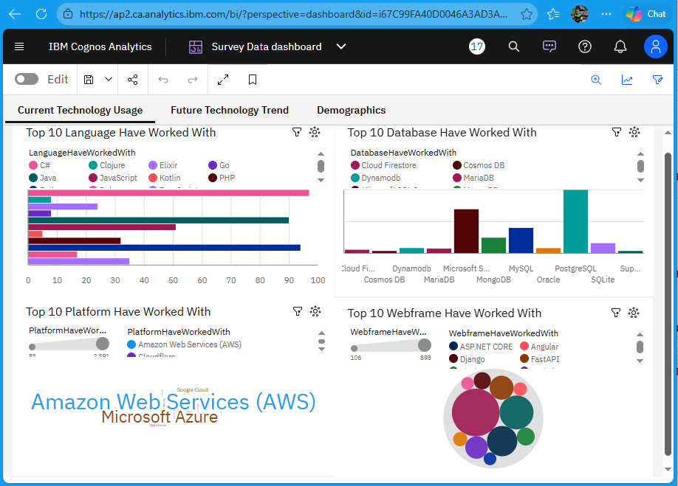
An interactive dashboard in IBM Cognos Analytics
Three tabs
Current technology usage
Future technology trends
Demographics: age, country, education
Built on a cleaned subset of the survey, so its counts are lower than the full-survey numbers in this deck.

Slide 11
Key takeaways
1
Core stack JavaScript/TypeScript, Python and SQL with PostgreSQL cover most of what developers use
2
Rising Rust and Go have far more developers wanting them than using them
3
Cloud AWS leads; Azure and Google Cloud follow
4
Caveat Survey respondents are self-selected Stack Overflow users; "want" is intent, not adoption
Code, data notes and dashboard: github.com/Sumant-crty/IBM-Data-Analyst-Capstone-Project

