Slide 1

IBM Data Analyst Capstone Project
Sumant Chakravarty
6 March 2026

Slide 2

OUTLINE
Executive Summary
Introduction
Methodology
Results
  Visualization – Charts
  Dashboard
Discussion
  Findings & Implications
Conclusion
Appendix

Slide 3

EXECUTIVE SUMMARY
Goal: identify which technologies developers use today, which they want to use next, and who they are, using the 2024 Stack Overflow Developer Survey (65,437 responses) and a sample of 27,005 job postings.
Key findings
Languages: JavaScript is the most used (63% of respondents); Python is the most wanted. Rust (2.3×) and Go (1.7×) have far more developers wanting them than using them.
Databases: PostgreSQL leads both lists (25,536 use it, 24,005 want it); MySQL and SQLite follow.
Platforms: AWS is the most used cloud platform (22,191), ahead of Azure (12,850) and Google Cloud (11,605).
Demographics: 58% of respondents are 18–34; 72% hold a bachelor's degree or higher; the US, Germany and India contribute the most responses.
Jobs: JavaScript (2,241), Java (1,209) and Python (1,165) appear in the most job postings.

Slide 4

INTRODUCTION
Data
Developer survey: 2024 Stack Overflow Developer Survey (65,437 responses), 114 questions, 185 countries
Job postings: 27,005 postings from the IBM Skills Network jobs dataset, accessed as a JSON API
Salaries: average salary by language, web-scraped from an IBM sample page
Questions
Which languages, databases, platforms and web frameworks do developers use today?
Which do they want to work with next year, and where is the gap biggest?
Who are the respondents (age, education, country)?
Which skills appear most in job postings?

Slide 5
INTRODUCTION
Who can use these results
Developers and learners: which skills are widely used and which are growing
Hiring managers: which skills are common in the talent pool and which are scarce
Technology leads: which stacks have strong community adoption
Educators: where to align courses with what developers use and want
Scope and limits
The survey reflects Stack Overflow users who chose to respond, not all developers
"Want to work with" measures interest, not future adoption

Slide 6

METHODOLOGY
Data collection: loaded the survey CSV; queried the jobs JSON API and counted postings per technology; web-scraped a salary table with BeautifulSoup
Data wrangling: removed duplicate responses, imputed missing values, normalized compensation, split multi-select answers (separated by ";")
Exploratory analysis: distributions, outliers and correlations with pandas, Matplotlib and Seaborn
Dashboard: three-tab IBM Cognos Analytics dashboard: current technology, future technology, demographics

Slide 7
Results

Slide 8
JOB POSTINGS
Postings that list each technology as a skill (27,005 postings, exact skill-name match). An earlier substring match counted any skill containing the letter "c" as C (25,114) and JavaScript as Java (3,428).

Slide 9
SALARY BY LANGUAGE
Average annual salary from the IBM sample page used in the web-scraping lab (illustrative, not market data). Swift, Python and C++ pay the most in this sample.

Slide 10
PROGRAMMING LANGUAGE TRENDS
JavaScript is the most used language; Python is the most wanted. Rust and Go show the largest gap between wanted and used.
Worked with (2024)
Want to work with

Slide 11
PROGRAMMING LANGUAGE TRENDS - FINDINGS & IMPLICATIONS
Findings
Web stack leads: JavaScript (37,492), HTML/CSS (31,816) and TypeScript (23,150) are among the most used
Python is most wanted: 25,047 developers want to work with it, more than any other language
SQL is foundational: used by 30,682 and wanted by 22,400
Rising systems languages: Rust is wanted by 17,232 but used by 7,559 (2.3×); Go 13,837 vs 8,103 (1.7×)
Implications
For learners: JavaScript/TypeScript and Python plus SQL cover the largest share of current work
For hiring: Rust and Go talent is scarcer than demand from developers suggests; expect competition
For teams: interest in Rust and Go points to performance-focused and cloud-native workloads

Slide 12
DATABASE TRENDS
PostgreSQL leads both today and next year. Redis is the only major database more developers want than use.
Worked with (2024)
Want to work with

Slide 13
DATABASE TRENDS - FINDINGS & IMPLICATIONS
Findings
PostgreSQL: most used (25,536) and most wanted (24,005)
Relational databases dominate: MySQL (21,099) and SQLite (17,365) follow; SQL Server is 4th (13,275)
NoSQL is established: MongoDB (13,007) and Redis (10,463) are in the top 6
Redis is gaining: the only major database with more developers wanting it (10,847) than using it
Implications
For learners: PostgreSQL is the safest single database skill
For teams: relational databases remain the default, with Redis and MongoDB as complements for caching and documents
Declining interest: MariaDB and SQL Server have far fewer developers wanting them than using them

Slide 14

DASHBOARD
1. Current technology usage
2. Future technology trends
3. Demographics
Built in IBM Cognos Analytics on a cleaned subset of the survey, so counts in the dashboard are lower than the full-survey numbers in this report.

Slide 15
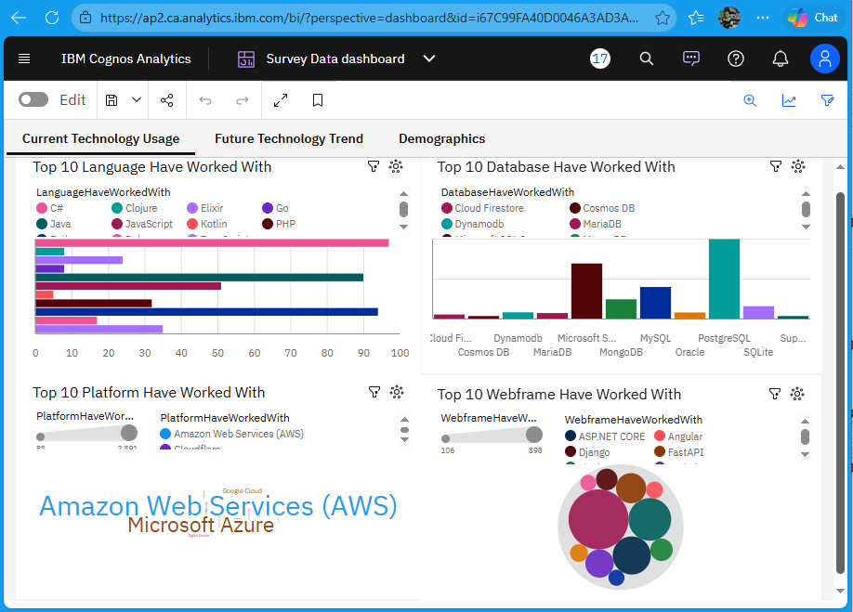
DASHBOARD 1: CURRENT TECHNOLOGY

Slide 16
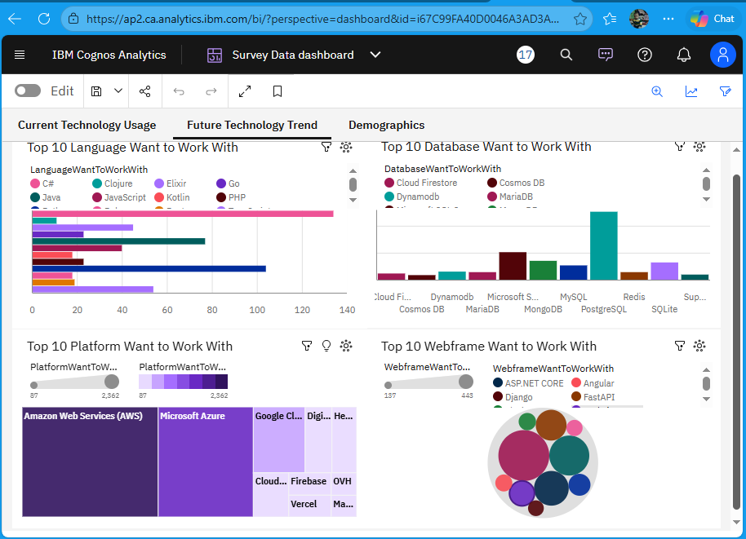
DASHBOARD 2: FUTURE TRENDS

Slide 17
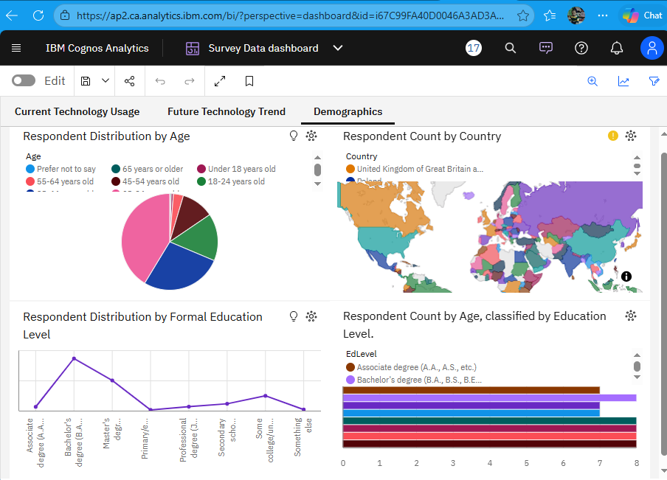
DASHBOARD 3: DEMOGRAPHICS

Slide 18
DISCUSSION
Survey bias: respondents are Stack Overflow users who chose to answer, so results over-represent engaged, English-speaking developers
Interest is not adoption: "want to work with" shows intent; it does not guarantee future use
Job data: a fixed sample of postings, not live market data; counts depend on how skills are written in each posting
Salary data: the scraped table is a small illustrative sample
Dashboard: github.com/Sumant-crty/IBM-Data-Analyst-Capstone-Project (Survey Data dashboard.pdf)

Slide 19
OVERALL FINDINGS & IMPLICATIONS
Overall insights
JavaScript ecosystem: JavaScript, TypeScript, Node.js and React lead both current use and future interest
Python and SQL: the most wanted language and the most common data skill
Cloud: AWS, Azure and Google Cloud dominate; Cloudflare, Vercel and Firebase are growing
Systems languages: Rust and Go have the biggest gap between interest and use
Implications
Developers: a JavaScript/TypeScript + Python + SQL + one cloud platform skill set covers most demand
Employers: Rust, Go and cloud skills are where competition for talent will grow
Educators: prioritize Python, SQL, modern web frameworks and cloud fundamentals

Slide 20

CONCLUSION
Languages: JavaScript is the most used language and Python the most wanted; Rust and Go are rising fastest relative to current use.
Databases: PostgreSQL leads both current use and future interest; MySQL, SQLite, MongoDB and Redis follow.
Platforms: AWS is the most used and most wanted cloud platform, followed by Azure and Google Cloud.
Web frameworks: Node.js and React lead current use; React, Node.js and Next.js lead future interest.
Respondents: mostly 25–34, mostly degree-holders, and largely from the US, Germany and India.
Jobs: JavaScript, Java and Python appear in the most postings.

Slide 21
RECOMMENDATIONS
Learn: JavaScript/TypeScript and Python first, SQL with PostgreSQL, then one cloud platform (AWS is the most common)
Watch: Rust and Go, which developers want far more than they currently use
Hire: expect a large talent pool for web and Python skills and competition for Rust, Go and cloud skills
Next analysis: compare with earlier survey years to measure trends over time rather than intent within one year

Slide 22

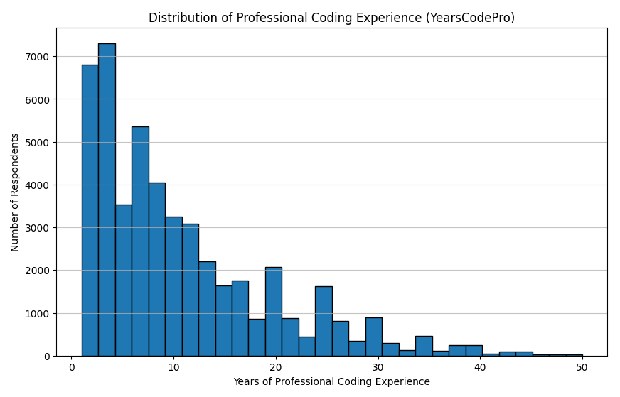
APPENDIX

Slide 23
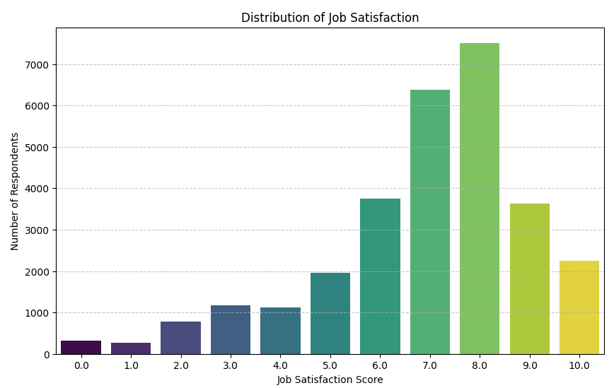
APPENDIX (CONTINUED)

