Slide 1
Predicting Falcon 9 Booster Landings
F9
A data science case study using public SpaceX launch data
Sumant Chakravarty
github.com/Sumant-crty/WinningSpaceRaceWithDataScience

Slide 2
Reusing the booster is what makes Falcon 9 cheap
$62M
$165M+
The question
Will the first stage land?
If we can predict landing success, a competitor can estimate SpaceX's cost for a launch and bid against it.
Falcon 9 launch price
typical price from other providers
Most of the price gap comes from recovering and reusing the first stage. Not every booster is recovered: some crash, and some are deliberately expended because of payload or orbit.

Slide 3
A five-step pipeline from raw API data to a model
1
2
3
4
5
Collect
Clean
Explore
Visualize
Model
SpaceX REST API and Wikipedia scraping
Falcon 9 only, imputed payload, binary landing label
SQL queries and charts by site, orbit, payload and year
Launch-site maps and an interactive dashboard
Four classifiers tuned with 10-fold cross-validation
requests, BeautifulSoup
pandas
SQLite, Seaborn
Folium, Plotly Dash
scikit-learn

Slide 4
90 launches, and two out of three boosters landed
90
Falcon 9 launches (2010–20)
66.7%
first stages landed

Slide 5
Experience is the strongest landing signal
36%
landed in the first 25 flights
78.5%
landed in the 65 flights after that
2018 dipped to 61% before reaching 90% in 2019.

Slide 6
Orbit matters: GTO missions land least often
GTO is the most common orbit and the hardest to land from: heavy payloads to a high-energy orbit leave little fuel for the booster's return.
For Polar, LEO and ISS missions, heavy payloads still land successfully most of the time.
Orbits with fewer than 5 launches (ES-L1, GEO, HEO, MEO, SO) are left out: their 0% or 100% rates rest on 1–3 launches.

Slide 7
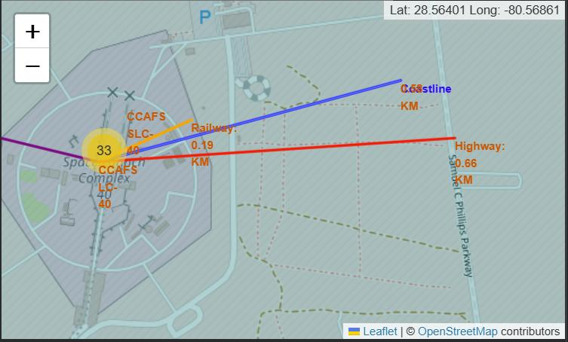
Launch sites hug the coast and transport links
0.19 km
to a railway
0.58 km
to the coastline
0.66 km
to a highway
23 km
to the nearest city (Titusville)
Distances from CCAFS LC-40, measured on the Folium map

Slide 8
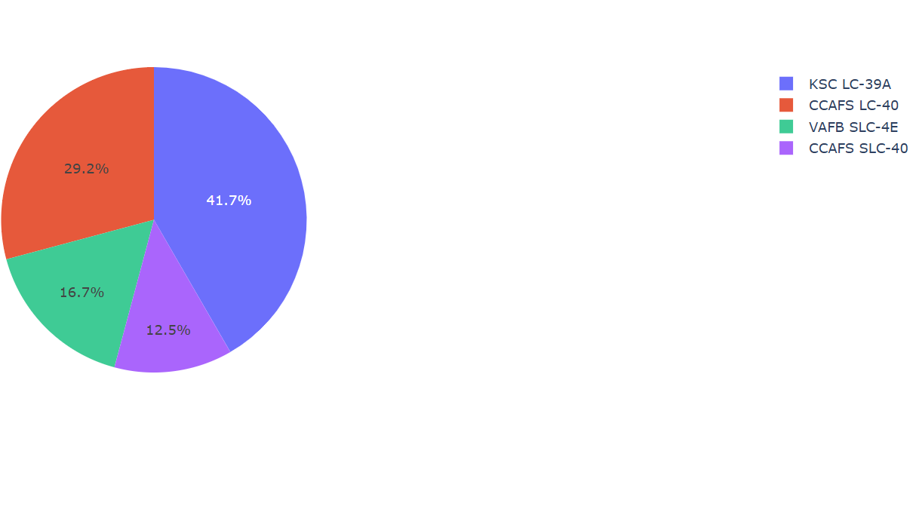
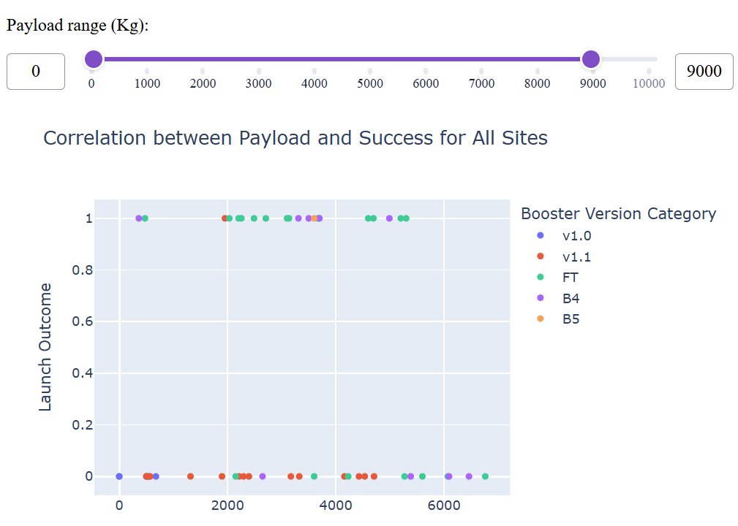
A dashboard to explore sites and payloads
KSC LC-39A has the highest success rate (76.9%) and the largest share of successful launches (41.7%).
Payload slider and site filter show how landing outcome varies with payload mass and booster version (Plotly Dash).

Slide 9
All four models reach 83% test accuracy
Confusion matrix (all four models)
12
0
landed, predicted landed
landed, predicted failure
3
3
failed, predicted landed
failed, predicted failure
Every landing is caught; the only errors are 3 false positives.

Slide 10
What these results can and cannot tell us
Limitations
Next steps
Only 90 launches; the test set has 18, so one prediction moves accuracy by 5.6 points
All models tie on the test set, so the ranking rests on cross-validation alone
Data ends in 2020; landing reliability has changed since
Repeated, stratified cross-validation to compare models fairly
Add recent launches from the SpaceX API
Engineer features such as booster reuse count, block version and landing type

Slide 11
Key takeaways
1
Experience Landing success rose from 36% in the first 25 flights to 78.5% afterwards
2
Orbit GTO missions land least often (52%); VLEO and LEO most often
3
Model 83% test accuracy with four classifiers; more data is needed to choose between them
Code, notebooks and dashboard: github.com/Sumant-crty/WinningSpaceRaceWithDataScience

