Slide 1


Slide 2
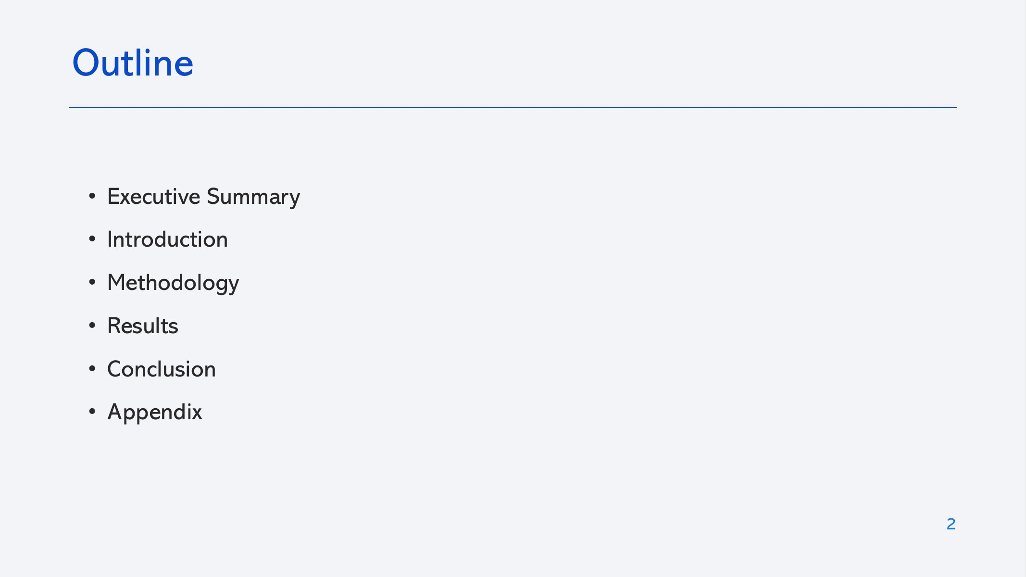

Slide 3
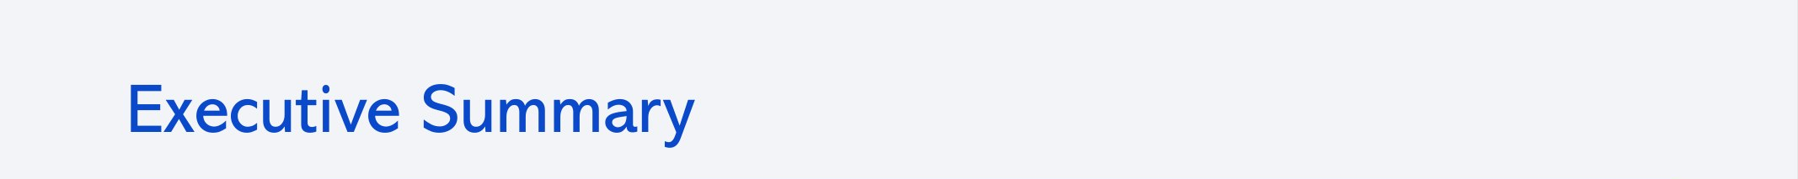
Methodology
Results
  Collected launch data from the SpaceX REST API and scraped Falcon 9 launch tables from Wikipedia
  Cleaned the data, imputed missing payload mass and created the binary landing label (Class)
  Explored the data with SQL, Seaborn/Matplotlib, Folium maps and a Plotly Dash dashboard
  Trained Logistic Regression, SVM, Decision Tree and KNN, tuned with GridSearchCV (10-fold CV) and evaluated with accuracy and confusion matrices
Success rate: 66.7% of 90 Falcon 9 first stages landed
Experience: 0% landed in 2010–2013, ~83% in 2017, a dip to ~61% in 2018, then ~90% in 2019
Orbits: VLEO (86%) and LEO (71%) do best; GTO is lowest (52%) among orbits with enough launches
Sites: KSC LC-39A has the highest success rate; CCAFS SLC-40 hosts most launches
Models: all four reach 83.3% test accuracy (15/18); Decision Tree has the best CV accuracy (88.8%)
3

Slide 4
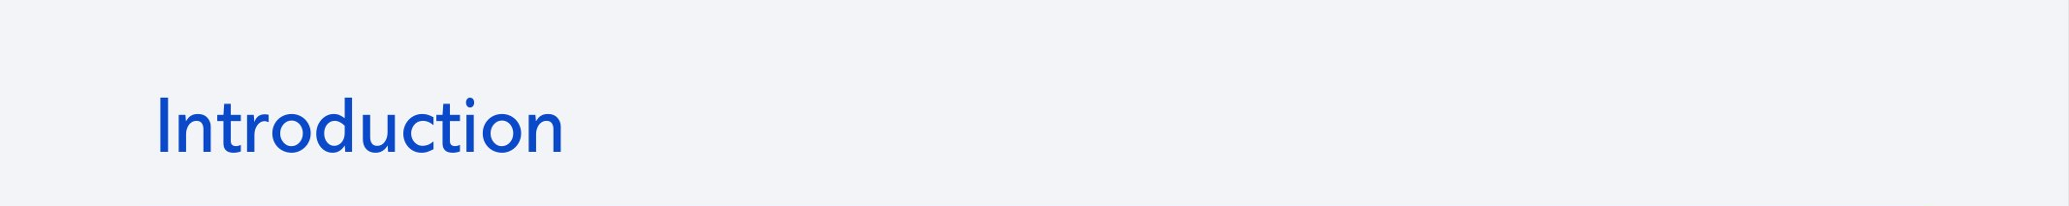
SpaceX advertises Falcon 9 launches at $62 million, compared with $165 million or more from other providers. Much of the saving comes from reusing the first stage, but not every booster is recovered: some crash, and some are sacrificed because of payload, orbit or customer requirements.
As a data scientist at Space Y, a fictional competitor founded by billionaire Allon Musk, my task is to:
  Predict whether the Falcon 9 first stage will land successfully
  Use that prediction to estimate the cost of a launch
  Build dashboards and machine learning models that support bidding decisions
Key question: Which launch characteristics determine whether the first stage lands successfully?
4

Slide 5


Slide 6
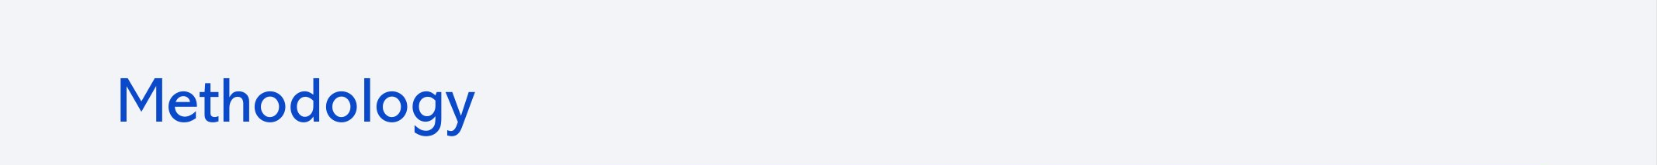
Data collection: SpaceX REST API, supplemented by web scraping Wikipedia launch tables
Data wrangling: filtered to Falcon 9, imputed missing payload mass with the mean, converted landing outcomes into a binary label
Exploratory analysis: SQL queries on SQLite plus Seaborn/Matplotlib charts
Interactive analytics: Folium maps of launch sites and their surroundings; Plotly Dash dashboard
Predictive analysis: Logistic Regression, SVM, Decision Tree and KNN; hyperparameters tuned with GridSearchCV (10-fold CV); evaluated with test accuracy and confusion matrices
6

Slide 7
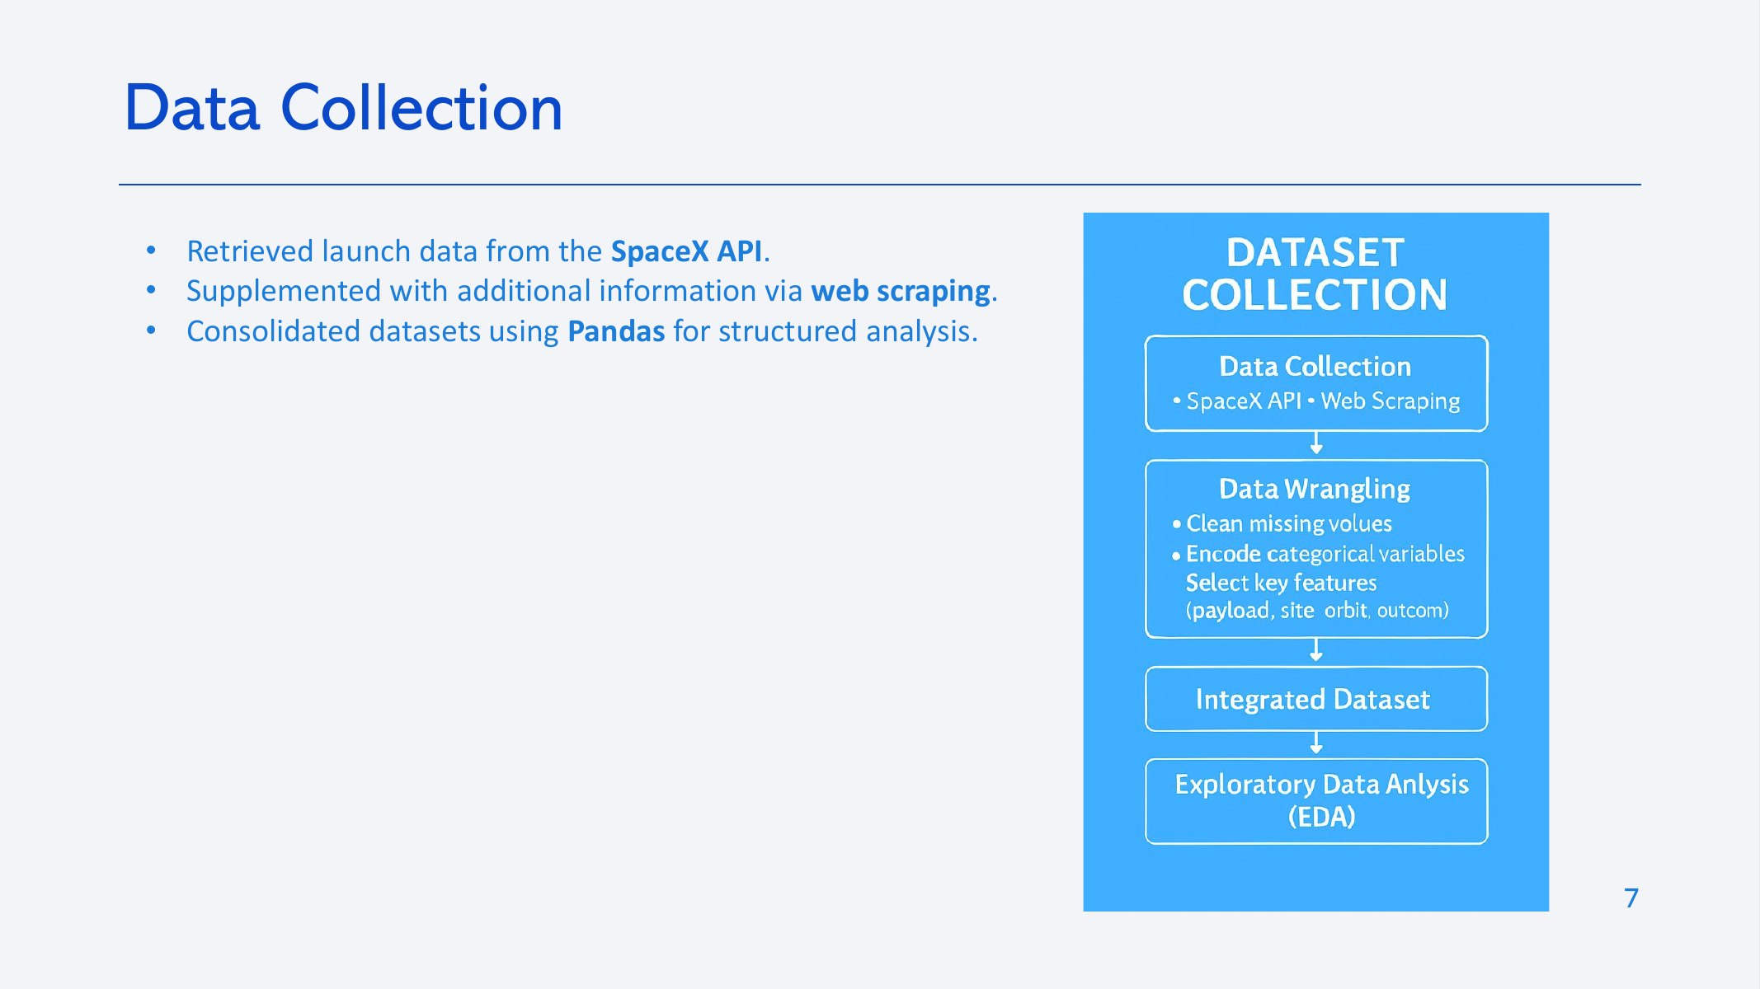

Slide 8
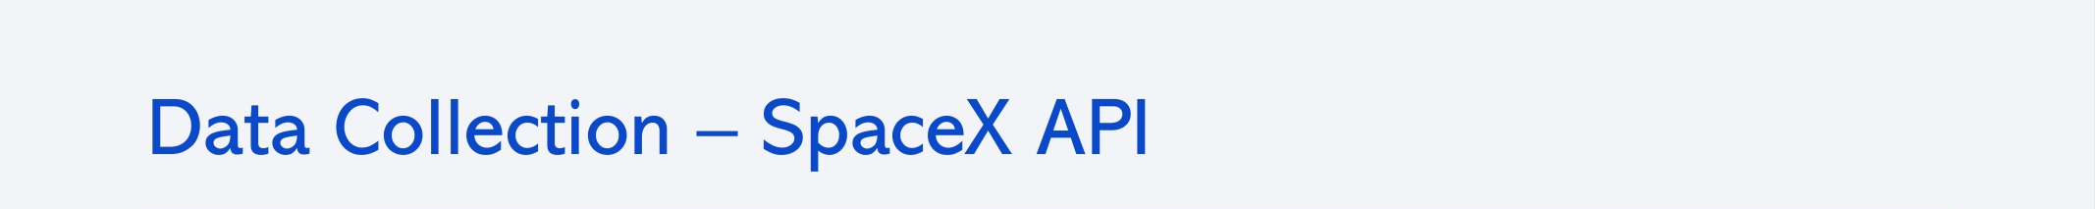
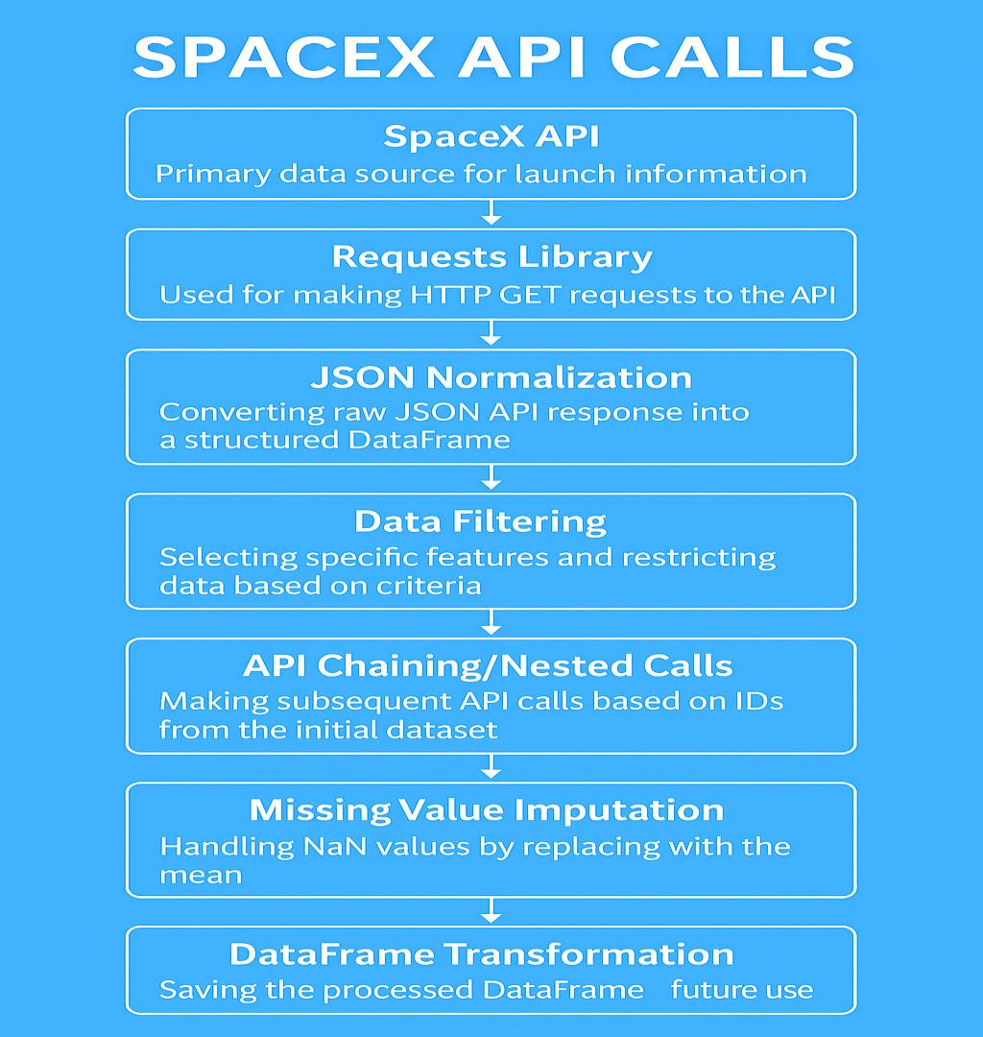
  Requested past launches from the SpaceX REST API (api.spacexdata.com/v4/launches/past)
  Resolved rocket, launchpad, payload and core IDs with follow-up API calls
  Normalized the JSON into a DataFrame and kept Falcon 9 launches only
  Replaced missing payload mass values with the mean
Notebook: notebooks/01_data_collection_api.ipynb
8

Slide 9
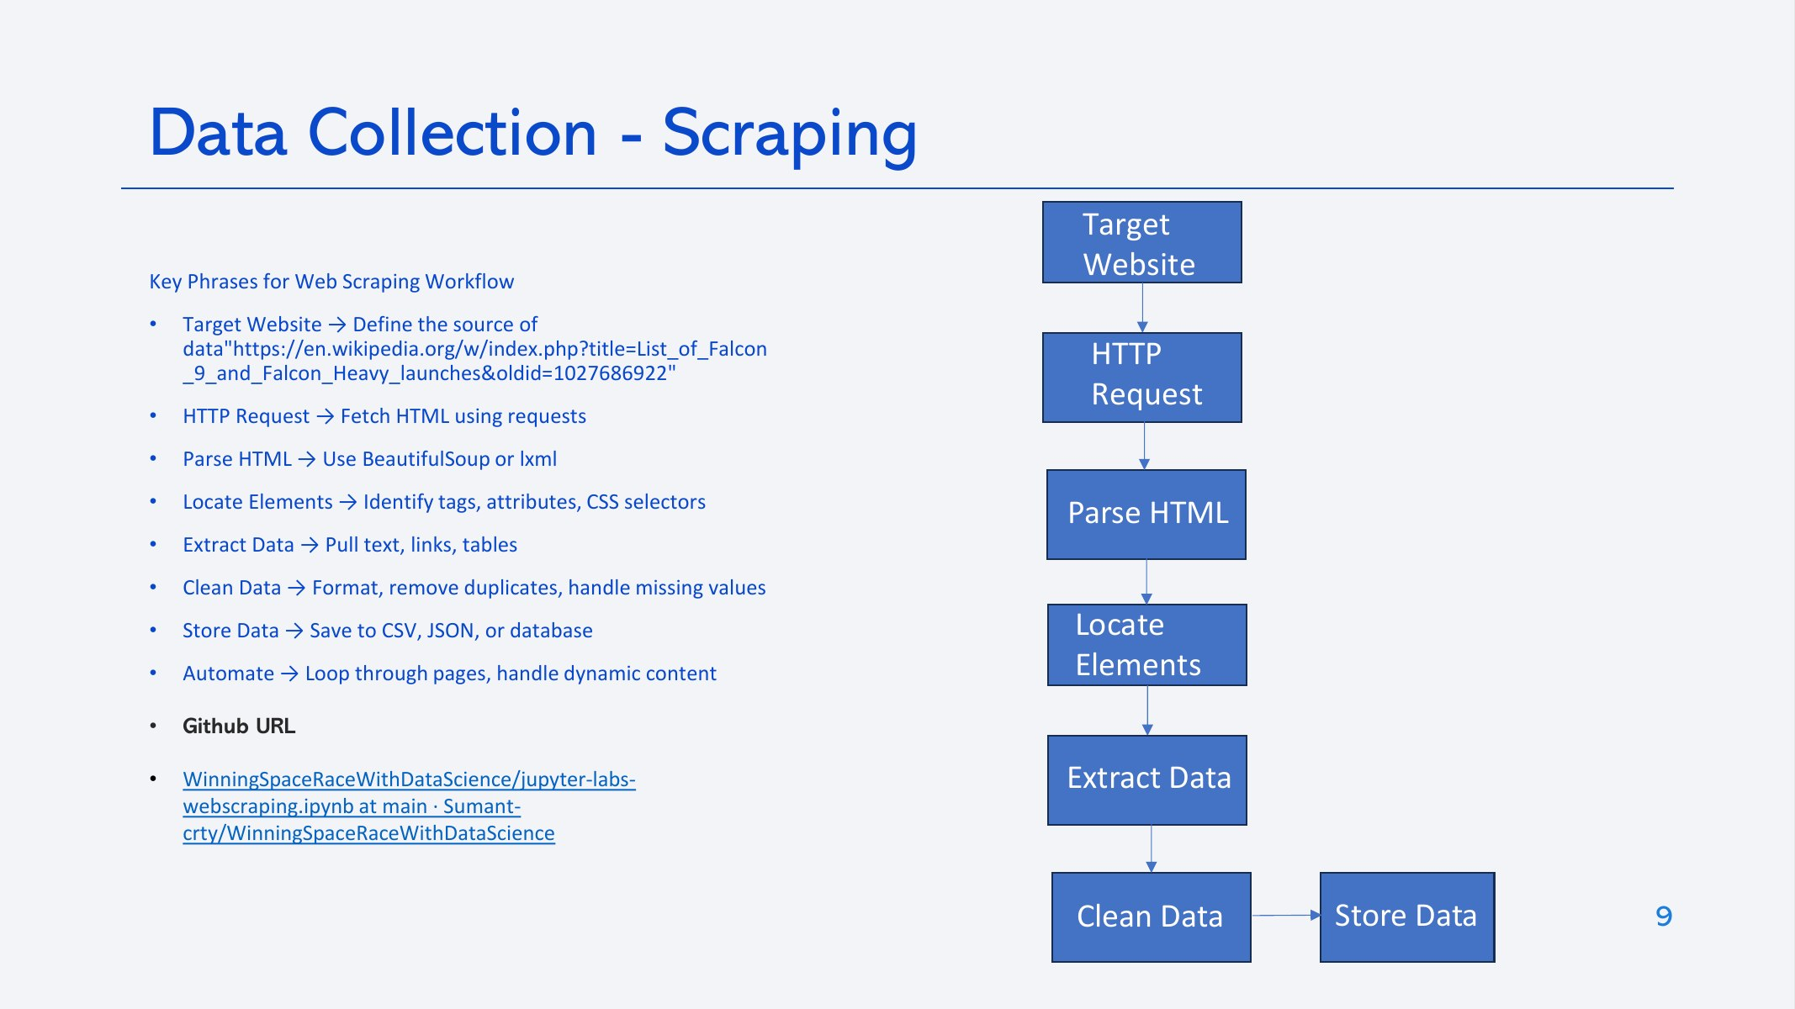
  Requested a fixed snapshot of the Wikipedia page "List of Falcon 9 and Falcon Heavy launches"
  Parsed the HTML with BeautifulSoup and located the launch tables
  Extracted column names from the table headers
  Parsed each row into flight number, date, booster, site, payload, orbit, customer and outcomes
  Built a DataFrame and saved it to CSV
Notebook: notebooks/02_data_collection_webscraping.ipynb
9

Slide 10
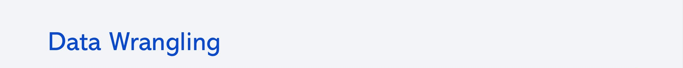
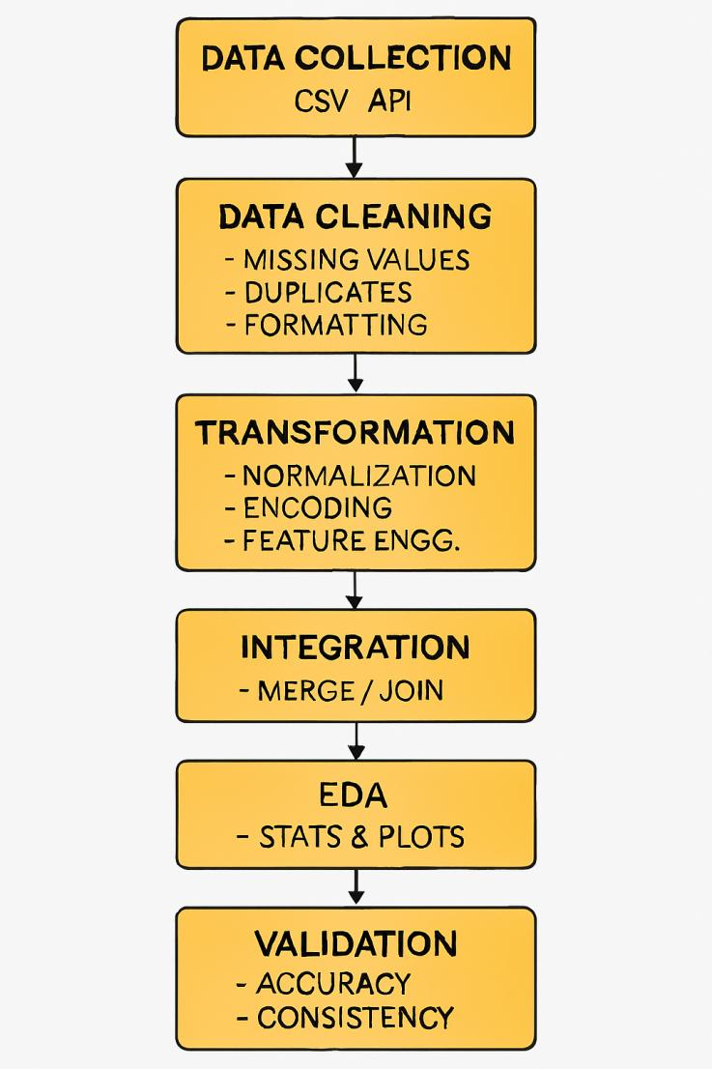
  Calculated the share of missing values per column (LandingPad: 28.9% missing, by design for launches without a landing pad)
  Counted launches per site and per orbit
  Grouped the landing outcomes and marked unsuccessful ones (False ASDS, False Ocean, False RTLS, None ASDS, None None)
  Created the Class label: 1 = landed, 0 = did not land
  Overall success rate: 66.7%
Notebook: notebooks/03_data_wrangling.ipynb
10

Slide 11
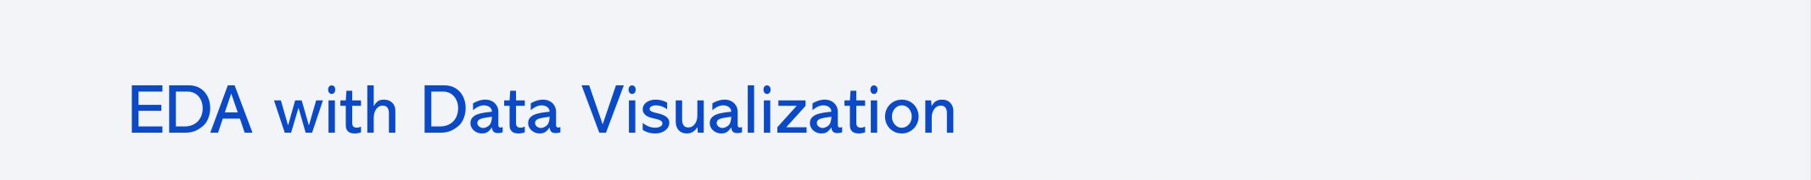
Scatter plots of Flight Number and Payload Mass against Launch Site and Orbit, coloured by outcome, to see how experience, payload and destination relate to landing success
Bar chart of success rate by orbit type, to compare orbits directly
Line chart of average success rate by year, to show the trend over time
Feature engineering: one-hot encoded Orbit, LaunchSite, LandingPad and Serial, and cast all features to float64 for modelling
Notebook: notebooks/05_eda_visualization.ipynb
11

Slide 12
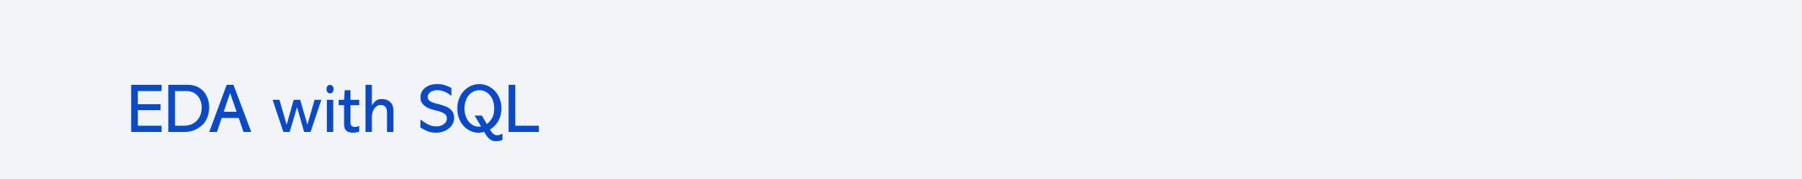
Queries run on the SPACEXTABLE (SQLite)
  Distinct launch sites
  First 5 records from sites starting with 'CCA'
  Total payload mass for NASA (CRS)
  Average payload mass for booster F9 v1.1
  Date of the first successful ground-pad landing
  Boosters with drone-ship success and payload of 4,000–6,000 kg
  Count of successful and failed mission outcomes
  Boosters that carried the maximum payload (subquery)
  Drone-ship landing failures in 2015, by month
  Landing outcomes ranked by count, 2010-06-04 to 2017-03-20
Notebook: notebooks/04_eda_sql.ipynb
12

Slide 13
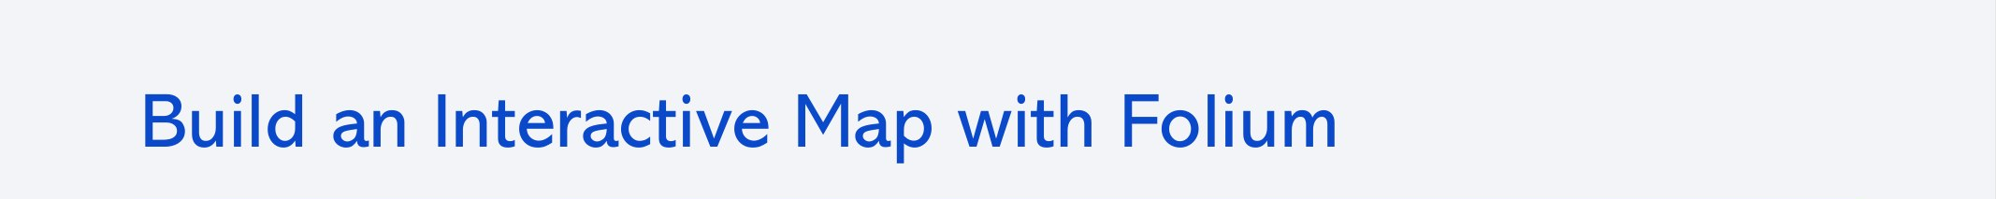
Circles and markers label each launch site and NASA Johnson Space Center
Marker clusters show every launch at a site, coloured green (landed) or red (did not land)
Mouse position plugin to read coordinates of nearby coastline, railway, highway and city
Polylines draw the distance from a launch site to each of those points
Notebook: notebooks/06_launch_site_analysis_folium.ipynb
13

Slide 14
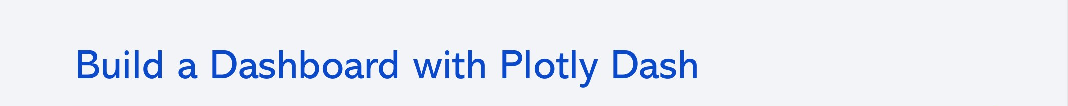
Launch-site dropdown to view all sites or a single site
Pie chart: share of successful launches by site (all sites), or success vs. failure for the selected site
Payload range slider to filter launches by payload mass
Scatter chart: payload mass vs. landing outcome, coloured by booster version, to show how payload and booster type relate to success
App: dashboard/spacex_dash_app.py
14

Slide 15
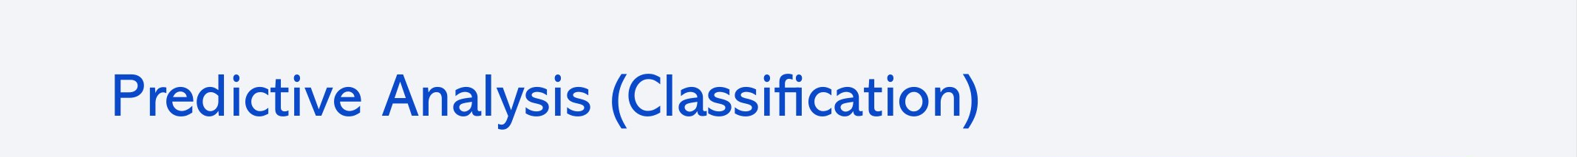
1 Prepare
2 Tune
3 Evaluate
4 Select
Class column as target (Y); standardized features (X); 80/20 train/test split (18 test launches)
GridSearchCV with 10-fold CV for Logistic Regression, SVM, Decision Tree and KNN
CV accuracy (best_score_), test accuracy (.score) and a confusion matrix per model
All models tie on test accuracy, so CV accuracy breaks the tie: Decision Tree (0.888)
Notebook: notebooks/08_machine_learning_prediction.ipynb
15

Slide 16
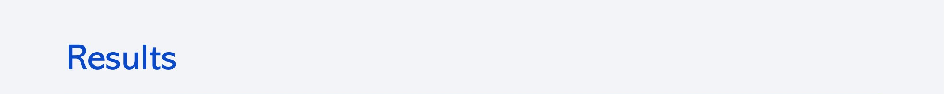
Model performance
Exploratory analysis
Model | CV accuracy | Test accuracy
Logistic Regression | 0.846 | 0.833
SVM | 0.848 | 0.833
Decision Tree | 0.888 | 0.833
KNN | 0.848 | 0.833
90 launches; 66.7% of first stages landed
Launches per site: CCAFS SLC 40: 55, KSC LC 39A: 22, VAFB SLC 4E: 13
Most common orbits: GTO 27, ISS 21, VLEO 14, PO 9
Outcomes: True ASDS 41, None None 19, True RTLS 14, False ASDS 6, True Ocean 5, False Ocean 2, None ASDS 2, False RTLS 1
Missing data: only LandingPad (28.9%), by design
All models score the same on the 18-launch test set; the Decision Tree has the best cross-validation accuracy.
16

Slide 17


Slide 18
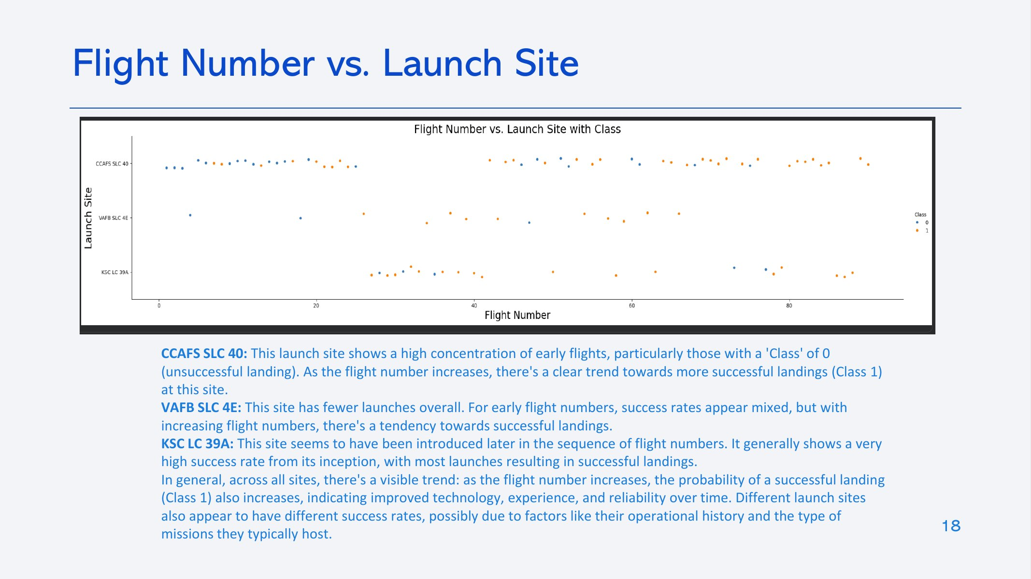

Slide 19
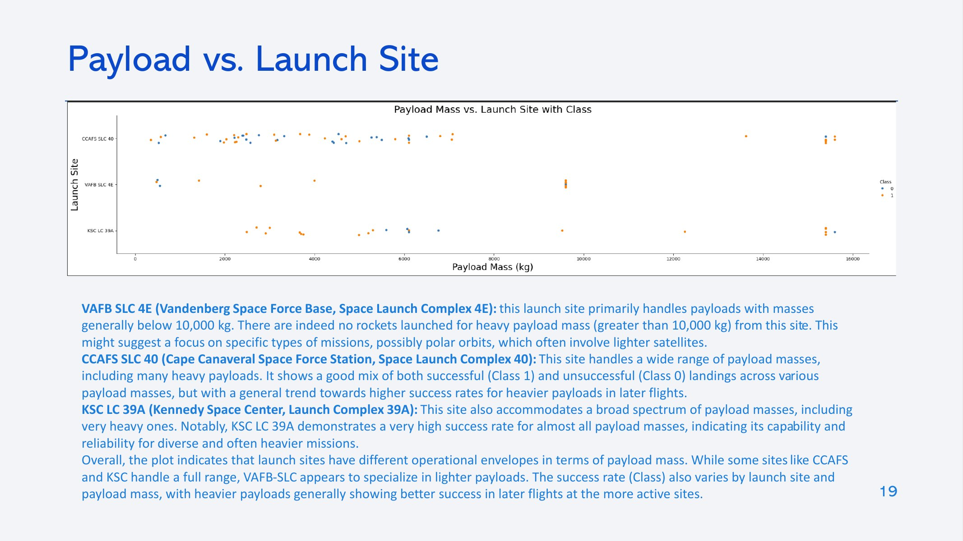

Slide 20
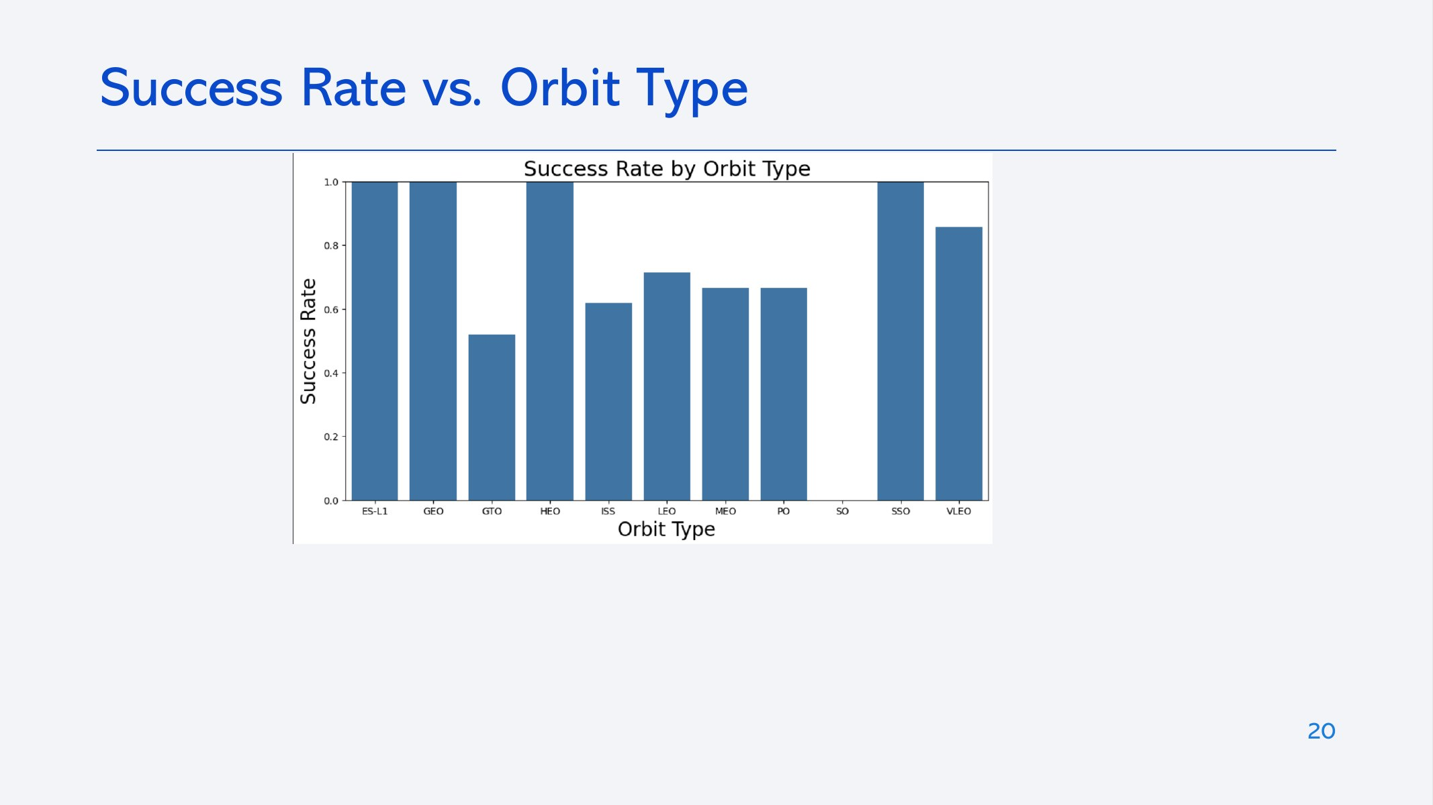

Slide 21
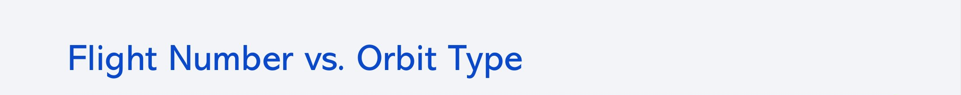
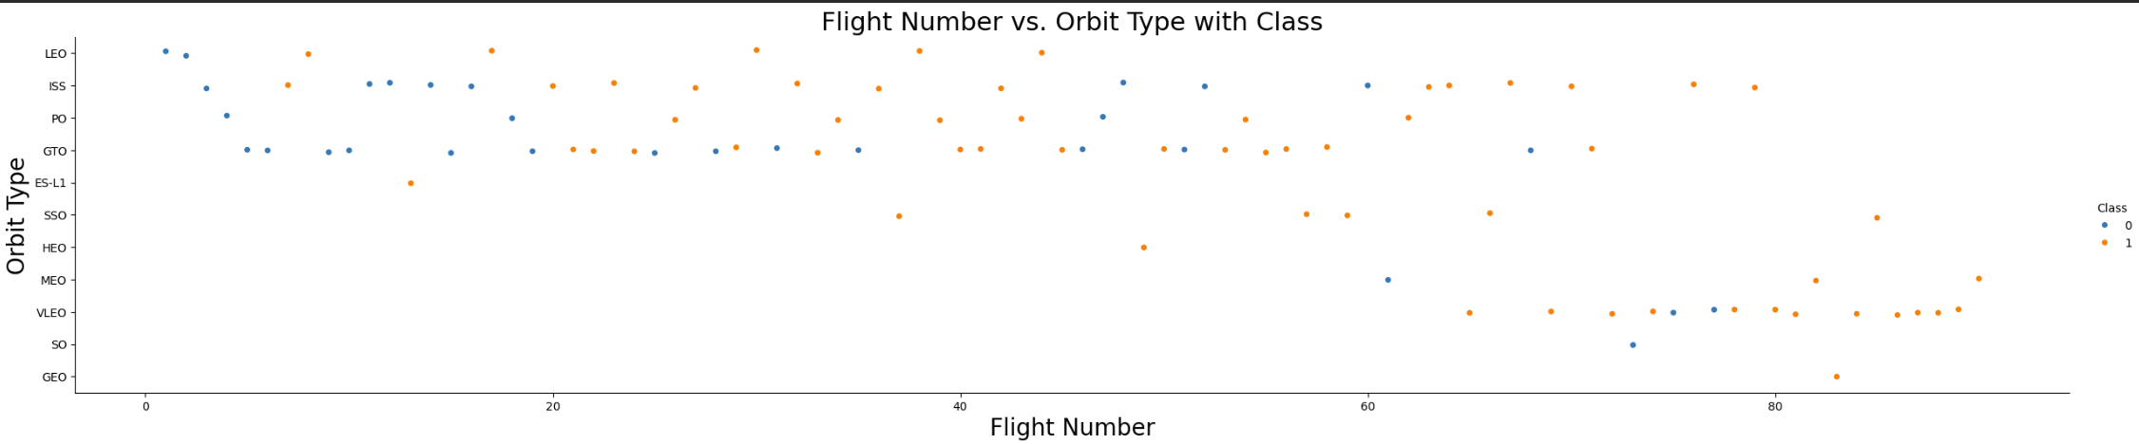
LEO: success improves clearly with flight number; later LEO flights almost all landed
GTO: successes and failures appear throughout, with no clear link to flight number
ISS: mixed outcomes; 62% of ISS missions landed (13 of 21)
Other orbits have few launches each, so their rates are not reliable on their own
21

Slide 22
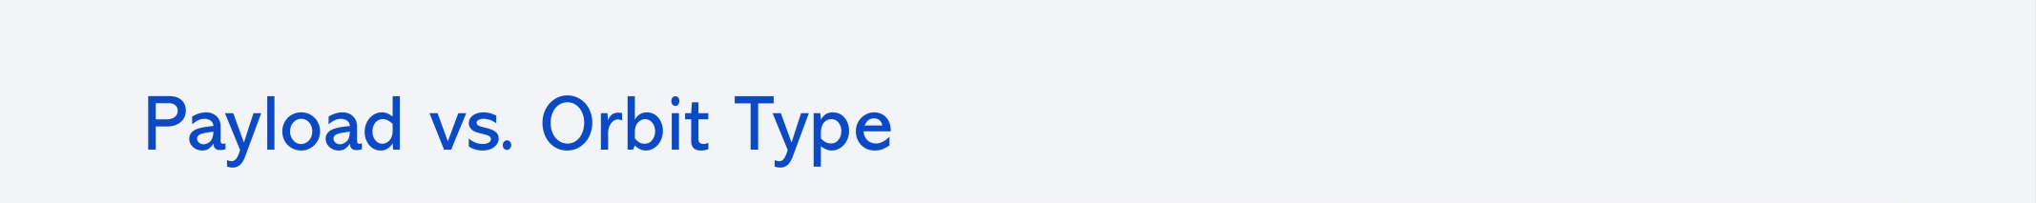
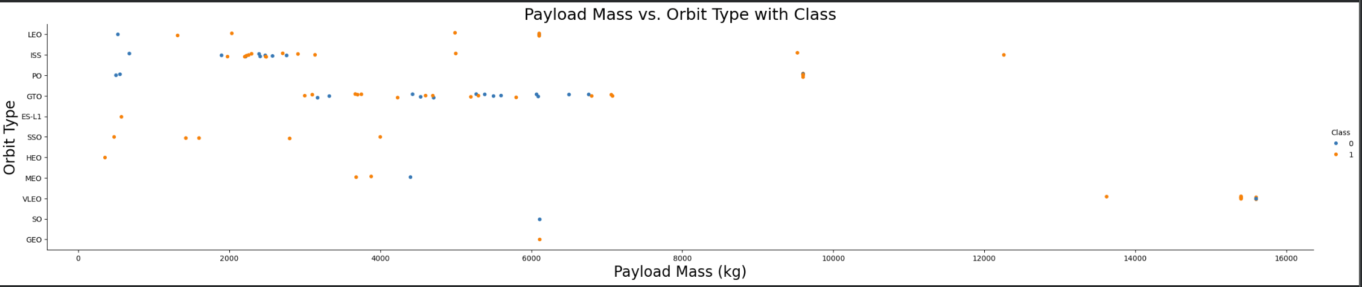
Polar, LEO and ISS: heavy payloads land successfully more often
GTO: successes and failures are mixed across payload masses, so payload alone does not predict landing
Overall: the effect of payload depends on the orbit, which is why both features are kept for modelling
22

Slide 23
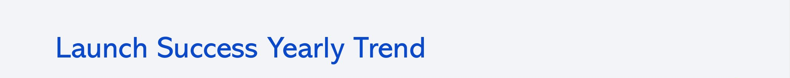
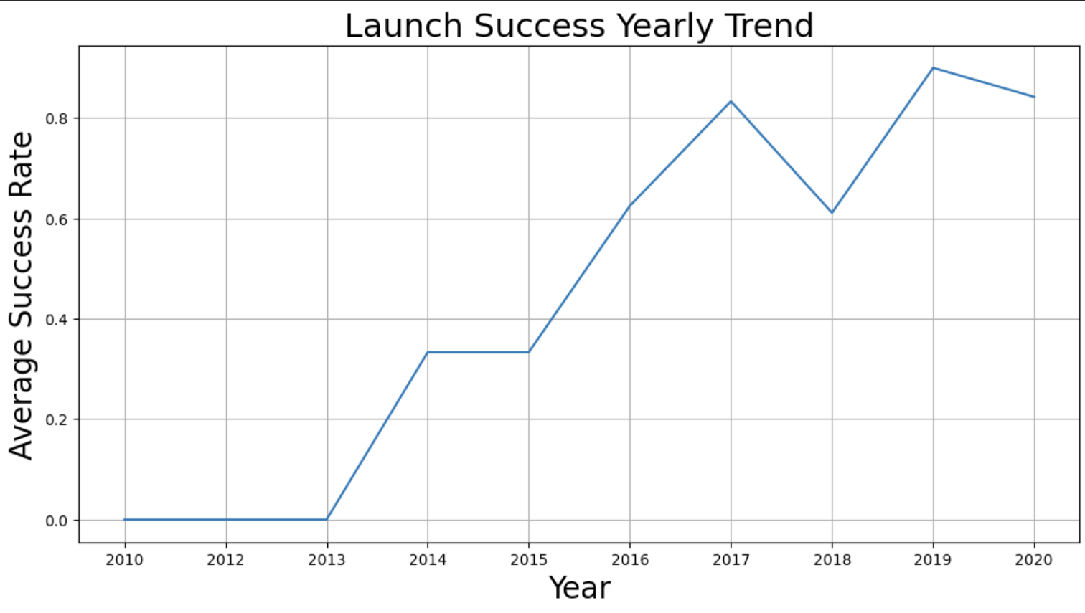
2010–2013: no first stage landed (early experimental attempts)
2014–2017: success rose from 33% to 83%
2018: a dip to 61%
2019–2020: 90% and 84%
  Landing reliability improved strongly with experience, but it had not reached 100% by 2020
23

Slide 24
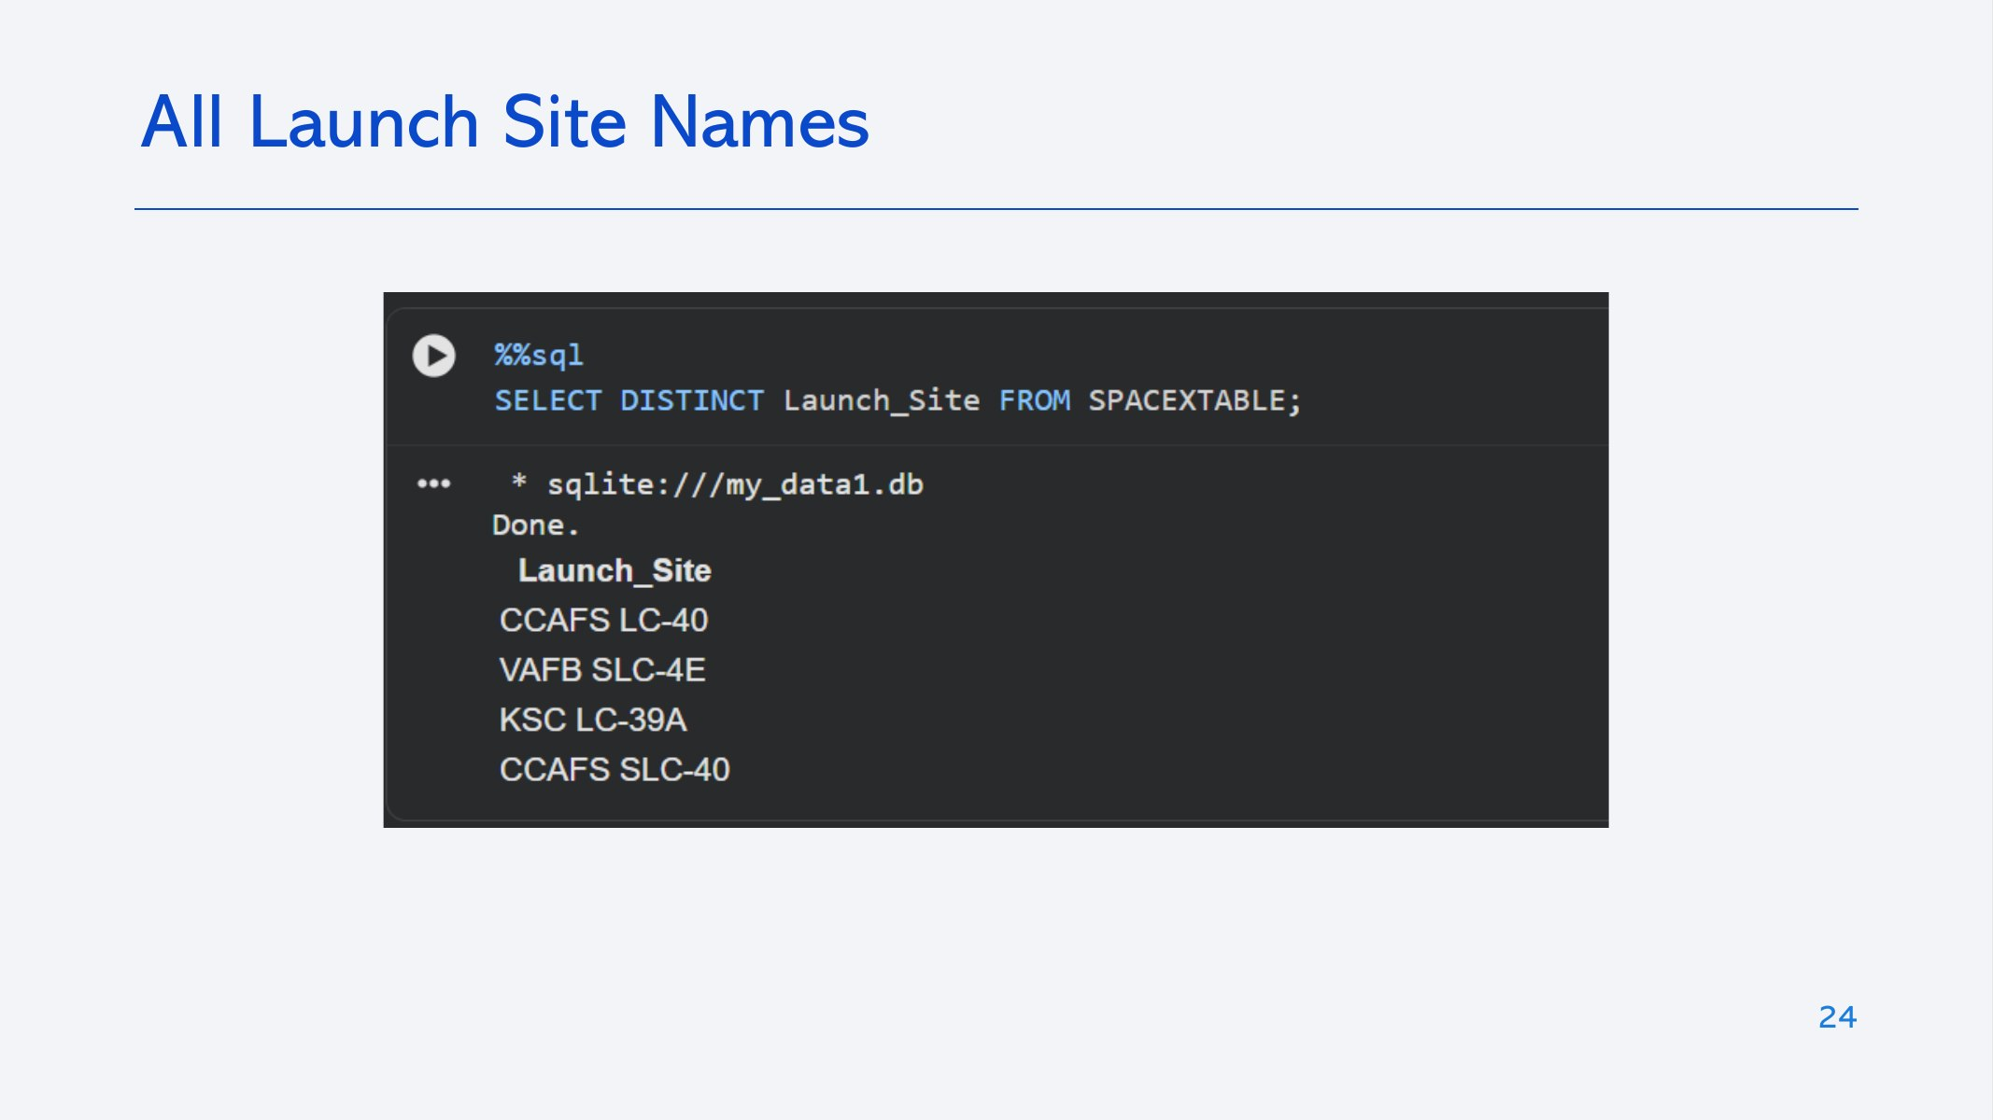

Slide 25
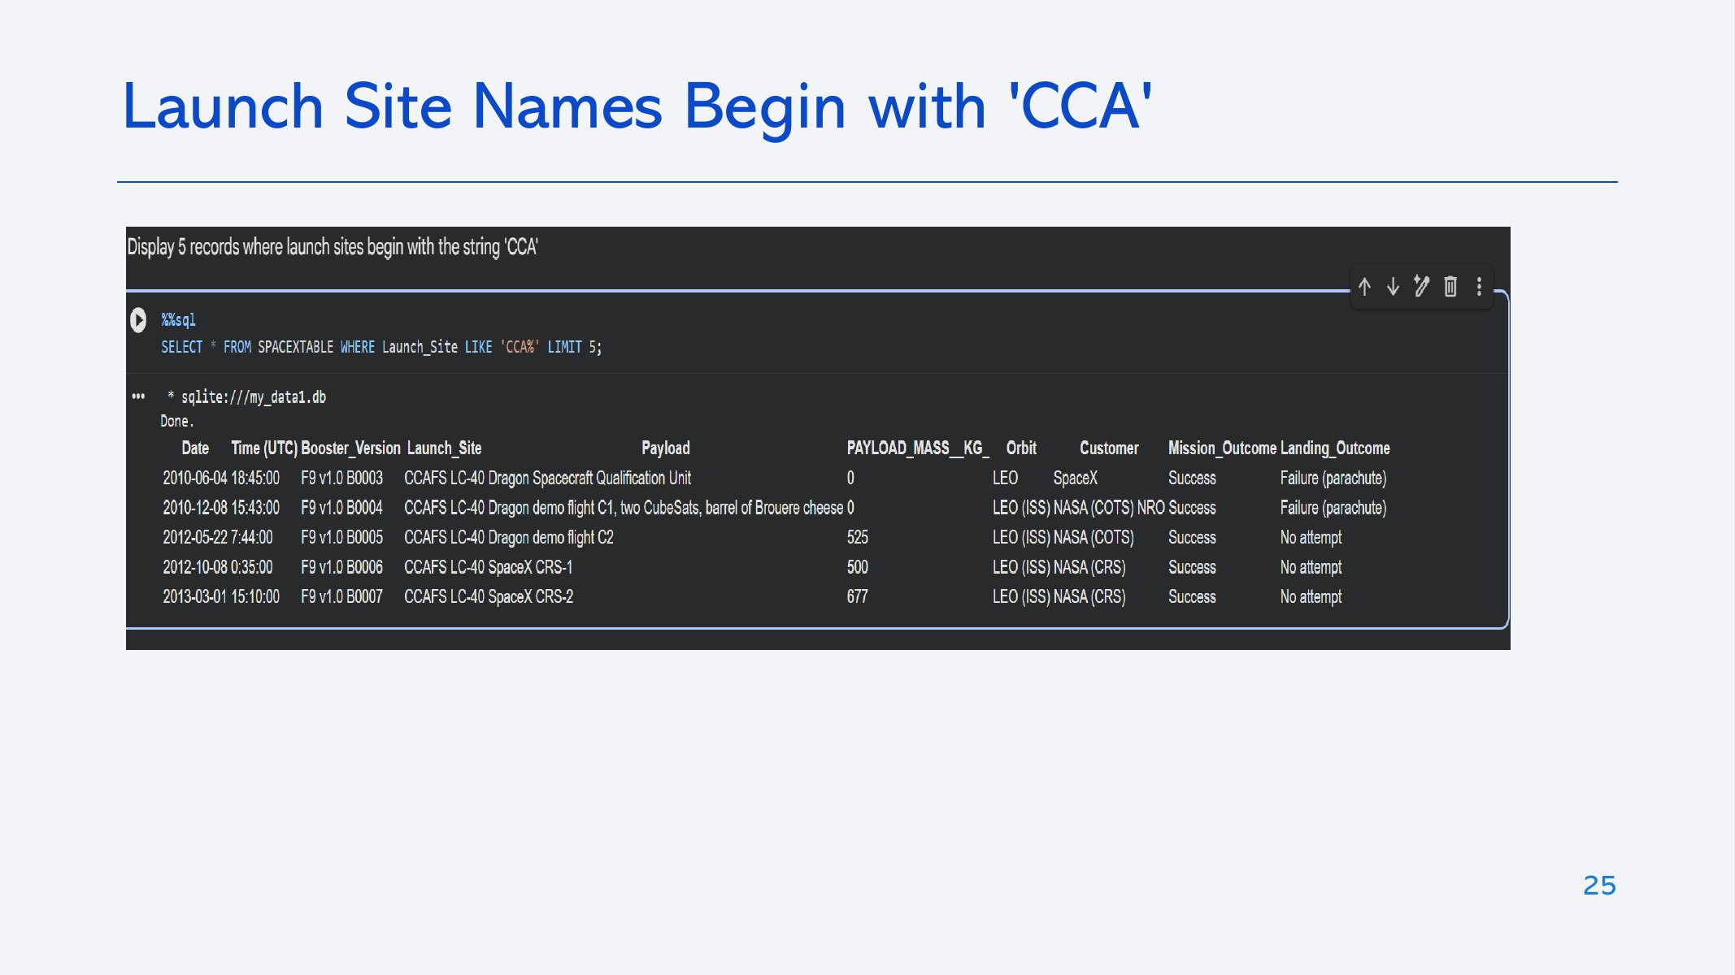

Slide 26
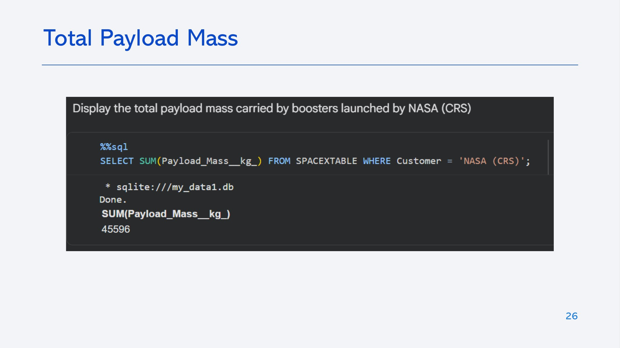

Slide 27
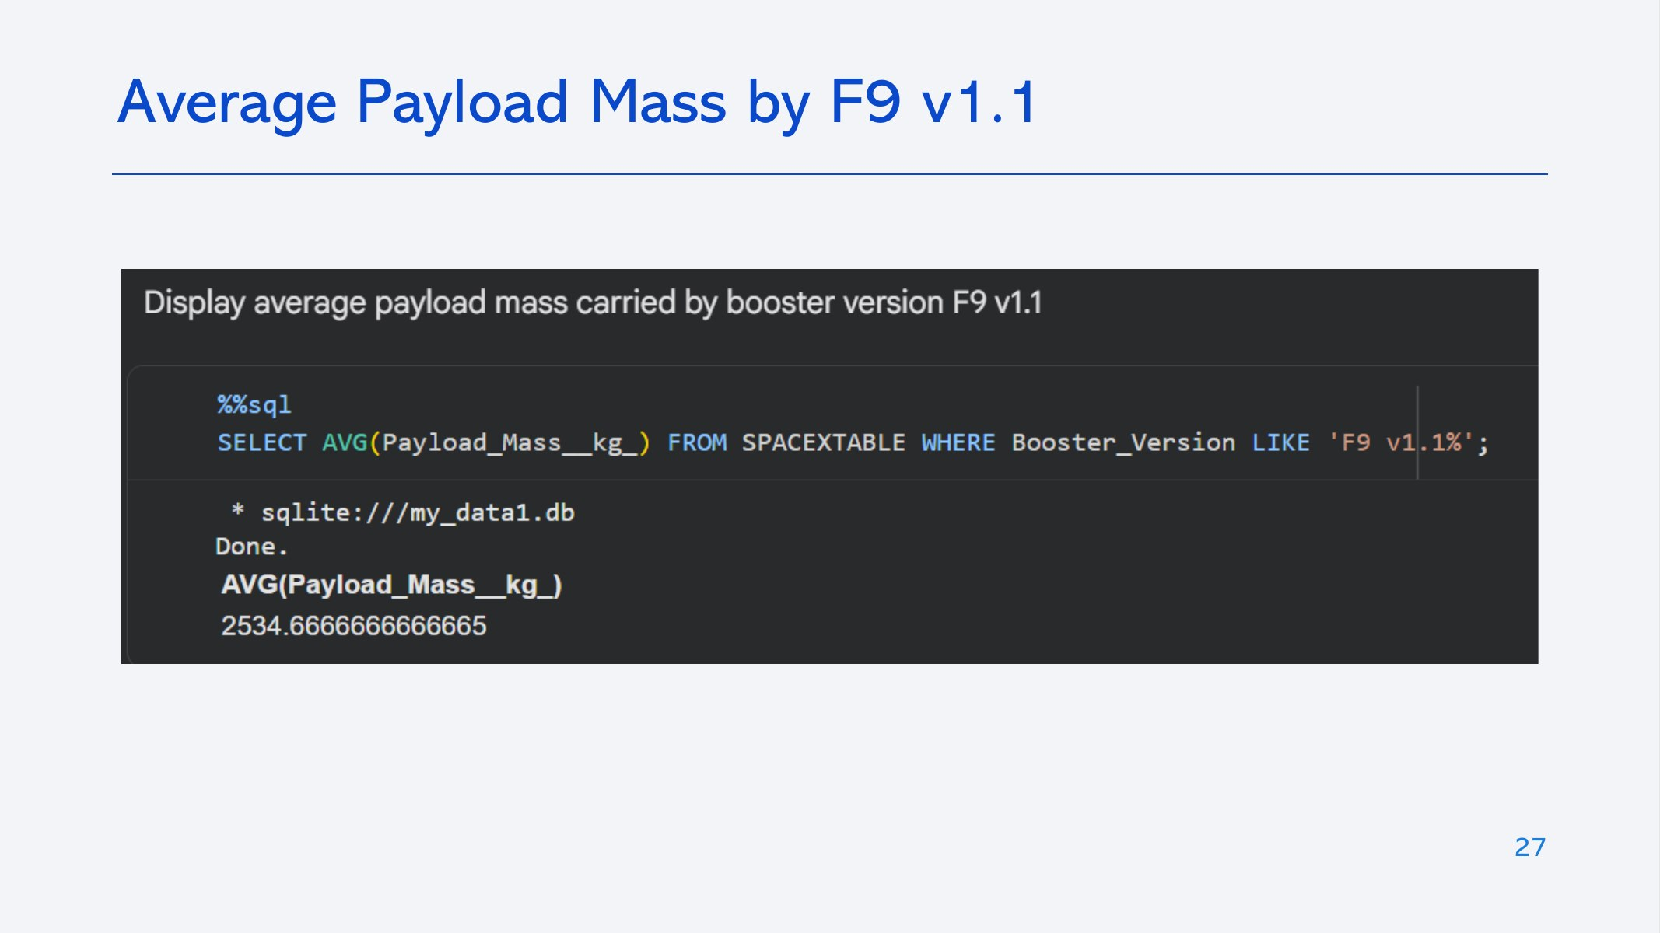

Slide 28
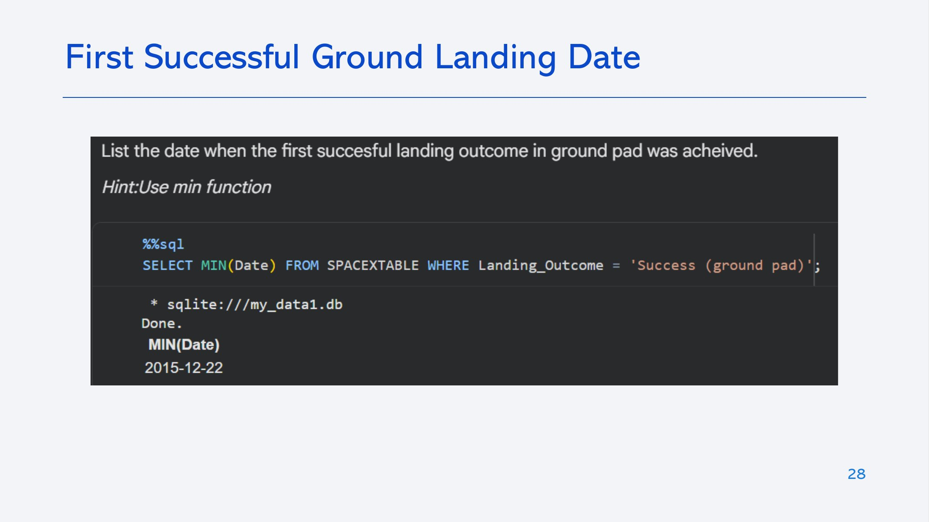

Slide 29
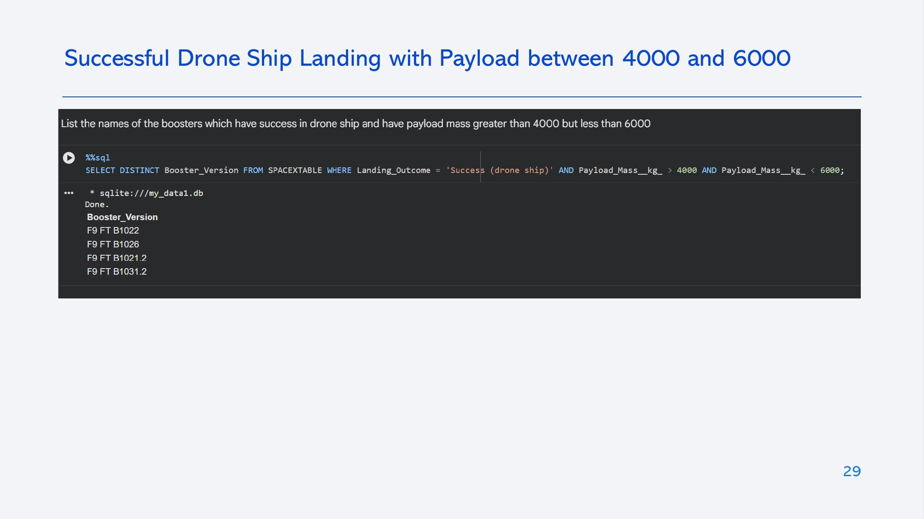

Slide 30
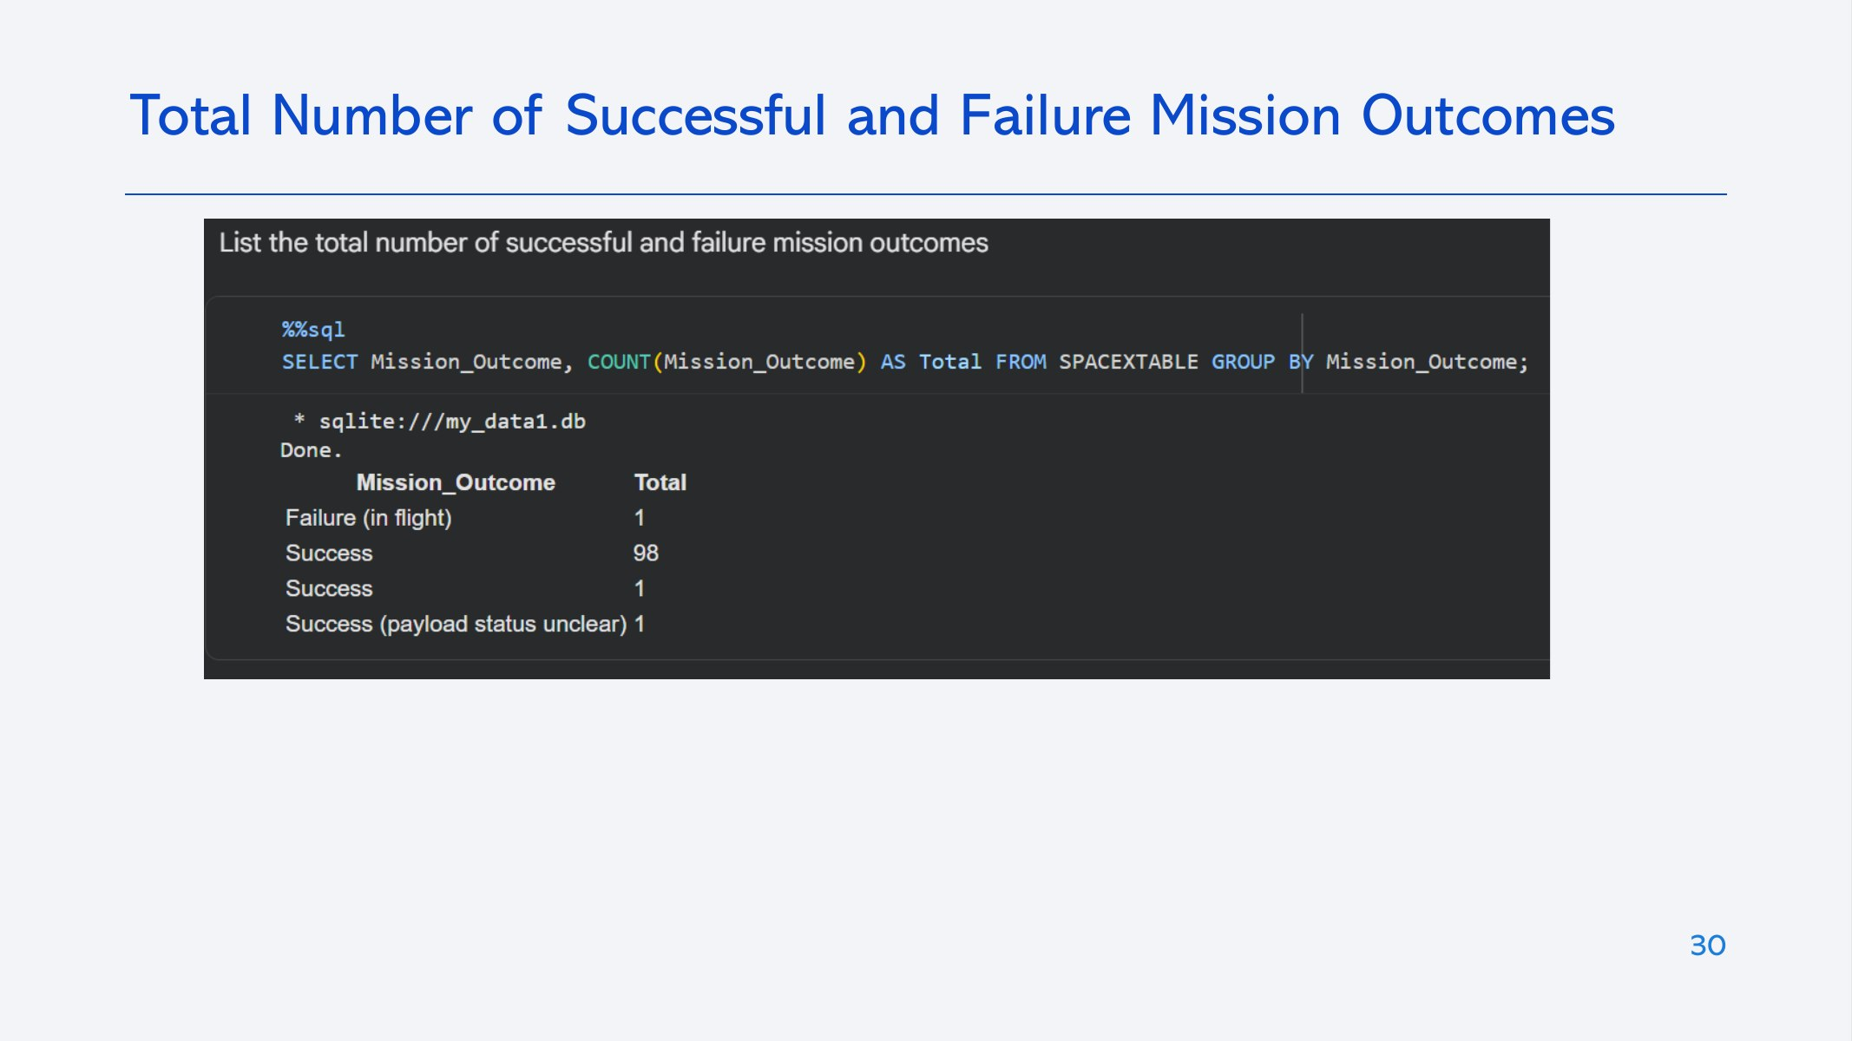

Slide 31
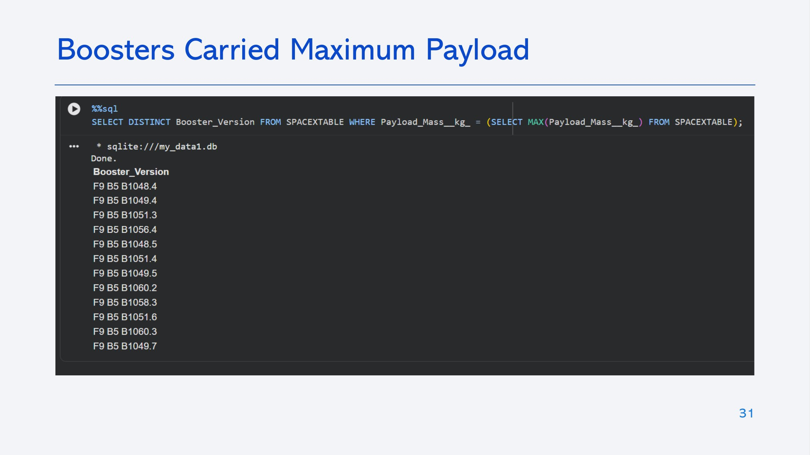

Slide 32
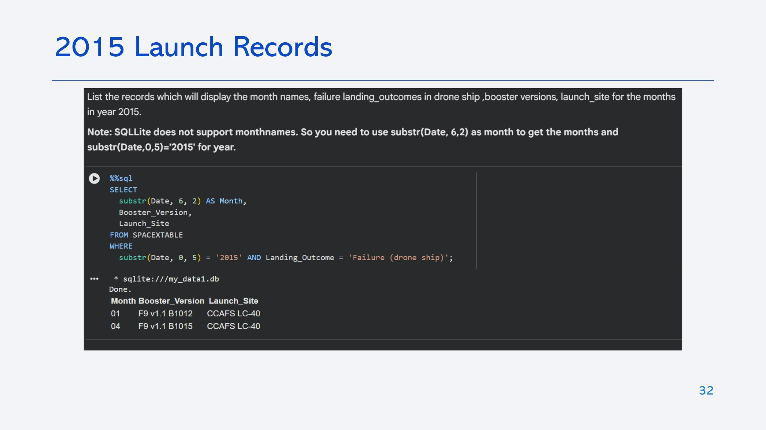

Slide 33
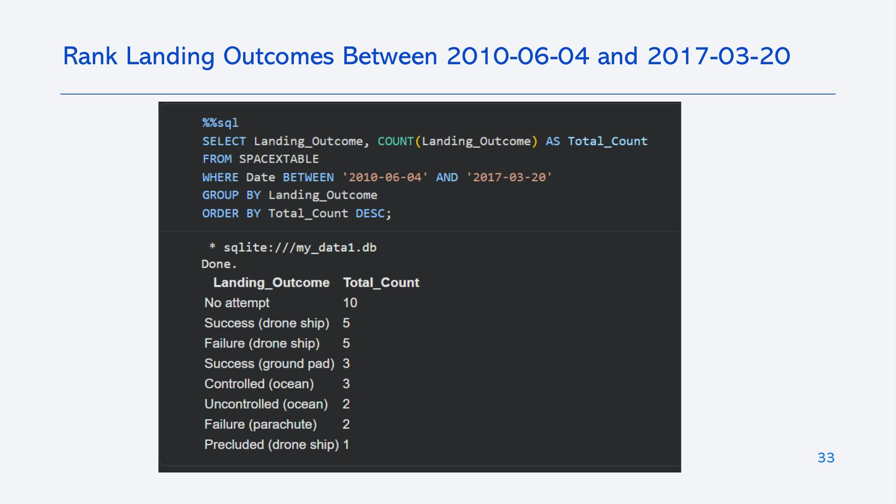

Slide 34


Slide 35
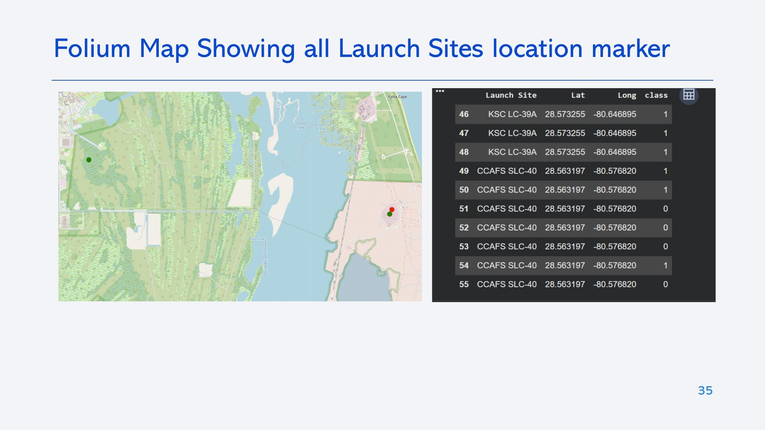

Slide 36
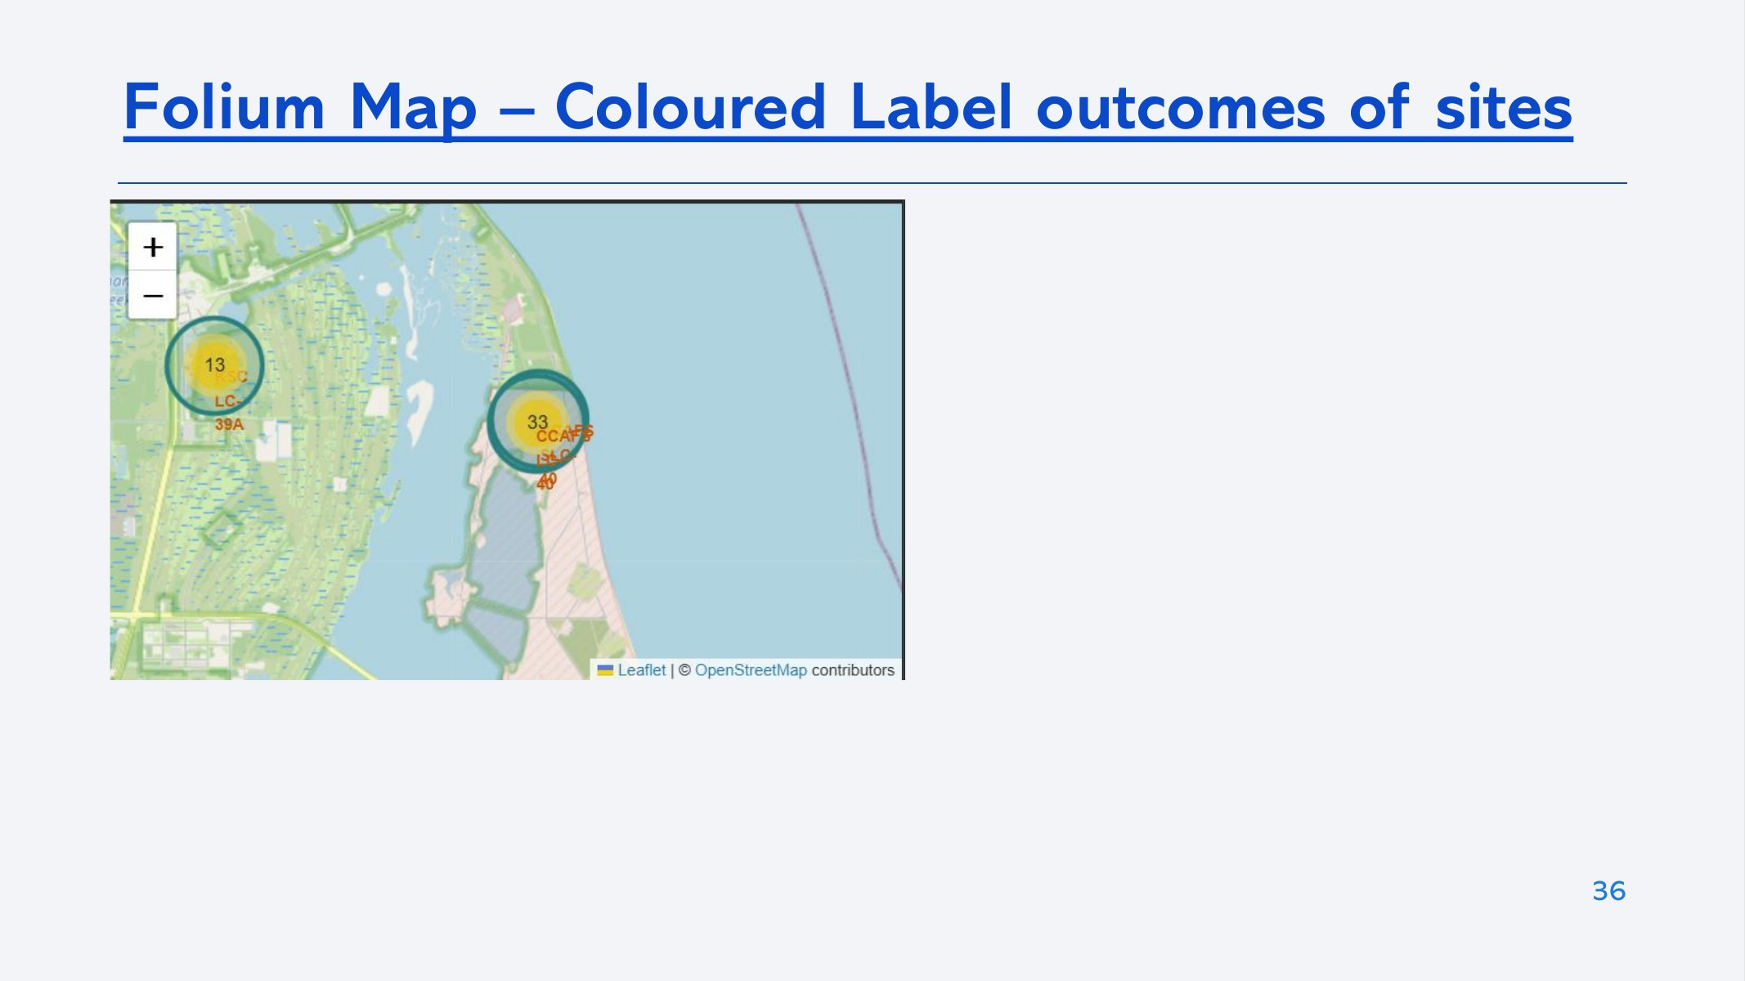

Slide 37
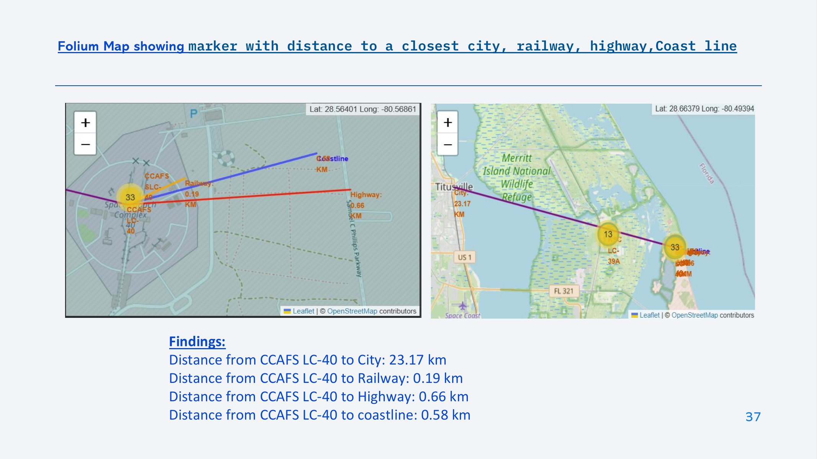

Slide 38


Slide 39
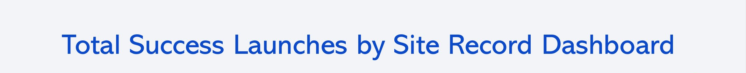
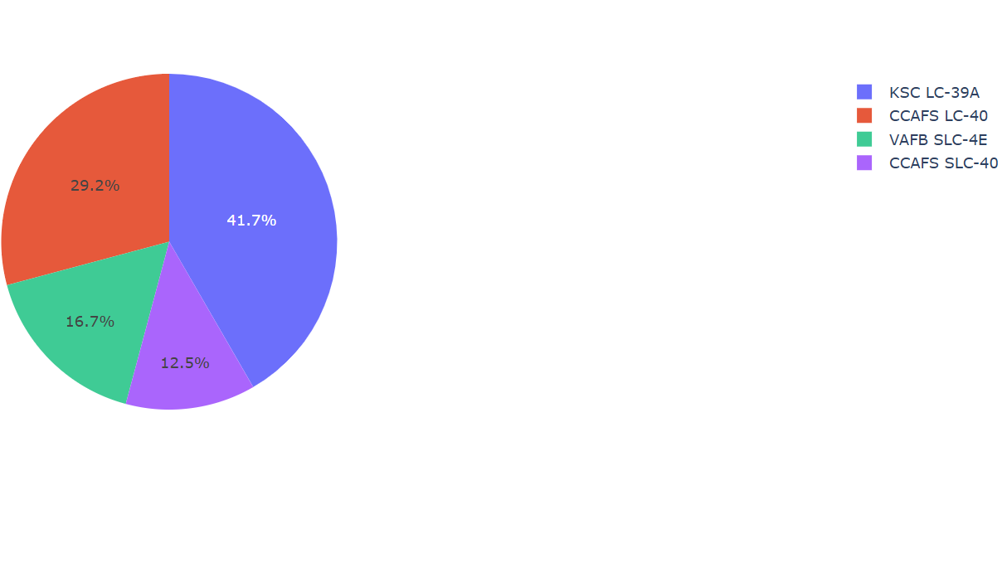
KSC LC-39A has the largest share of successful launches (41.7%) and the highest success rate (76.9%)
CCAFS LC-40 hosted the most launches in this dataset (26) but had the lowest success rate (26.9%), as it carried most early flights
39

Slide 40
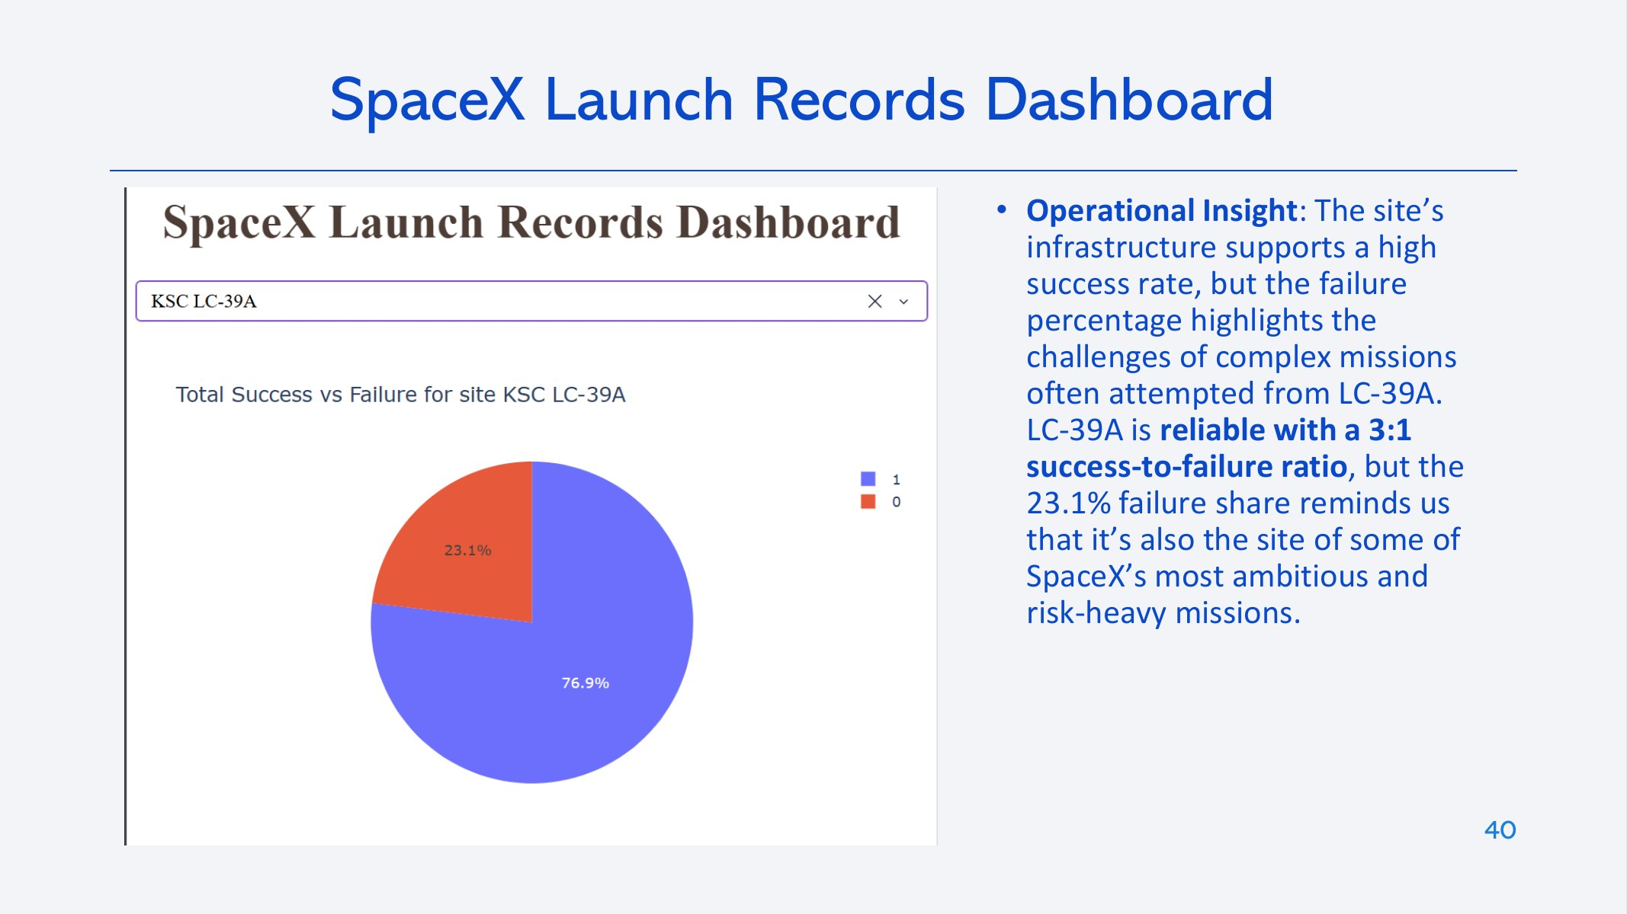

Slide 41
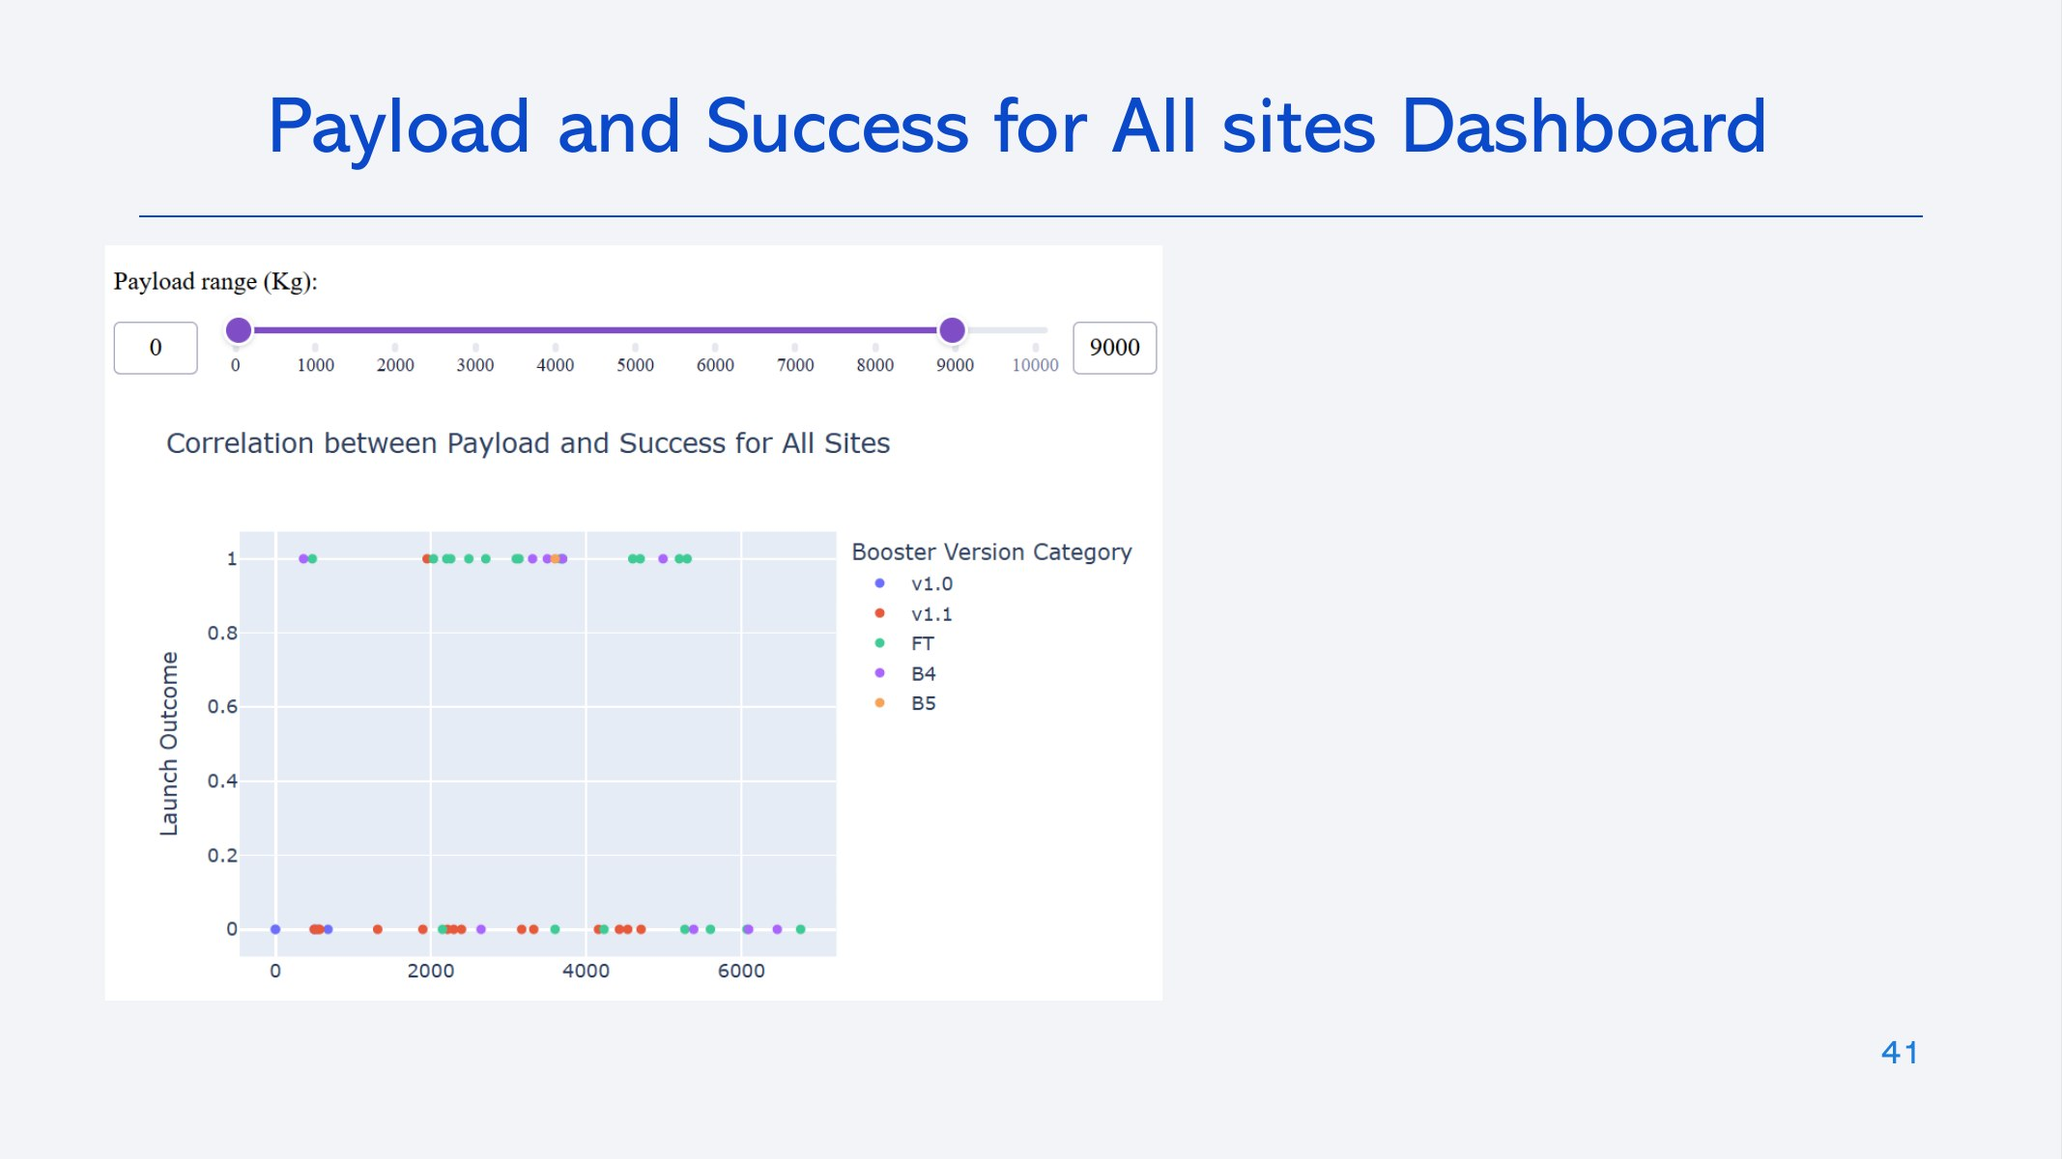

Slide 42


Slide 43
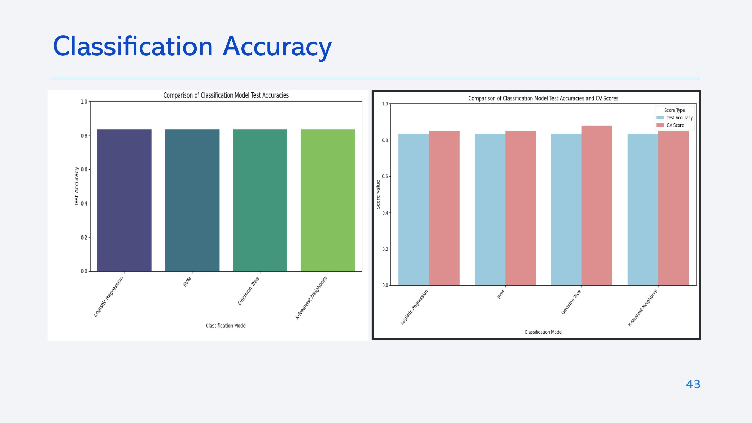

Slide 44
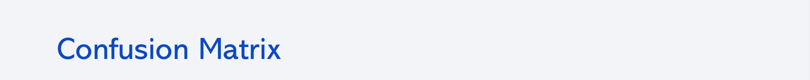
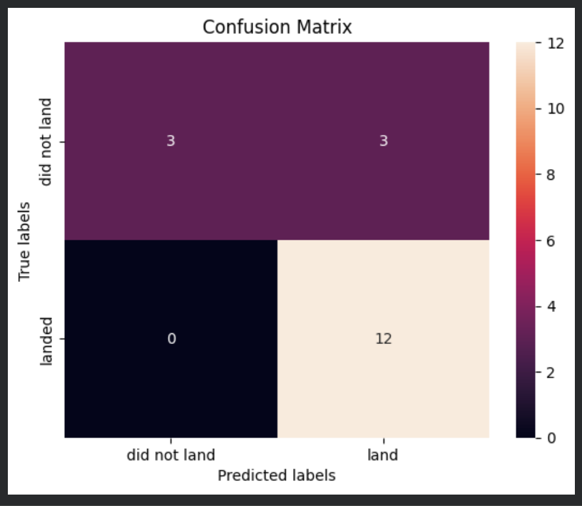
  All four models produce this same confusion matrix on the 18 test launches; the Decision Tree is shown because it has the best CV accuracy
True positives = 12: every booster that landed was predicted correctly
True negatives = 3: 3 of 6 failed landings were predicted correctly
False positives = 3: the model predicted a landing that did not happen
False negatives = 0: recall for landings is 100%
  Accuracy = 15 / 18 = 0.833
44

Slide 45
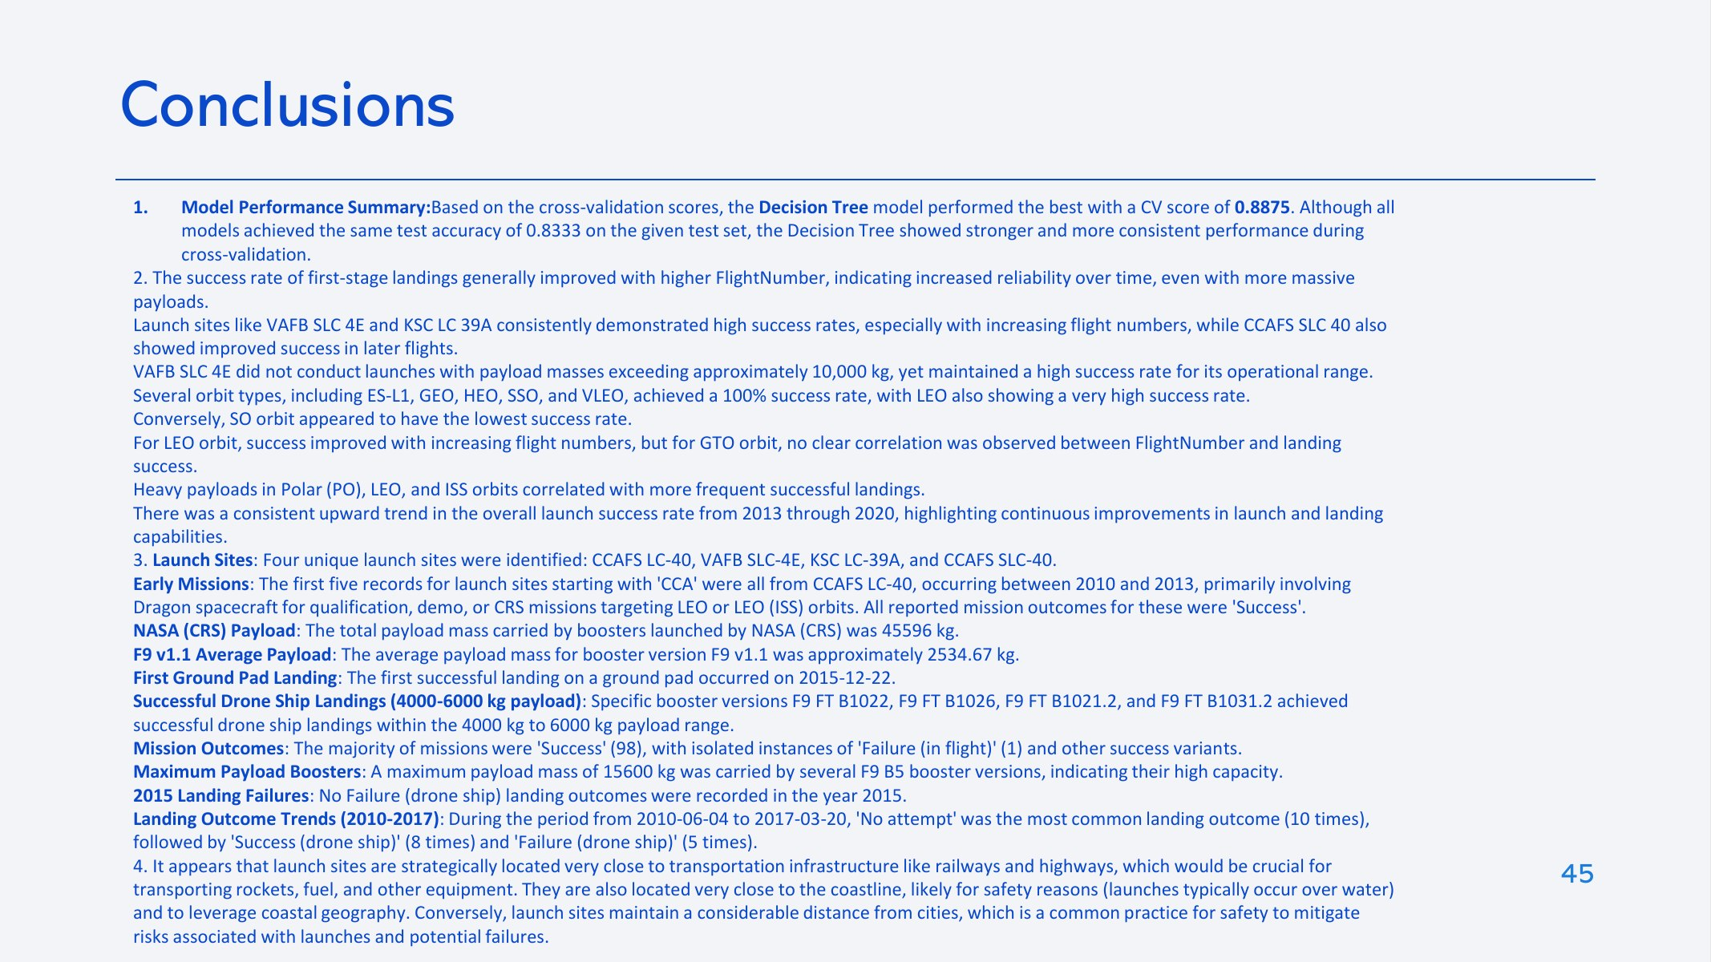
Experience drives success: the first 25 flights landed 36% of the time; later flights landed 78.5% of the time
Orbit matters: VLEO (86%) and LEO (71%) land most often; GTO is lowest (52%). ES-L1, GEO, HEO and SSO show 100% but on 1–5 launches each
Payload matters by orbit: heavy payloads land more often for Polar, LEO and ISS missions; GTO shows no clear pattern
Launch sites: VAFB SLC-4E never launched payloads above 10,000 kg; KSC LC-39A has the highest success rate
Site location: CCAFS LC-40 is close to a railway (0.19 km), highway (0.66 km) and coastline (0.58 km) and 23 km from the nearest city
45

Slide 46
Model: all four classifiers reach 83.3% test accuracy; the Decision Tree has the best CV accuracy (88.8%). The only errors are false positives
SQL facts: first ground-pad landing on 2015-12-22; two drone-ship landing failures in 2015 (January and April); the maximum payload was 15,600 kg
Limitations: 90 launches and an 18-launch test set are too few to separate the models; a different random split could change the ranking
Next steps: repeated cross-validation, more recent launch data, and features such as booster reuse count and landing type
46

Slide 47
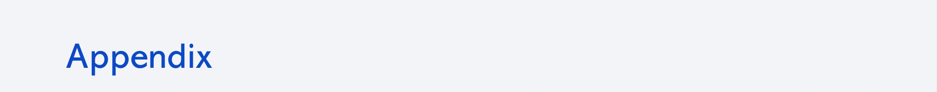
Repository: github.com/Sumant-crty/WinningSpaceRaceWithDataScience
Notebooks: notebooks/
Dashboard app: dashboard/spacex_dash_app.py
Data sources: SpaceX REST API v4; Wikipedia "List of Falcon 9 and Falcon Heavy launches" (fixed snapshot); IBM Skills Network course datasets
Tools: Python, pandas, NumPy, scikit-learn, Matplotlib, Seaborn, Folium, Plotly Dash, BeautifulSoup, SQLite
47

Slide 48


