Slide 1
Smart optimisation of a catalytic fixed-bed reactor
Fewer experiments to the best operating point - for someone who is not a specialist
Sumant Varanasi · Parva Chaudhary
Supervisors: Prof. Rachit Khare · Prof. Rahul Singh
ACOD310 mid-term presentation · Semester 1, 2026–27 · 16 October 2026
Notes:
Good morning. We are Sumant and Parva. Our question: when every reactor experiment costs a day, how do you find the best operating point in as few runs as possible? We built a tool for that.

Slide 2
Outline
OVERVIEW
MOTIVATION AND PROBLEM STATEMENT
1
Motivation and problem
LITERATURE REVIEW
2
Literature and the gap
METHODOLOGY AND RESULTS
3
The digital twin and the protocol
4
How the advisor decides
5
Results
NEXT STEPS
6
Using it, and next steps
ACOD310 mid-term · 16 October 2026 · Sumant Varanasi & Parva Chaudhary
2 / 10
Notes:
Here's the plan. First, the problem and why it matters. Then what the research already offers and where it stops. Then how we built the reactor twin and the advisor, the results, what it means for the person running the reactor, and what comes next.

Slide 3
One reactor, five knobs, one day per run
MOTIVATION AND PROBLEM STATEMENT
Feed
Fixed bed
Gas chromatograph (GC)
Operator
A, B and inert gas through mass-flow controllers
catalyst (loaded once) at a set temperature and pressure
the instrument that prints what came out: A, B, product C, by-products
decides tomorrow's set points
↺ the loop repeats once a day: a run is ~24 h on stream, so a campaign affords 10–25 runs
1
Five knobs, one day per run
2
Today: rules of thumb
3
The real constraints
Pressure, the flows of A, B and the inert, and temperature
The catalyst is loaded once and never changed mid-campaign
Each run costs a day, feed gas and operator time
Too much waste product (poor selectivity) → go cooler; too little feed reacting (poor conversion) → go hotter
It works, but slowly, and it needs an experienced chemist on call
Cost of today's way: a 25-run campaign is five weeks of reactor time and feed gas, and most early runs lose money
No knob may jump more than one step between runs (10 bar, 10 mL/min, 30 K)
The product must meet a spec; suggestions must stay inside safety ranges
Runs cost money, so the campaign should earn while it learns
Problem statement
Given: the run log the operator already keeps - the set points and the GC printout of what came out.
Objective: maximise profit per hour (product value − feed − compression − by-products, worked out from the GC reading), subject to a product spec, safety ranges and one allowed step per run.
Deliver: the next run, the reason, the expected profit and whether another run is worth its cost - reaching the best operating point in fewer runs than the usual rules of thumb, for someone who knows neither kinetics nor machine learning.
ACOD310 mid-term · 16 October 2026 · Sumant Varanasi & Parva Chaudhary
3 / 10
Notes:
This is the system: a gas-phase fixed-bed reactor. Reactants A and B, plus an inert gas, flow through mass-flow controllers over a bed of catalyst at a set temperature and pressure. At the outlet, a gas chromatograph, the GC, tells us what came out.
There are five knobs we can change between runs: pressure, the three gas flows, and temperature. The catalyst is loaded once and stays. Each run takes about a day to reach a steady, reliable reading, so a campaign gets maybe 10 to 25 runs. Today, operators tune this by rules of thumb: too much waste product, go cooler; too little reacting, go hotter. It works, but it's slow, needs an experienced chemist, and the early runs lose money. And there are real limits: no knob can jump more than one step per run, the product must meet a spec, and every run costs money.
So our problem: take the run log the operator already keeps, and say what to run next, why, what profit to expect, and whether another run is worth it, in fewer runs than the rules of thumb.

Slide 4
What the literature offers, and where it stops
LITERATURE REVIEW
Optimising expensive experiments
Specs, step costs, composition
Physics + data
a statistical model guesses where the best experiment is; run it; update; repeat (Bayesian optimisation)
respect product specs, keep the search near what you know, use what the instrument measures
mix textbook physics with learned corrections; choose runs that sharpen the model
Box & Wilson 1951 — response-surface methodology: climb step by step along the steepest ascent; what a chemist's tuning still is
Jones, Schonlau & Welch 1998 — Efficient Global Optimization: a Gaussian process (a model that predicts a value and how unsure it is) plus Expected Improvement choose the next experiment
Shields et al., Nature 2021 — Bayesian optimisation beat expert chemists at reaction optimisation
Taylor et al., Chem. Rev. 2023 — review: algorithms versus intuition
Gelbart, Snoek & Adams 2014 — unknown constraints: a product spec enters as a probability of feasibility
Eriksson et al. 2019 (TuRBO) — trust regions keep the search local
Folch et al. 2022 (SnAKe) — when changing the inputs costs, plan paths, not jumps
Astudillo & Frazier 2019; Paulson & Lu 2022 — grey-box BO: the objective is a known function of a measured vector, learned from scratch with a Gaussian process
Psichogios & Ungar 1992; von Stosch et al. 2014 — hybrid models: mechanistic balances with learned parts
Franceschini & Macchietto 2008; Waldron et al. 2019 — model-based design of experiments: runs chosen to sharpen or discriminate kinetic models, in closed loop on a heterogeneous catalyst
The gap
Black-box BO sees one profit number per run. Grey-box BO sees the composition but learns it from scratch. Model-based DoE uses the kinetic model and the full GC reading, but designs runs for parameter precision, not profit, and may run any point. None combine kinetics learned from every GC reading, step-limited planning toward profit under a product spec, a catalyst that cannot change and a plain-language operator interface — benchmarked against the rules of thumb and black-box BO under the same limits. That is this project.
ACOD310 mid-term · 16 October 2026 · Sumant Varanasi & Parva Chaudhary
4 / 10
Notes:
There are three strands of research relevant to our problem. First, optimising expensive experiments: from response surfaces in the 1950s to Bayesian optimisation today. A statistical model picks the next experiment, and in 2021 it was shown to beat expert chemists. Second, the extensions a real plant needs: product specs as constraints, keeping the search local, the cost of changing settings, and grey-box methods that use the measured composition but still learn everything from scratch. Third, physics plus data: hybrid models and model-based experiment design. These use the kinetic model, but to pin down its parameters, not to make money, and they can jump to any setting. The gap: nobody combines kinetics learned from every GC reading with step-by-step planning toward profit, under a product spec and a fixed catalyst, in a tool a nonspecialist can use. That's this project.

Slide 5
The digital twin, and the way a reactor is really run
METHODOLOGY I
The digital twin
The protocol every method follows
A textbook model of the reactor: how much of each substance is left after the gas passes over the catalyst, written per square metre of catalyst (S = a_BET · W_cat), so what we learn belongs to the catalyst material, not to one loading
Reaction speeds rise with temperature in the standard way (Arrhenius); more inert gas dilutes the feed; the reversible reaction's ceiling comes from thermodynamics. Profit = product sold − feed − compression − by-products, all from the GC reading
Assumptions: isothermal plug flow, no pressure drop, no transport limitations, ideal gas, first-order rates (energy balance and pressure drop are on the next-steps list)
Two chemistries: simple (A + B → C, A → D) and complex (A + B ⇌ C exothermic, C + B → E over-reaction, A → D cracking): three reactions competing; only ~2 % of the operating box makes any profit
The virtual reactor we test on is deliberately imperfect: the product slows the reactions (Langmuir–Hinshelwood inhibition, with a reactant term the advisor never has) and the GC has 1 % error; the new ageing scenario adds a catalyst that loses activity
Load the catalyst once (mass, BET area) — never a suggestion
Five screening runs an operator would do anyway (temperature ladder, pressure up, more B): identical for every method
From run 6 on, the method proposes the next run: within one step of the last, inside the safety ranges, GC flow minimum respected
25 runs per campaign (five weeks at one run a day); 10 campaigns per method from different starting points
Score: the true profit of the settings each method would recommend, as % of the best possible — known only because the reactor is simulated
500 K
550 K
600 K
650 K
700 K
ACOD310 mid-term · 16 October 2026 · Sumant Varanasi & Parva Chaudhary
5 / 10
Notes:
To test this safely, we built a digital twin: a textbook model of the reactor that predicts what comes out for any settings. It works per square metre of catalyst surface, so what it learns belongs to the catalyst material, not to one loading. Reactions speed up with temperature by the standard Arrhenius law, and profit is product value minus the costs of feed, compression and by-products, all from the GC reading. We use two chemistries. A simple one, and a complex one where three reactions compete: hotter is faster, but side reactions eat the product. On the complex one, the profitable temperature window is only about 30 degrees wide. Miss it and most of the profit is gone. The test reactor is deliberately imperfect: the product slows the reactions, and the GC has 1% error, effects our advisor isn't told about.
Every method follows the same protocol: catalyst loaded once, the same five screening runs, then one allowed step per run, 25 runs, 10 campaigns. Because the reactor is simulated, we know the true best, and we score every method against it.

Slide 6
How the advisor learns and decides
METHODOLOGY II
1
Fit the chemistry
2
Keep alternatives
3
Plan
4
Correct
5
Decide
Find the reaction speeds that explain every GC number. Start simple; add “the product slows the reaction” or “the catalyst is ageing” only when the data clearly justify it (model ladder chosen by BIC).
Several chemistries that fit about equally well, not one lucky fit (posterior draws).
Predict profit everywhere in the operating box; find the best spot and how many allowed steps away it is.
A flexible statistical model (Gaussian process) learns whatever the textbook still gets wrong, and is told how noisy the GC is, so it never chases noise.
Look up to four runs ahead; score each allowed path by the profit earned on the way plus what the best point found is worth for the runs left; respect the product spec (receding-horizon planner).
What we tell it, and what it works out for itself
Compared against, under the same step limits
We tell it
Which reactions happen, and their stoichiometry
The reactor's mole balances
The Arrhenius form, ideal gas, inert dilution
Equilibrium from thermodynamics
Prices and costs
It works out from your runs
Every reaction speed and how it rises with heat (activation energy)
Product inhibition, when the data show it
Catalyst ageing, from repeated check runs
A statistical correction for whatever is still missing
Rules of thumb: our scripted encoding of the standard heuristics (poor selectivity → cooler, more pressure; poor conversion → hotter …; repeat what worked)
Plain Bayesian optimisation: our own v2 package (fitted GP + Expected Improvement) on the profit number only
Random walk: a random allowed step each run
ACOD310 mid-term · 16 October 2026 · Sumant Varanasi & Parva Chaudhary
6 / 10
Notes:
"The advisor runs a five-step loop after every run. One, fit the chemistry. It finds the reaction speeds that best explain every number on the GC. It starts simple, and adds 'the product slows the reaction' or 'the catalyst is ageing' only when the data clearly justify it. Two, keep alternatives. Several versions of the chemistry fit about equally well, so it keeps them all instead of trusting one lucky fit. Three, plan. Using the physics, it predicts profit everywhere in the operating range, finds the best settings, and works out how many allowed steps away they are. Four, correct. A statistical model, a Gaussian process, learns whatever the textbook still gets wrong, and it knows how noisy the GC is, so it never chases noise. Five, decide. It looks up to four runs ahead and picks the next step that earns the most over the runs you have left. The key idea: the physics we know is typed in, and what we don't know is learned from your runs. We compare it against the rules of thumb, plain Bayesian optimisation and a random walk, all under the same limits. Sumant will now show how it performed.

Slide 7
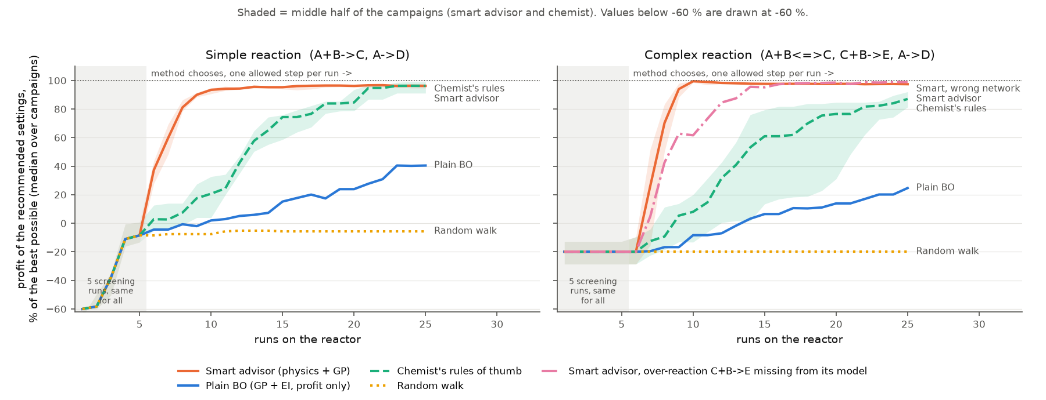
Advisor vs the rules of thumb vs black-box optimisation
RESULTS I
10 / 10
paired campaigns won against the rules of thumb after 10 and 15 runs, on both chemistries — not luck (Wilcoxon p = 0.002)
To be fair: the rules get there too — 96 % after 25 runs on the simple chemistry (a tie with the advisor, p = 0.92), 87 % on the complex one. The advisor's value is speed.
The “chemist” is our scripted encoding of the standard heuristics, not a human. Plain BO is a protocol comparison, not a surrogate comparison: the advisor wins because it reads the whole GC composition and plans ahead, which is the point.
A blind comparison against a chemist at the bench is on the list.
smart advisor
rules of thumb
plain Bayesian optimisation
advisor with one reaction missing from its model
 | Simple chemistry | Complex chemistry
Smart advisor | 9.5 runs to 90 % · 93 % after 10 | 9 runs to 90 % · 99 % after 10
Rules of thumb | 21 runs · 21 % after 10 | > 25 runs · 8 % after 10
Plain Bayesian optimisation | > 25 runs · 2 % after 10 | > 25 runs · −8 % after 10
Random walk | never · −8 % after 10 | never · −20 % after 10
Median of 10 campaigns. Each number is the profit the method's recommended settings would earn, as a share of the best the reactor can earn: 100 % = the best possible, negative = those settings lose money.
ACOD310 mid-term · 16 October 2026 · Sumant Varanasi & Parva Chaudhary
7 / 10
Notes:
Here is the head-to-head, from the previous version of the advisor; the new planner's benchmark has just finished; first look on the next slide.
Grey band: the five screening runs, identical for everyone. From run six each method chooses.
The advisor, in orange, reaches 90% of the best possible profit in a median of 9 to 10 runs. The rules of thumb, in green, need twenty-one runs on the simple chemistry and do not get there within twenty-five on the complex one. Plain Bayesian optimisation, in blue, sees only one profit number per run and cannot plan beyond one step, so it falls far behind. After ten and fifteen runs the advisor wins ten out of ten paired campaigns. To be fair: the rules get there too — after twenty-five runs they tie on the simple chemistry; the advisor's value is speed. And in the pink stress test we told the advisor an incomplete chemistry — one reaction left out, as a user might. Slower, but it still ends at ninety-nine per cent, because the statistical correction learns what it was not told.

Slide 8
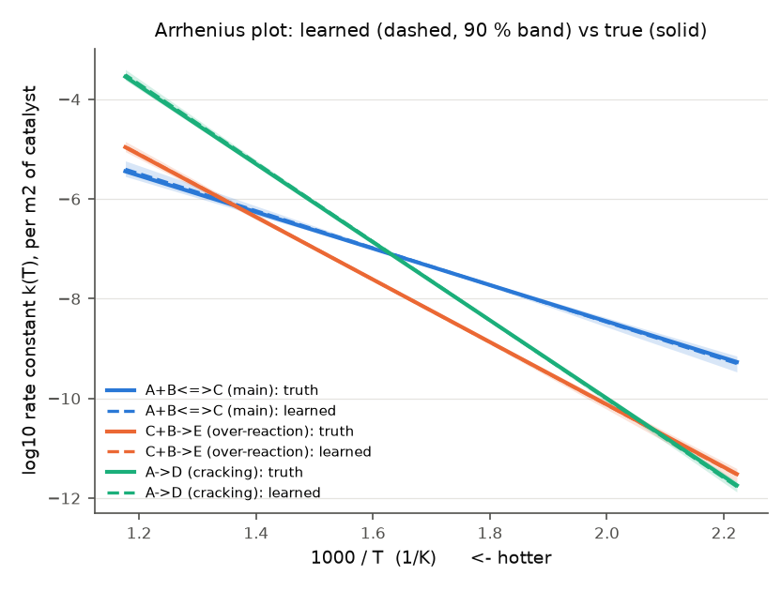
It learns the chemistry, not just the optimum
RESULTS II
What it learned
How strongly each reaction speeds up with heat (its activation energy) comes out in the right order - and that order decides the best temperature
In this live run the activation energies come out as 71 / 120 / 151 kJ/mol (± 3) against a truth of 70 / 120 / 150; the data chose the model with product inhibition (K_C = 0.031 /bar); recommended settings at 100 % of the best possible.
Product inhibition and catalyst ageing are added only when the data support them; ageing needs a repeated set point, so the protocol now repeats a check run every 5th run
The planner counts the runs you have left, respects the product spec and reports the heat load (adiabatic temperature rise)
: on the complex reactor v5 ends at the best point in 10 of 10 campaigns and earns more on the way than v4 in 8 of 10; on a catalyst losing 2 %/day every method ends at 41–73 % of the fresh-catalyst best - ageing is detected and reported, not solved - and v5 earned more than v4 in 8 of 10
How fast each reaction goes vs temperature, learned from 15 runs (dashed, with its uncertainty band) against the truth it never saw (solid). v5 advisor, live run on the virtual complex reactor.
Limits we know
Kinetics, prices and GC noise are placeholders until agreed with Prof. Khare; the reactor is simulated so far
The advisor must be told which reactions happen (two schemes built in ); with one missing it still works, more slowly
Under step limits the covered temperature range is narrow, so absolute activation energies are less certain than their ordering; the rules-of-thumb baseline is a script, not a human
ACOD310 mid-term · 16 October 2026 · Sumant Varanasi & Parva Chaudhary
8 / 10
Notes:
The advisor does not just find an optimum, it learns the chemistry. Dashed is what it learned from fifteen runs, solid is the truth it never saw. How strongly each reaction speeds up with heat comes out in the right order, and that order decides the best temperature. We want to make the learning honest: product inhibition and catalyst ageing are only added when the data support them, and the new planner counts the runs you have left. The benchmark shows it ending at the best point and earning more on the way; on an ageing catalyst it earns more than before, but ageing is detected and reported, not solved. We are honest about the limits: all kinetics and prices are placeholders, the reactor is simulated, and the advisor needs to be told which reactions happen.

Slide 9
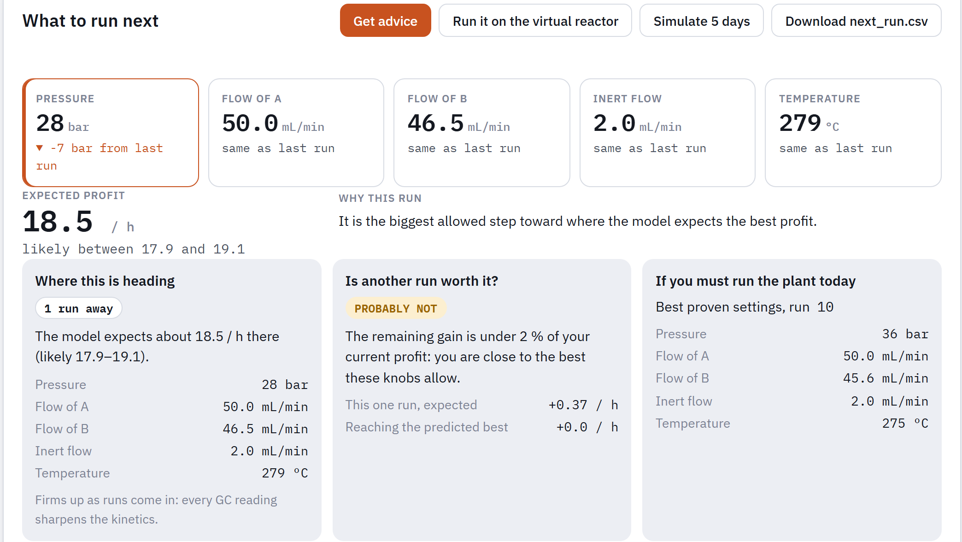
What this means for the person at the reactor
USING IT
A day at the reactor
1
Type yesterday's run
set points and the GC printout - or import the CSV log you already keep
2
Read the next run
five set points, the change from last time, the expected profit and why
3
See where it is heading
predicted best settings, how many runs away, and whether another run is worth its cost in money
4
Run it, repeat, export
every suggestion is one allowed step inside the ranges you set, catalyst untouched
Runs on your laptop, nothing leaves it; also a command-line tool on the same CSV log.
9 runs instead of 21+
No kinetics, no code
Always within your limits
Earns while it learns
≈ two weeks of reactor time, feed gas and operator time saved per campaign (simulated reactor). Give it your cost per run and it reports the saving in money.
You supply the run log, the catalyst mass and surface area, what you may change per run, and your prices. Two reaction schemes are built in today; your own is next.
One allowed step from the last run, inside the ranges you set, catalyst untouched; spec and heat load shown. You still check your plant's safety rules.
Scored on profit earned, not only the end point: by run 10 its settings earn 93 % of the maximum, the rules of thumb 21 % (simulated).
Before: five weeks of trial and error with an experienced chemist on call. After: about two weeks, and a technician can drive it.
ACOD310 mid-term · 16 October 2026 · Sumant Varanasi & Parva Chaudhary
9 / 10
Notes:
What does this mean for a person? This is the web page — it runs on your own laptop. You type yesterday's set points and the GC printout, or import the log you already keep. It answers in plain English: the next run as five set points, the change from last time, the expected profit and why. It tells you where this is heading, how many runs away, and whether another run is worth its cost — in money, if you give it a cost per run. You run it, come back tomorrow, repeat. For a lab or a pilot plant with one reactor and no data scientist, that is about two weeks of reactor time, gas and operator time saved per campaign, a plant that earns while it learns, and suggestions that always stay one allowed step inside your limits. Today it ships with two reaction schemes; letting you type in your own chemistry is one of our next steps.

Slide 10
Where we are, and what comes next
NEXT STEPS
v1 Verified twin + first optimiser
v2 Benchmarked BO package
v3 / v4 Smart advisor + web tool
v5 Learning upgrade
packed-bed balances, GP + EI over 5 knobs
fitted GP, 4 acquisitions, NN surrogate, constrained BO, 20 seeds
physics-informed, real protocol, rules-of-thumb baseline, plain-English UI
model ladder, campaign planner, specs, ageing - benchmark just finished
1
Make the numbers real
2
Your own chemistry
3
Blind test vs a chemist
4
Profit vs selectivity
Everything so far runs on placeholder kinetics and prices; next we collect real ones and a real GC log from the Micromeritics reactor, with Prof. Khare
Rerun the benchmark on them and see how far the textbook model is from the real reactor
Type in your own reactions on the page
The advisor proposes runs that reveal which reactions are really happening (model discrimination)
Same reactor, same run budget: the advisor against a chemist at the bench, judged blind on profit and runs used
The fair version of our rules-of-thumb comparison
Show the trade-off curve between profit and product purity (Pareto front), not one answer
The operator picks the point that fits the contract
We asked for fewer experiments to the best operating point, for someone who is not a specialist. On the simulated reactor the answer is nine runs instead of twenty-one, in plain English. The next step is the real reactor.
ACOD310 mid-term · 16 October 2026 · Sumant Varanasi & Parva Chaudhary
10 / 10
Notes:
Where we are: a verified twin, a benchmarked optimisation package, the advisor with a rules-of-thumb baseline and a web tool, and this month's learning upgrade; everything is tested and on GitHub. Next, four steps. First, make the numbers real: so far everything runs on placeholder kinetics and prices, so next we collect real ones and a real GC log from the reactor with Professor Khare. Second, let users type in their own reactions, and let the advisor work out which reactions are actually happening. Third, a blind test: the advisor against a real chemist on the same reactor and budget. Fourth, show the trade-off between profit and purity, so the operator picks the point that fits the contract. To close: we asked for fewer experiments to the best operating point, for someone who is not a specialist. On the simulated reactor the answer is nine runs instead of twenty-one, in plain English. The next step is the real reactor. Thank you.
k(r) = σ² · (1 + √5·r/ℓ + 5r²/(3ℓ²)) · exp( −√5·r/ℓ ) - matern kernel

