Slide 1
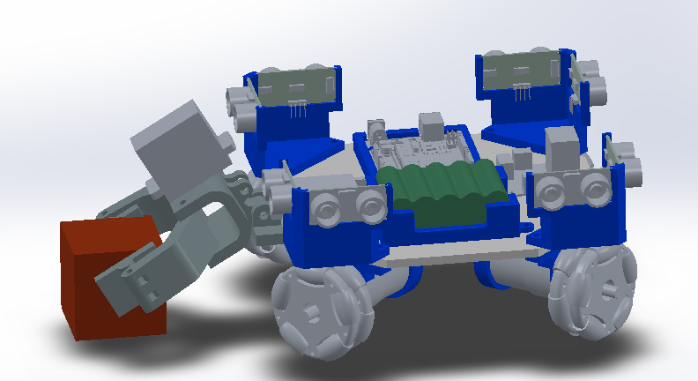
Ultrasonic Sensor (pair)
Arduino Uno
Servo Motor
Omni-directional Wheel
2”x2”x2” Target Block
IR Sensor (not visible)
12V Battery
12V DC Motor

