Slide 1
Challenges faced by Silicon Photonics based Biosensing
Mihir Pakhale
Yash Chopra
Sumant Sakhalkar

Slide 2
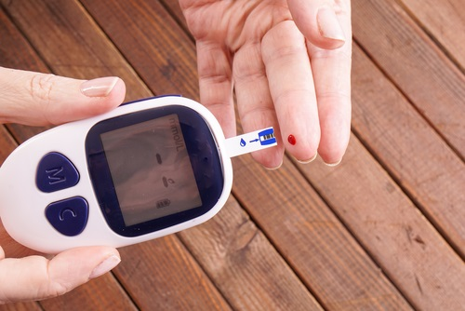
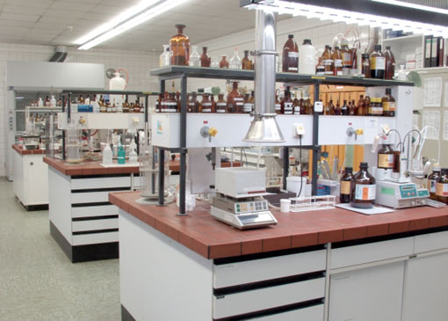
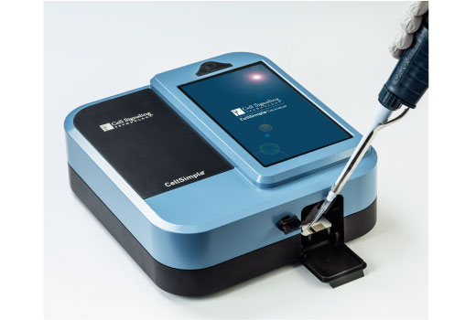
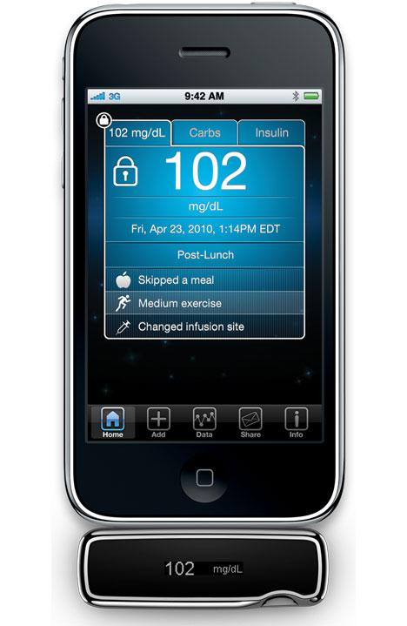
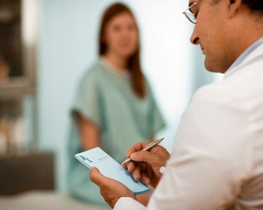
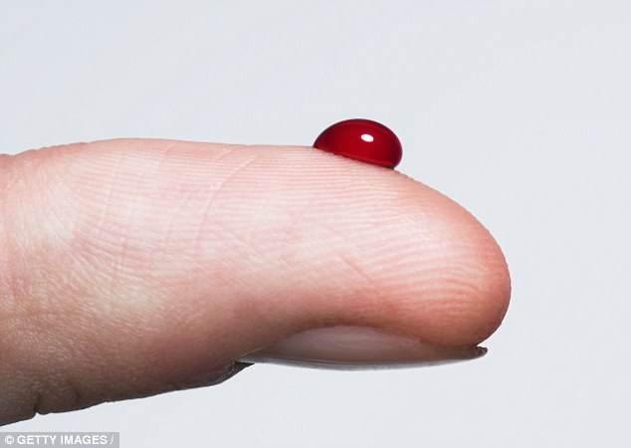
MOTIVATION: Why SiPh Biosensors?
Analytical Laboratory:
Limited to Centralized Lab
Time consuming, Trained personnel
Expensive Instrumentation
Not available to everyone
Point-of-care device POC:
Very fast and high sensitivity
User friendly/no-training required
Low sampling volume
Final Goal in Diagnostics

Slide 3
BIOSENSOR DEVICES: Overview
Electrochemical Biosensors
Microfluidic Paper-based Biosensor
Magnetic Biosensor
MEMS based Biosensors
Biosensor based on Nanoparticle
SiPh Biosensors
WHY SiPh BIOSENSORS ?
Immunity towards electromagnetic interference
High Bandwidth
Miniaturization (capacity of integrating in lab-on-chip).
HIGH SENSITIVITY
Multiplexing
Label Free
Refractive Index Changes (Real Part)
Absorption Changes (Imaginary Part)
Fluorescence
Raman Scattering
DETECTION PRINCIPLES

Slide 4
Approach
MIHIR PAKHALE:
Sensing Techniques
Sensing Devices
SUMANT SAKHALKAR:
Analysis of commercial Lab-On-Chip architectures.
Challenges in designing Lab-On-Chip.
YASH CHOPRA:
Evaluation of existing simulation models and their limitations.
Devise the designed simulation model.

Slide 5
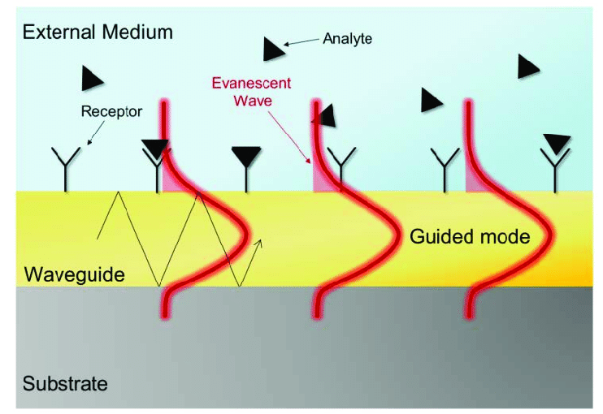
OPTICAL WAVEGUIDE BIOSENSOR
Evanescent Field Detection
It is an Electric or Magnetic field going out of core.
In Silicon Photonics we try to reduce evanescent field by confining mode into core of the waveguide.
But in biosensing the sample is placed above waveguide (i.e. cladding) surface.
Evanescent field need to 100-900 nm outside core of the waveguide so that the biomolecule interaction with bioreceptors occur inside the evanescent field.
This very generic technology.
Transducers
Surface Plasmon Resonance (SPR)
Grating Coupler
MRR
Interferometer
BiModel waveguide
Change of optical parameters,
Intensity
Phase
Polarization
Resonant momentum, etc.
Binding event
Change of refractive index

Slide 6
SENSITIVITY COMPARISON
Biosensors | Limit of detection (pg/mm²) | Bulk Sensitivity (∆n)
SPR | 0.5-5 | 10⁻⁵ – 10⁻⁷
Grating Coupler | 0.3 | 2*10⁻⁶
MZI/BiModel waveguide | 0.01 – 0.06 | 10⁻⁷ – 2*10⁻⁸
Young interferometer | 0.013 – 0.75 | 9*10⁻⁸ – 9*10⁻⁹
Micro-ring Resonator | 1 - 3 | 5*10⁻⁵ – 8*10⁻⁷
Silicon wire based | 0.25 | 2*10⁻⁶
STATE OF THE ART PHOTONIC BIOSENSER
Bulk Sensitivity : What is the minimum amount of refractive index change we are able to monitor.
Limit of detection: The amount of mass per square millimeter we can detect.
In Biosensors normally designed to works in visible range.
WHY ?
REFERENCE: Laser & Photonics Reviews 6, 463-487 (2012)
2012 Breakthroughs. IEEE Photonics Journal (2013)
Sensors 16(3), 285 (2016)

Slide 7
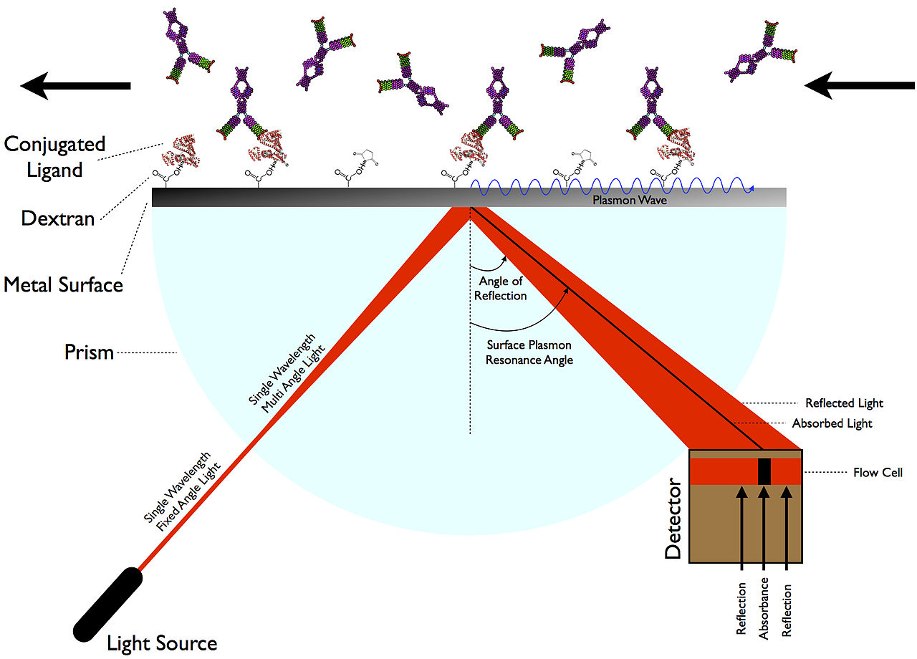
Surface Plasmon Resonance (SPR)
Plasmonic biosensor technology offers an attractive alternative to traditional laboratory diagnostics
Versatility: analysis of any type of biomolecular interaction.
Robustness and simplicity
Sensitivity: ~10⁻⁵ – 10⁻⁷ RIU (LOD pM – nM)
Affinity & kinetic studies
Widespread technique and commercially available.
Limitation:
Limited miniaturization.
Reduced multiplexed capabilities.
Not enough sensitivity for small analytes/low concentration.
Main competitor to upcoming silicon photonic biosensor.
All new upcoming technology need to compare to SPR sensitivity.

Slide 8
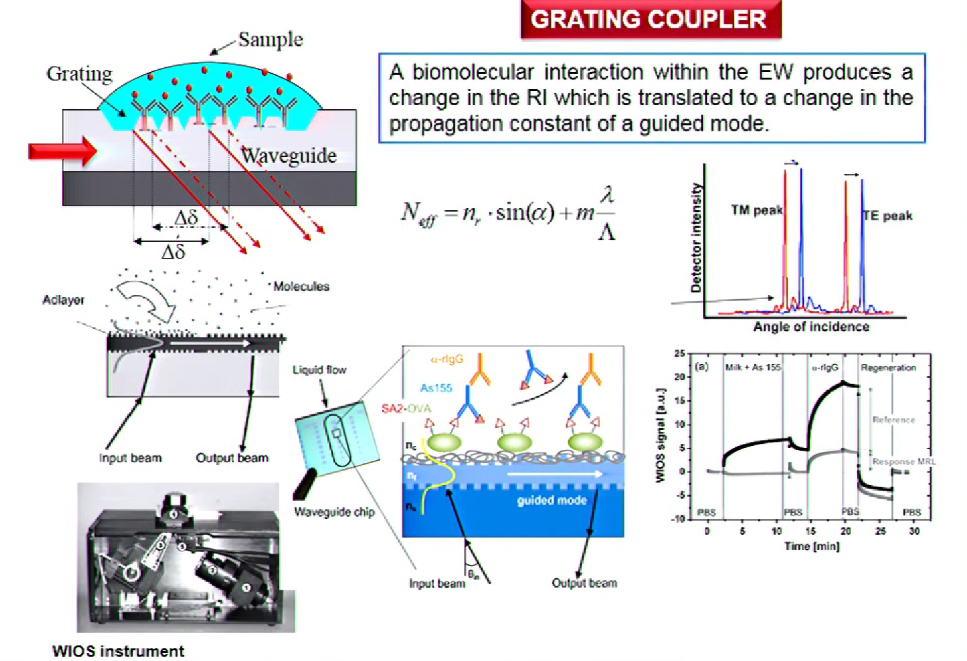
GRATING COUPLER
This was the very first attempt to design silicon photonics biosensor
Multiplexing
Mass sensitivity : 0.3 pg/mm²
2*10⁻⁶ RIU
M Wiki, R.E Kunz, G Voirin, K Tiefenthaler, A Bernard,"Novel integrated optical sensor based on a grating coupler”, 5th World Congress on Biosensors and Bioelectronics", Volume 13, Issue 11,1998,Pages 1181-1185

Slide 9
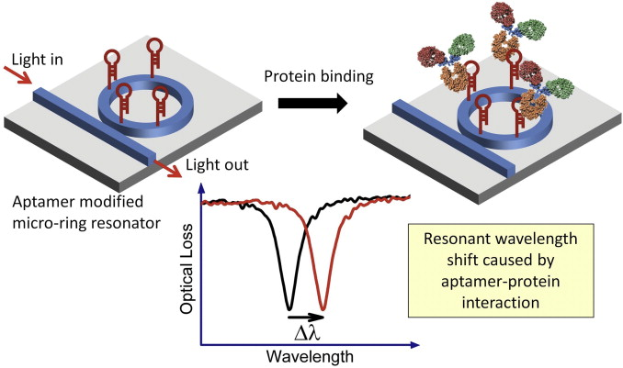
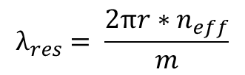


OPTICAL MRR WORKING PRINCIPLE
Light is coupled by evanescent wave of an input waveguide. Whispering gallery modes are circulating in multiple round trips, enhancing the sensitivity.
Sensitivity depends on Q-factor of MRR means sensitivity increases with increasing Q-factor of the ring
High Q-factor means low losses/long photon lifetime
Q-factor in range of 10⁶
$$Q=\frac{λ_{res}}{{∆λ}_{3dB}}$$
Advantages:
Reduced footprint
High multiplexing capabilities
Good sensitivity (not scaling with length)
Drawback:
1550 nm design (strong absorption)
Expensive (tunable laser and optical spectrum analyzer)
$$λ_{res}= \frac{2πr∗n_{eff}}{m}$$
$$L_{eff}= \frac{Qλ}{2πn}$$
Monitoring spectral shift, gives quantitative information about the biointeraction.
Mi Kyoung Park, Jack Sheng Kee, Jessie Yiying Quah, Vivian Netto, Junfeng Song, Qing Fang, Eric Mouchel La Fosse, Guo-Qiang Lo,"Label-free aptamer sensor based on silicon microring resonators, Sensors and Actuators B: Chemical",Volume 176,2013,Pages 552-559

Slide 10
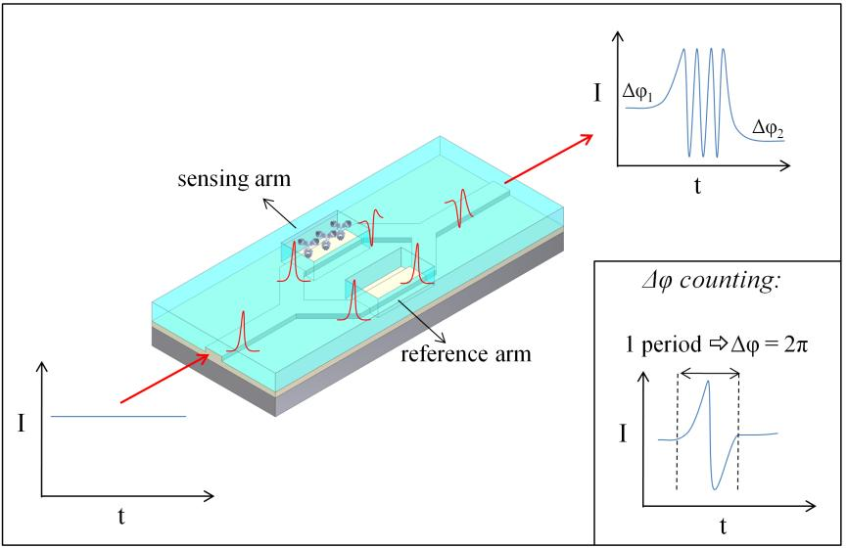
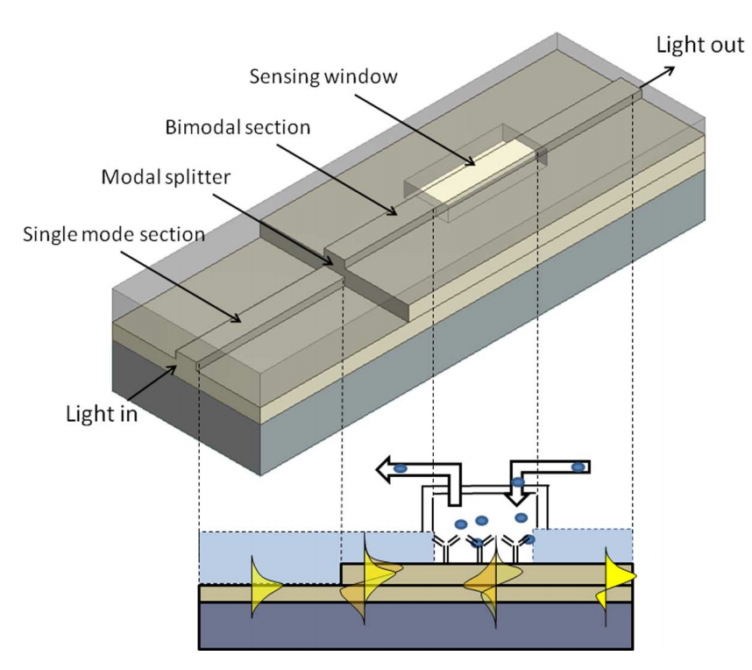
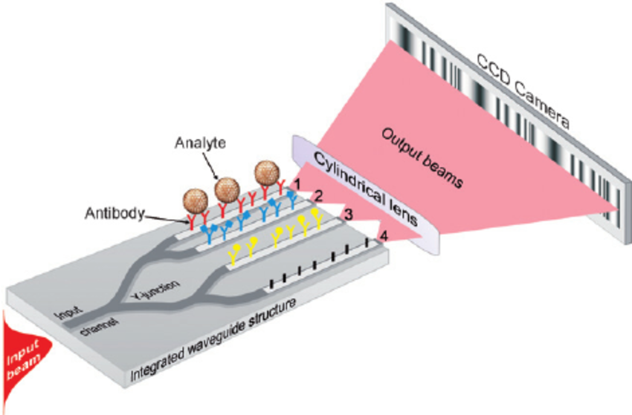


INTERFEROMETER BIOSENSOR
Highest Sensitivity among all the SiPh Biosensor.
It is very tough to design MZI for biosensing purpose, because we need to consider single mode.
Another interferometer is young interferometer. This has higher sensitivity then MZI and better reliability.
But again designing this interferometer is difficult and branching excites higher order mode which are again not desirable.
$$∆∅_{S,R}=2π\frac{L}{λ}(N_{eff,S}−N_{eff,R})$$
BiModel Waveguide Interferometer
Starts with fundamental mode and then excites first order mode.
Interference between first and fundamental mode.
$$I= I_{S}+I_{R}+2\sqrt{I_{S}I_{R}}\cos{(∆∅_{S,R}})$$
Design for visible range 600-700 nm
K. Zinoview,”Integrated Bimodel waveguide interferometer biosensor” 2017

Slide 11
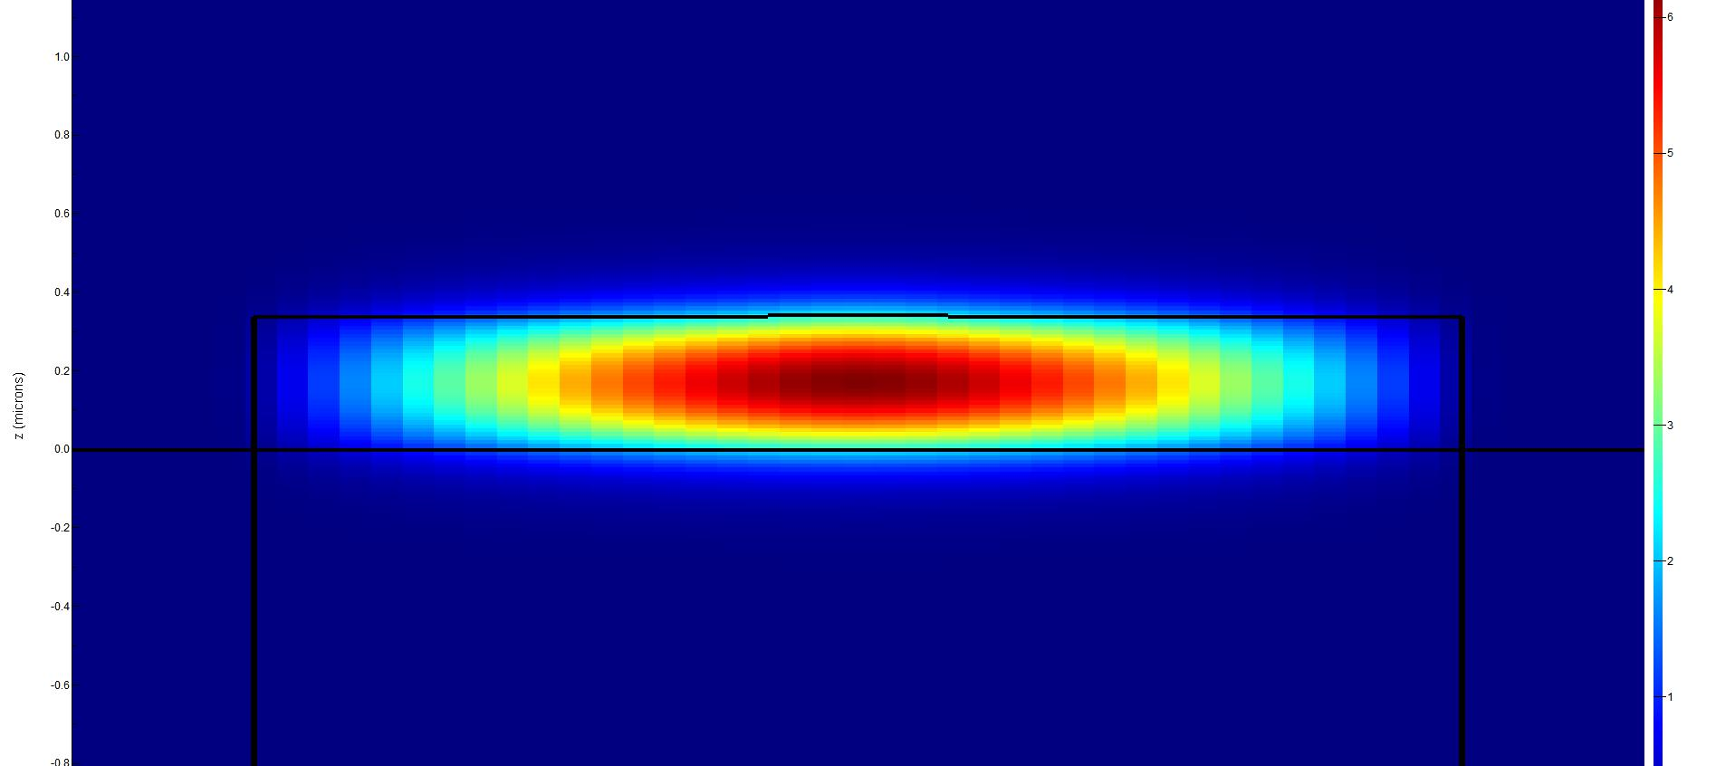
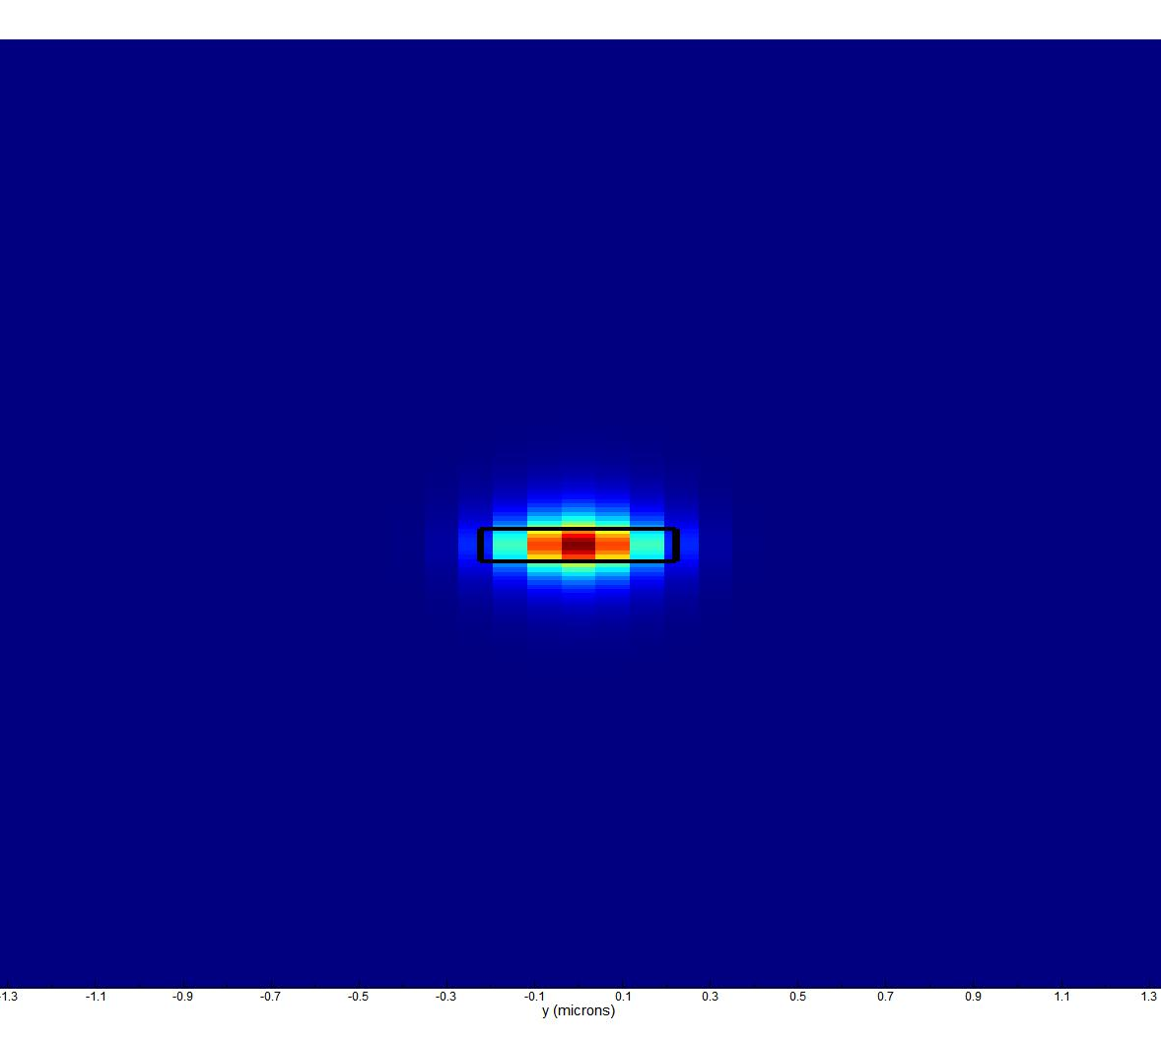
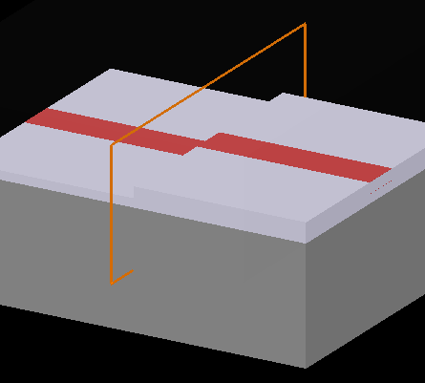
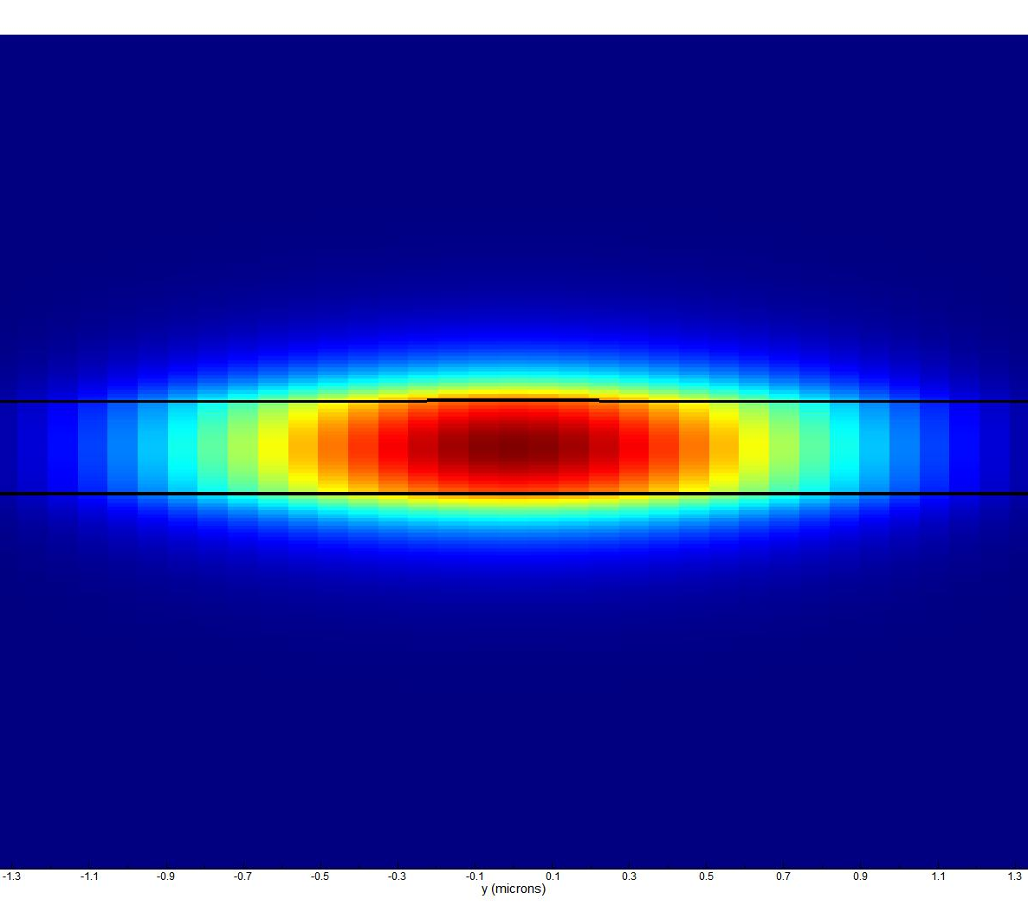
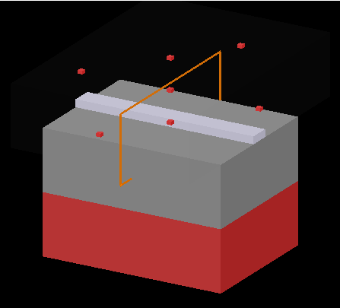
MZI and BiModal Inferometer Design
The sensor designed for single mode:
A Si3N4 (nc = 2.00) core layer, 250nm thick(For TM)/ 75nm(For TE)
Width <= 4um; rib_depth: 1-4nm
A SiO2 Cladding layer; 2um (n = 1.46)
The sensor designed for BiModal:
A Si3N4 (nc = 2.00) core layer, 150nm thick(For Single Mode)/ 340nm(For BiModal)
Width <= 4um; rib_depth: 1-3nm
A SiO2 Cladding layer; 2um (n = 1.46)

Slide 12
Evanescent Field(%) | Si Core Thickness
17.65 | 0.24
16.76 | 0.252
15.5 | 0.265
13 | 0.29
12 | 0.31
9.81 | 0.35
8 | 0.4
6.5 | 0.45
5 | 0.5

Slide 13
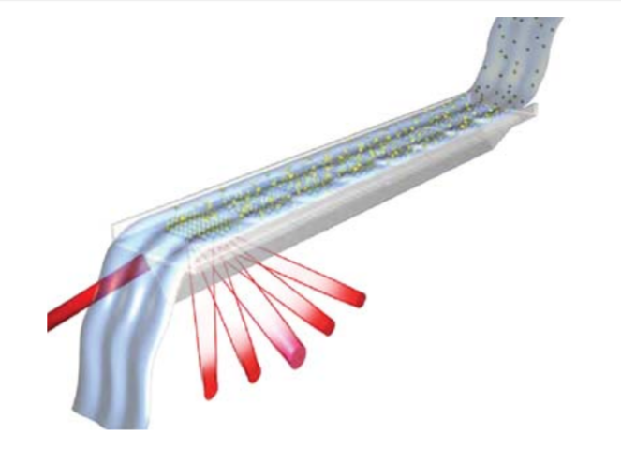
Axela dotLab® mX System
The dotLab® mX System, is a highly flexible and easy to use assay platform appropriate for protein biomarker research and the investigation of new diagnostic tests.
Based on Diffractive optics technology or DOT which brings together two technologies: grating-based light diffraction and immobilized capture surfaces.
The results are obtained in less than an hour.
Has small sample requirement (3.5 μL of serum).

Slide 14
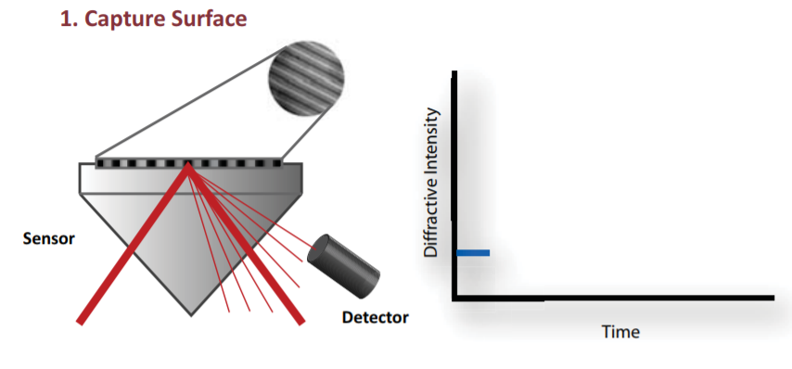
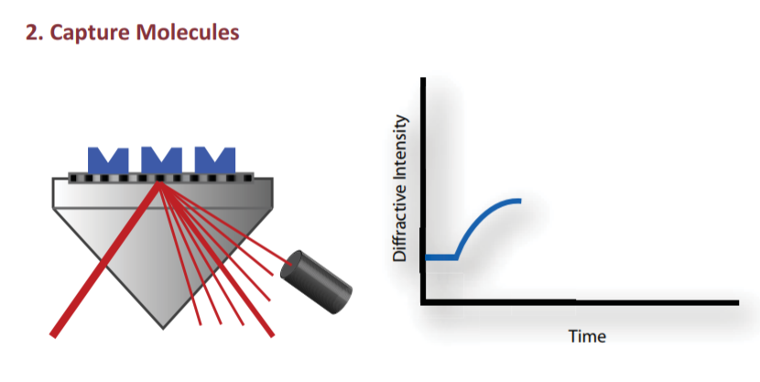
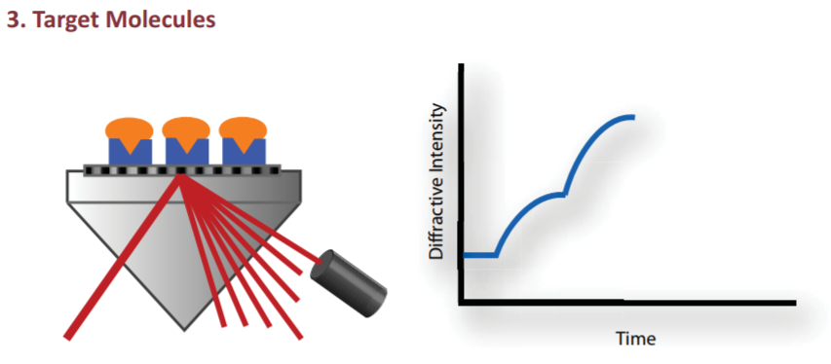
ANGLE Biosciences Inc., “Diffractive Optics Technology”. [Online]. Available: http://www.axela.com/products-services/diffractive-optics-technology.php. [Accessed: Sept. 12, 2018].

Slide 15
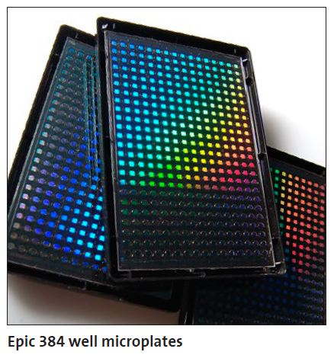
Epic® System.
Corning (Corning, New York, NY, USA) came up with a label free detection equipment based on Resonant Waveguide Grating Biosensor System called Corning® Epic®.
They have used a microarray which contains up to 384 wells for multiplexed detection.
It takes just 3 seconds to read the entire microarray. Although the detection may take up to 8 hours.

Slide 16
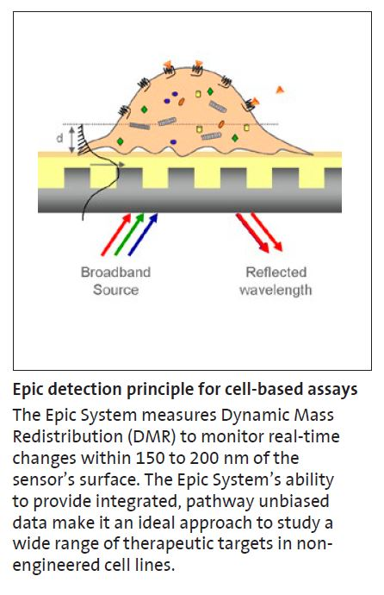
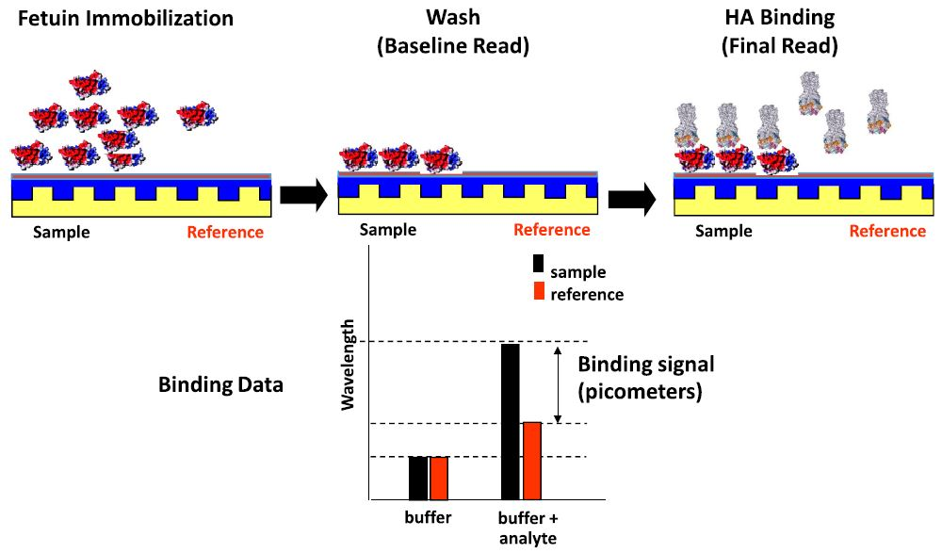

Slide 17
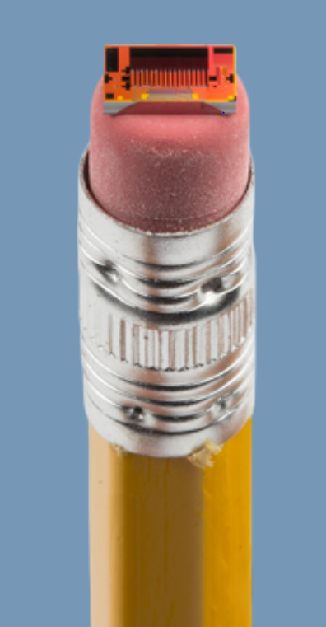
Maverick Detection Method
The Maverick Detection System is a full-fledged commercial Lab-On-chip architecture designed by Genalyte.
It is based on micro-ring resonator-based biosensor.
The results are available usually in 15 minutes depending on the type of assay performed.
Genalyte announced the CE Mark For Maverick (TM) Detection System in 2013.

Slide 18
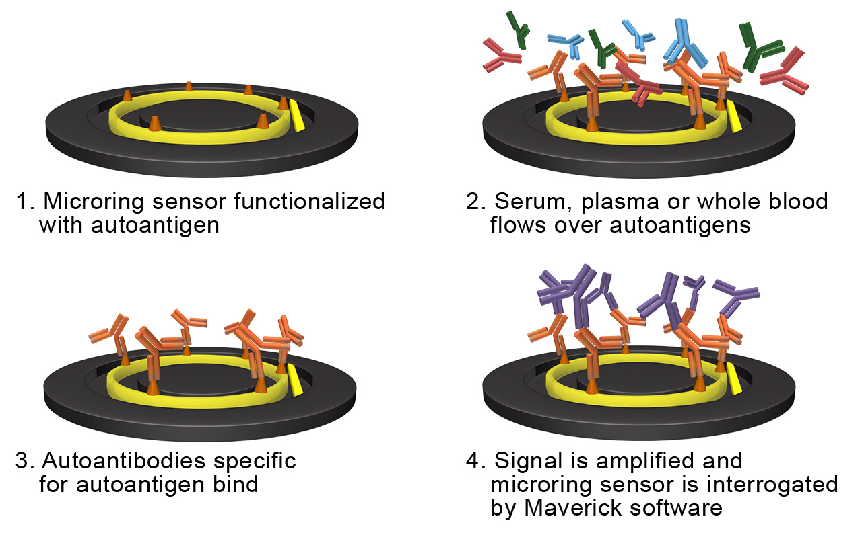
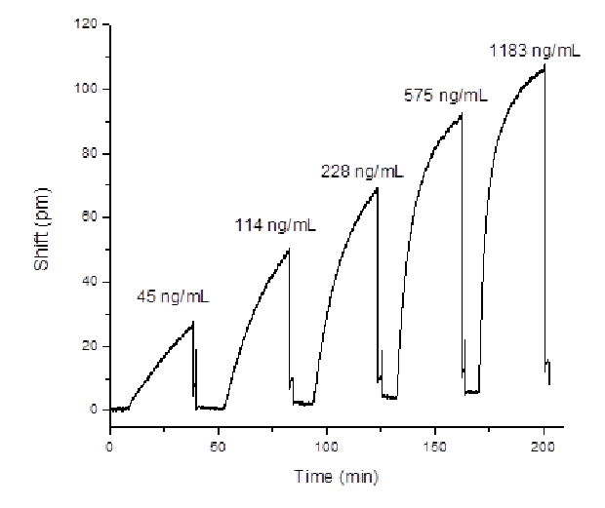
REFERENCE: Genalyte Inc., “The Maverick Detection System “, [Online]. Availablehttps://www.genalyte.com/about-us/our-technology/. [Accessed: Sept. 12, 2018].

Slide 19
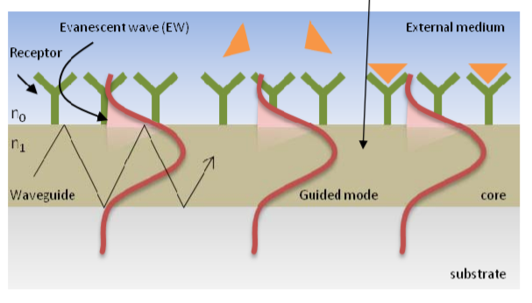
Models for SiPh Bio-sensing
Types of Models:
Di-electric
n,k
Permittivity based:
Conductive
Plasma
Drude
Requirements for a model:
Neff vs wavelength
Permittivity
Neff vs temp
Neff vs concentration
Neff vs time
Neff vs types of binders

Slide 20
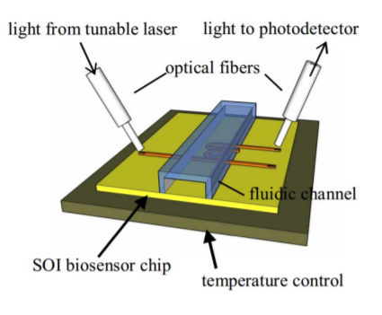
Did We find any models?
Ans: Yes and No!
Yes:
Models created for specific research (restricted access)
Parameters captured : neff vs time, neff vs wavelength
No:
Exhaustive exploration of parameters
Limitations of lumerical’s tools

Slide 21
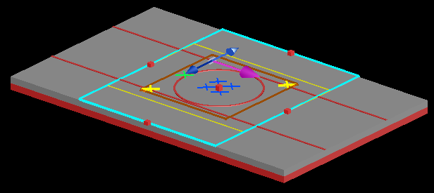
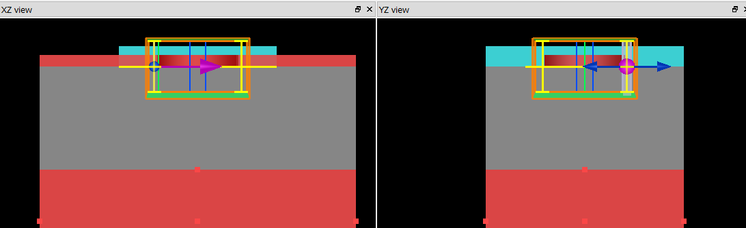
Our Approach
Our Approach
Make shift model from data acquired from references
Subject : glucose concentration in aq. Solution
Structure:
Make shift model from data acquired from references
Subject : glucose concentration in aq. Solution
Structure:

Slide 22
Model: neff vs Glucose concentration
Linear relationship
Concentration (mg/100ml) | Neff
0 | 1.3320
5 | 1.3394
10 | 1.3469
15 | 1.3543
20 | 1.3617
25 | 1.3691
30 | 1.3840
Model fitting equation: neff = 0.0186 x C + 1.332 as lambda = 1550 nm

Slide 23
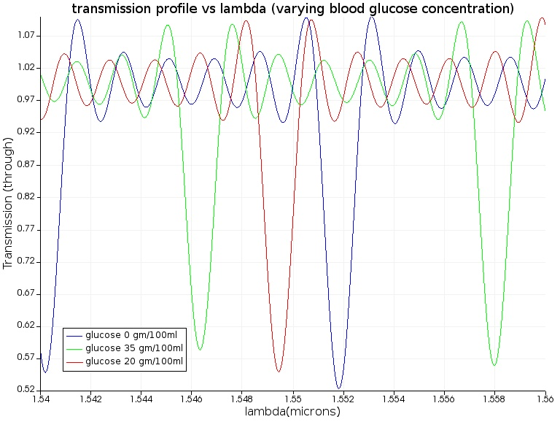
Results:

Slide 24
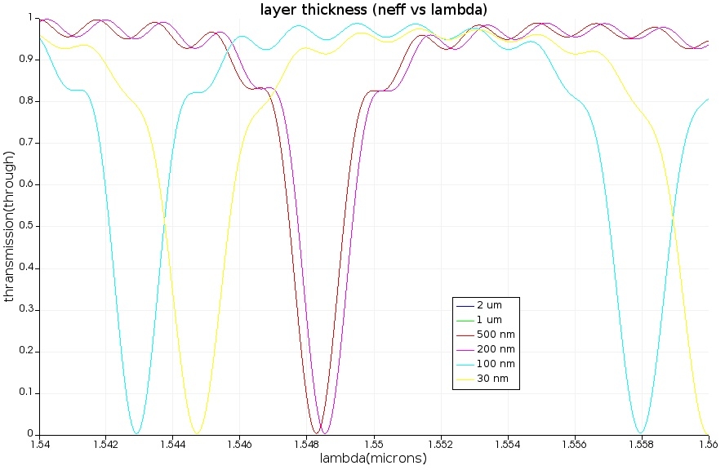

Slide 25
Conclusion
Integrated Silicon Biosensors are the future of point-of-care devices but it also comes with its own drawbacks.
These challenges need to be overcome for future commercialization.
We have successfully reviewed some of these challenges in our project and tried to make a small contribution towards mitigating at least one of the challenges.

