Slide 1







Data Analyst Capstone
Sumanta Das
25th December 2023

Slide 2

OUTLINE
Executive Summary
Introduction
Methodology
Results
Visualization – Charts
Dashboard
Discussion
Findings & Implications
Conclusion
Appendix

Slide 3

EXECUTIVE SUMMARY
Two type Data Download from API.
Current Technology Usage
Top 10 Language worked
Top 10 Database worked
Platform Worked
Top 10 Web Frame worked
Future Technology Trend
Top 10 Language Desire Next Year
Top 10 Database Desire Next Year
Platform Desire Next Year
Top 10 Web Frame Desire Next Year
Demographics
Respondent classified by Gender
Respondent Count for Countries
Respondent Count by Age
Respondent Count by Gender, classified by Formal Education Level

Slide 4

INTRODUCTION
Collect data for the technology skills that are in demand from various sources including: Job postings, blog posts, surveys.
collected enough data, you will begin analyzing the data and identify insights and trends that may include the following
What is the top programming languages in demand.
What is the top database skills in demand.
What is the popular IDEs
Show off your storytelling skills by sharing your findings in a presentation.

Slide 5

METHODOLOGY
Collecting Data Using APIs
Collecting Data Using Webscraping
Exploring Data
Collected data and prepare it for analysis by using data wrangling techniques like:
Finding duplicates
Removing duplicates
Finding missing values
Inputting missing values.
Data Visualization and apply statistical techniques to analyze the data and identify insights and trends like :- Top programming languages, Top Database skills and the most popular IDEs.
Also Visualize the data in Cagnos and create Dashboard.

Slide 6
RESULTS
Top 10 Language is JavaScript, HTML/CSS, SQL, Bash/Shell/PowerShell, Python, Java, C, Typescript, PHP and C++ .
Top 10 Database is MySQL, PostgreSQL, Microsoft SQL Server, SQLite, MongoDB, Radis, Elastic search, Maria DB, Oracle and Firebase.
Windows is a good platform.
Top 10 Web frame is :- jQuery, Angular.js, React.js, ASP.NET, Express, Spring, Vue.js, Flask, Django and LA ravel.
JavaScript, HTML/CSS and Python is top language desire for next year.
PostgreSQL, MongoDB and Radis is top in database desire for next year.
Linux and Docker will top in platform desire.
React.js is in top for web frame.
Men with bachelor’s degree(BA, BS, B.Eng..) is the highest percentage in respondent classification.

Slide 7
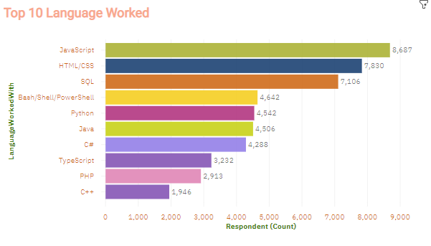
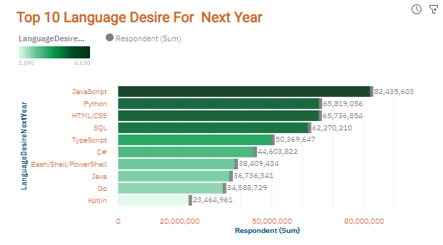
PROGRAMMING LANGUAGE TRENDS
Current Year
Next Year

Slide 8
PROGRAMMING LANGUAGE TRENDS - FINDINGS & IMPLICATIONS
Findings
JavaScript is the top language worked in current season with 8687 number.
HTML/CSS is the second top in current year.
SQL is the 3rd position in language worked for current year.
Implications
JavaScript in demand for next year in language desire list.
Python will 2nd position and new thread in language desire for future.
HTML/CSS and SQL will be 3rd and 4th position in language desire list for next year.

Slide 9
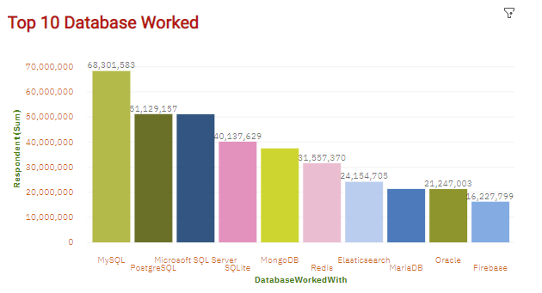
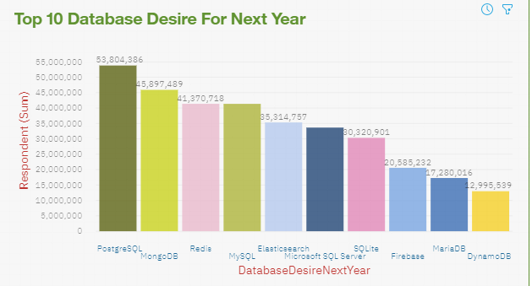
DATABASE TRENDS
Current Year
Next Year

Slide 10
DATABASE TRENDS - FINDINGS & IMPLICATIONS
Findings
MySQL is top in Database worked list.
PostgreSQL and Microsoft SQL Server is in 2nd and 3rd position in database worked list in current year.
SQLite is the 4th position in database with 40,137,629 numbers
Implications
PostgreSQL will be the top od database desire list.
MongoDB will the 2nd highest in database desire list for next year.
Redis and MySQL will be in 3rd and 4th in database desire list for next year.

Slide 11

DASHBOARD
https://dataplatform.cloud.ibm.com/dashboards/947c46a3-d3da-4dd6-9ec3-9a32944e5f41/view/0569e00e63aa35e96fced0e407c82e032f3f2258bbbb815783d37b4959652497f36a4797c8794f0e88175166f6eb145a9b

Slide 12
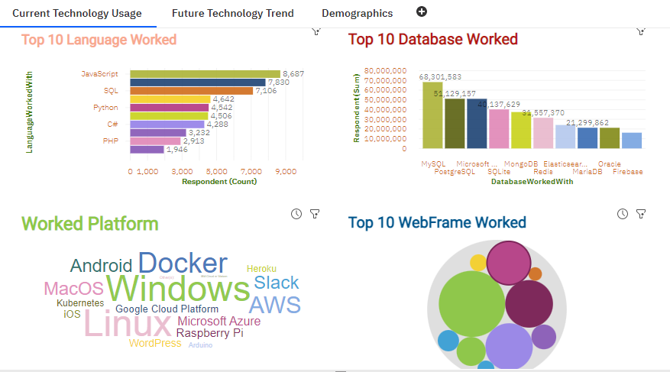
DASHBOARD TAB 1

Slide 13
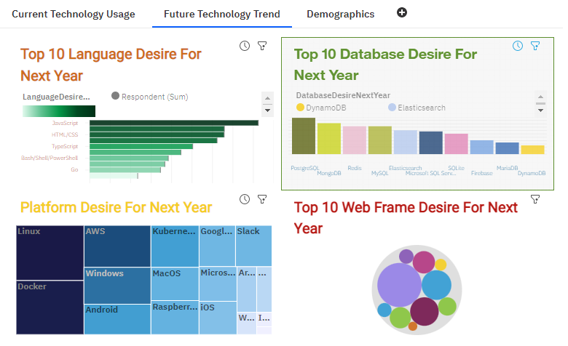
DASHBOARD TAB 2

Slide 14
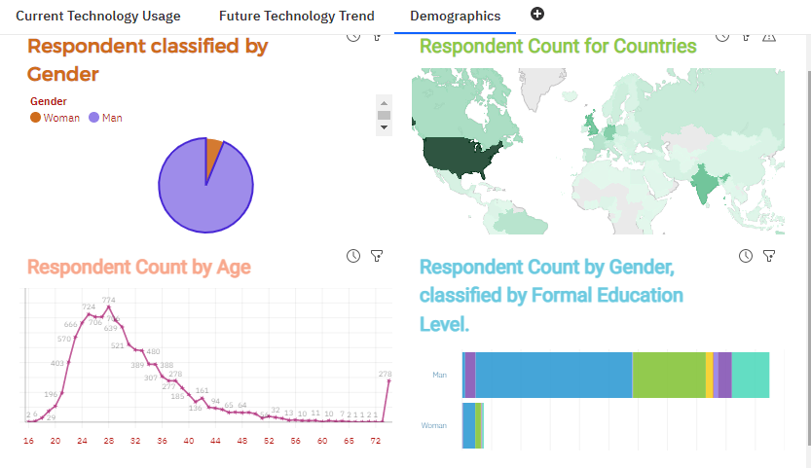
DASHBOARD TAB 3

Slide 15
DISCUSSION
Top 10 Language is JavaScript, HTML/CSS, SQL, Bash/Shell/PowerShell, Python, Java, C, Typescript, PHP and C++ .
Top 10 Database is MySQL, PostgreSQL, Microsoft SQL Server, SQLite, MongoDB, Radis, Elastic search, Maria DB, Oracle and Firebase.
Windows is a good platform.
Top 10 Web frame is :- jQuery, Angular.js, React.js, ASP.NET, Express, Spring, Vue.js, Flask, Django and LA ravel.
JavaScript, HTML/CSS and Python will top language desire for next year.
PostgreSQL, MongoDB and Radis will top in database desire for next year.
Linux and Docker will top in platform desire.
React.js will in top for web frame.
Men with bachelor’s degree(BA, BS, B.Eng..) is the highest percentage in respondent classification.

Slide 16
OVERALL FINDINGS & IMPLICATIONS
Findings
Top 5 Language like : - JavaScript, HTML/CSS, SQL, Bash/Shell/PowerShell and Python in current year.
Top 4 Database like: - MySQL, PostgreSQL, Microsoft SQL Server and SQLite.
Windows is a good platform.
jQuery is the top web frame in current year.
Implications
JavaScript, HTML/CSS and Python will top 3 language desire for next year.
PostgreSQL, MongoDB and Radis will top in database desire for next year.
Linux and Docker will top in platform desire.
React.js will in top for web frame.
Men with bachelor’s degree(BA, BS, B.Eng..) is the highest percentage in respondent classification.

Slide 17

CONCLUSION
Windows is a good platform.
Top 10 Web frame is :- jQuery, Angular.js, React.js, ASP.NET, Express, Spring, Vue.js, Flask, Django and LA ravel.
JavaScript will top language desire for next year.
PostgreSQL will top in database desire for next year.
Linux and Docker will top in platform desire.
React.js will in top for web frame.
Men with bachelor’s degree(BA, BS, B.Eng..) is the highest percentage in respondent classification.

Slide 18
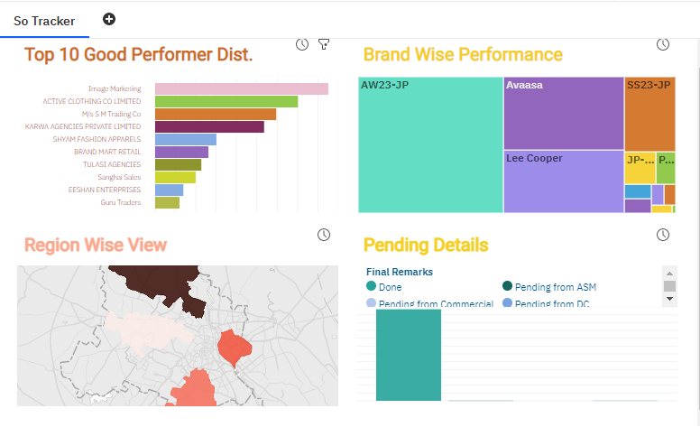

APPENDIX

Slide 19
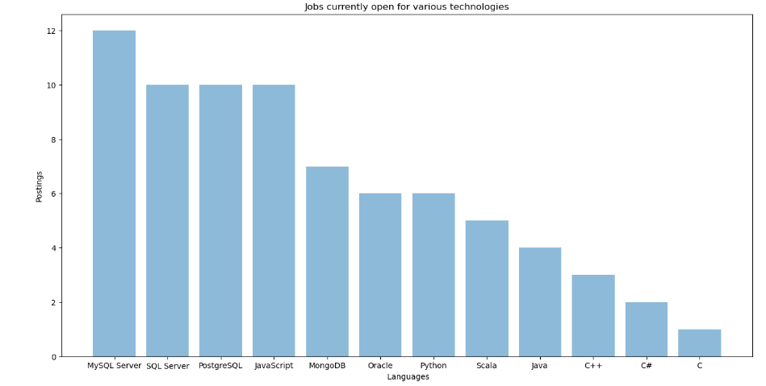
JOB POSTINGS

Slide 20
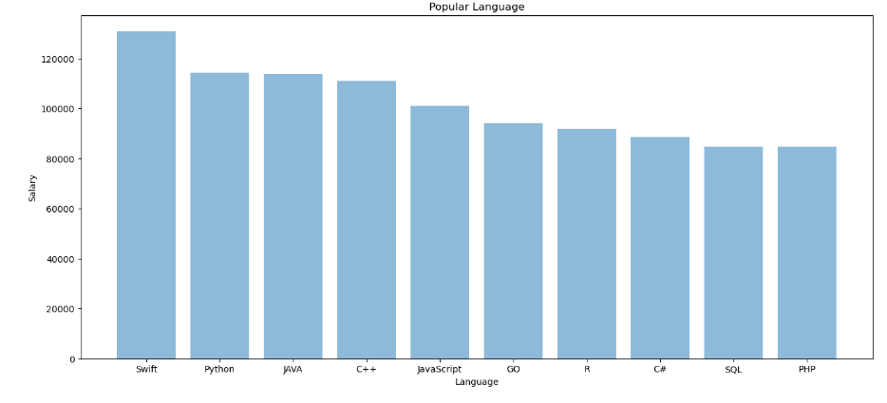
POPULAR LANGUAGES

