Slide 1
Fake Currency Detection using Image Processing
Group Members:
1.Prakhyath Shetty-55
2.Aryan Singh-57
3.Sumant Singh-58

Slide 2
INTRODUCTION
Fake currency poses a serious threat to the economy and financial system.
Manual detection of counterfeit notes is difficult and time-consuming so Automated systems for detecting fake currency are essential.
Image processing is a widely used technique for detecting fake currency notes.
Image processing techniques such as filtering, segmentation, and classification are used to analyze currency note images.
Python libraries such as OpenCV, PIL, Panda, and NumPy are used for implementing a robust and efficient system for detecting fake currency notes.
The system can be used by banks, financial institutions, and law enforcement agencies to prevent counterfeit notes from circulating and protecting the economy.

Slide 3
PROBLEM STATEMENT
To create a reliable and automated system using image processing in Python to detect counterfeit currency notes, which can be used by banks and law enforcement agencies to prevent the circulation of fake notes..

Slide 4
METHODOLOGY
The methodology for detecting fake currency using image processing in Python involves the following steps:
1.Image acquisition: Digital images of currency notes are obtained using a scanner or a camera.
2.Preprocessing: The acquired images are processed to improve their quality and remove any noise or distortions. This involves techniques such as filtering, thresholding, and resizing.
3.Feature extraction: Relevant features such as texture, color, and pattern are extracted from the preprocessed images using techniques such as edge detection, gradient analysis, and histogram equalization.
4.Classification: The extracted features are compared with those of genuine currency notes using machine learning algorithms such as Support Vector Machines (SVM), Random Forests, and Artificial Neural Networks (ANN). The classifier determines whether the note is genuine or counterfeit.
5.Validation: The system is tested using a dataset of genuine and counterfeit notes to evaluate its accuracy and efficiency. The system can be refined by adjusting the parameters of the feature extraction and classification algorithms.

Slide 5
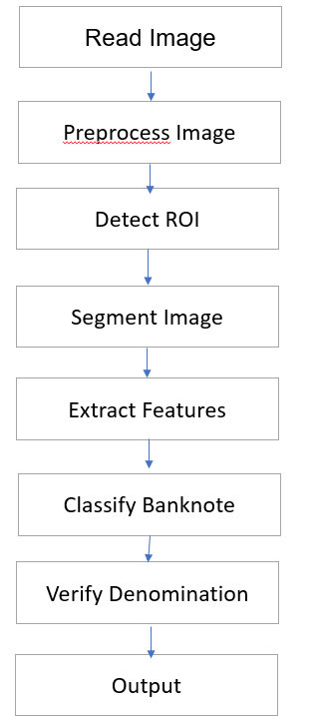
Flowchart

Slide 6
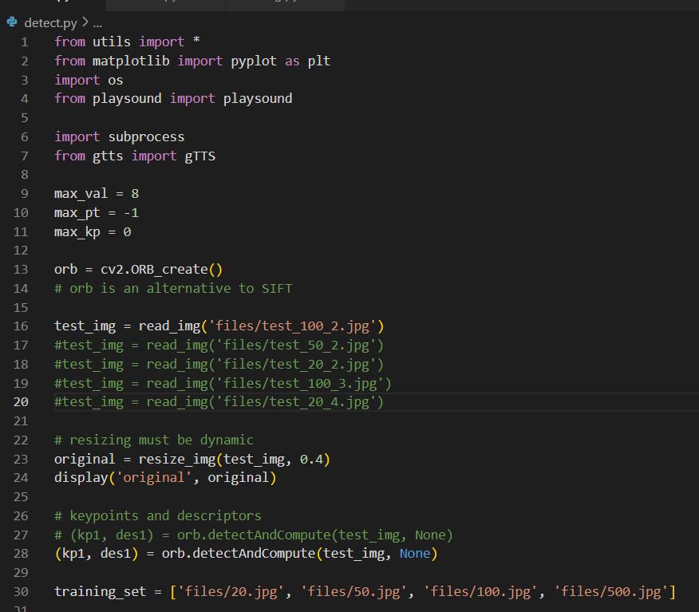
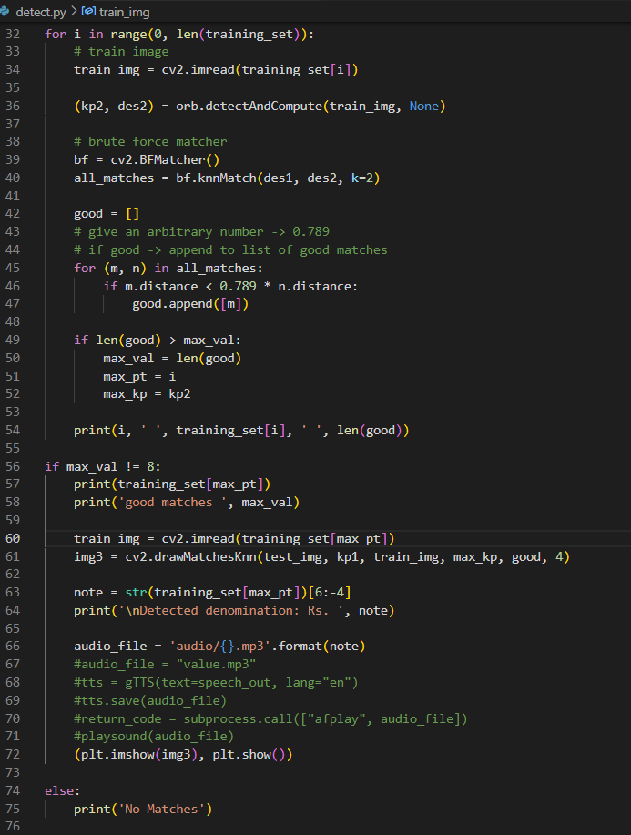

Slide 7
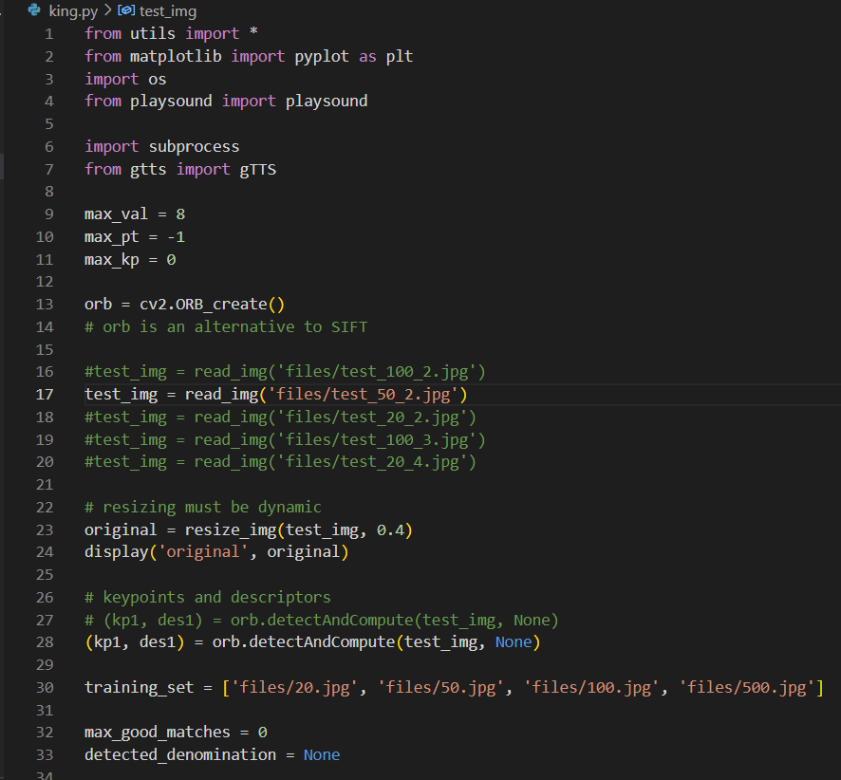
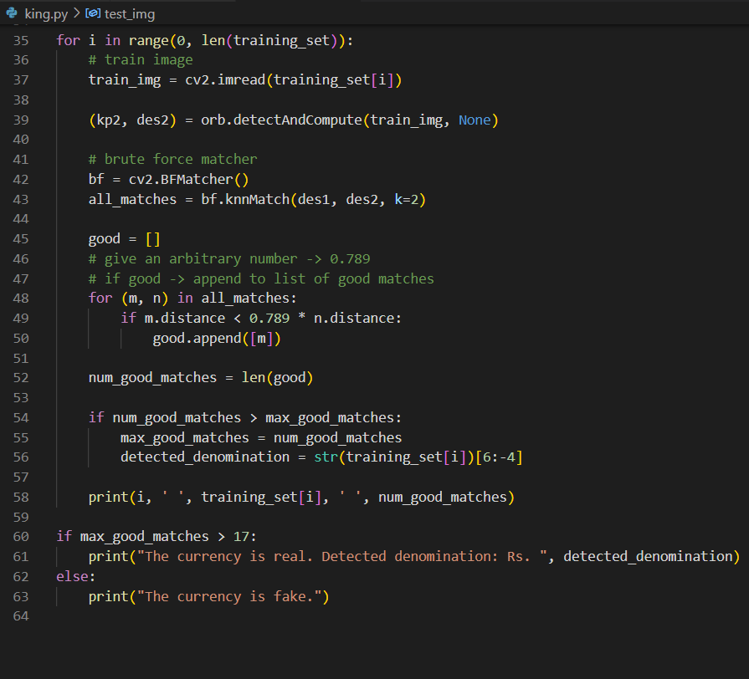

Slide 8
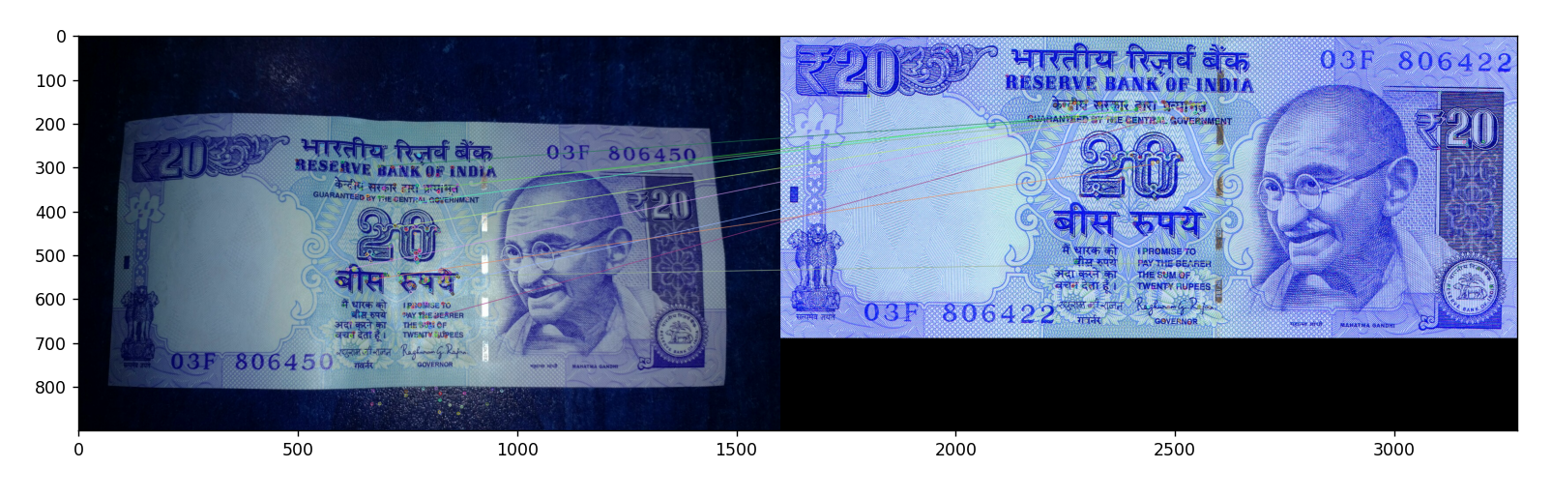
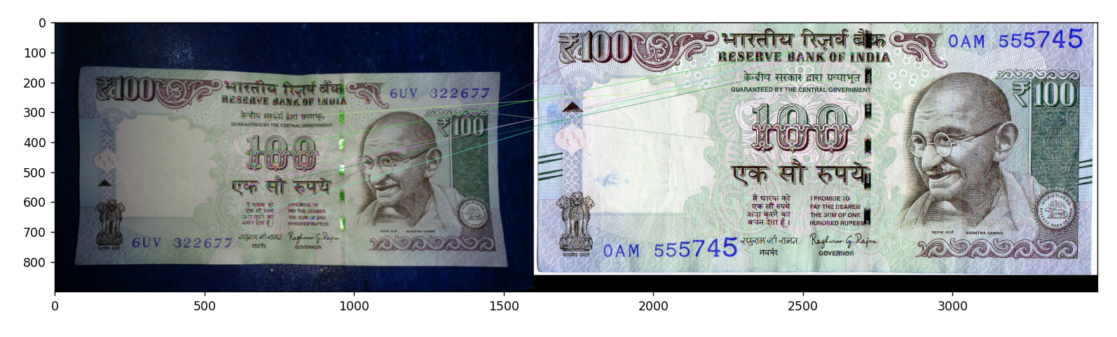
OUTPUT

Slide 9
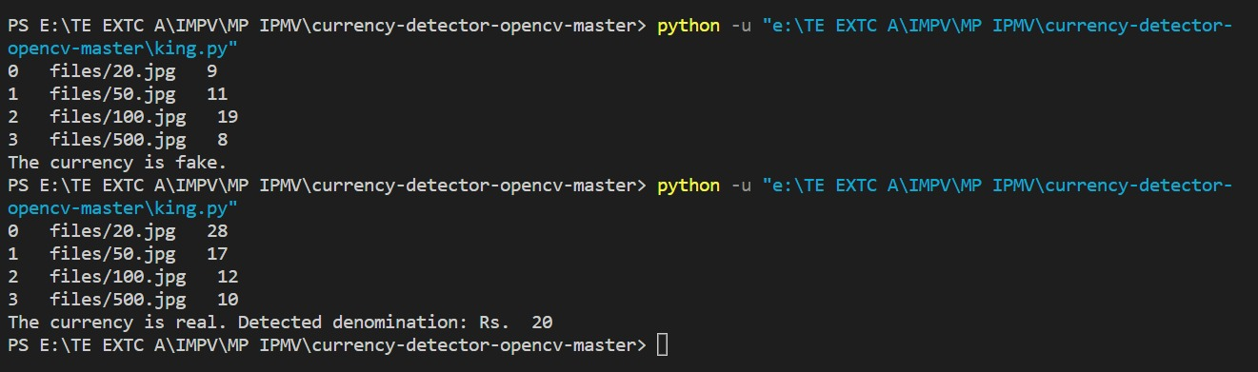
OUTPUT

Slide 10
RESULT
The result of using image processing for fake currency detection in Python is an automated and reliable system that can detect counterfeit notes with high accuracy. The system analyzes digital images of currency notes and extracts relevant features such as texture, color, and pattern. The extracted features are then compared with those of genuine currency notes using machine learning algorithms to identify any inconsistency. The system has been tested on a dataset of genuine and counterfeit notes, and it has demonstrated high accuracy and efficiency. This system can be used by banks, financial institutions, and law enforcement agencies to prevent the circulation of counterfeit notes and protect the economy.

Slide 11
REFERENCE
https://github.com/dudeanurag/Fake-Currency-Identification
https://en.wikipedia.org/wiki/Counterfeit_money

Slide 12
THANKS!

