Slide 1
Mini E-Commerce Application
Presented by: P Sumanth
Date: 26-05-2025

Slide 2
Project Overview
Spring Boot + React-based e-commerce system
Three microservices: User, Product, Order
JWT-based authentication and role-based access

Slide 3
Architecture
Architecture includes:
- User, Product, Order Microservices
- Eureka Discovery Service
- React Frontend
- Feign for inter-service communication

Slide 4
User Management MS
Endpoints:
- Register/Login/Logout
- Get/Update/Delete User
- Dashboard Menu by Role
Security: JWT + Role (ADMIN, CUSTOMER)

Slide 5
Product Management MS
Endpoints:
- Add/Update/Delete Product (ADMIN only)
- Get All / Get by ID
Security: JWT Role Check for ADMIN

Slide 6
Order Management MS
Cart Endpoints: Add/Update/Delete/View
Order Endpoints: Place, Cancel, View All, Order Details
Integration: Feign Client to Product MS

Slide 7
Security and Authentication
Spring Security with JWT
Role-based access control
Token stored in frontend (localStorage)
Secure routes for ADMIN vs CUSTOMER

Slide 8
Frontend UI
React + Bootstrap
Pages:
- Login/Register
- Product List
- Cart Management
- Checkout
Redux used for state management

Slide 9
Tech Stack
Backend: Java, Spring Boot, Eureka
Frontend: React, Redux, Bootstrap
Database: MySQL
Tools: Postman, Eclipse, VS Code

Slide 10
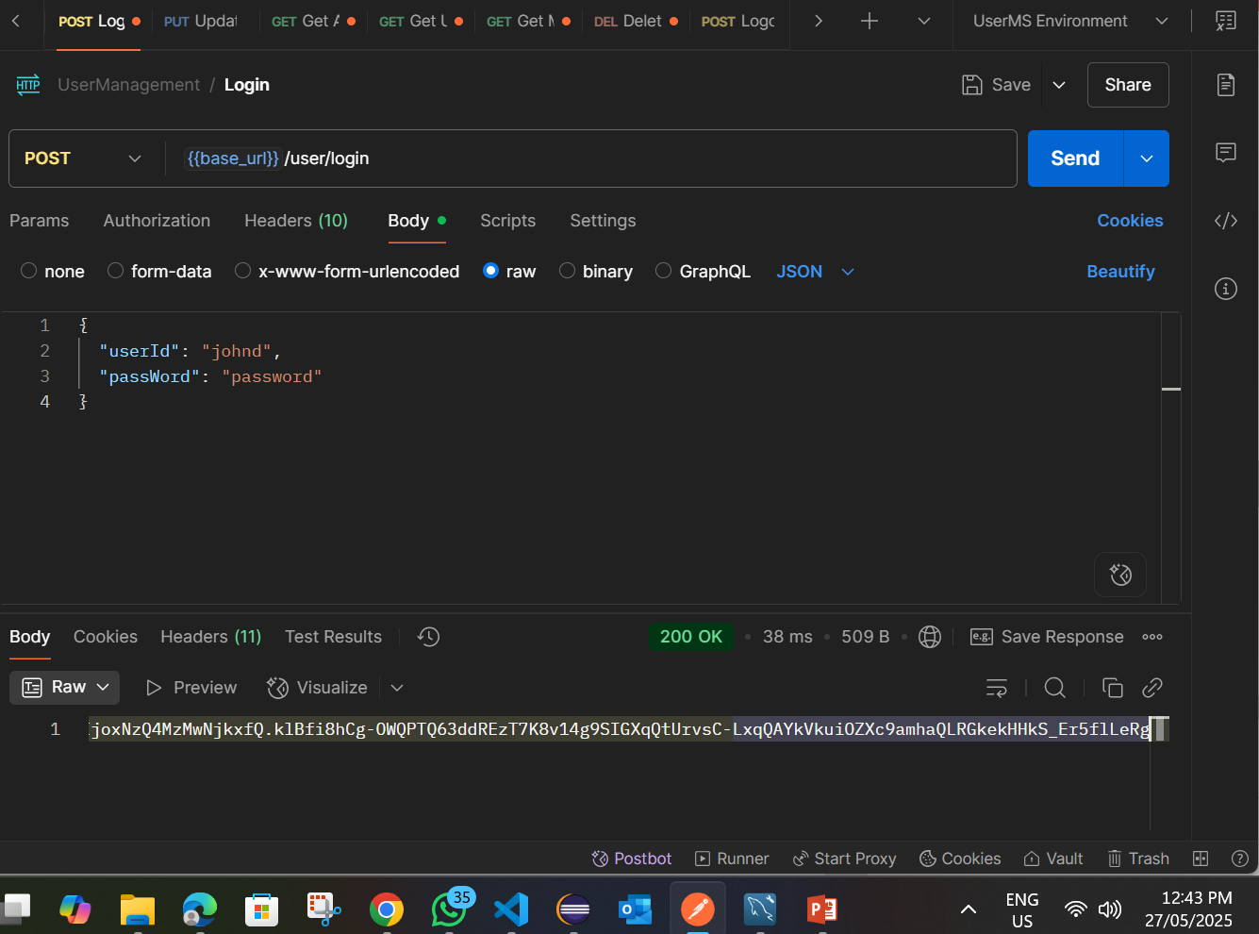
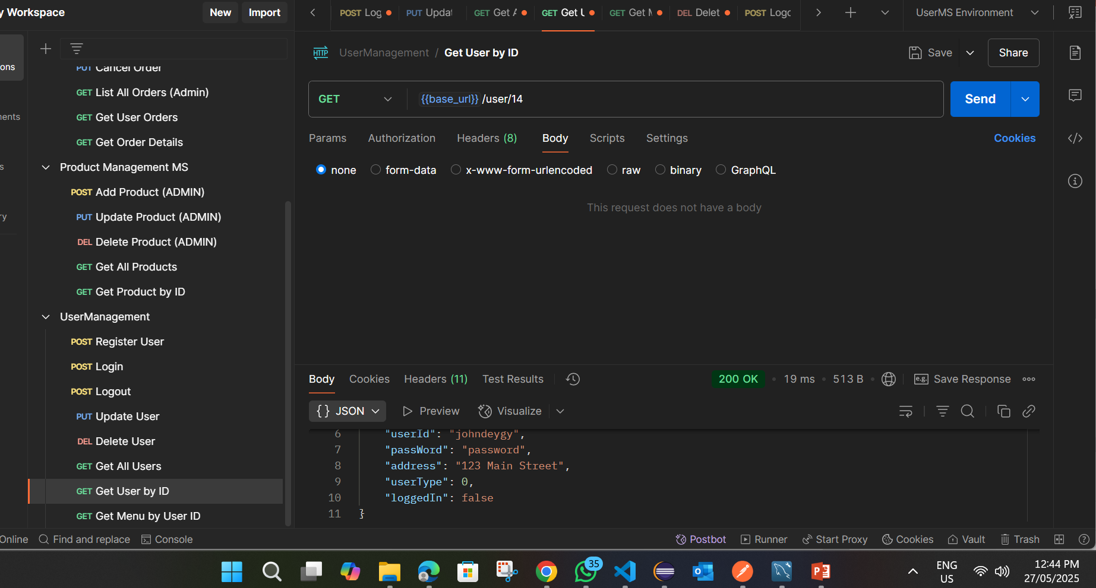
Samples of Postman Success Response

Slide 11
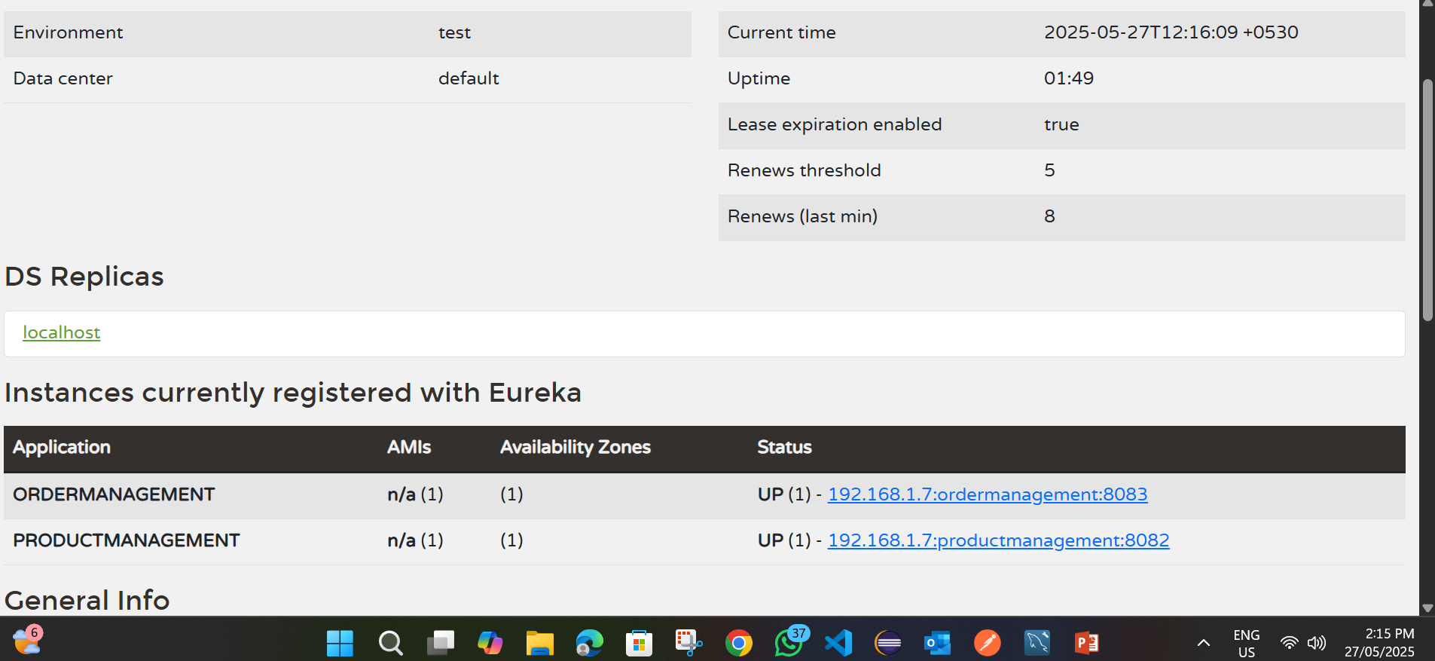
Eureka

Slide 12
Sample frontEnd

Slide 13
Future Enhancements
- Payment Gateway Integration
- Kafka/Event-driven architecture
- Docker, Jenkins

Slide 14
Thank You

