Slide 1
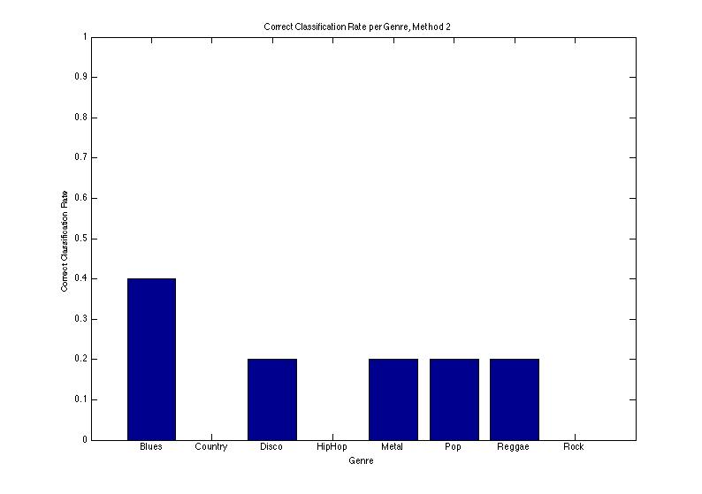
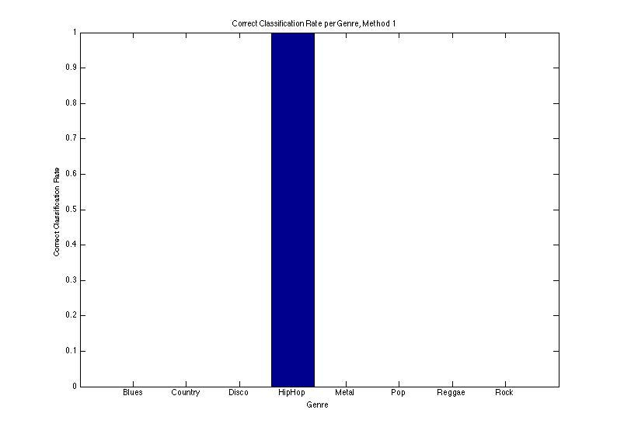
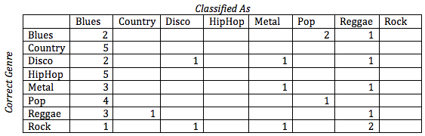
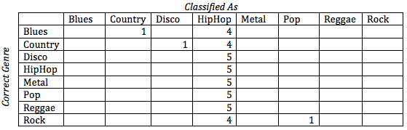
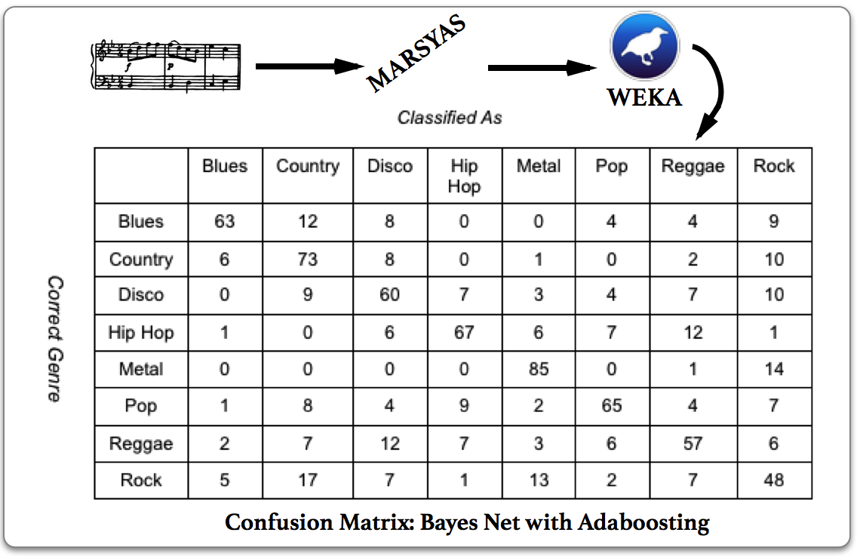
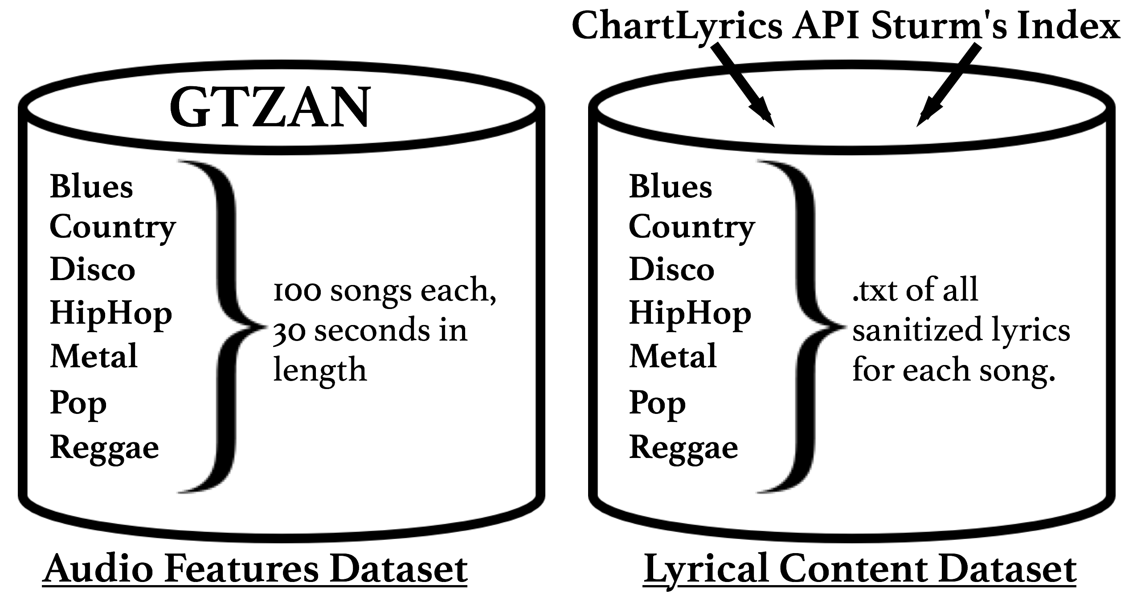
Genre Classification Gellner M., Potter C., Jacobson J., Toizer S. EECS 349, Pardo, B., Northwestern University
Introduction
Approach
Lyric Features
Genre Classification is an elusive, and generally unsolved challenge. By performing comparative analytics on a creative variety of potential features, and by utilizing an equally diverse selection of classification techniques, we distinguished some of the most important genre classification features.
Our primary areas of feature extraction were lyrics and a diverse range of audio features. We scraped lyrics online and implemented a variety of techniques to gauge their efficacy in classification. For Audio, we used feature extraction and machine learning software to pinpoint telling features, and combined them to optimize outcome.
Lyrical extraction ultimately proved to be a much weaker classification technique. With a frequency-dependent naïve bayesian classifier, we were able to classify with 9% accuracy. Upon switching to a more basic naïve bayesian classifier, we could improve our classification accuracy to 12.75%. Alternative heuristics, such as word count in songs, achieved an accuracy of 23.25%. Unfortunately, though higher than prior probability, this accuracy was far too low—and likely overfit—for boosting.
Motivation
Audio Features
We have a passion for music. We believe that learning how to better discern and classify the characteristics that define musical tendencies will provide insights into the nature of music itself. This can open the doors to further computational involvement in music, and has a number of exciting potential applications.
We used MARSYAS to conduct our feature extraction. We then classified our data using WEKA. We used a bayes net as our classifier and Adaboosting to bring our total classification accuracy up to 64.75%. Prior to boosting, we had a classification accuracy of 61.125%. The features we ultimately used in our analysis are below.
Dataset
Spectral Centroid
Spectral Flux
Spectral Rolloff
Spectral Flatness
13 coefficient MFCC.
We used the GTZAN dataset, originally composed by George Tzanetakis. With the help of Bob Sturm, we were able to index the entire 1000 song data set by name and title. We used 800 of these songs, spanning 8 genres. We classified across blues, country, disco, hiphop, metal, pop, reggae, and rock. Each genre was represented by 100 songs, each with a 30 second audio sample. For lyrical analysis, we used ChartLyrics’ web API to gather the entire lyrical content of each song, we then printed this data into text files, where we able to write a parser to use it in our classification tool.
Conclusions
We found Audio Features to be far more accurate than lyrics, and boosted exclusively on those features. With our optimization of extraction features, we outperformed previous standards by small margins. Ultimately, Genre Classification appears to be semi-reliable, but has much room for improvement, particularly were it to be effective in a real world situation. Lyrical analysis with refined heuristics and substantially more data, combined with more sophisticated audio features, could prove useful in future analyses.

