Slide 1
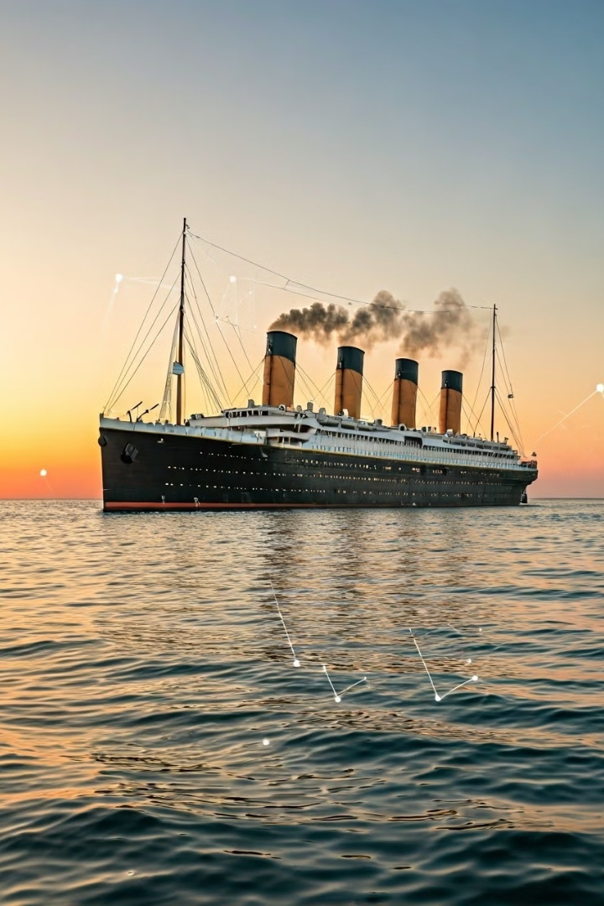
Machine Learning Predictions: Cleaning Titanic Data for Smarter Survival Insights
After reading this blog, you'll be ready to build any machine learning model for any dataset - no matter how messy it starts! "You miss 100% of the shots you don't take." - Wayne Gretzky -

Slide 2
Revealing Titanic's Fate: A Machine Learning Journey
The tragic story of the RMS Titanic continues to capture the world's imagination - but what if we could predict who might have survived that fateful night? By diving into the passenger data and applying machine learning, we can uncover patterns hidden beneath the surface.
In this blog, we'll clean messy data, handle missing values, and build a powerful predictive model to separate survivors from the lost - transforming raw data into life-saving insights. Ready to sail through data and machine learning? Let's embark on this journey! Let's see who dies and who lives.
PassengerId
Survived
Pclass
A unique identifier for each passenger - useful for tracking but not for prediction.
The target variable - 1 means survived, 0 means did not survive.
Ticket class (1st, 2nd, or 3rd) - an important indicator of social status and survival chances.

Slide 3
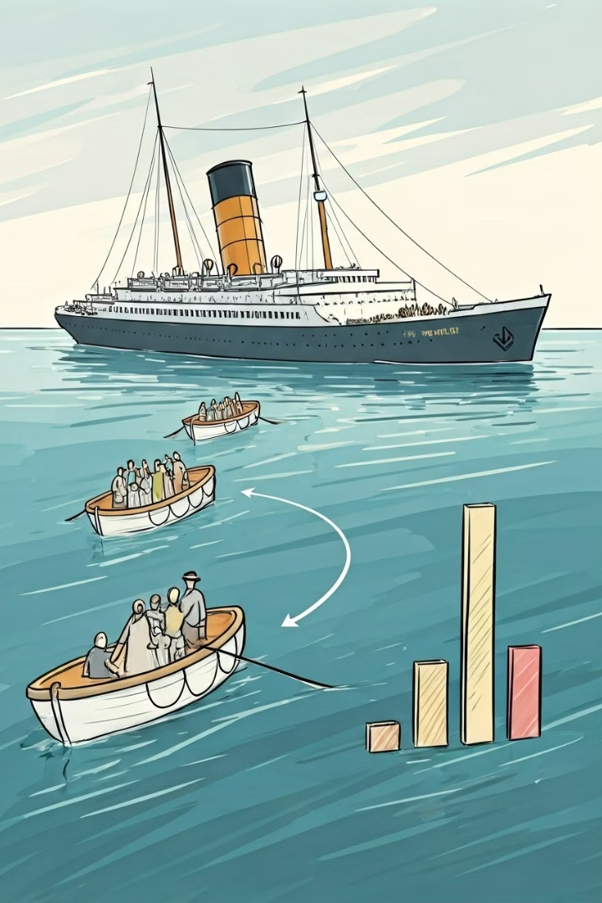
Insights from Survival Shape Plot
Pclass Analysis
Sex Analysis
1st Class: Fewer children compared to 2nd and 3rd classes. Contains more elderly passengers. Younger passengers had higher survival rates than older ones.
Males: Male children (0 to 14 years) had a strong survival rate. Females: Women aged 18 to 40 had a notably higher chance of survival.
Embarked Analysis
Embarked Q: Passengers over 40 years old from this port had a remarkably low survival rate.
These observations highlight how survival varied significantly based on class, gender, and age - unveiling patterns influenced by social hierarchy and evacuation priorities during the Titanic tragedy.

Slide 4
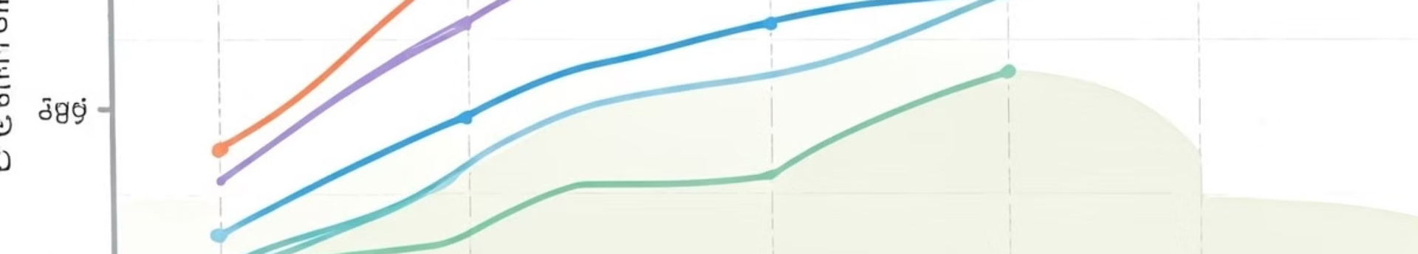
Correlating Features
This heatmap visualizes the correlation between numerical features in the Titanic dataset, showing that Fare has a positive correlation with Survival, while Pclass has a negative correlation.
0.26
-0.34
-0.077
Fare vs. Survived
Pclass vs. Survived
Age vs. Survived
Higher fares linked to better survival chances, reflecting wealth and cabin advantages.
Lower-class passengers had worse survival rates, showing social inequality.
Weak negative correlation - age wasn't a major survival factor.
It quickly highlights key relationships, supports feature selection for modeling, and simplifies complex data insights in one visual.

Slide 5
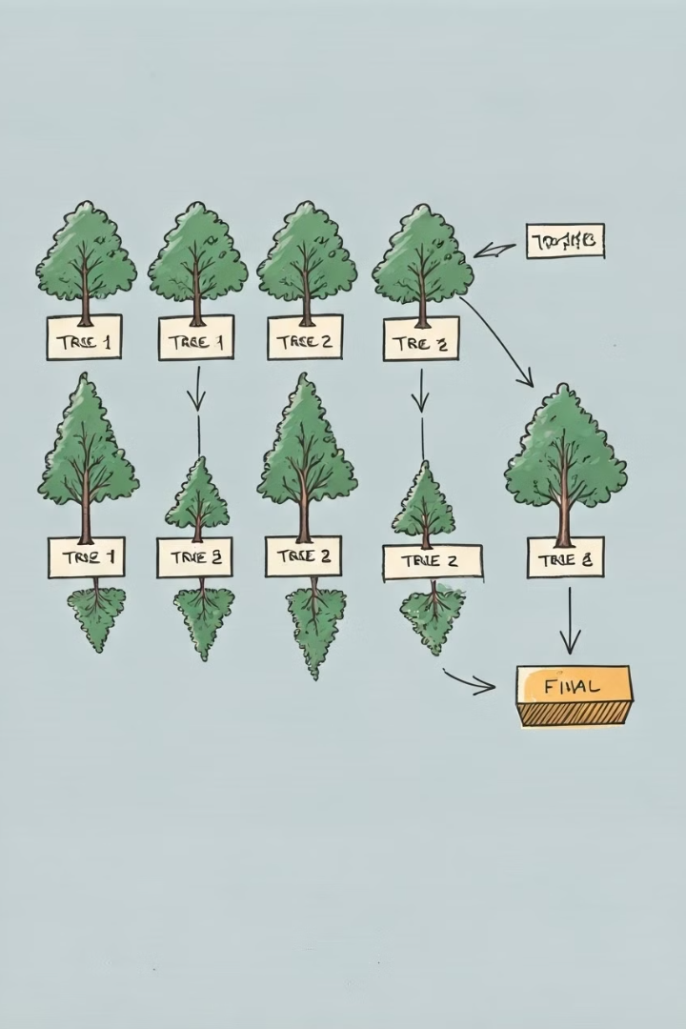
The Best Predicting Model: Random Forest Classifier
It strikes the best balance between accuracy, precision, recall, and F1-score - especially for the survivor class (1), which other models struggled with.
Test Accuracy
Precision
76% (higher than most models)
0.85 (Non-survivors), 0.65 (Survivors)
Recall
0.76 (Non-survivors), 0.77 (Survivors) → Best recall for survivors, meaning it catches more true positives.
This runs the RandomForestClassifier (model3) on new_test, generating predictions. The predictions are stored in a DataFrame called output - each row gets a 0 or 1 based on the prediction.

