Slide 1
CI/CD Pipeline
- Sumanth subrahmanya

Slide 2
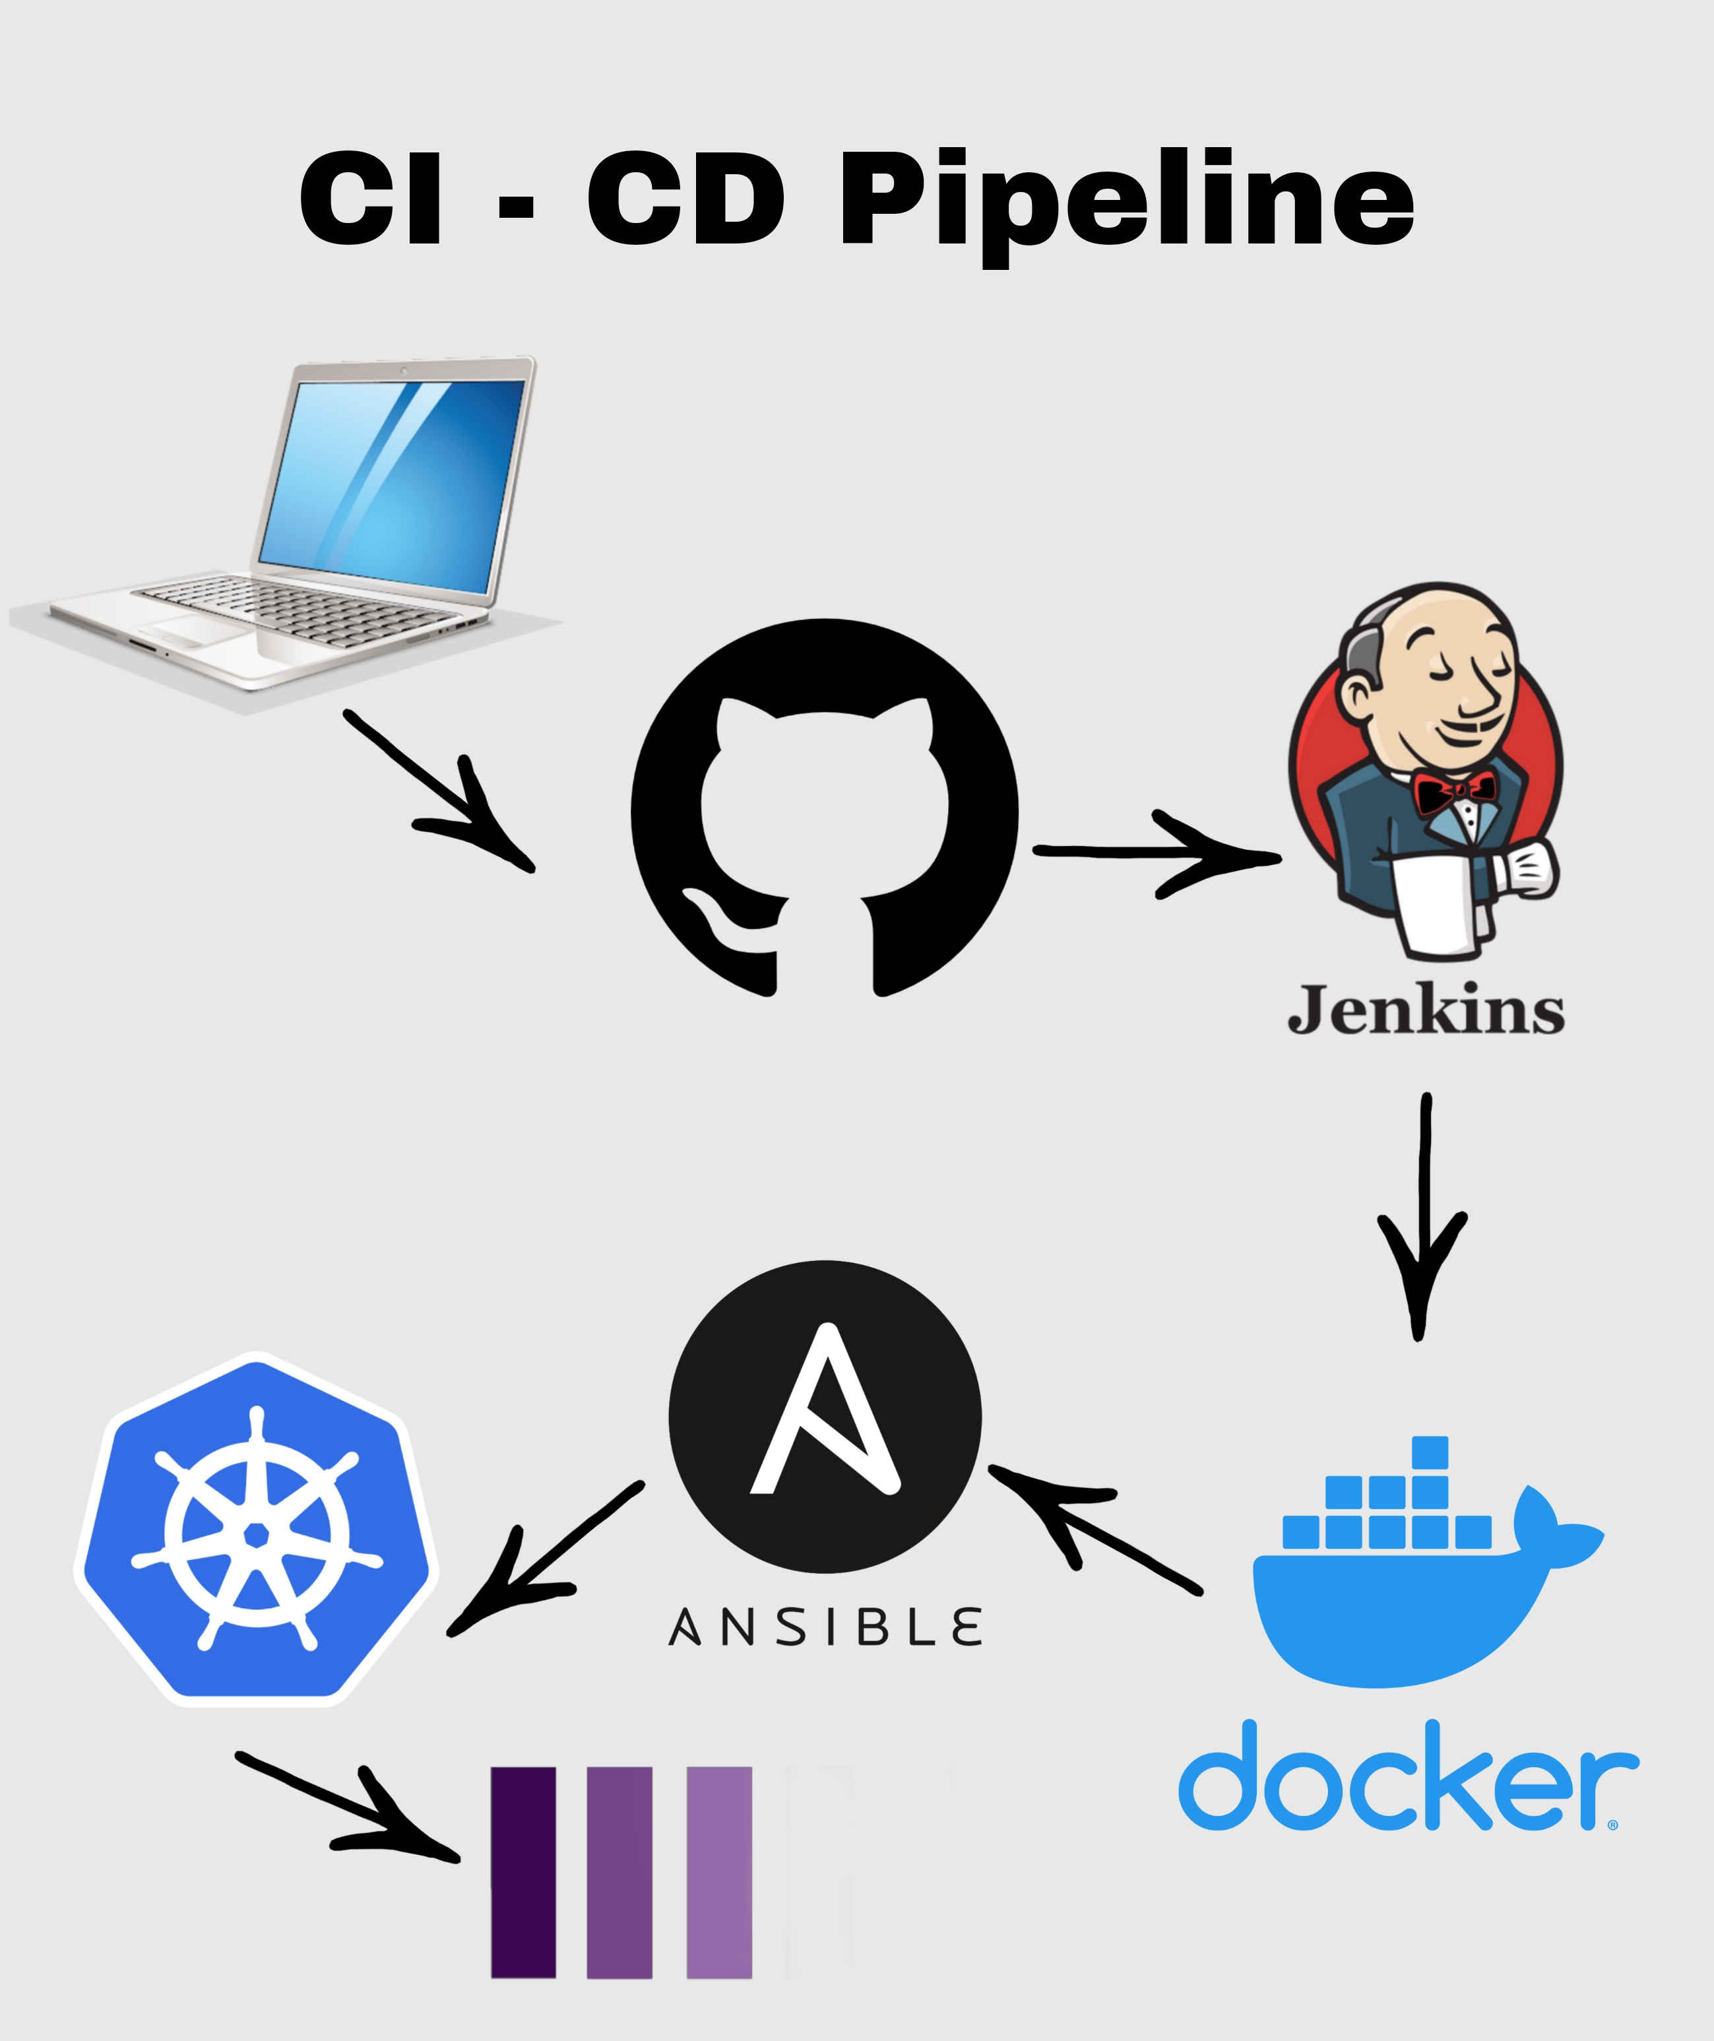
Diagram

Slide 3
Plugins
Git
Convert to pipeline
Docker
Docker pipeline
CloudBees Docker build and publish
Ansible

Slide 4
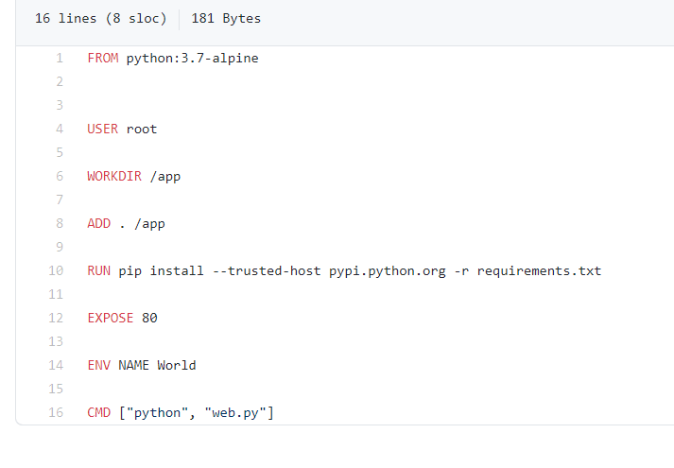
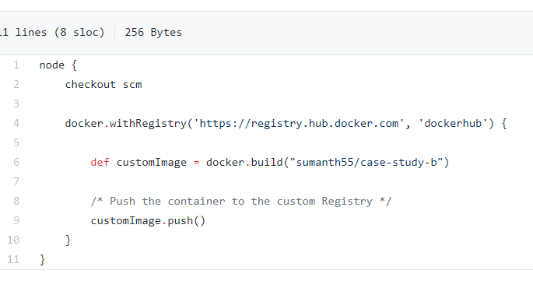
Dockerfile, Jenkinsfile

Slide 5
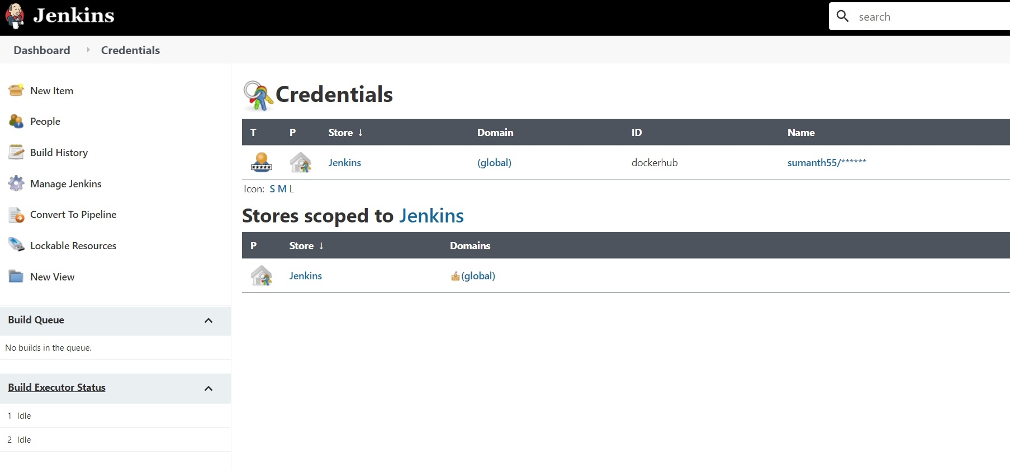
Credentials

Slide 6
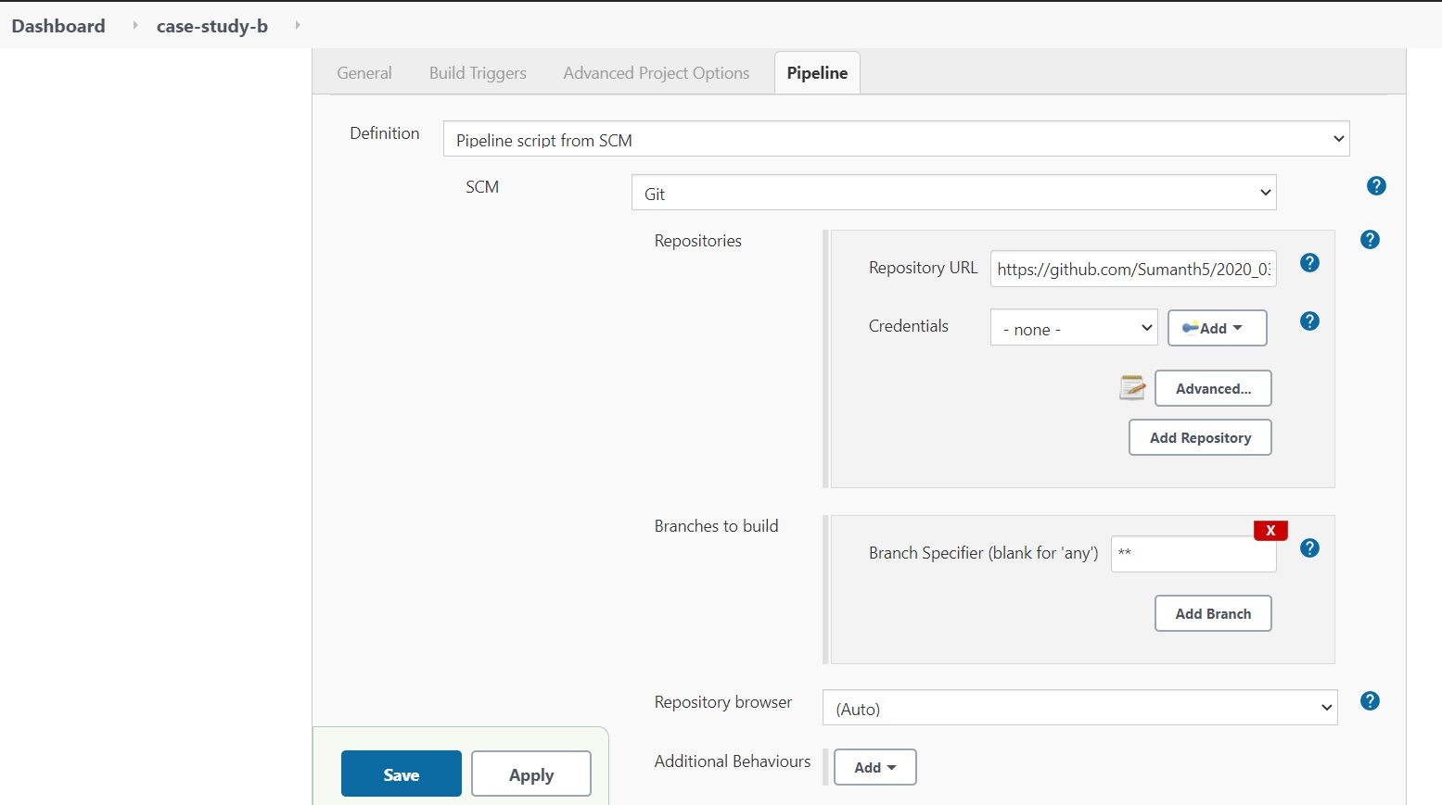

Slide 7
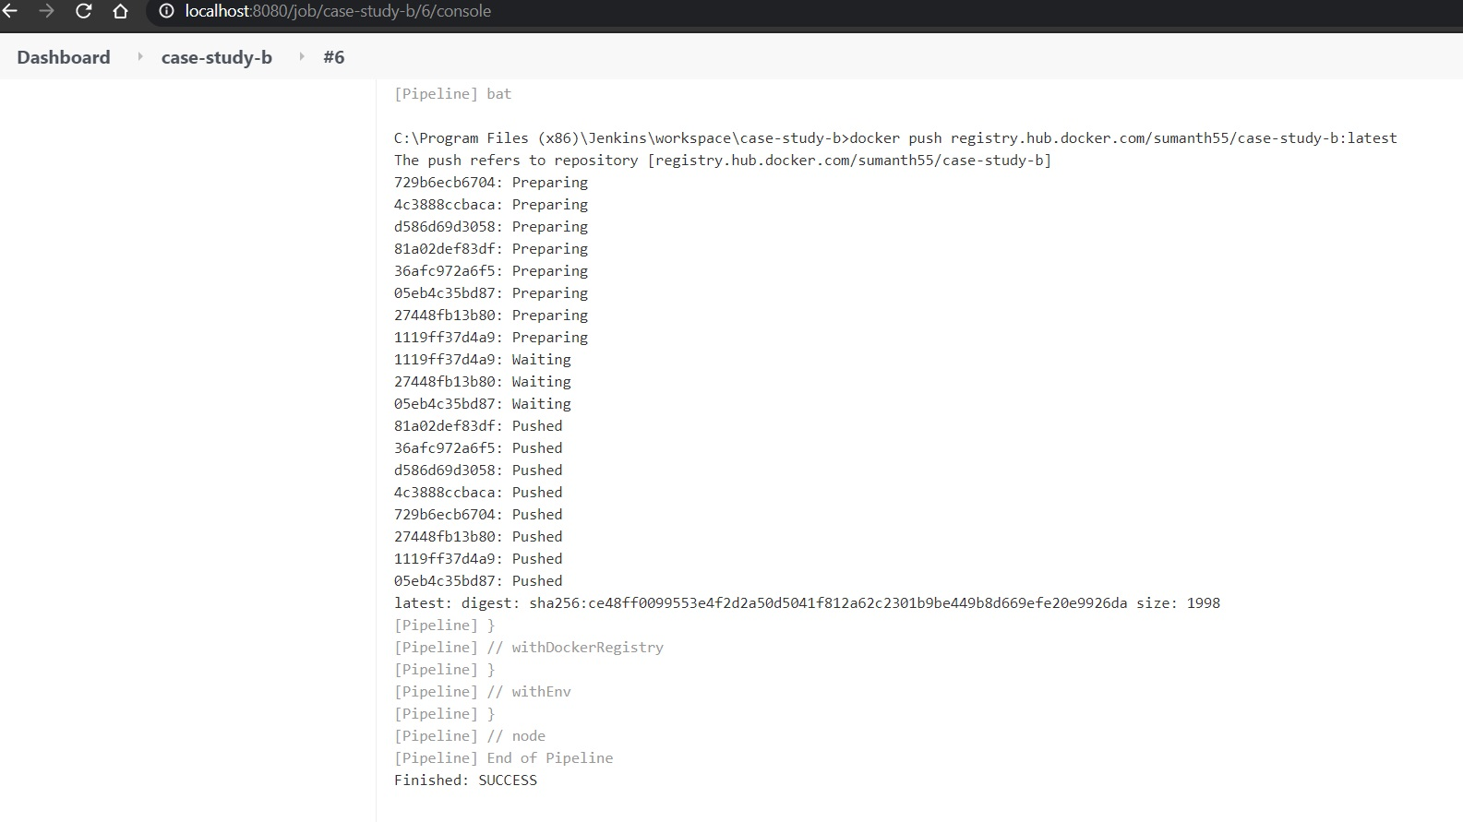
Build

Slide 8
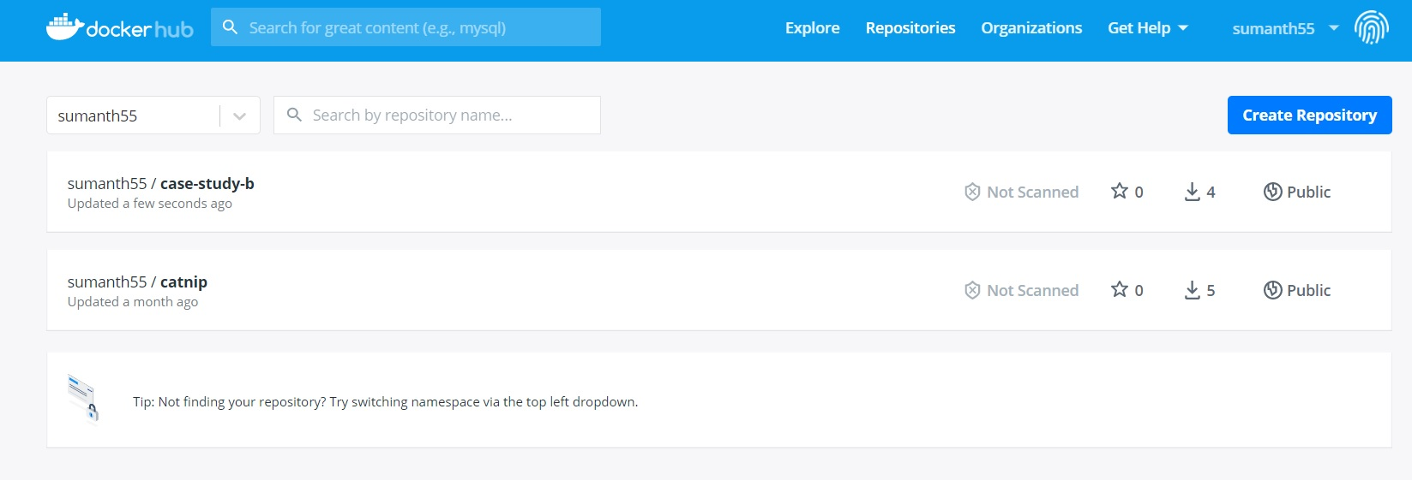
Docker registry

