Slide 1
BANK CRM ANALYSIS
SUMANTH RAJ S

Slide 2


Slide 3
Table of Contents
Problem Statement
Data Description
Date Schema
Observations
Key Insights
Dashboard
Conclusion

Slide 4
Problem Statement
You are an analytical CRM (Customer Relationship Management) specialist hired by a bank to extract meaningful insights from various customer-related datasets.
The bank aims to reduce customer churn, improve service delivery, and enhance customer satisfaction.
They have provided you with datasets including customer demographics, transaction details, customer exit information, and active customer profiles.

Slide 5
Data description :
Row Number: The row number in the dataset, likely used for reference or indexing.
Customer Id: A unique identifier for each customer.
Credit Score: A numerical representation of the customer's creditworthiness.
Geography ID: A numerical identifier that likely corresponds to a geographical location, such as a country or region.
Gender ID: A numerical identifier for the customer's gender, where for example, '1' could represent male and '2' could represent female.
Age: The age of the customer.
Tenure: The number of years the customer has been with the bank.
Balance: Current balance in the customer's account.

Slide 6
Data description:
Num Of Products: refers to the number of products that a customer has purchased through the bank.
Has Cr Card: denotes whether or not a customer has a credit card. This column is also relevant, since people with a credit card are less likely to leave the bank.
Is Active Member: active customers are less likely to leave the bank (as per the criteria defined by the bank for identifying the activeness).
Estimated Salary: as with balance, people with lower salaries are more likely to leave the bank compared to those with higher salaries.
Exited: whether or not the customer left the bank.
Bank DOJ: date when the Customer associated/joined with the bank.

Slide 7
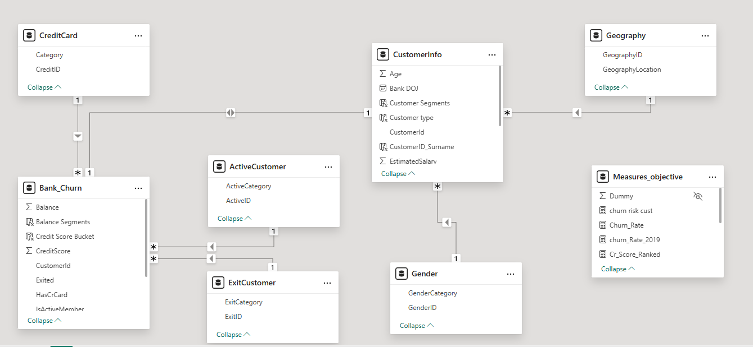
DATABASE SCHEMA:

Slide 8
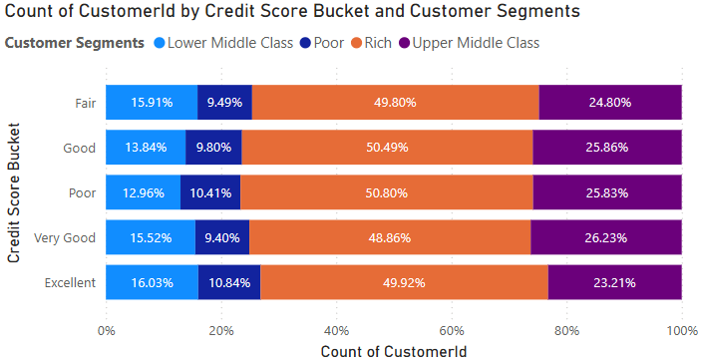
Observations
Churn Risk Management Assessment
Rich Segment Dominance – The Rich segment holds the largest share across all credit score buckets.
Lower Middle Class & Poor – These segments have the smallest shares.
Upper-Middle Class Stability – This segment remains fairly consistent .
Credit Score Distribution – Customer segments remain stable across credit scores, indicating no major shifts in composition.

Slide 9
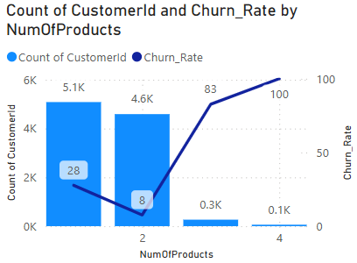
Total Customers and Churn Rate VS
Num of Products
Customers who purchased 4 products have the highest churn rate at 100%, which steadily decreases as the number of products purchased decreases.
Additionally, the majority of customers have purchased only one product, with the number of customers decreasing as they buy more products..

Slide 10
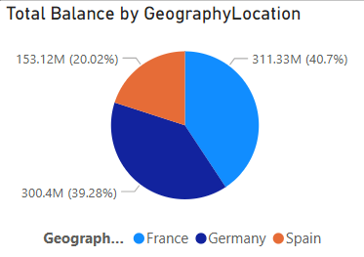
Total Balance of customers in each Region
Among the three regions in the dataset. France has highest account balance.
From this pie chart that we can visualize and see total distribution of balances across different regions.
Germany is 2nd most country having Balance and slightly lower then France.
Spain is lower among all the three country. It is almost half of Germany’s balance. Recorded balance in Spain is 0.15 billion.

Slide 11
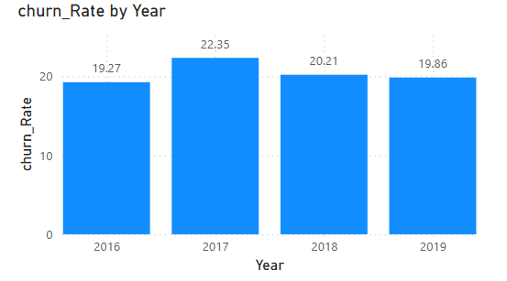
Churn rate Analysis
From 2016 to 2019, the average churn rate was 20%, which is not ideal since a lower churn rate is preferable.
A high churn rate can suggest that customers are dissatisfied with the services or do not find them valuable.
Enhancement in quality and customer support will increase their satisfaction.
Rewards and Incentives can be used to encourage long-term customer retention.

Slide 12
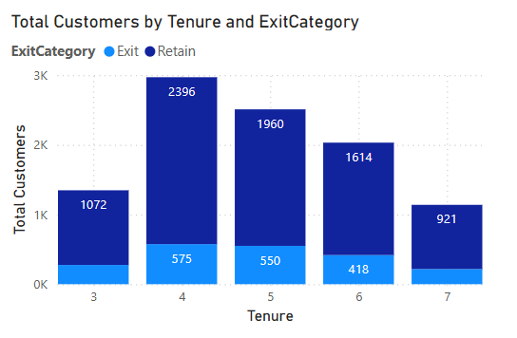
Total customers vs Tenure
Customers with tenure greater than or equal to 4 years show significantly higher retention rates.
At 4 years of tenure, 2,396 customers are retained, with 575 exits.
At 5 years of tenure, 1,960 customers are retained, with 550 exits.
Retention consistently remains high as tenure increases.
In contrast, customers with tenure of 3 years or less have a relatively higher churn rate:

Slide 13
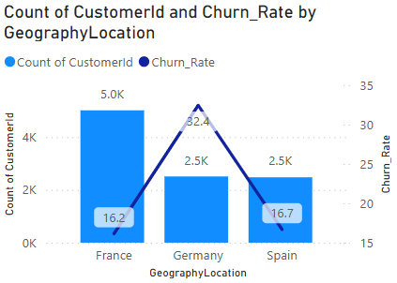
Region VS Total Customers and Churn Rate
In France:Highest active members (5.0K) and low churn rate (16.2%).Strong retention.
In Germany: High churn rate (32.4%) despite fewer active members (2.5K). Retention challenges.
In Spain: Same active members as Germany (2.5K) but lower churn rate (16.7%). Stable retention.

Slide 14
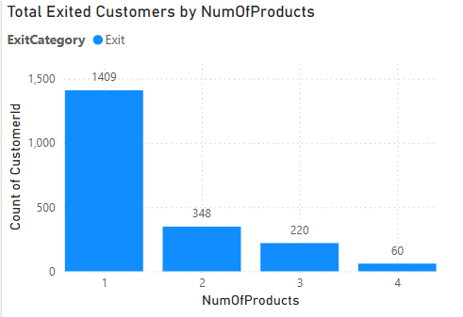
Total Exited customers VS no. of products
Customers bought one product have highest churn count (1409).
Churn count decreases as the number of products used increases.
Customers using multiple products are more loyal, indicating a need to encourage product diversification.

Slide 15
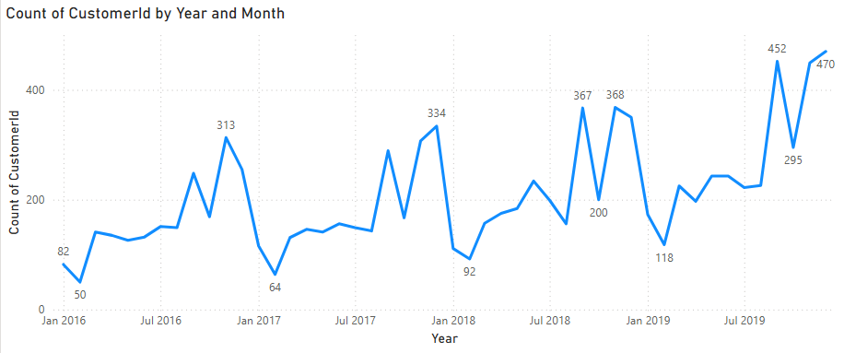
Total Customers joined monthly
Highest peak is in 2019 with a value of 452 joining's and dip is in 2016 with a joining’s of 50.
There are significant dips every year in month of the January and a significant peak before that dip.
Despite the fluctuations, there seems to be an overall upward trend in the count of Customers over the years.

Slide 16
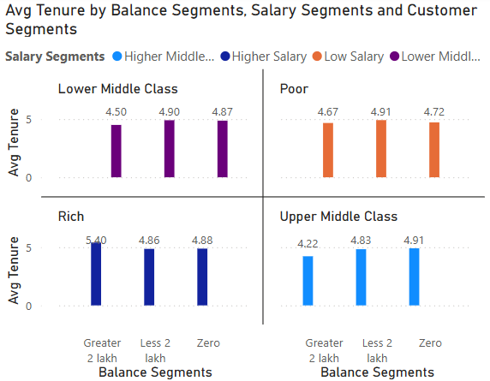
Average Tenure vs various factors
Customers with higher balances, especially those earning high salaries and with balances above 2L, have the longest tenure (5.4 years).
Zero-balance customers have the shortest tenure (4.2 years).
Offer exclusive benefits to high-balance customers to maintain loyalty.
Provide incentives like fee waivers or savings plans to engage and retain zero-balance customers.

Slide 17
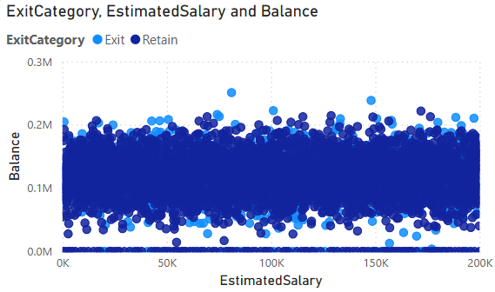
Correlation between Balance and Salary
Customers who exited tend to have a lower sum of estimated salary and balance compared to retained customers.
However there are no outliers.
There is a positive correlation between the sum of estimated salary and the sum of balance.
This means that customers with a higher estimated salary also tend to have a higher balance.

Slide 18
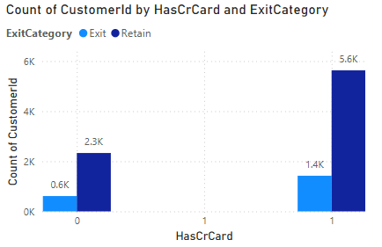
Total customers with Credit Card
Retention of customers with a credit card is retention of customers without one.
This indicates that credit card ownership is a strong factor in customer retention.
Non-cardholders represent a disproportionate number of exits compared to their overall population.
Credit card Ownership significantly impact's customer retention rate.

Slide 19
KEY INSIGHTS
The poorest credit score segment (300-579) experiences the highest exit rate.
Possessing a credit card does not significantly affect churn rates.
The most common number of products among customers who have exited the bank is one.
Many customers join the bank during the months of August to December.
Individuals aged 30-50 hold the most credit cards.
The highest churn rate and the lowest number of active members indicate that germany is a significant financial risk for the bank

Slide 20
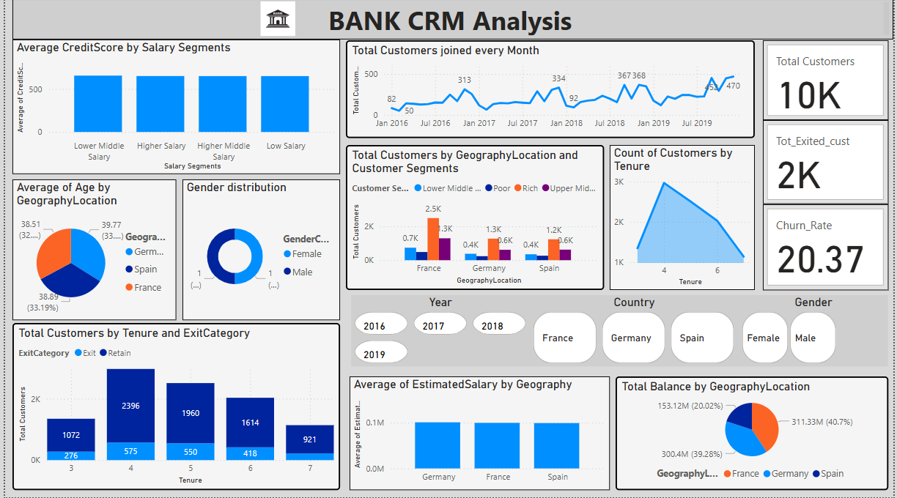
Final Dashboard:

Slide 21
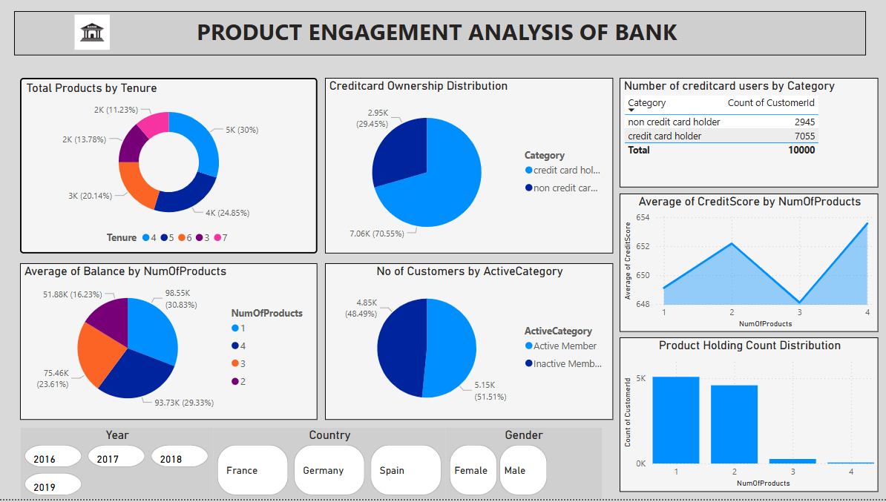

Slide 22
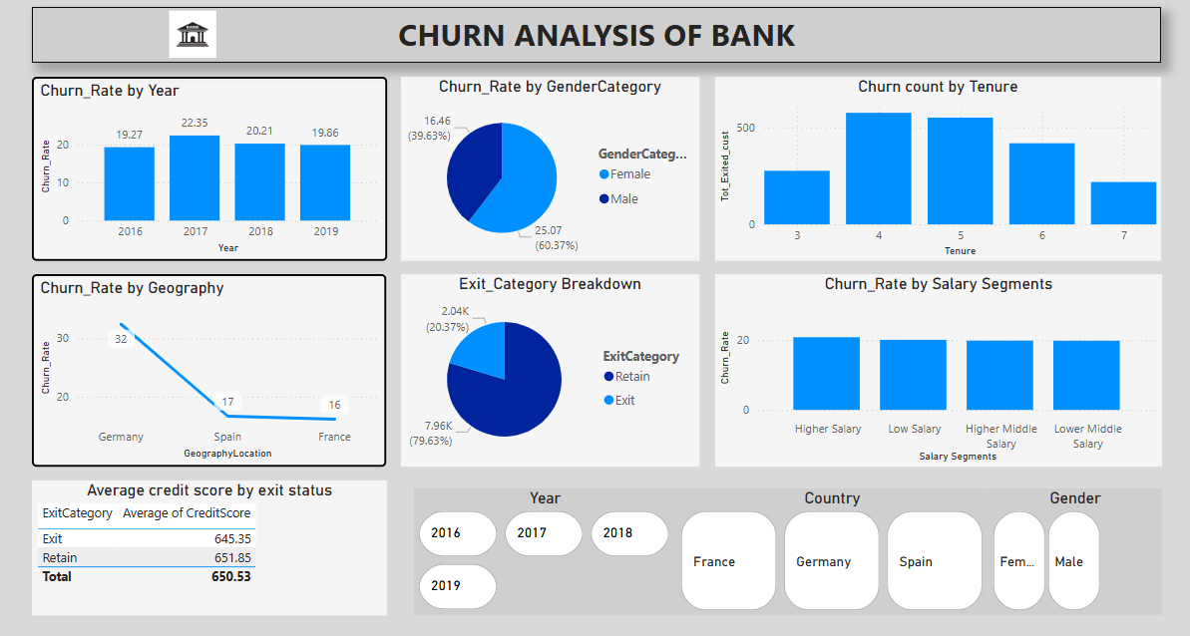

Slide 23
Strategies to Decrease Churn Rate
Provide incentives on bundled product offerings to attract single-product customers.
Develop new schemes to encourage longer customer tenure.
Enhance customer engagement and service quality.
Improve products based on customer feedback.
To boost profitability and reduce loan defaults, offer loans only to customers with high credit scores.
Offer incentives to customers who join in Quarter 1 to expand the customer base during that period.

Slide 24
Conclusion :
The bank has faced a consistent churn rate despite a steady increase in new customers.
Customers with lower credit scores and those using fewer bank products are more likely to churn.
Older and middle-aged groups have the highest churn rates, posing unique retention challenges.
Focus on customer engagement, feedback system, service enhancement for the customers who are likely to churn to improve the customer retention and which will enhance customer loyalty.
Provide combo offers on multiple products in the bank to increase higher usage of products by customers which decreases churn rate.

