Slide 1

ZOMATO RESTAURANTS ANALYSIS
SUMANTH RAJ S
13 FEB 2025

Slide 2
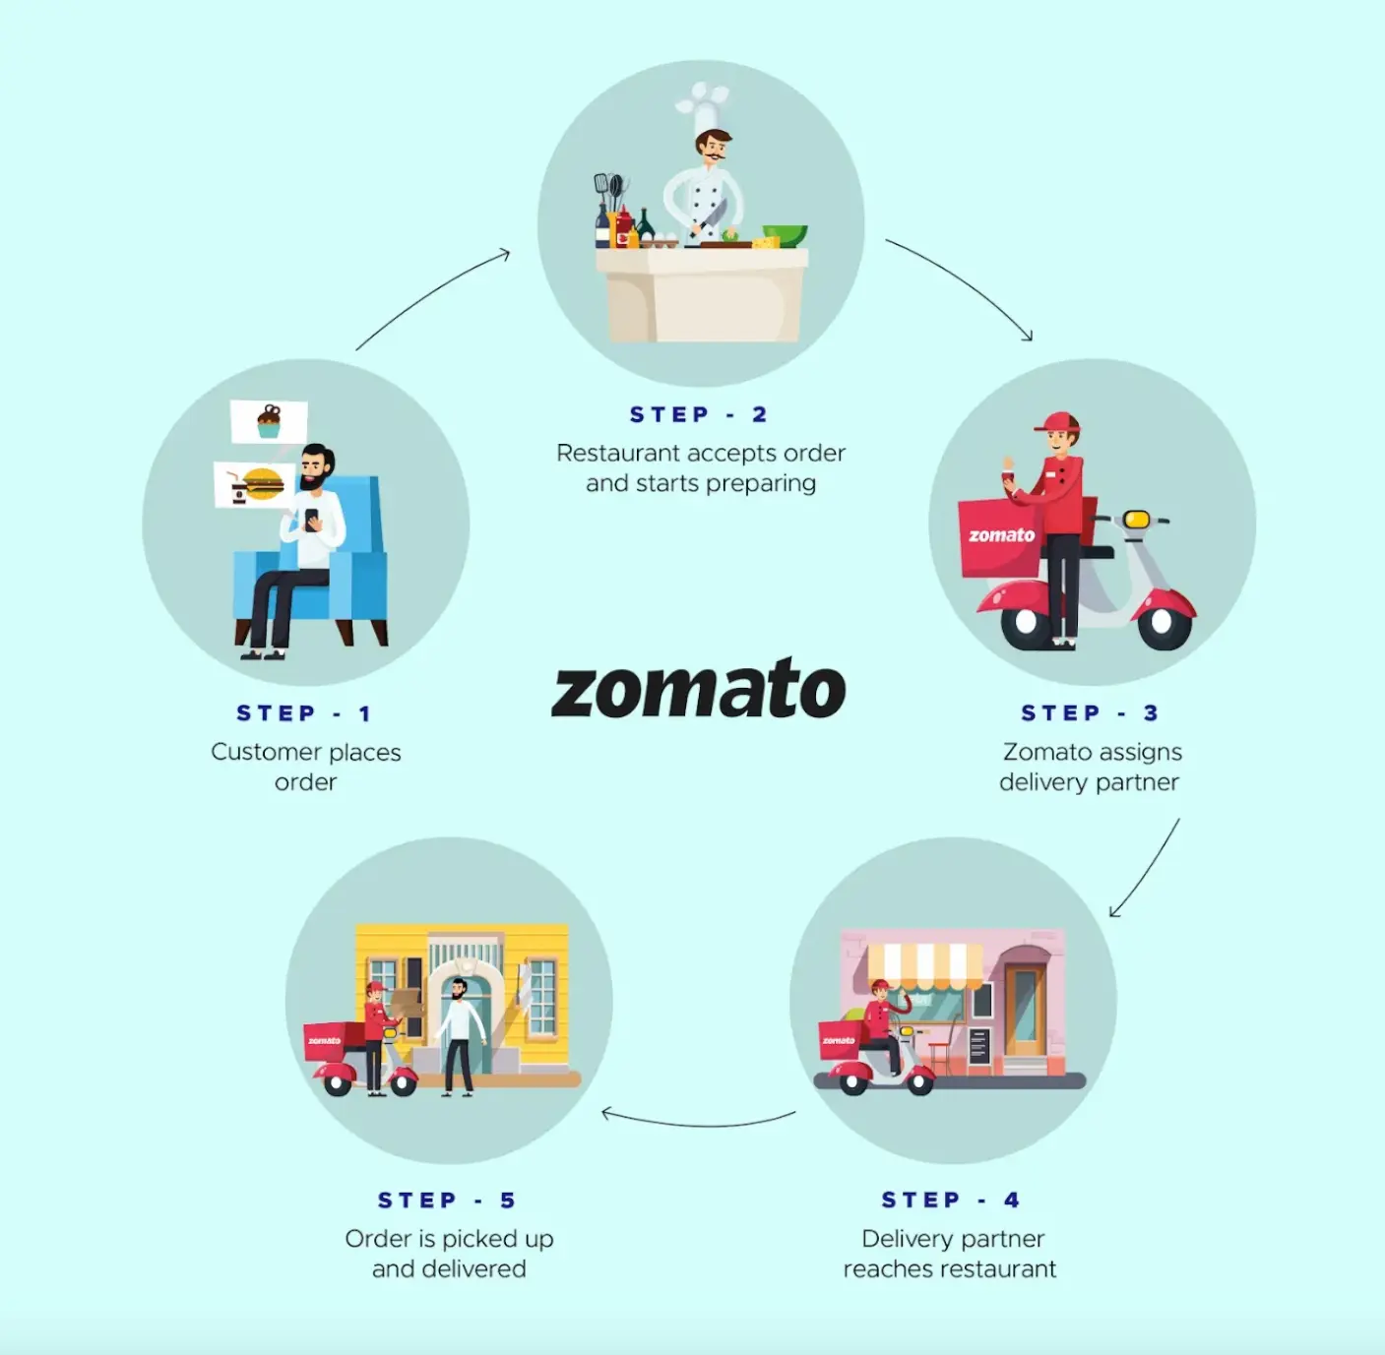
Introduction and Objectives
1. Zomato is a widely used and intuitive app that helps users locate nearby restaurants and cafes for dining in or ordering food online. It also provides menus, customer feedback, and ratings, allowing users to make well-informed choices about eateries .
2.The aim of this project is to identify the potential countries(cities) for establishing new restaurants based on the analysis of the available data which involves identifying key competitors , people spending behavior , rating etc.
3.The image to the right explains the workflow of the ZOMATO as a whole .

Slide 3
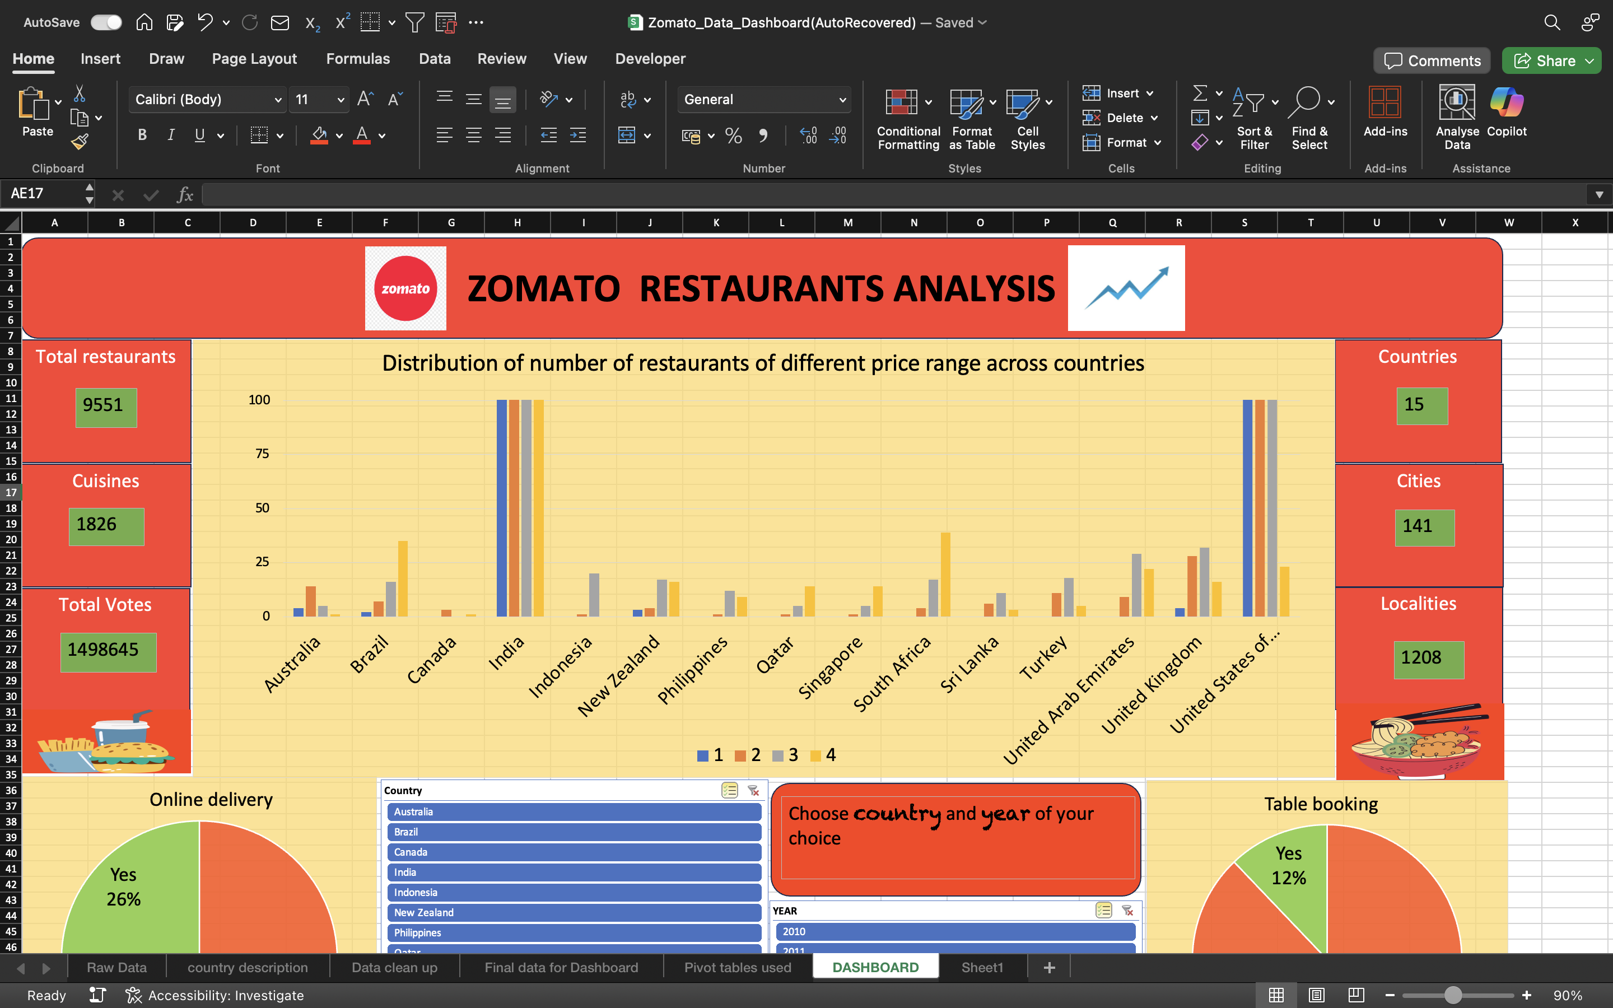
Summary of the data set
1.The key attributes of the given data set includes total restaurants , countries , cuisines , cities , localities , total votes whose values are mentioned to the left .
2.Data cleaning and preprocessing steps :
a. Addressed missing values in the Cuisines data field to enhance data integrity.
b. Datekey_Opening data field has been used to obtain a proper format dates using which years , months are extracted as different attributes for better analysis.
c. Data fields Longitude and Latitude have been dropped as they don’t have much significance in the analysis part and a new data field Country is created using reference worksheet country description using XLOOKUP()
d. Further details are highlighted in the worksheet Data clean up
3.The given dataset is critical for analysis as it clearly mentions the market presence and operational scope of ZOMATO enhancing clarity on customer behavior ,seller’s performance over years , restaurants performance .

Slide 4
Methodology
Analytical approach and tools :
1.Data cleaning and enrichment : Utilized functions like COUNTBLANK(),XLOOKUP(),COUNTIF(),VLOOKUP(),TEXBEFORE(),CONCATENATE(),VALUE(), SUBSTITUTE(), etc to refer external data source and create new custom data fields for better analysis .
2.Descriptive analysis: Worksheets, Objective analysis and subjective analysis include a complete detailing of this which involves creating around 20 Pivot tables , multiple charts to analyze trends ,correlation between data fields to facilitate dashboard creation and achieve project aim
3.Visualization: Includes a dashboard with multiple charts and slicers ( year , country) to arrive at the project aim of identifying potential sites for expansion.

Slide 5
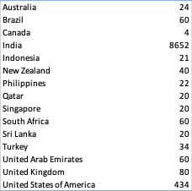
Analysis of Objective questions
The file contains 2 worksheets (Raw data and Country description) and hence 2 tables (structured datasets)
Number of attributes(columns) in the Raw data worksheet and Country Description worksheet is 20 and 2 respectively.
Categorical columns : either have text or fixed set of values as a value ,in the given data file there are 14 categoricalcolumns,RestaurantName,City,Address,Locality,LocalityVerbose,Cuisines,Currency,Has_Table_booking,Has_Online_delivery,Is_delivering_now,Switch_to_order_menu etc
Used XLOOKUP() function to fetch the country data field from country description worksheet
Number of restaurants in each country analysis is done using pivot table and column chart as seen in the images to the right

Slide 6
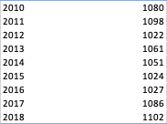
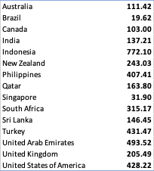

Restaurants opened each year is analyzed with the help of pivot table and line chart
Using the COUNTIFS() function
Average number of voters in each restaurant as per countries is analyzed using pivot table
The above calculation was performed using the array formula which includes AVERAGE () aggregate function & IF logical function

Slide 7

Customized the average price per two column using combination of CONCATENATE(),TEXTAFTER() and TEXTBEFORE() functions
The below calculation was performed using COUNTIFS() function referring to specific criteria ranges

Slide 8
Objective analysis conclusion
With the objective analysis , we can clearly see that the countries with lower restaurants count will be a crucial factor to consider for establishing our new restaurants which signifies low competition, and this is not the only factor, hence objective analysis has limited scope.
With this analysis we will be considering cities in the countries with less than 25 restaurants as a potential place to expand our restaurants .For further detailed analysis we need to consider more factors , this will be performed and analyzed in the upcoming slides using Subjective question analysis .

Slide 9
Insights from Subjective analysis
Places where new restaurants can be opened considering lower competition in mind:
Key factors to consider are number of restaurants already set up in each country , average rating given by people for restaurants in respective countries , Average expenditure by people with respect to each country ,Number of new restaurants set up each month across various years. We can analyze this using pivot tables and column charts
After analyzing combining these factors potential countries where we can establish new restaurants are Australia ,Brazil ,India ,Newzealand,Qatar, Sri Lank ,UAE, USA, UK
Of these countries Australia offers the best opportunity with people willing to spend more and both numbers and ratings of restaurants being lowest
Sri Lanka will be the last choice as the amount people are willing to spend is lowest compared to other countries
This analysis is presented in the form of column charts in the next slide also can be viewed in the dashboard by selecting rating range ( <=3 ) , Price range for two (>=3000) also can be analyzed by viewing number of restaurants in the column chart ( Country vs number of restaurants )

Slide 10
Column charts

Slide 11
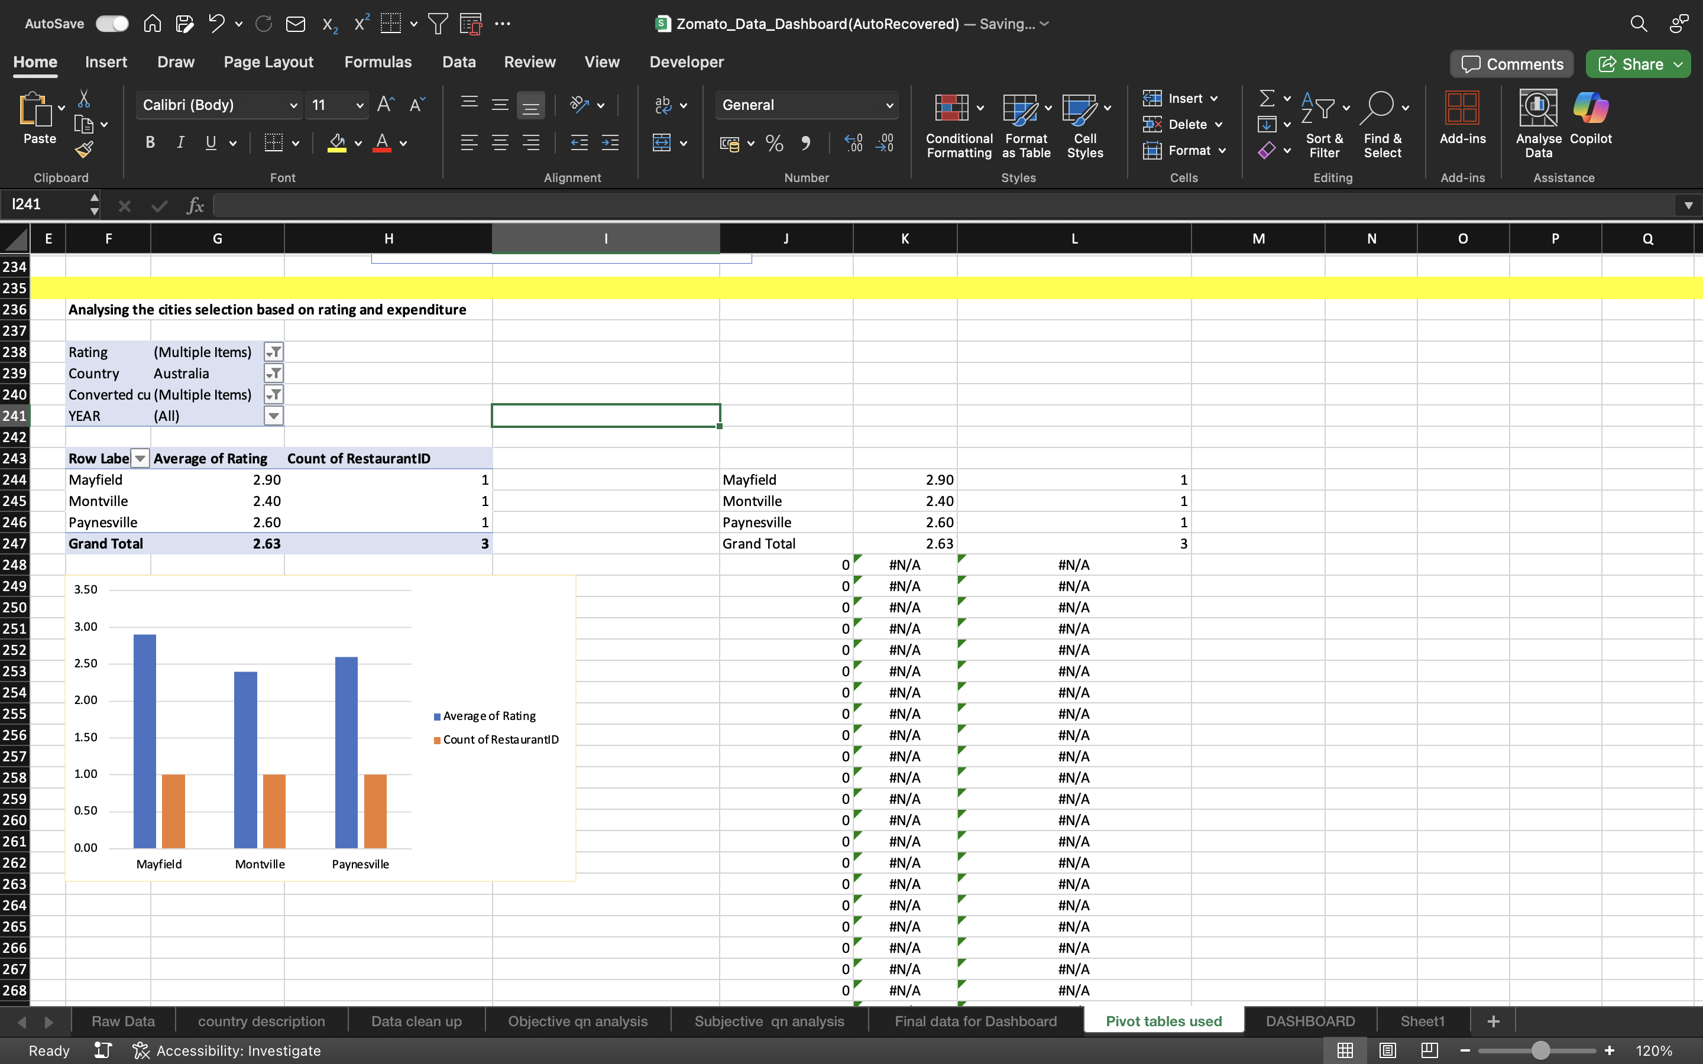
To identify names of states or cities where we can target ,its better to look beyond the countries that we have selected as per our objective analysis ,the reason being there might be cities in other countries with <5 restaurants ,poor rating (<=3),people’s willingness to spend based on conversion of different currencies to Indian rupees(>=2000)
With this approach we will create a pivot table with cities , count of restaurants , average rating and expenditure criteria to finalize our main target cities.
They are as follows :
Australia ( Mayfield , Montville , Paynesville ) , Brazil (Brasilia, Rio De Janeiro , Silo Paulo),India ( Faridabad , Ghaziabad , Gurgaon, Jaipur, Nagpur , New Delhi , Noida),New Zealand(Auckland),Sri Lanka (Colombo),UAE(Sharjah), UK(Birmingham) , USA(Davenport , Gainesville , Mc Millan , Pocatello )
Example considering Australia , rating <=3 , expenditure>=2000 gives us 3 output cities as seen beside in the image

Slide 12
Average ratings of restaurants in the list of selected countries can be analyzed with the help of a pivot table , chart and a slicer for rating
Rating of respective countries that we have considered looks as presented in the image to the right
We cannot consider rating alone as a standalone factor because number of restaurants will have an impact on rating but still these values add validate our findings

Slide 13
Average expenditure by people based on our selected countries (image to the right)
Clearly Singapore, Qatar , UK , UAE offer best opportunity in terms of people willing to spend
Again, considering this as a standalone factor by ignoring number of restaurants is not the best decision but truly adds value.

Slide 14
Biggest competitor restaurants can be analyzed considering restaurants with >=5 outlets, expenditure per two <=500(affordable) & with a rating >=3 respectively
Whereas the lower ranked restaurants can simply be analyzed considering poor ratings(<3) and highly priced(>=1000) for two people and <5 restaurants
We can analyze this using a pivot table with the count of restaurants beside the restaurant name adding filters to select the rating ,expenditure per two , specific cities which we are looking for as per our earlier analysis .
High competitors: Cafe Coffee Day, Green Chick Chop, Keventers, Giani, Giani's, Chaayos, Baskin Robbins, Twenty Four Seven, Cocoberry, Gopala, Frontier, Burger Point, RollsKing, 34 Chowringhee Lane, Angels in my Kitchen, Tibb's Frankie, Republic of Chicken, BTW, Wow! Momo, Pudding & Pie, Nirula's Ice Cream, L'Opera, Mad Over Donuts, and Goli Vada Pav No. 1
Lowest rated: Jade Garden, K2 Multi Cuisine Restaurant, 9 Mars Lounge, 4 on 44 Restaurant & Bar, Admission Lounge, Kayasth Cuisine, Alcoholic Lounge & Bar, Lattitude - Skycity Hotel etc

Slide 15
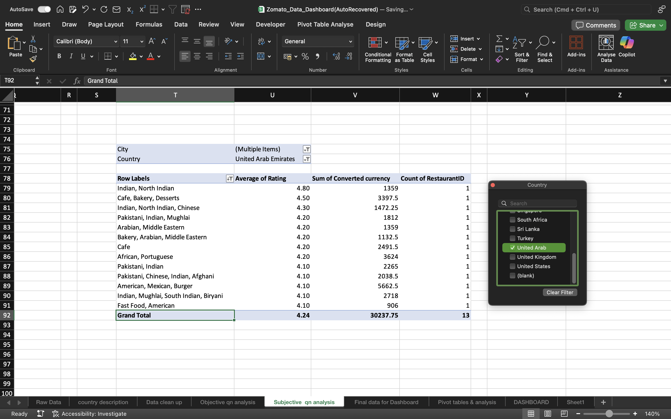
By this analysis we can clearly see that the choice of cuisines also had an impact on the ratings of restaurants , in the cities where we have planned to set up our new restaurants we need to focus on the following cuisines to attract customers. Hence analyzed as per cuisines average rating >=4 ), filtering the cities that we have identified , expenditure per two (<=2000) affordable.
The following cuisines should be the target group: Australia,USA, Brazil ( Sandwich , Seafood , Kajun ) ,India ( North Indian , mediterranean ,Mexican , healthy food ),UK(Latin American) , UAE(Indian , north Indian ) ,Newzealand ( Desserts ) , Brazil ( Beverages ) , Sri Lanka ( Sea food )

Slide 16
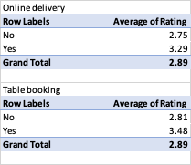
Choice of online delivery and table booking matters while setting up new restaurants and the analysis clearly says having both online delivery and table booking helped improve ratings significantly as seen here

Slide 17
Country | (Multiple Items)
City | (Multiple Items)
YEAR | (All)
Row Labels | Average of Rating | Count of RestaurantID
0-1000 | 2.55 | 6622
1000-2000 | 3.51 | 858
2000-3000 | 3.57 | 240
3000-4000 | 3.65 | 77
4000-5000 | 3.99 | 43
5000-6000 | 3.86 | 21
6000-7000 | 3.80 | 8
7000-8000 | 4.10 | 1
8000-9000 | 4.05 | 2
9000-10000 | 4.70 | 1
>10000 | 4.50 | 1
Grand Total | 2.71 | 7874
Correlation between price and ratings of restaurants can be analyzed for the shortlisted cities as per our analysis in the previous slides.
In the image to the right , we can clearly see that for the cities of our choice the price range between 1000-2000 and 2000-3000 have a significant sample space of >1000 restaurants compared to all other ranges .
Thus, the pricing should be in the range of 1000-3000 in the new restaurants in the selected cities.

Slide 18

Distribution of number of restaurants of different price ranges across countries
To analyze this, we will need a pivot column chart :
Considering price ranges 1,2,3,4 as budget , moderate , expensive , luxury
Here we can clearly notice that the number of restaurants are high for India and USA , price range of 4 ( highest ) dominates in Brazil , Sri Lanka , Qatar , South Africa which clearly tells us that the LUXURY category is dominating in these countries whereas other countries have a price range of moderate to expensive in dominance

Slide 19
Strategic recommendations
Considering all the attributes of the data following pointers can be the best strategy to set up new restaurants
1.Choice of country and specific city to be based on 4 key factors , average rating of restaurants(<=3) , average cost per two ( rupee converted )<=2000 ,number of existing restaurants in the city <=5.
2.The next crucial aspect will be the choice of cuisine ,price range , table option, online delivery options and average ratings with respect to the cities where we are planning for our expansion
3.By accomplishing this we can clearly see the findings mentioned in the next slide

Slide 20
Key findings for strategy making
1. Market Entry Strategy
Target Countries for Expansion:
High potential markets: Australia, Canada, Indonesia, Philippines, Qatar, Singapore
Best opportunity: Australia (high spending, low competition)
Last choice: Sri Lanka (lowest spending behaviour)
Target Cities within Selected Countries:
Australia: Mayfield, Montville, Paynesville
Brazil: Brasília, Rio de Janeiro, São Paulo
India: Faridabad, Ghaziabad, Gurgaon, Jaipur, Nagpur, New Delhi, Noida
New Zealand: Auckland
Sri Lanka: Colombo
UAE: Sharjah
UK: Birmingham
USA: Davenport, Gainesville, Mc Millan, Pocatello

Slide 21
2.Competitive Positioning
Low-Competition Cities
Target cities with less than 5 restaurants & poor ratings (≤3)
Focus on expenditure for two ≥ INR 2000 after currency conversion( expensive )
Competitive Threats & Differentiation
High competitors: Cafe Coffee Day, Green Chick Chop, Keventers, Giani, Giani's, Chaayos, Baskin Robbins, Twenty Four Seven, Cocoberry, Gopala, Frontier, Burger Point, RollsKing, 34 Chowringhee Lane, Angels in my Kitchen, Tibb's Frankie, Republic of Chicken, BTW, Wow! Momo, Pudding & Pie, Nirula's Ice Cream, L'Opera, Mad Over Donuts, and Goli Vada Pav No. 1
Lowest rated: Jade Garden, K2 Multi Cuisine Restaurant, 9 Mars Lounge, 4 on 44 Restaurant & Bar, Admission Lounge, Kayasth Cuisine, Alcoholic Lounge & Bar, Lattitude - Skycity Hotel etc
How to stand out?
Improve customer service & hygiene
Focus on price-value balance
Introduce unique cuisines

Slide 22
3. Pricing & Consumer Behaviour
Pricing Strategy:
Ideal price range for new restaurants: INR 1000-3000 for two people
Most successful restaurants are within this pricing bracket
Cuisines to Focus On (Based on Ratings & Preferences):
Australia, USA, Brazil: Sandwiches, Seafood, Cajun
India: North Indian, Mediterranean, Mexican, Healthy food
UK: Latin American
UAE: Indian, North Indian
New Zealand: Desserts
Sri Lanka: Seafood

Slide 23
4. Service Model & Customer Experience
Must-Have Features for Higher Ratings:
Both Online Delivery and Table Booking
Improves ratings and customer satisfaction
Fast Service & Customization Options
Faster service drives repeat customers
Customization (e.g., spice levels, portion sizes) increases loyalty
Marketing Strategies:
Localized Promotions: Target specific cities with influencer marketing and partnerships
Digital-First Approach: Optimize Zomato application with updates
Loyalty Programs: Discounts & memberships for repeat customers

Slide 24
5. Expansion Risks & Mitigation:
Challenges & How to Overcome Them:
High Competition in Some Markets → Offer unique cuisine & premium service
Changing Consumer Behaviour → Data-driven decisions, trend tracking
Regulatory & Operational Challenges → Local partnerships for smoother entry.

Slide 25
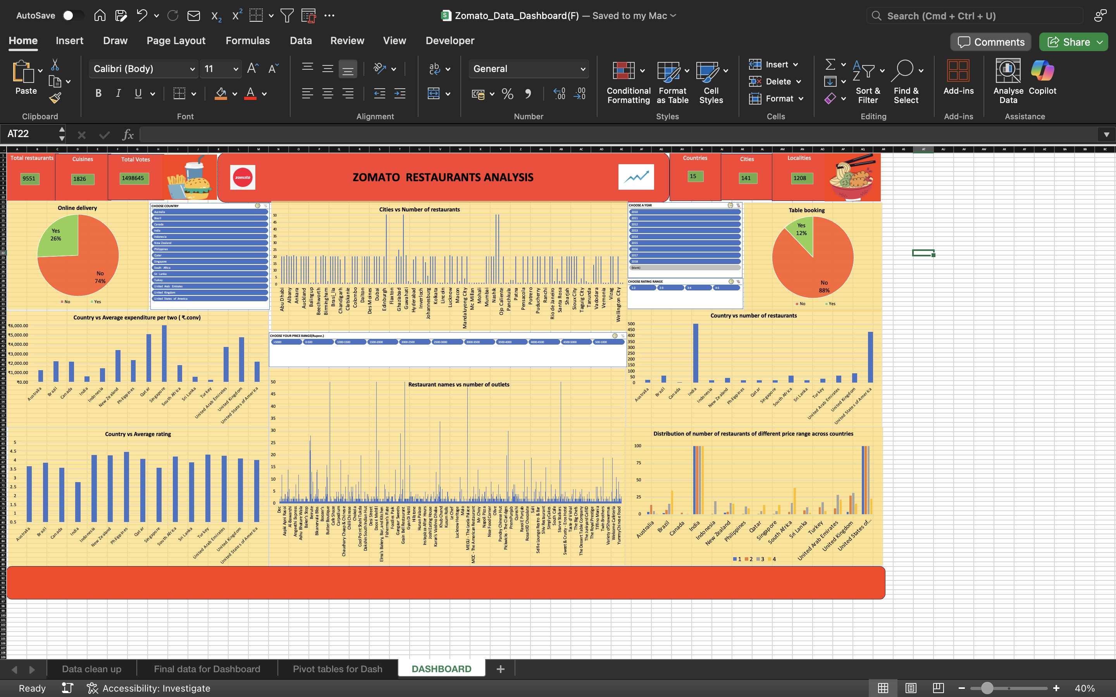
DASHBOARD

Slide 26
Features of DASHBOARD
It includes 4 slicers (year , country , rating range , expenditure per two range )
Also includes dynamic updating text boxes for counting selected number of countries , votes , cities , localities etc. .
It includes column , pie and line charts representing ,City vs number of restaurants , country vs number of restaurants , country vs average expenditure , table booking and online delivery pie charts , country vs average expenditure , month vs number of restaurants set up ,Restaurant names vs count of outlets, distribution of number of restaurants of various ratings across countries
We have the option to choose the country of our choice , year of our choice , rating range , expenditure per two range to Similarly, on our expansion of new restaurants.
Example : We can choose the rating range (4-5) , expenditure per two range (1000-2000 & 2000-3000) , select all years to analyze our competitors in terms of countries , cities , names of restaurants using the column charts in the dashboard .
Similarly, we can apply various conditions based on which we can arrive at a decision

Slide 27
CONCLUSION
The core objective of this analysis is to identify the most viable countries and cities for setting up new restaurants. To achieve this, the approach is structured around three key questions:
Why? To maximize profitability and enhance market reach by strategically expanding into high-potential locations.
Where? Selection is based on multiple critical factors, including customer ratings, expenditure patterns, price range distribution, and competition intensity at the city level.
How? By optimizing the business model through highly profitable cuisines, enabling online delivery and table booking, and maintaining an affordable yet sustainable pricing strategy (expenditure per two in Indian Rupees).
By integrating this framework, I successfully identified specific target cities and countries, optimal cuisine offerings, ideal pricing ranges, and the necessity of key service features like online delivery and table booking. With these data-backed insights mentioned in the strategic recommendations , we can confidently proceed with restaurant expansion, ensuring a competitive edge and market success.

