Slide 1
SOCIÉTÉ GÉNÉRALE HACKATHON · CLOUD SECURITY GOVERNANCE & RISK
Sentinel
Ephemeral Cloud & Kubernetes Resource Risk Detection — catching risk in resources that live for minutes and vanish before a scan sees them
Track:
Cloud Security Governance & Risk
Live demo:
sentinel-rho-sooty.vercel.app/app
Repo:
github.com/pavannaik2004/Sentinel
Notes:
Sentinel is a near-real-time detection pipeline for the blind spot traditional security has — CI pods, spot instances, assumed-role sessions, gone before the daily scan runs.

Slide 2
THE BLIND SPOT
Traditional security assumes stable assets. Ephemeral reality breaks every assumption.
Traditional assumption | Ephemeral reality
Inventory synced daily | Assets exist for minutes
Alert maps to a durable resource | Resource gone before triage
Identities are long-lived, baselineable | Sessions have 15-min TTLs
Alert volume is manageable | Autoscaling floods thousands of look-alikes
Sentinel · Société Générale Hackathon
2
Notes:
A daily scan literally cannot see a pod that lived 11 minutes at 3 AM.

Slide 3
FOUR REAL INCIDENTS, REAL MONEY
Four real incidents, real money
▸ Crypto-mining via a compromised CI account — 20 spot VMs at 3 AM → $14k in 90 min, zero alerts
▸ Debug pod with NodePort open to 0.0.0.0/0 — exploited in 11 minutes, then died
▸ Assumed-role session reads PII from S3 — expired in 15 min, never linked to its Lambda
▸ Autoscaler burst of 40 pods — 40 false alerts buried one real credential-abuse alert
Sentinel · Société Générale Hackathon
3
Notes:
These four canonical incidents drive every design decision and every metric.

Slide 4
WHY IT'S GENUINELY HARD
Every hard case is a pair of look-alikes:
▸ 40 pods in 2 minutes → autoscale or hijack?
▸ Untagged spot VM, public IP → misconfigured CI or attacker staging?
▸ Assumed-role hits S3 at 3 AM → scheduled Lambda or stolen credential?
▸ At the event level, the attack and its benign twin are identical.
Sentinel · Société Générale Hackathon
4
Notes:
If your simulated attacks are trivially separable, your metrics prove nothing. This is the discipline most submissions skip.

Slide 5
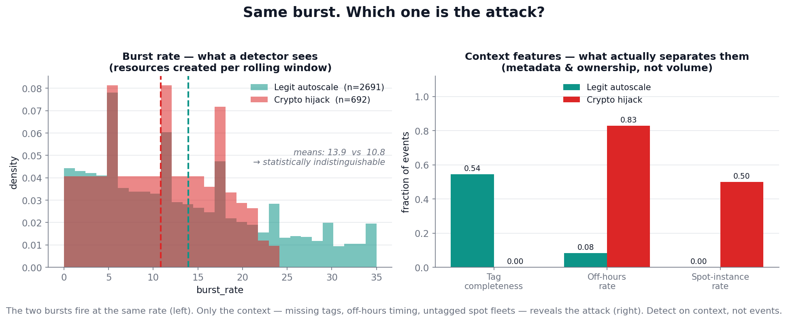
THE THESIS, IN ONE FIGURE
Same burst rate (left). Only context separates them (right). Detect on context, not events.
Sentinel · Société Générale Hackathon
5
Notes:
These are two real populations from our data. Most teams cheat by making attacks bigger or faster — we refuse that shortcut; confusability is enforced at generation time. PAUSE here.

Slide 6
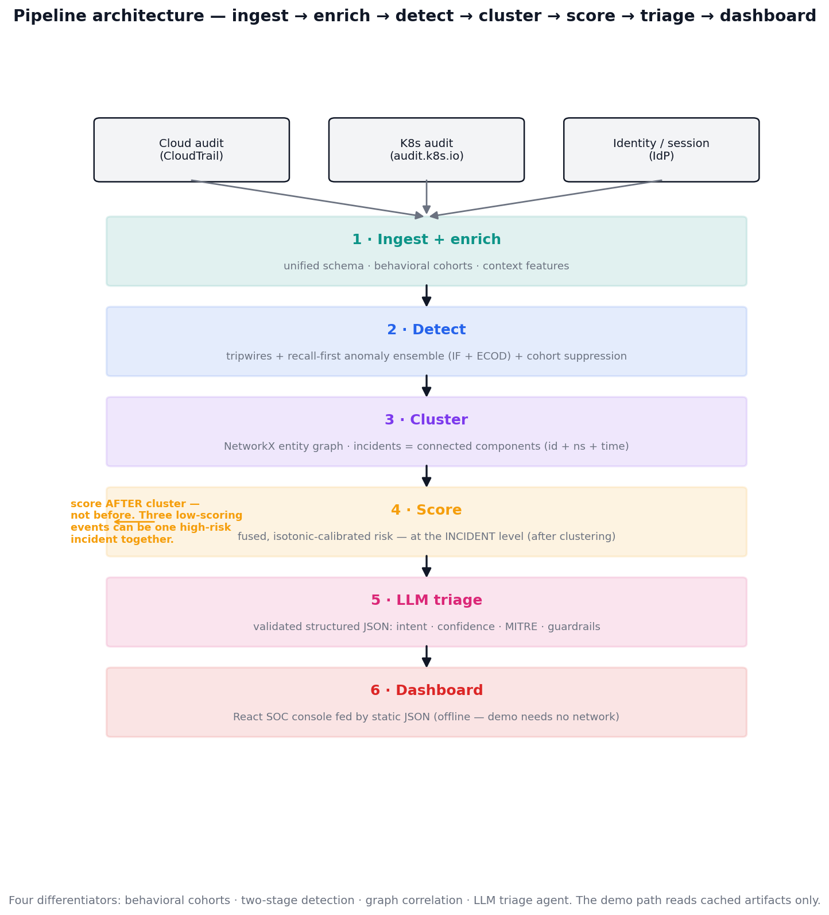
ARCHITECTURE
ingest → enrich → detect → cluster → score → triage → dashboard. We merge all three brief options into one pipeline.
Sentinel · Société Générale Hackathon
6
Notes:
Note the order — we score AFTER clustering, never before. Three low-scoring events can be one high-risk incident together. Option A (ML+LLM) is the spine, B (statistics) the pre-filter, C (rules) the always-on tripwires.

Slide 7
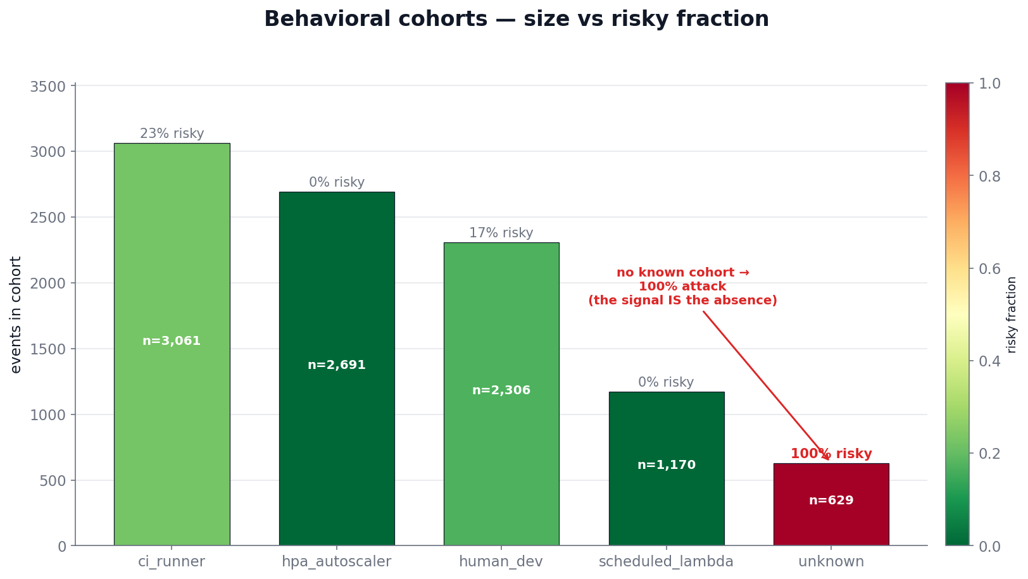
DIFFERENTIATORS 1 & 2: COHORTS + TWO-STAGE DETECTION
The unknown cohort is 100% attack — "fits no baseline" is the signal.
▸ Behavioral cohorts replace per-identity baselines — a new pod inherits its cohort baseline instantly
▸ Two-stage detection — recall-first ensemble (IsolationForest + ECOD), then cohort-aware suppression
▸ Recall climbs 72% → 84% without giving back precision
Sentinel · Société Générale Hackathon
7
Notes:
Ephemeral identities have no history, so we baseline the cohort, not the identity. An identity that fits no cohort is itself the alarm.

Slide 8
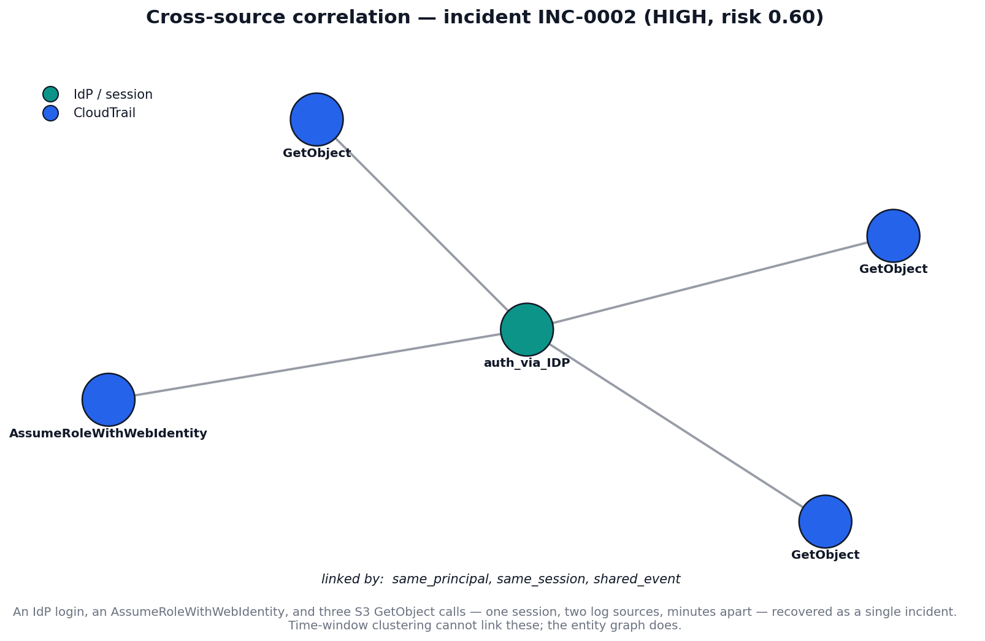
DIFFERENTIATOR 3: GRAPH CORRELATION
IdP login → AssumeRole → 3× S3 GetObject: one incident across two log sources. Time-windowing can't recover this.
Sentinel · Société Générale Hackathon
8
Notes:
This chain unfolds over minutes and across CloudTrail + IdP. The entity graph links it; a time-window cluster cannot. Recall 84% → 100%, alerts −89%.

Slide 9
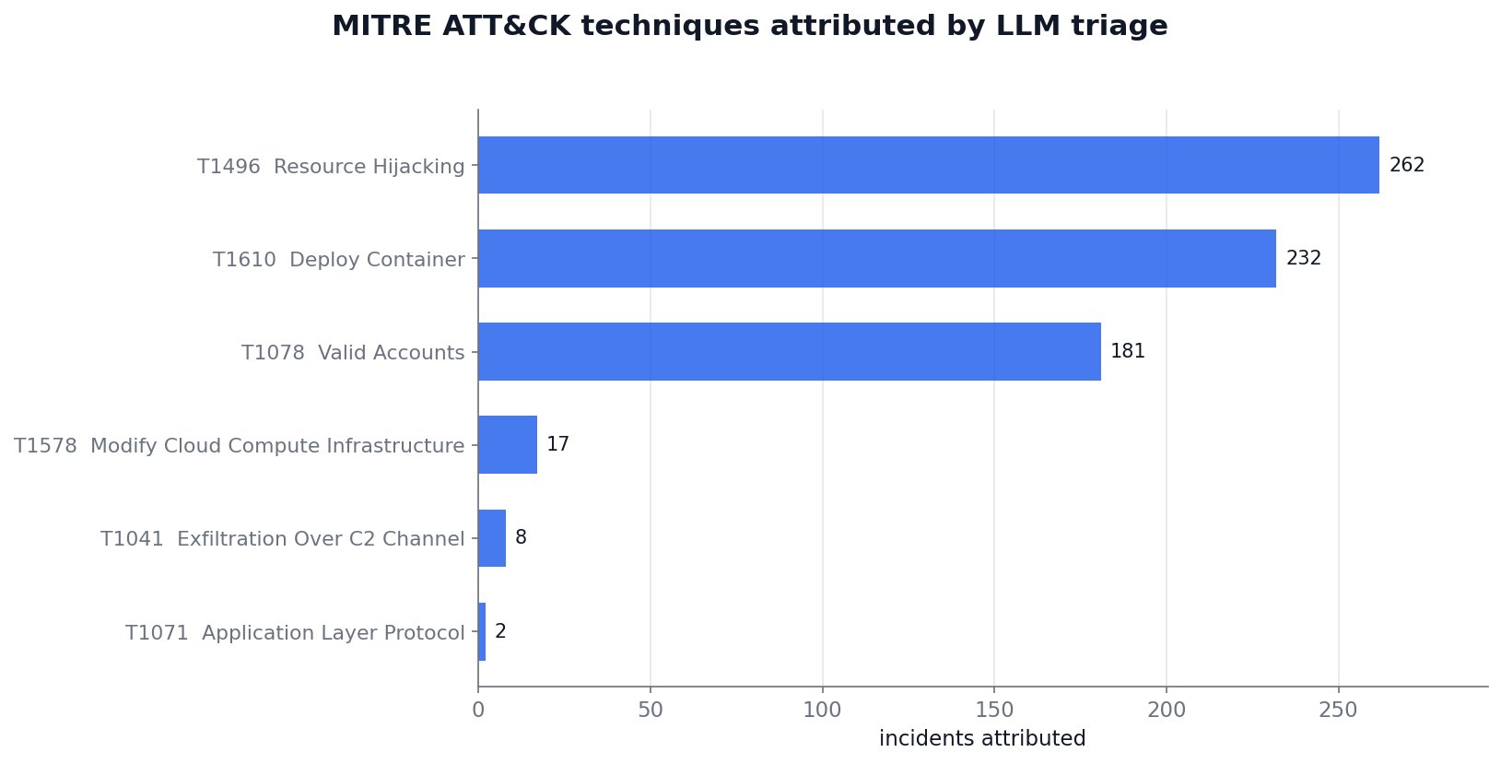
DIFFERENTIATOR 4: THE LLM TRIAGE AGENT
Analyst-ready narratives, not raw alerts.
▸ Returns validated structured JSON — intent, confidence, MITRE, disambiguation, guardrails
▸ Strict schema + retry + cached → the demo never needs a network call
▸ A triage agent that reasons over evidence, not a prose generator — 263 incidents, 100% MITRE coverage
Sentinel · Société Générale Hackathon
9
Notes:
The LLM is the last mile — it turns a scored incident into something an analyst can act on in seconds.

Slide 10
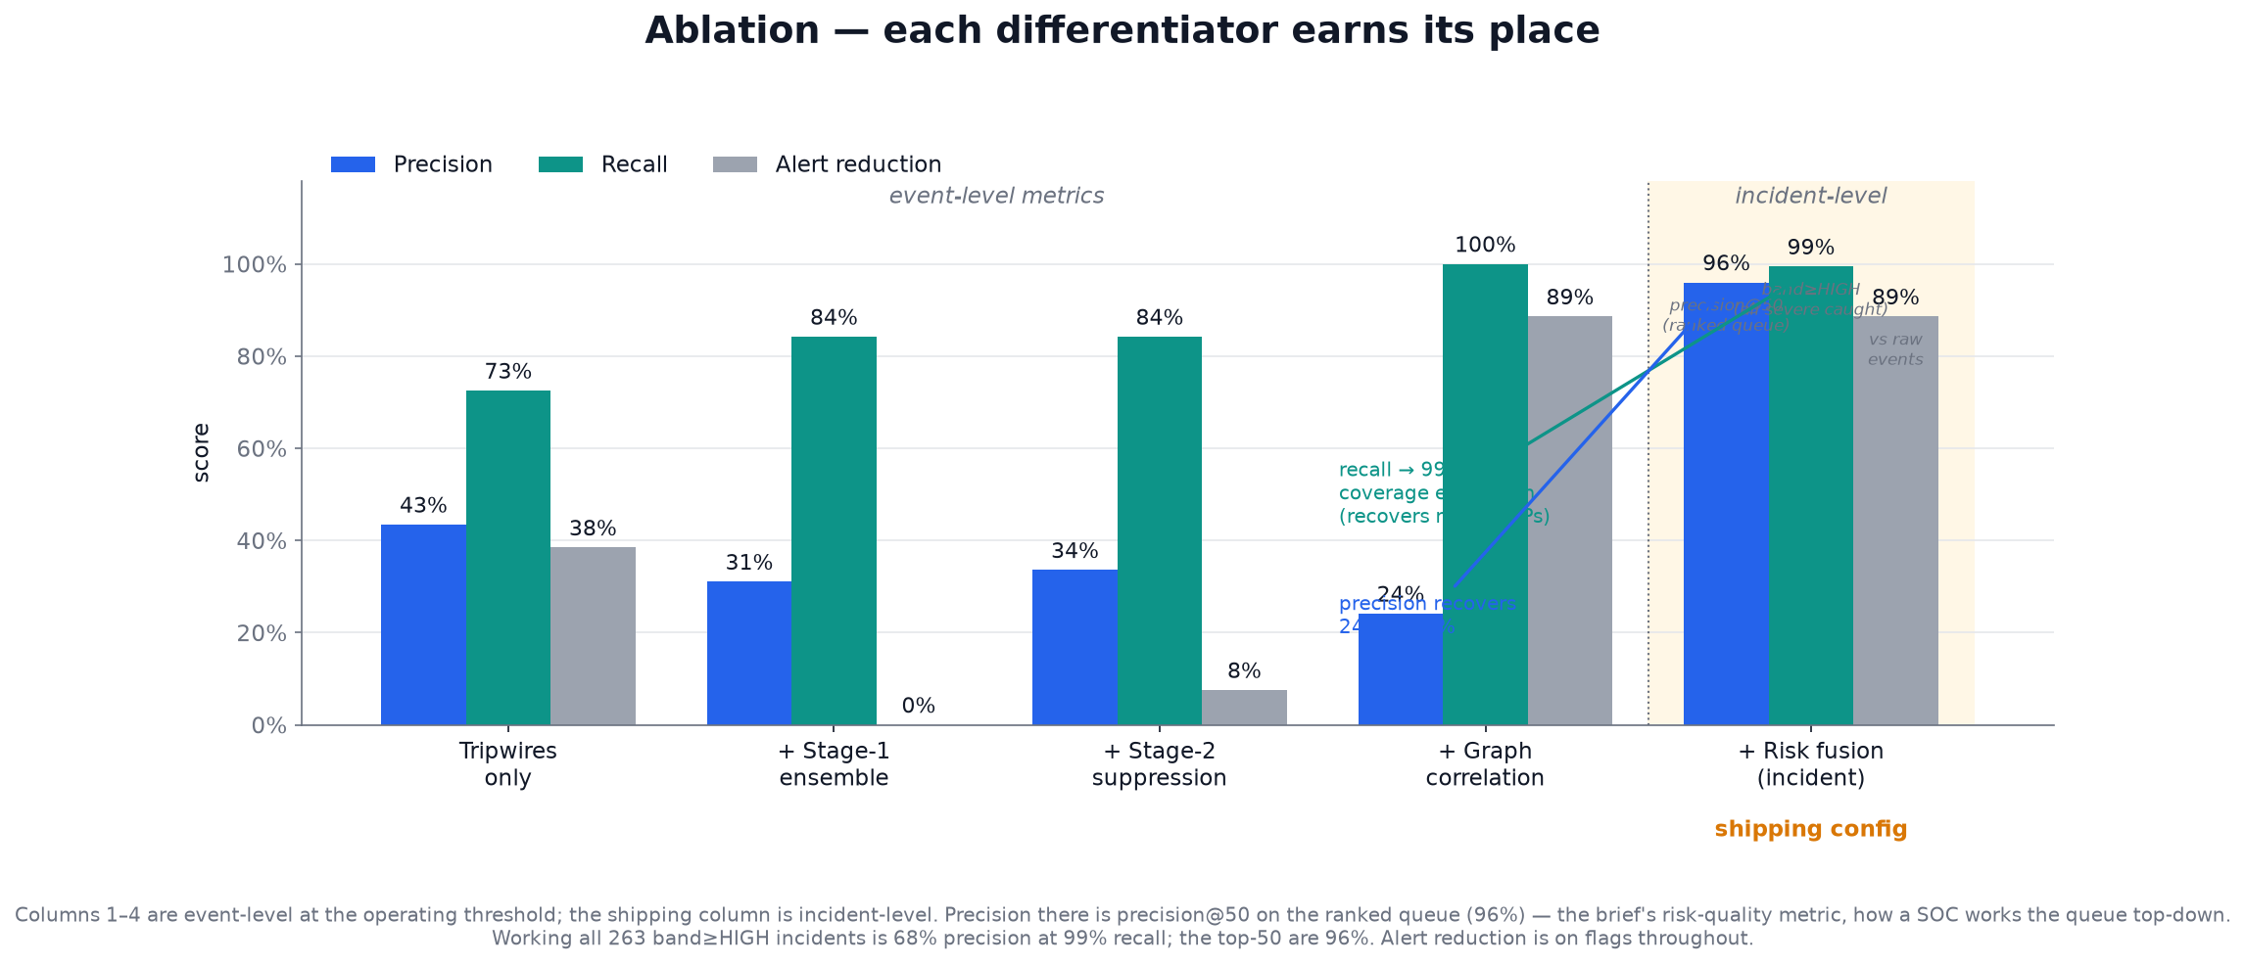
THE PROOF: ABLATION
Each differentiator earns its place. Recall → 100%, alerts → −89%.
Sentinel · Société Générale Hackathon
10
Notes:
This is the single most persuasive artifact — every row adds exactly one differentiator. Event-level precision dips at correlation by design; it is won back by ranking, next slide.

Slide 11
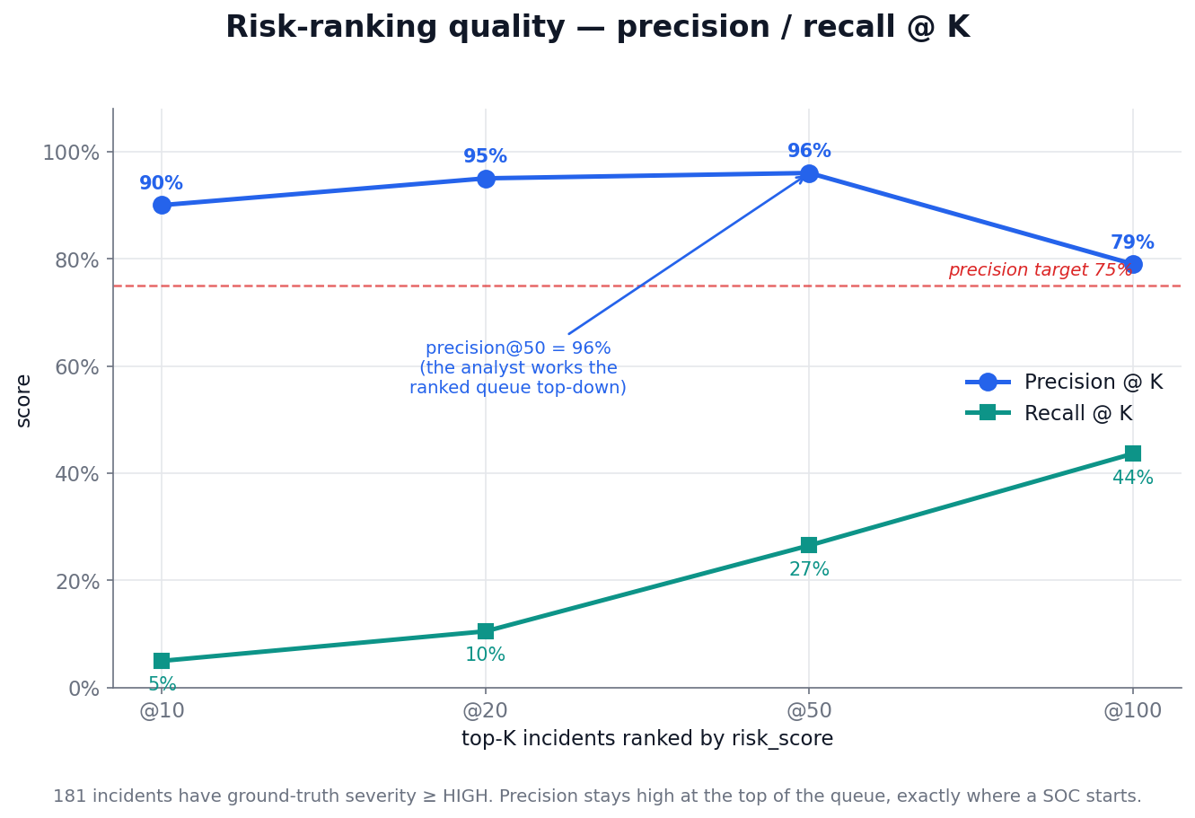
THE PROOF: WE BEAT EVERY TARGET
Precision is measured the way a SOC works the queue — top-down. precision@50 = 96%.
Success criterion | Target | Sentinel
Risk-scoring quality — precision@50 | > 75% | 96% ✓
Detection coverage — recall | > 70% | 100% ✓
Noise reduction — alert reduction | ≥ 40% | 89% ✓
Correlation accuracy — V-measure | high-confidence | 0.93 ✓
Risk calibration — predicted ≈ observed | well-calibrated | max err 0.016 ✓
Sentinel · Société Générale Hackathon
11
Notes:
We optimize the ranked queue an analyst works top-down, not a single global threshold. That is the brief's prescribed risk-quality metric.

Slide 12
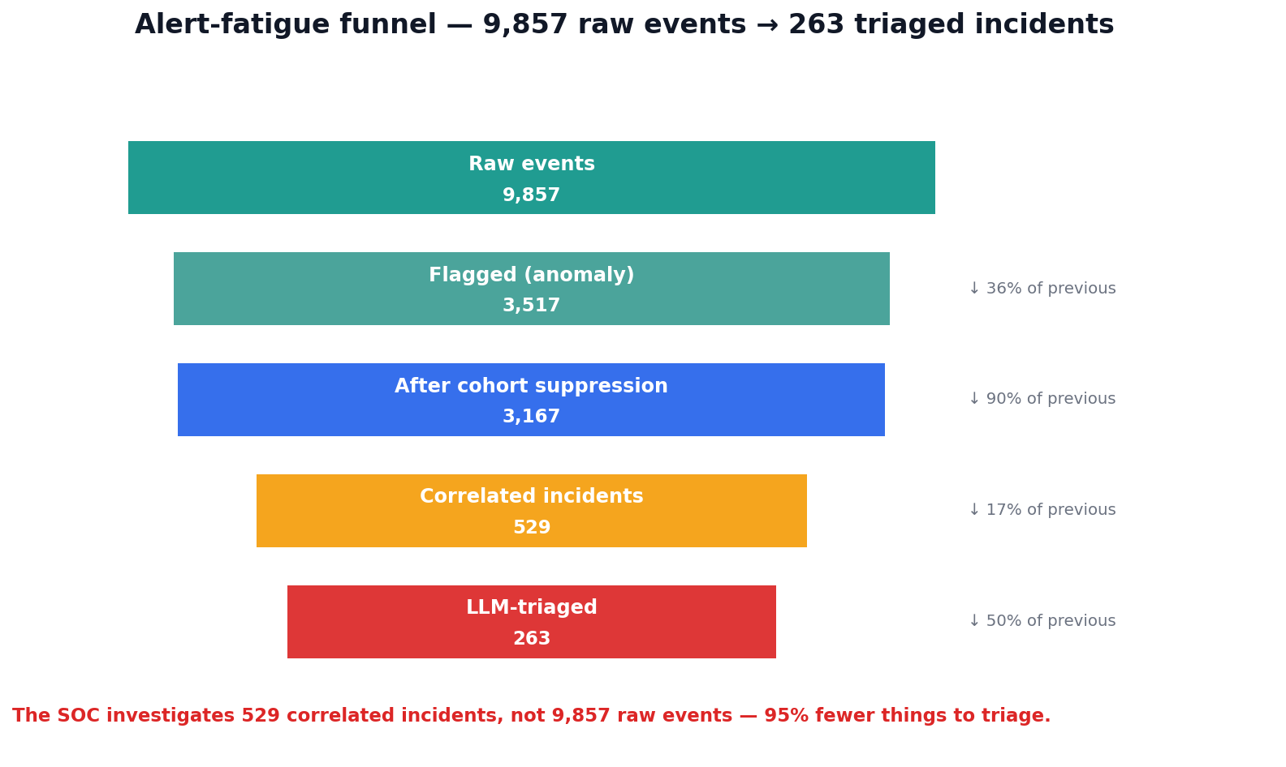
THE PROOF: NOISE REDUCTION
9,857 raw events → 529 incidents to investigate. The SOC's actual workload drops 95%.
Sentinel · Société Générale Hackathon
12
Notes:
4,638 raw flags collapse to 529 correlated incidents — an 89% alert reduction. This is the alert-fatigue problem solved.

Slide 13
HONEST EVALUATION
Honest evaluation
▸ "Isn't cohort=unknown just the label you injected?" — No. The score is label-free; confusability is enforced at generation; the only label touch is out-of-fold calibration.
▸ "Precision is 68%, target was 75%." — That's the conservative high-recall band cut. The brief's metric is precision@K — we hit 96% @50 on the ranked queue.
▸ "It's all synthetic." — Controlled, not faked. No public dataset has this ground truth; schemas are grounded field-by-field in real AWS / K8s / Okta. Reproducible at seed 1337, offline demo.
Sentinel · Société Générale Hackathon
13
Notes:
This slide wins trust. Volunteer the hard questions before the judges ask them.

Slide 14
CLOSE
Detect on context, not events.
Ephemeral resources exist for minutes. Attackers need less. Sentinel catches them in time.
▸ Live demo: sentinel-rho-sooty.vercel.app/app
▸ Repo: github.com/pavannaik2004/Sentinel · Video: add link
▸ Measured: recall 72% → 100%, alerts −89%, precision@50 96%, V-measure 0.93
Sentinel · Société Générale Hackathon
14
Notes:
Close on the demo — let the replay simulation show detection beating the next daily scan by 17.9 hours.

