Slide 1
Write Less, Do More
The power of modern Java

Slide 2
TOPICS
var – Local Variable Type Inference
New String Methods
Compact number formatting
Text blocks
Records
Pattern matching
Pattern matching with instanceof operator
Pattern matching with primitive data types
Pattern matching with records
Enhance switch expressions
Pattern matching for switch
Sealed types
Virtual thread
Class file API
Module import
Stream gatherers
Scoped values
Flexible constructor bodies
Sequenced collections
Unnamed classes
Multi-file source

Slide 3

github repo
https://github.com/SumanthJain144/modern-java-features

Slide 4
Significance of Modern Java Adoption
Improved Performance & Memory Efficiency
Modern Concurrency Simplified
Better Data Modelling & Immutability
Less Boilerplate, More Expressive Code
Long-Term Stability & Security

Slide 5
var – Local Variable Type Inference
Introduced in Java 10 (standard)
Allows using var to declare local variables with inferred types
Syntax: var name = "John"; → compiler infers String
Reduces boilerplate for obvious types

Slide 6
New String methods
Introduced in Java 11(standard)
Added methods: isBlank(), lines(), strip(), stripLeading(), stripTrailing(), repeat()
Simplifies common string operations without external libraries
Unicode-aware trimming (replaces trim())
Enables cleaner code with fewer helper methods

Slide 7
Compact Number Formatting
Introduced in Java 12 (standard)
getCompactNumberInstance()
Formats numbers in a shortened, human-readable form (e.g., 1K, 2M)
Eliminates the need for custom number shortening logic
Enhances readability in UI and reports

Slide 8
Text blocks
Introduced in Java 15 (standard)
Allows writing multi-line strings using the """ syntax
Improves readability of JSON, SQL, XML, and HTML

Slide 9
Records
Introduced in Java 16 (standard)
Compact syntax for declaring immutable data carriers
Auto-generates: Constructor, Getters, equals(), hashCode(), toString()
Eliminates boilerplate code in POJOs
Ideal for DTOs, event models, and value objects

Slide 10
Pattern matching
instanceOf pattern matching introduced in Java 16 (standard)
Simplify code that deals with type-checking and casting
instanceOf and switch statements/expressions

Slide 11
Pattern matching with instanceOf Operator
if (obj instanceof String) {
String s = (String) obj;
System.out.println("String value: " + s.toUpperCase());
} else {
System.out.println("Not a string");
}
if (obj instanceof String s) {
System.out.println("String value: " + s.toUpperCase());
}

Slide 12
Pattern matching with primitive data types
Introduced in Java 25 (standard)
if (obj instanceof int i) {
System.out.println("Primitive int: " + i);
} else if (obj instanceof double d) {
System.out.println("Primitive double: " + d);
}
When using primitive type patterns, the value must be exactly convertible to the target primitive type for the pattern to match
This feature enhances type safety by allowing the compiler to enforce type compatibility during pattern matching, reducing the need for explicit and potentially unsafe casts.

Slide 13
Pattern matching in records
Introduced in Java 21 (standard)
Record patterns in Java, introduced as a stable feature in Java 21, enhance pattern matching by allowing the deconstruction of record objects. This feature simplifies the extraction and use of data stored within records, making code more concise and readable.

Slide 14
Pattern matching in records
Complete deconstruction: The first condition extracts and names all components of a composite object, printing every available value.
Partial extraction with unnamed patterns: The second condition shows how the underscore _ lets you ignore components that are not relevant to the current logic while still accessing others.
Nested selective extraction: The final condition performs pattern matching within a nested structure, pulling out only one specific field while ignoring the rest. This shows how patterns can focus on just the data you need, even deep inside complex records.

Slide 15
Enhanced switch Expressions
Introduced as standard in Java 14
Allows a switch to be used as an expression that returns a value
Supports arrow syntax (->) and yield
Eliminates the need for break and fall-through cases
Great for returning values directly from switch, improving readability and maintainability

Slide 16
Pattern Matching for switch
Standardized in Java 21
Enhances the switch to support type patterns and guarded patterns
Works with objects, records(Stadardized in Java 22), and sealed types
Makes the switch more powerful and expressive
Eliminates the need for multiple if-else instanceof blocks

Slide 17
Sealed Types
Introduced in Java 17 (standard)
Allow a class or interface to restrict which other classes may extend or implement it
Provide explicit control over type hierarchies
Improve code safety and intent clarity

Slide 18
Virtual thread
Introduced in Java 21 (standard)
High-Level Overview of Thread vs. Virtual Thread. At a high level, a thread is managed and scheduled by the operating system, while a virtual thread is managed and scheduled by a virtual machine.
Lightweight: Virtual threads are lightweight in terms of memory and CPU overhead compared to native threads. They typically have lower context-switching costs and consume fewer system resources, making them suitable for highly concurrent applications

Slide 19
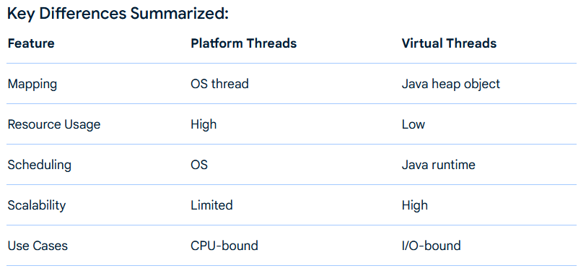
Quick Glance - Traditional vs Virtual Threads

Slide 20
Motivation for class file API
Need for a Standard Class-File API: Current reliance on third-party libraries like ASM, BCEL, and Javassist causes version skew, leading to errors and delays in supporting new class-file features.
Evolution of Class-File Format: Frequent JDK updates (every six months) introduce new features (e.g., sealed classes, value classes), making it challenging for frameworks to stay compatible with the latest class files.
Proposed Solution: A standardized class-file API within the Java Platform, evolving with the class-file format, would ensure seamless adoption of new features and eliminate the need for third-party libraries to update independently.

Slide 21
Example
Create a class file example
javac ClassFileApi.java
.java ClassFileApi
java HelloWorld
Parse a class file example
javac parse.java
java parse

Slide 22
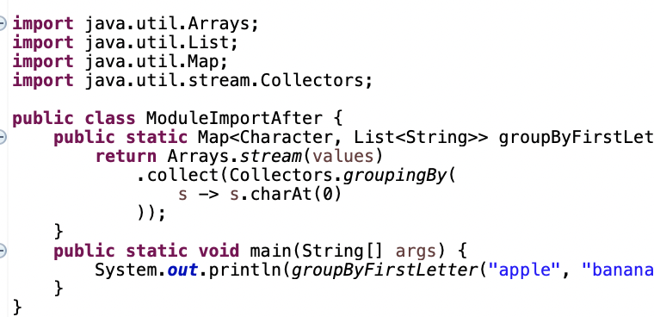
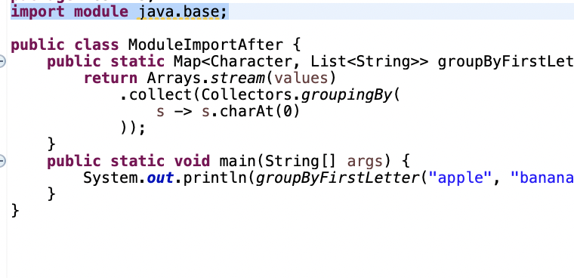
Module Import Declarations(J23-J25)
Earlier
Now
Beware of ambigious import for eg java.awt.List and java.util.List, can lead to compilation error

Slide 23
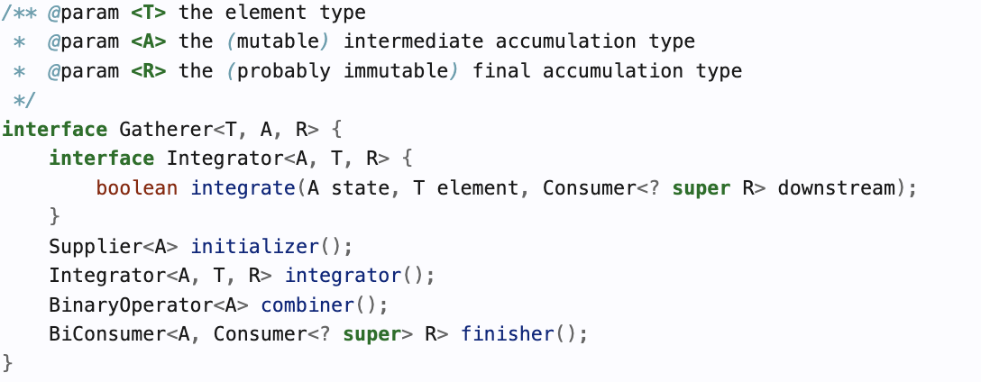
Stream Gatherers
Introduced in Java 24 (standard)
Allow custom stream collection logic beyond map, filter, collect.
m-to-n mapping of input elements grouped into a list of configured size.
Can be reused and composed like any other stream operation.

Slide 24
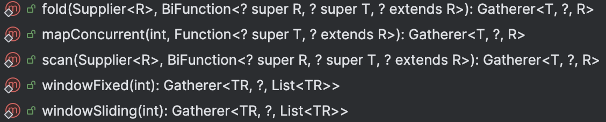
Stream Gatherers
Initializer | Creates internal state | () -> S
Integrator | Processes each input element | (S state, T input, Downstream<T> out) -> void
Finisher | Emits remaining output and completes | (S state, Downstream<T> out) -> void
Combiner | Merges state when parallelized | (S left, S right) -> S
Built-in Gatherers

Slide 25
Scoped values
Introduced in Java 25 (standard)
A cleaner and safer alternative to ThreadLocal
Works well with concurrent code and structured concurrency
Immutable by design → avoids cross-thread data leaks
Share context data safely without passing it through method parameters
Useful for request-scoped values (e.g., Request ID, User ID, Logging context)

Slide 26
Flexible constructor bodies
Introduced in Java 25
Allows more flexible initialization in constructors — statements can now appear before delegating to another constructor (this(...)) or superclass constructor (super(...)).
Removes long-standing restrictions on constructor structure
Enables validation or setup before calling another constructor
Makes constructor overloading more natural and expressive

Slide 27
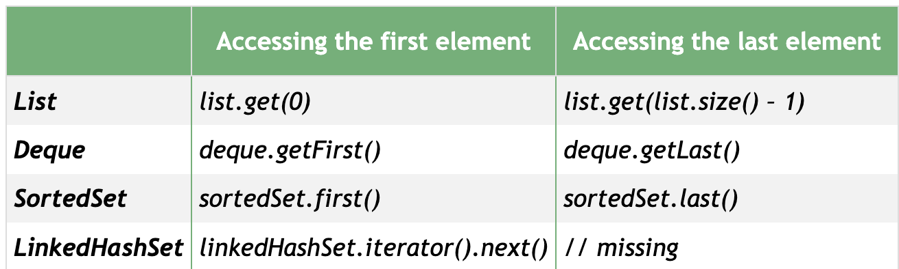
Motivation for Sequenced collection(J21)– lack of consistent way

Slide 28
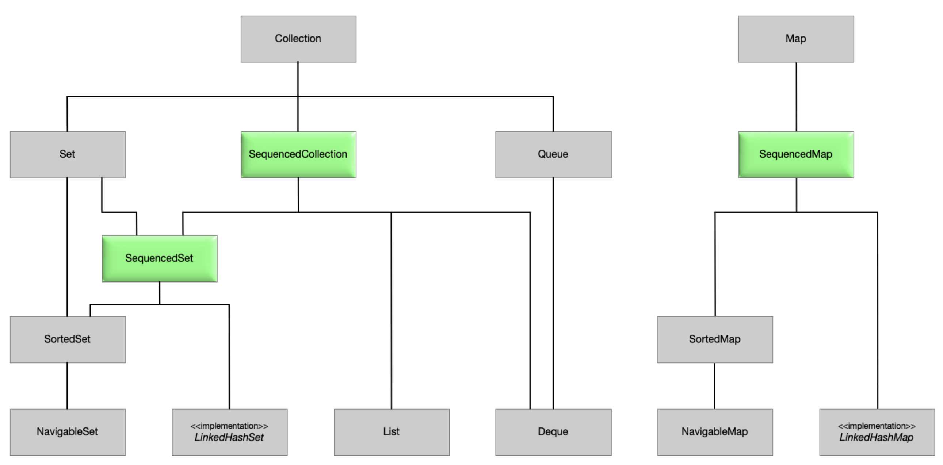
Sequenced Collections

Slide 29
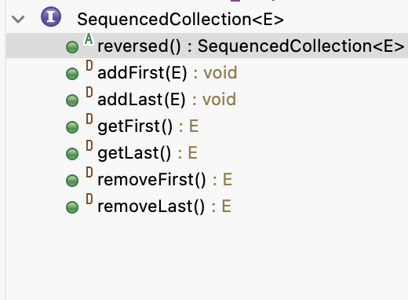
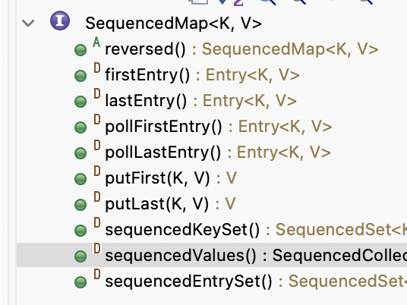
Methods in the new interface
Compatibility:
If your class already has a getFirst() method with the same signature, your method will override the default method from the interface.
If the method signature is different (for example, different return), you will get a compile-time error due to method signature conflict or ambiguity

Slide 30
Motivation for unnamed classes(J21)
Reducing initial barriers for learners: Students can write simple programs without needing to declare a class explicitly or deal with static context and access modifiers
More concise and intuitive syntax: Instance main methods allow the main method to be non-static and without the traditional String[] argument.
Multiple unnamed classes and programs: Multiple unnamed classes can exist in the unnamed package/module, each representing a standalone program, which is useful for quick tests

Slide 31
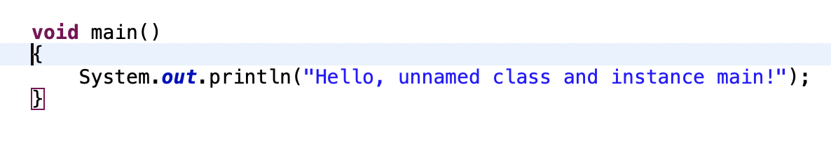
Unnamed Classes and Instance Main Methods
Enhancing user experience for beginners
javac Hi.java
Hi

Slide 32
Motivation for multifile Motivation for source
Support gradual transition from small to larger projects: Previously, only single-file source programs could be run directly. Extending this to multiple files allows developers to start small and scale up without the immediate need for configuring build tools or complex project structures.
Facilitate fast iteration and exploration: Early development is often experimental and fluid, with frequent changes. By enabling in-memory compilation of all referenced source files on the fly, developers can quickly test and modify code without manual compilation steps.

Slide 33
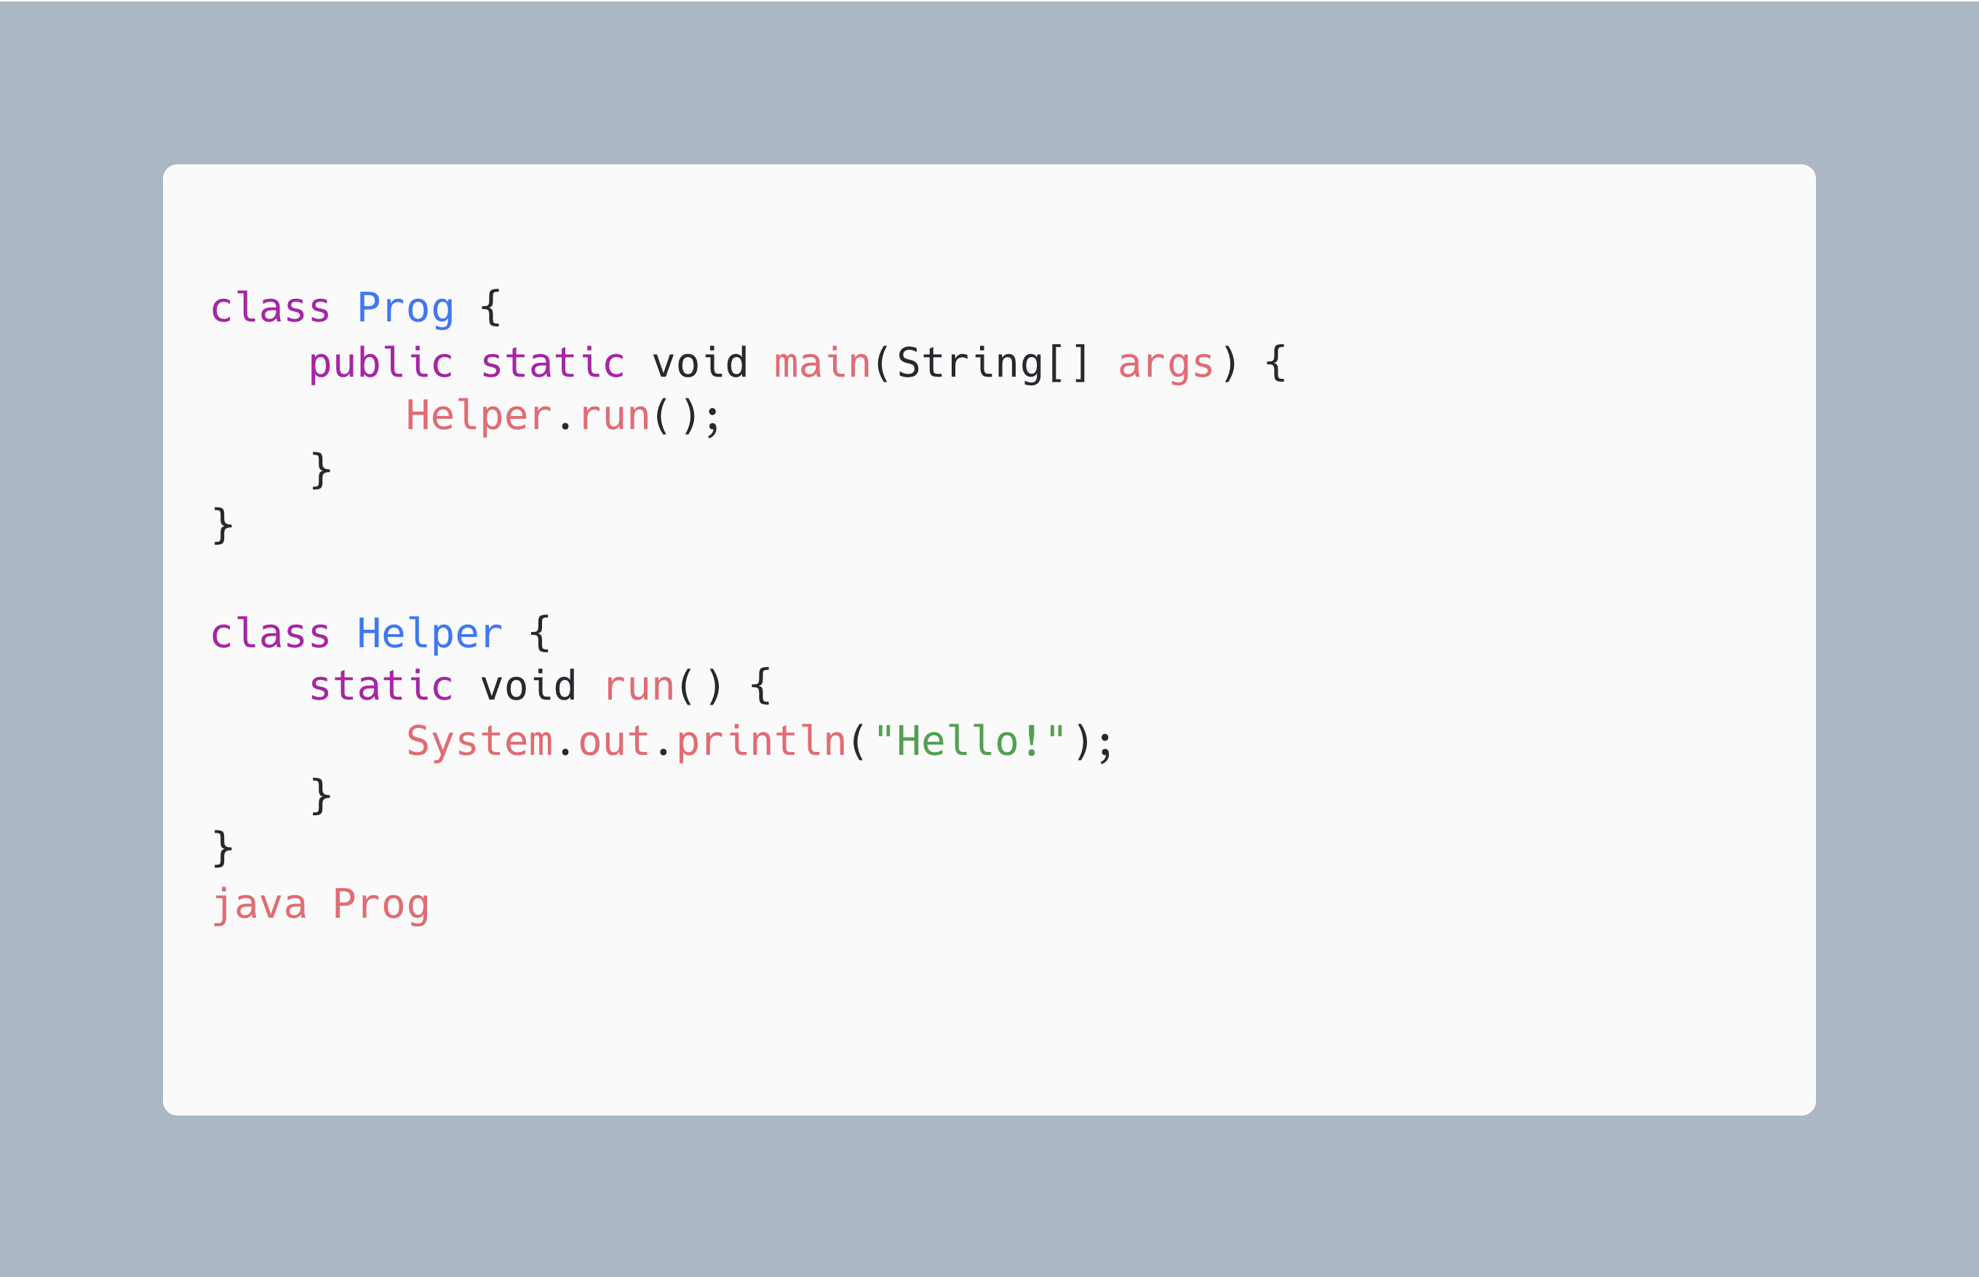
Launch Multi-File Source-Code(J22) Program

Slide 34
What is coming Java 26 and beyond
JEP 504: Remove the Applet API
The Applet API is being removed because it is obsolete; modern web browsers no longer support Java applets, and the Java Development Kit itself no longer includes the tools or runtime support to run applets.
JEP 517: HTTP/3 for the HTTP Client API
This feature updates the HTTP Client API to support the newer HTTP/3 protocol.
JEP 522: G1 GC: Improve Throughput by Reducing Synchronization
This enhancement optimizes the G1 Garbage Collector by reducing synchronization overhead between application threads and GC threads.
AND MANY MORE ( not announced yet)

Slide 35
Road Ahead
Preview features introduced in recent Java releases are set to become permanent, solidifying the innovations in syntax and performance.
Focus on improving the developer experience with simpler, more concise syntax

Slide 36
Thank you

