Slide 1
Angry Birds
Using NLP to extract customer sentiments
By Sumanth Lazarus

Slide 2
Nature of Text Data?
Customer Reviews or Verbatims. Automotive Clientele.
Unstructured Text data in the English Language
Possibly extracted from an online Auto forum, car dealership

Slide 3
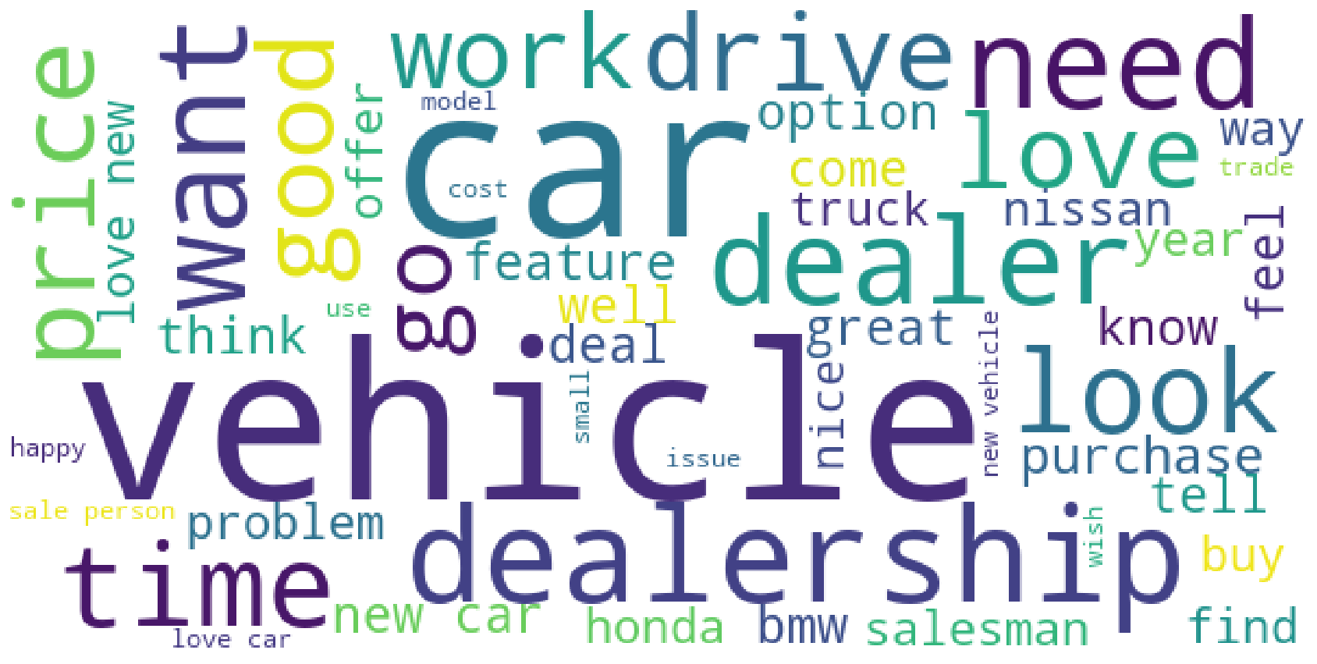
Prominence and Variety of Words in Verbatims

Slide 4
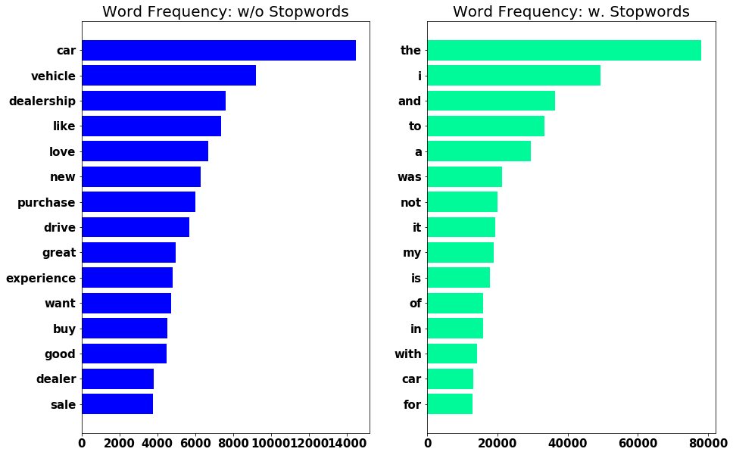
Pre-Processing

Slide 5
Pre-Processing
Bucketing of Verbatims based on Word Count of Unique Words
Bucket | Word Count
S | <= 5
A | 5 < A <=10
B | 10 < B <=25
C | 25 < C <=50
D | 50 < D <=100
E | 100 < E

Slide 6
Word Variety per Bucket

Slide 7
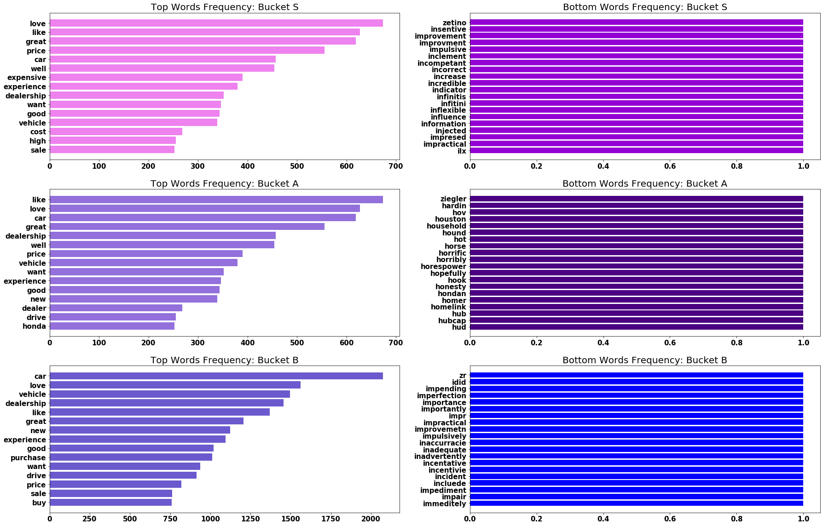

Slide 8
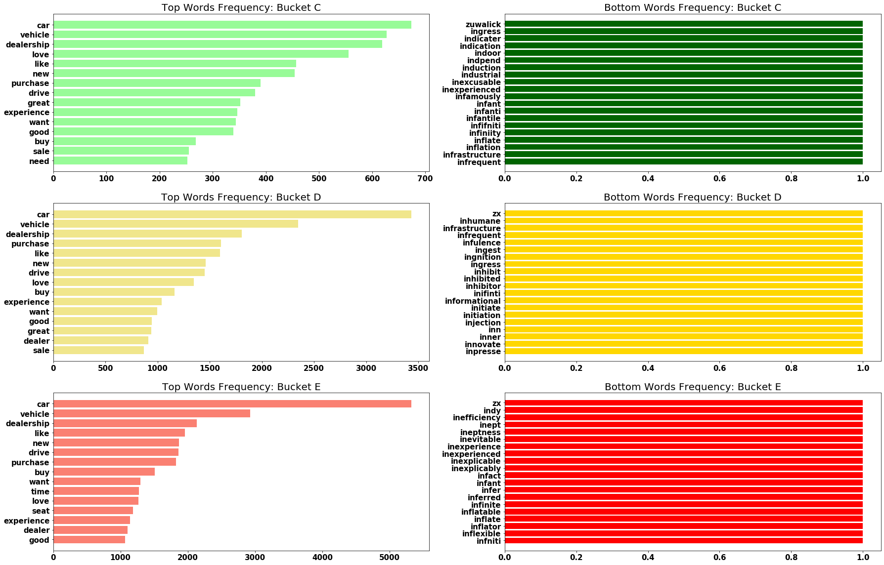

Slide 9
Strategy
Verbatims (pre-processed)
Vader Sentiment Analyser
Positives
Custom Lexicon-based Filter
Negatives
Or Filter
-ve
+ve

Slide 10
Tagging & Findings
Negative Tagging by Filter 1 & Filter 2
Value Counts in Filter 1
----------------------------------------
Value Counts in Filter 2
----------------------------------------
Total Sentiments
----------------------------------------
Negative | 3029 | 7.6%
Positive | 36781 | 92.4%
Negative | 13,535 | 33.9%
Positive | 26,275 | 66.1%
Negative | 13,990 | 35%
Positive | 25,820 | 65%

