Slide 1
Machine Learning Approaches in Systems Biology Modeling
Learning approaches in data processing – Data Mining
Decision Making systems for Pathways modeling
- or How ML synergies with deterministic modeling
Simplified Classification Systems
Limitations of pattern-based decision making
- Genomic data-loss in pattern-building, loss of uniqueness and personalization
New possibilities of Stochastic-Deterministic synergism (SDS) – cancer susceptibility prediction systems

Slide 2
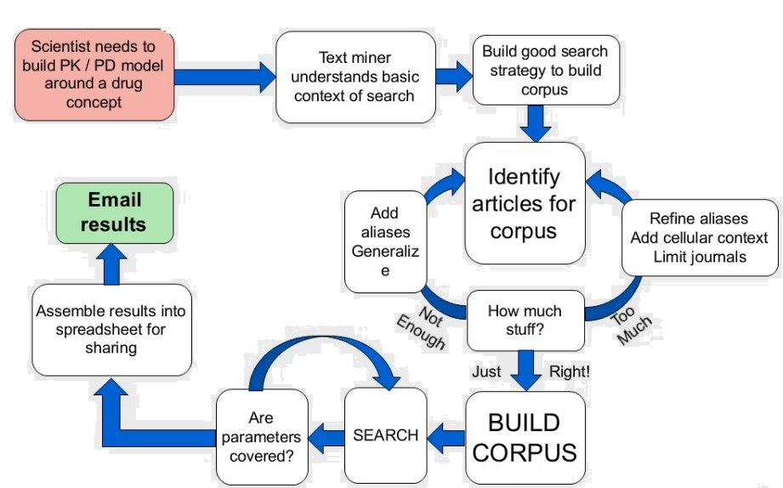
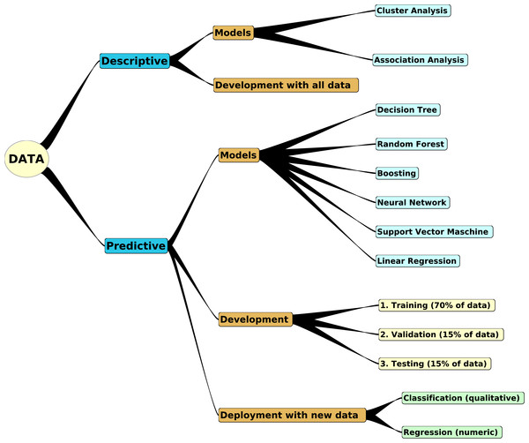
Learning approaches in data processing – Data Mining
Source : peerj.com

Slide 3
Decision Making systems for Pathways modeling
- or How ML synergies with deterministic modeling

Slide 4
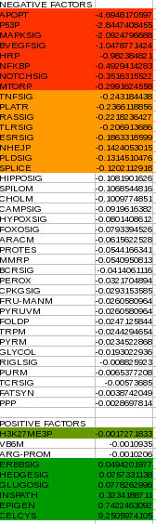
Case 1 : JQ-1 Drug Modeling

Slide 5
Simplified Classification Systems

Slide 6
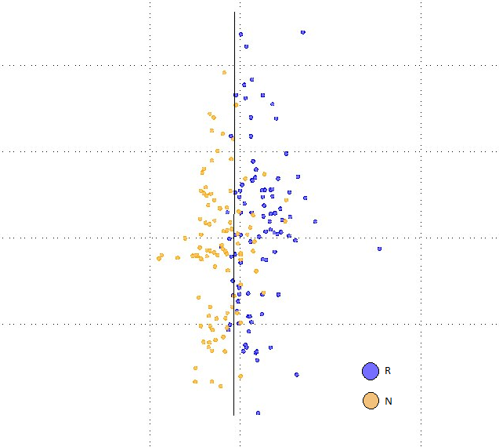
Case 2 : Methotrexate Response Classification

Slide 7
Limitations of pattern-based decision making
- Genomic data-loss in pattern-building, loss of uniqueness and personalization
Genomic Data-Loss
Current pattern-recognition approach relies on converting the n dimensional genomic mutations data, where n is the number of mutations, into a 1 X f matrix, where f is a fixed number, and represents the pathways descriptors. Hence, this is a generalization of the actual mutation, which represents more the general class of patient population rather than the individual patient
Loss of personalization
This results in a lack of uniqueness in the data and hence a loss of personalization . This can also lead to loss of unique mutation factors that are not accounted for in known literature or in pathway descriptors. This can be achieved only through recurrent occurrence and/or scientific literature.
However, with deterministic modeling, this can be easily established and proven via simulations. In other words, data-mining / pattern recognition approaches can identify patterns and establish hypotheses, but cannot create new data. A combination of deterministic and stochastic approaches can accomplish this at a faster rate and higher frequency.

Slide 8
Limitations of pattern-based decision making
- Genomic data-loss in pattern-building, loss of uniqueness and personalization
Reduced Focus
Based on genomic descriptors of a patient, we can construct a generalized pathway description of the patient cancer-biome. Since all the drug inclusion and exclusion are defined based on the same set of descriptors, individual drugs cannot be identified as best-fit for the patient, rather a normal curve for the general class of drugs that can be the probable best fit can be generated.
This leads to reduced focus of drugs which can be identified and proved by deterministic simulations
Hence pattern-recognition here can serve as a filter for selecting best class of drugs based on genomic generalizations but the best drug/combination of drugs can be selected based on simulation data

Slide 9
New possibilities of Stochastic-Deterministic Synergism (SDS)
– cancer susceptibility prediction systems

Slide 10
New possibilities of Stochastic-Deterministic Synergism (SDS)
Virtual clinical trials

