Slide 1


•
•
•
•
of the world monitor Application
•
•
Team Name (Registered on portal)- Impactverse
Team ID- 165122
PS Category- Software
Theme- Smart Automation
Problem Statement Title-Security Assessment
Sentinel-X
Problem Statement ID – 26163
SMART INDIA HACKATHON 2026
Please look into the video
Video

Slide 2





















































DETECT | ASSESS | PRIORITIZE
| SECURE
Website
S E N T I N E L - X
Video
Impactverse
OUR SOLUTION
Sentinel-X continuously scans, tests,
validates, and uses AI to prioritize security risks.
WHY IT MATTERS
Traditional security checks are periodic
and fragmented, leaving evolving risks undetected.
THE SECURITY GAP
Real-time platforms face multiple attack
surfaces, increasing security risks
1
IDENTIFY
Broken Access
Control
→
app/controllers/api.php
Vulnerable Co
2
END-TO-END VULNERABILITY WALKTHROUGH
From discovery to remediation — a real example
LOCATE
BUILD SECURITY FROM THE GROUND UP
de
∞
Sentinel-X
SENTINEL-X SECURITY WORKFLOW
@SIH Idea
Continuous monitoring → actionable insights
→
Discover assets
& model threats
Scan code,
libraries & secrets
submission- Template
REPRODUCE
Role A → Role B
Data
3
Test web,
API & mobile
Validate
safely
Prioritize
with AI
Minimal risk.
Smarter decisions.
→
Find
weaknesses.
Know your attack surface.
Across all
platforms.
4
VALIDATE
Safe PoC
→
Data exposure
Missing security headers
SSRF
Token theft
Injection / XSS
API abuse
Unauthorized access
RISK
Weak authentication
8.1
5
C
VSS Severity
SCORE
SECURITY ASSESSMENT PLATFORM
DETECT | ASSESS | PRIORITIZE | SECURE
HIGH
VS
→
Encrypt & minimize data
Harden security headers
URL allowlisting
Secure sessions
Input validation
API protection
Role-based access
SOLUTION
Adaptive authentication
REMEDIATE
Authorization Check
FIX VERIFIED
6
2

Slide 3























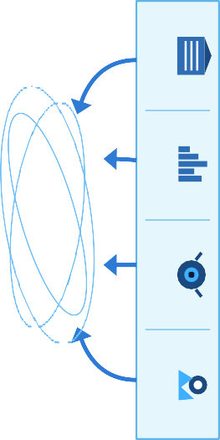
































Assess severity and impact
Recommend fixes and retest
Repo
SECURITY ASSESSMENT METHODOLOGY
Understand system & assets
RISK & IMPACT ASSESSMENT
REMEDIATION & RETESTING
Impactverse
Github Repo
5
6
Verify findings in a controlled environment
VALIDATION & SAFE PoC
WORLD MONITOR
SECURE · RESILIENT · TRUSTED
4
SYSTEM DISCOVERY
1
SECURITY TESTING
ATTACK SURFACE MAPPING
3
2
TECHNICAL APPROACH
Find and exploit vulnerabilities
Identify entry points
Web
(Vite + TypeScript)
News Feeds
@SIH Idea submission- Template
SYSTEM ARCHITECTURE
(SECURITY VIEW)
WORLD MONITOR
DATA FUSION & INTELLIGENCE
Market Data
Desktop
(Tauri + Rust)
DATA & CACHE
SECURE API LAYER
AI / ML ANALYSIS
Webcams
PWA
(Installable)
SECURITY
ASSESSMENT ACROSS ALL LAYERS
Geospatial Data
</>
TECHNOLOGIES USED
FRONTEND (Web)
CACHING & DATA
DEPLOYMENT
API & COMMUNICATION
Ollama
AI / ML
DESKTOP (Cross-platform)
TS
TypeScript
Redis
Vercel
Protocol Buffers
Tauri
Groq
groq
R
Vite
upstash
Railway
Rust
Three.js
PWA
sebuf
Transformers.js
Node.js
globe.gl
3

Slide 4



























Uses established security standards
Follows OWASP, CVSS and industry
best practices.
Modular scanners
Easy to extend for new checks and technologies.
01
Uses existing web/API infrastructure
Works with the current World Monitor
application architecture.
Docker-based isolated testing Safe and repeatable security testing environment.
Impactverse
No special hardware required Runs on standard servers/cloud infrastructure.
Can operate against cloned/staging environments
No impact on production users or data.
Practical and Easy to Implement
FEASIBILITY
FEASIBILITY AND VIABILITY
BUSINESS POTENTIAL
SECURITY GATE
Flag serious findings before moving to next stage.
SAFE VALIDATION
Validate findings in authorized staging or sandbox environments.
02
@SIH Idea submission- Template
Security becomes part of the development lifecycle — not a final checkpoint.
SECURITY VERIFIED
Validated fixes become part of a continuous security process.
RETEST
Verify whether the issue is resolved.
DEVELOPER FIX
Developers address the identified vulnerabilities.
Document severity, affected component and potential impact.
RISK SCORE
AUTOMATED SECURITY SCAN
Identify potential vulnerabilities across key areas.
VIABILITY
Security in the Development Lifecycle
CODE PUSH
New application code or API changes trigger security assessment.
L+
Deveopment
Back to
Citizen-service applications
Improves trust and protects citizen data.
APIs
Secures internal and external API communication.
Mobile applications
Helps secure mobile access and data exchange.
Enterprise dashboards
Protects organizational data
and insights.
Critical information systems
Enhances security for sensitive and mission-critical systems.
03
Monitoring platforms
Ensures secure and reliable monitoring services.
Government portals
Applicable for national and state monitoring platforms.
Safer Applications, Greater Impact
4

Slide 5


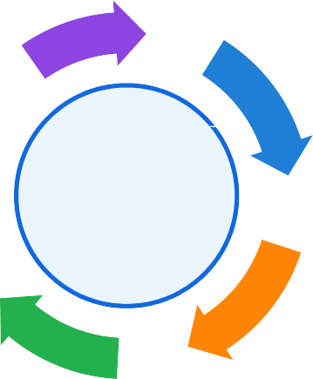






























TRUST
Compliance Certified
Evidence mapped to secure-coding and audit requirements, report-ready.
INTELLIGENCE
AI-Enhanced
LLM-assisted triage ranks every finding by CVSS, exploitability and impact.
Impactverse
FASTER DEVSECOPS
Security baked into every build – scan, fix and ship in one loop.
COMPLIANCE COVERAGE
99.8%
SENTINEL-X
CONTINUOUS SECURITY
ASSURANCE
IMPACT AND BENEFITS
@SIH Idea submission-
SPEED
Faster DevSecOps
Security baked into every build – scan, fix and ship in one loop.
Findings stream to the
dashboard the moment a scan completes..
VISIBILITY
Real-Time Alerts
Auth, API and access-
control flaws closed before attackers reach them
.
RISK
Lower risk
Template
Authorization & Access Control
nput Validation & Data Handling
Authentication & Session…
SECURITY VULNERABILIT ANALYSIS
24 Unresolved
Vulnerabilities
GENERAL SYSTEM REQUIREMENT
Data Storage & Privacy
BEFORE
From Vulnerable to Verified Secure
API Security
-5
5
10%
1%
5%
4%
10%
8%
0 Open
Vulnerabilities
Client-Side Controls
15
23%
20%
20%
AFTER
25
5
35
40%
45

Slide 6


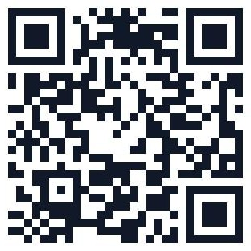



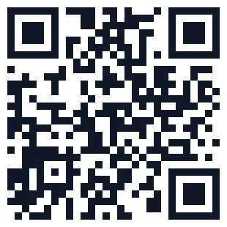


VALIDATED / REPORTED FINDINGS
Insecure token storage
IDOR / broken object-level access
XSS
SQL/NoSQL injection
SSRF
API resource-abuse / rate-limit concern
team assessment / report
•
•
•
PRIMARY
World Monitor Security Assessment —
World Monitor Open Source Repository
World Monitor Application
Impactverse
RESEARCH
•
•
•
•
•
•
SECURITY STANDARDS
SECURITY GAPS / HARDENING
MFA
CSP
HSTS
Cookie hardening
TLS configuration
Encryption at rest
Logging / privacy controls
OWASP Cryptographic Storage Cheat Sheet
OWASP User Privacy Protection Cheat Sheet
OWASP HTTP Security Headers Cheat Sheet
OWASP Session Management Cheat Sheet
OWASP API Security Top 10
OWASP Top 10
@SIH Idea submission-
AND REFERENCES
Template
Security
Demo flow:
PROTOTYPE / DEMO
Server-side role checking was
reported as present.
CORS was reported as locked
down during the test.
No live privilege-escalation
exploit was performed.
CONTROL VERIFIED / NOT A CONFIRMED VULNERABILITY
Scan
→
LIVE DEMO
→
!
Finding
Safe PoC
→
✓
CVSS
→
GITHUB / PROJECT REPO
★
Remediation Retest
→
⚙
6
→
↻

