Slide 1
Presentation on Decision Tree Algorithm With CHAID K . Sumanth

Slide 2
Outline
Introduction of Decision Tree Classification
Why Use Decision Tree
Definition of CHAID
Formula of CHAID
How CHAID Works
Steps involved in CHAID Algorithm
Example of Decision Tree Classification using CHAID
Mathematical steps involved in Decision Tree Classification(CHAID)
Advantages and limitations of CHAID

Slide 3
Introduction
Decision Tree Classification:
Decision tree classification is a machine learning algorithm used for both classification and regression tasks. It builds a tree-like model where each internal node represents a feature or attribute, each branch represents a decision rule or condition based on that feature, and each leaf node represents a class label or a predicted target value. The tree is built by recursively splitting the data based on the most informative features until a stopping criterion is met.
Let’s look at the basic terminology used with Decision trees:
Root Node: It represents entire population or sample and this further gets divided into two or more homogeneous sets.
Splitting: It is a process of dividing a node into two or more sub-nodes.
Decision Node: When a sub-node splits into further sub-nodes, then it is called decision node.
Leaf/ Terminal Node: Nodes do not split is called Leaf or Terminal node.

Slide 4
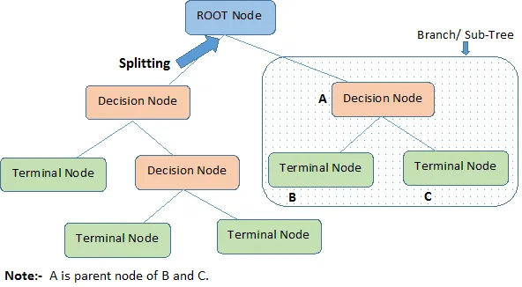
5. Pruning: When we remove sub-nodes of a decision node, this process is called pruning. You can say opposite process of splitting.
6. Branch / Sub-Tree: A sub section of entire tree is called branch or sub-tree.
7. Parent and Child Node: A node, which is divided into sub-nodes is called parent node of sub-nodes where as sub-nodes are the child of parent node.

Slide 5
Why use Decision Tree :
Easy to understand: Decision trees are easy to understand and interpret, even for non-technical users. The tree structure allows you to see how each feature contributes to the classification decision, and the decision rules are easy to follow.
Handles both categorical and continuous data: Decision tree classification can handle both categorical and continuous data, which is useful when working with diverse datasets.
Non-linear relationships: Decision trees can capture non-linear relationships between features and the target variable, which can be difficult for linear models to capture.
Handles missing data: Decision trees can handle missing data, either by imputing missing values or by excluding missing values from the analysis.
There are different algorithm written to assemble a decision tree, which can be utilized by the problem
A few of the commonly used algorithms are listed below:
• CART
• ID3
• C4.5
• CHAID

Slide 6
CHAID
CHAID (Chi-Square Automatic Interaction Detection):
CHAID (Chi-squared Automatic Interaction Detector) is a decision tree algorithm that is commonly used for classification tasks. It was developed by Kass in 1980 and is based on the principle of chi-squared tests.
Chi-Square is a statistical measure to find the difference between child and parent nodes. To calculate this we find the difference between observed and expected counts of target variable for each node and the squared sum of these standardized differences will give us the Chi-square value.
The higher Chi-Square value, the higher the statistical significance.

Slide 7
Formula of CHAID:
To find the most dominant feature, chi-square tests will use that is also called CHAID whereas ID3 uses information gain, C4.5 uses gain ratio and CART uses the GINI index.
The formula of chi-square = √((y – y’)² / y’)
where y is actual and
y’ is expected.

Slide 8
How CHAID Works and steps involved:
CHAID (Chi-squared Automatic Interaction Detector) is a decision tree algorithm that builds a tree by recursively partitioning the data based on the variables that are most strongly associated with the outcome variable. Here is an overview of how CHAID works:
Select a target variable
Split the data
Evaluate the splits
Continue splitting
Generate the decision tree

Slide 9
Example of Decision Tree Classification With CHAID:
CHAID is a powerful tool for solving many different types of problems.
For example, it can be used in marketing to identify customer segments, in healthcare to diagnose diseases, and in finance to predict stock prices. It can also be used in medicine to find risk factors for diseases and to predict the response to treatments.
CHAID can also be used to analyze survey responses and identify relationships between different variables.

Slide 10
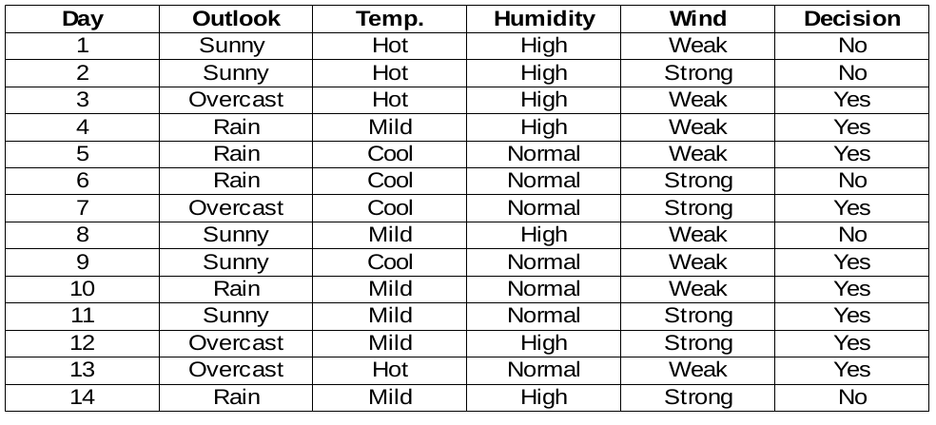
Calculation of Decision Tree Classification Using CHAID : Lets see an example to decide the root node by using CHAID

Slide 11
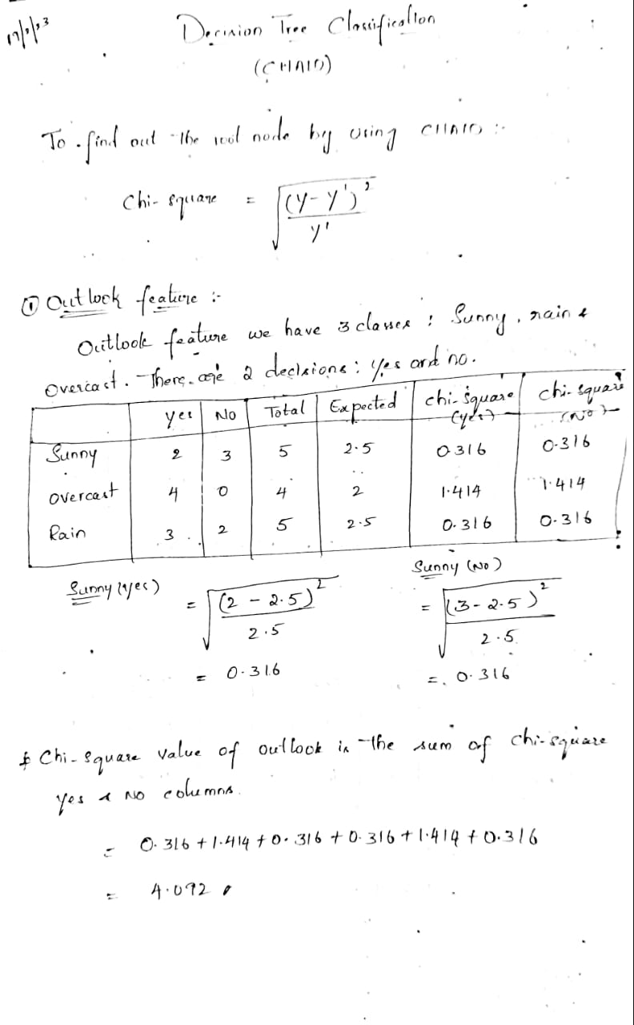
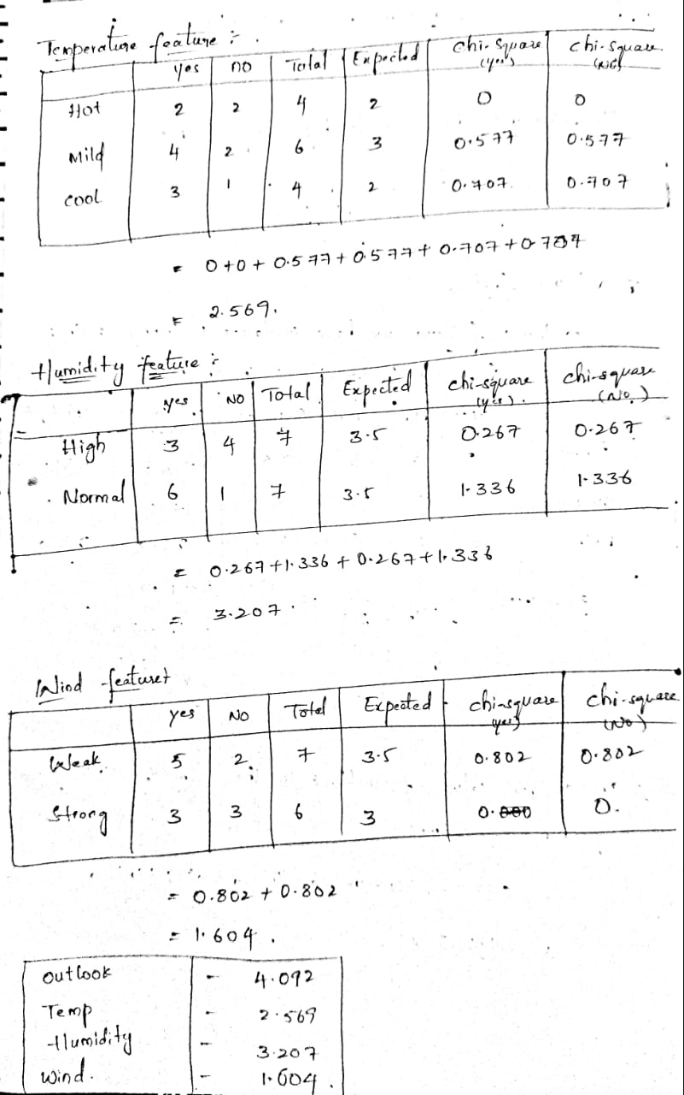

Slide 12
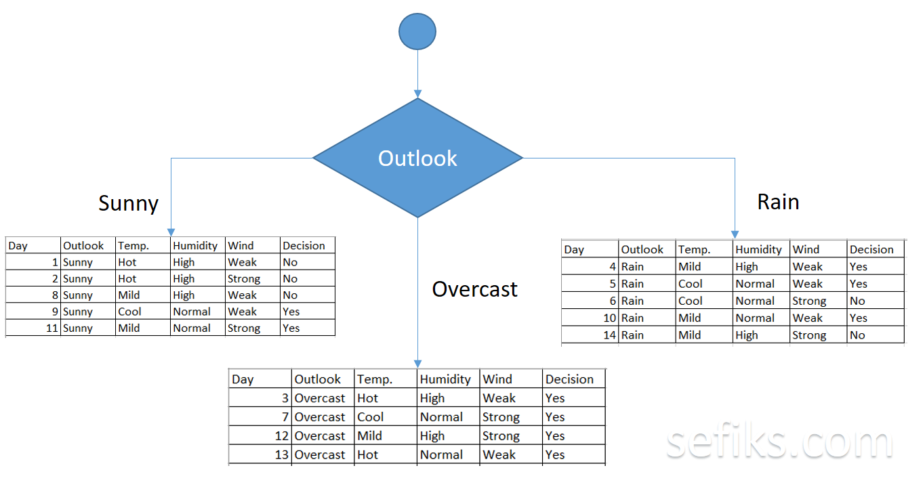
As seen, outlook feature has the highest chi-square value. This means that it is the most significant feature. So, we will put this feature to the root node.
We’ve filtered the raw data set based on the outlook classes. For example, overcast branch just has yes decisions in the sub data set. This means that CHAID tree returns YES if outlook is overcast.
The both sunny and rain branches have yes and no decisions. We will apply chi-square tests for these sub data sets.

Slide 13
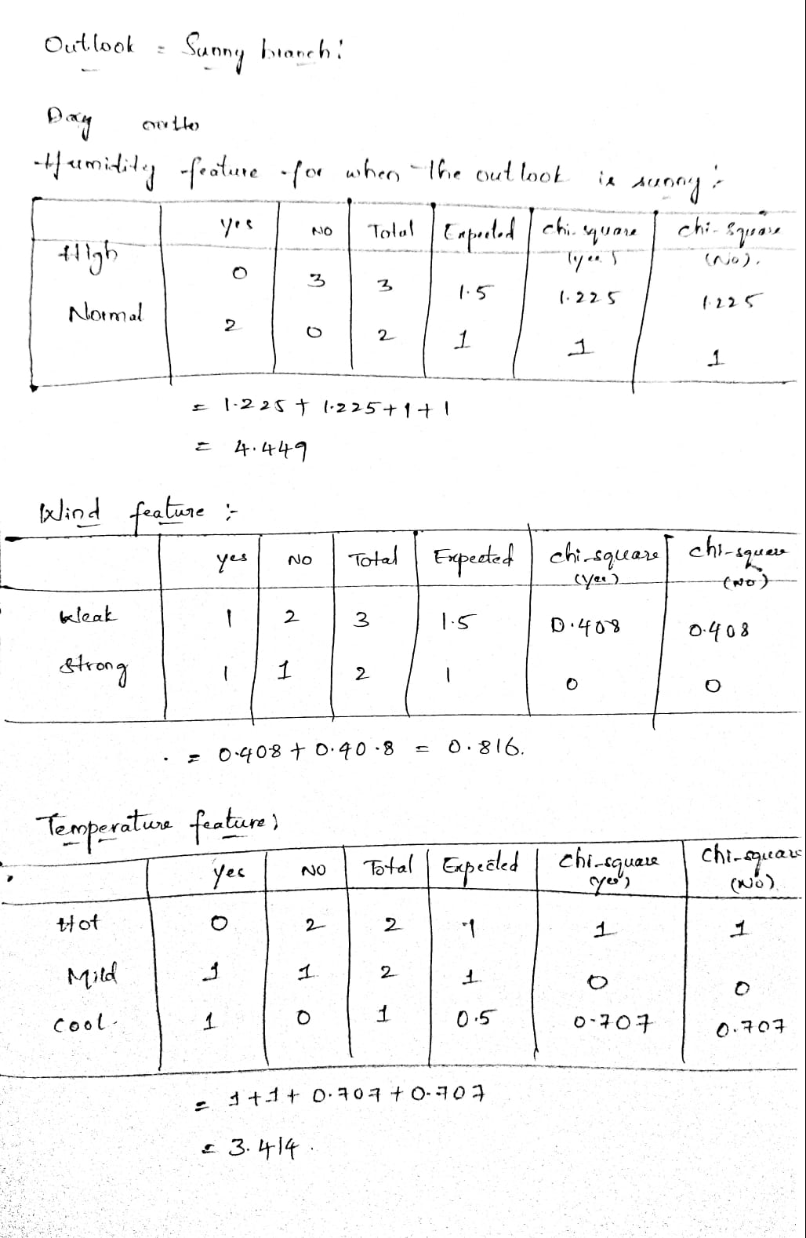
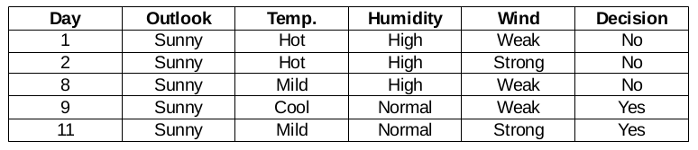
Outlook = Sunny branch This branch has 5 examples. Presently, we search for the most predominant feature. By The Way, we will disregard the outlook feature now since they are altogether the same. At the end of the day, we will find out the most predominant columns among temperature , humidity and wind.

Slide 14
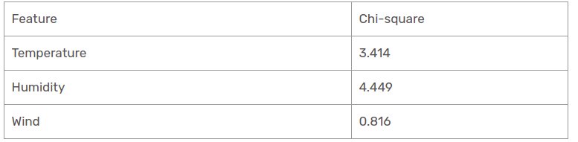
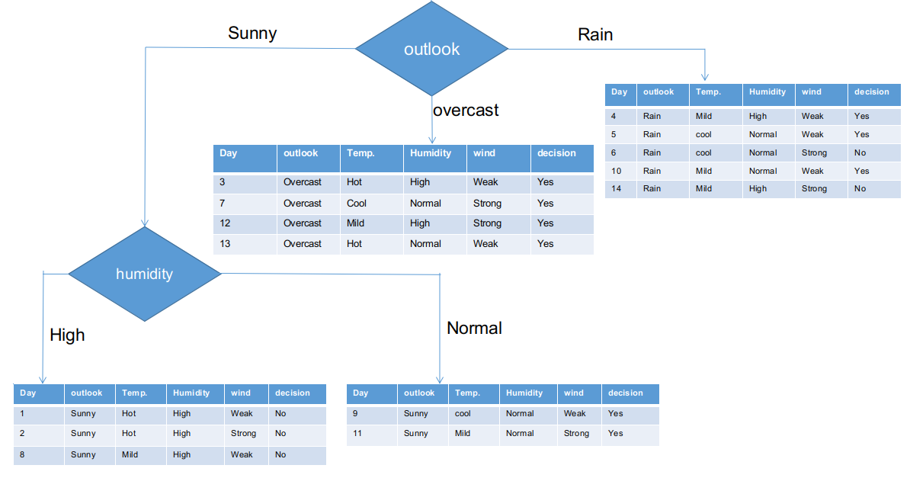

Slide 15
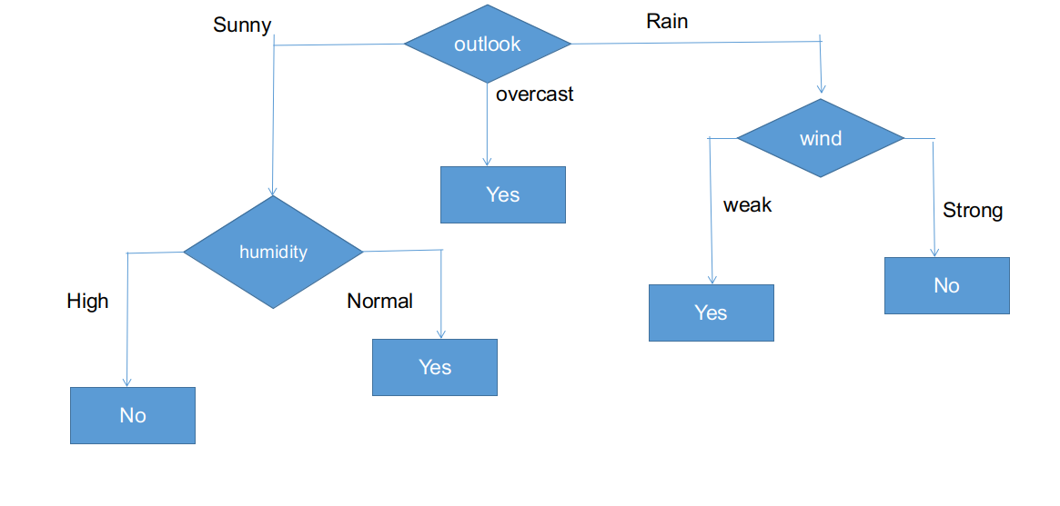
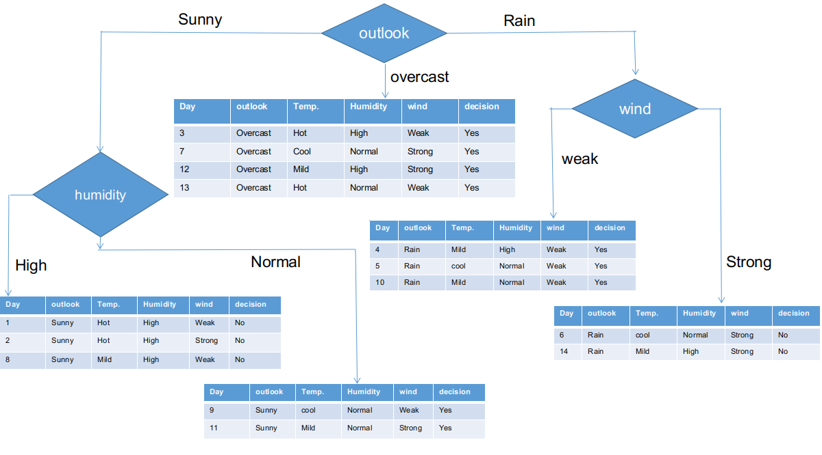
As seen, all branches have sub informational datasets having a single decision such that yes or no. In this way, we can generate the CHAID tree as illustrated below.
Thus, the wind feature is the victor for the rain is the outlook branch. Put this column in the connected branch and see the corresponding sub informational dataset.

Slide 16
Advantages and limitations of CHAID:
CHAID has many advantages that make it a popular choice for classification tasks.
It is easy to interpret, can handle both categorical and continuous data, and is robust to outliers. Additionally, it is fast and efficient, and can handle large datasets.
However, there are also some limitations to CHAID that should be considered. It can be prone to overfitting, and can be biased towards variables with more categories.
Additionally, it can be difficult to determine the optimal number of splits.

Slide 17
THANK YOU:)

