Slide 1
HackZon 2022
Pongal Vada Techies
Team members:
Bhagyashree V C
Vathsala K
Deepak
Sumanth Raj

Slide 2
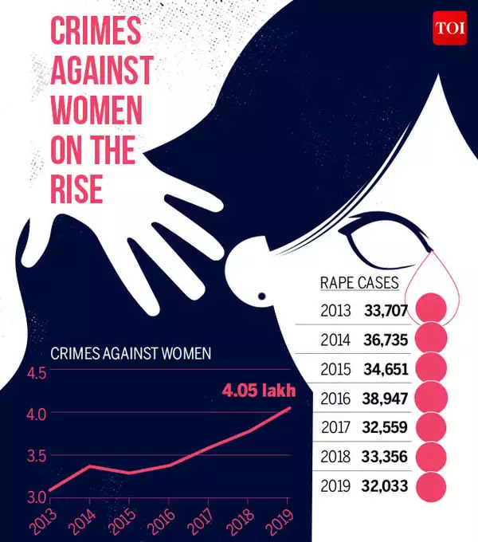
Women’s safety
Women safety has been a major concern in our society, we assume to be striding forward about this concern.
But, How safe are women in our country?
Crimes against women have been steadily rising over the years. According to the latest NCRB report, 2019 saw over 4 lakh reported cases of crimes committed against women, up from 3.78 lakh in 2018 and 3.59 lakh cases in 2017.
Hence, we can come to a conclusion that women aren’t free of fear.
Yet, women ponder :
How safe it is to step out alone?
If it is , At what time?
How safe is that particular place?

Slide 3
Here we come with a solution,
“ BE SAFE APP”
The Be Safe app is designed keeping in mind the concept of personal safety. It incorporates all the essential features such as GPS tracking, Emergency contact numbers, directions to safe locations. It also pins the safe areas along with their safety scores to go at the time of any problem. It also enables the users to pin unsafe areas and help others
After the 2012 Delhi rape incident ,apps for women safety flooded the market
The App comes equipped with a buzzer which will send messeges to your loved ones with your location in a situation of distress. You can select the contacts, which will be able to see your location.
Moreover if the App is switched off and is not working, then also you will be able to send alerts my simply pressing the volume key.

Slide 4
Future scope:
As far as India is concerned, use of technology for aiding women’s security is important.
The constant use of these apps and regular updates as per the need and awareness about security will help the apps see good days in the future.
Our app work on inputs given by women themselves.
Since they are not in a condition to provide inputs at all times, external monitoring and integration of various users on the same app can help provide better results. Integration of SOS facility and GPS can prove beneficial for the users

Slide 5












4
App
Notifying the contacts
Contacts Syncing
User
Location safety
buzzer

Slide 6
Thank you

