Slide 1




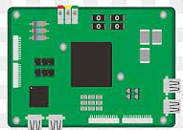
(CWFM Signals with Spark Fun radar)
Local Data Based
Gestures
ML/DL –ALGO
Pi

