Slide 1

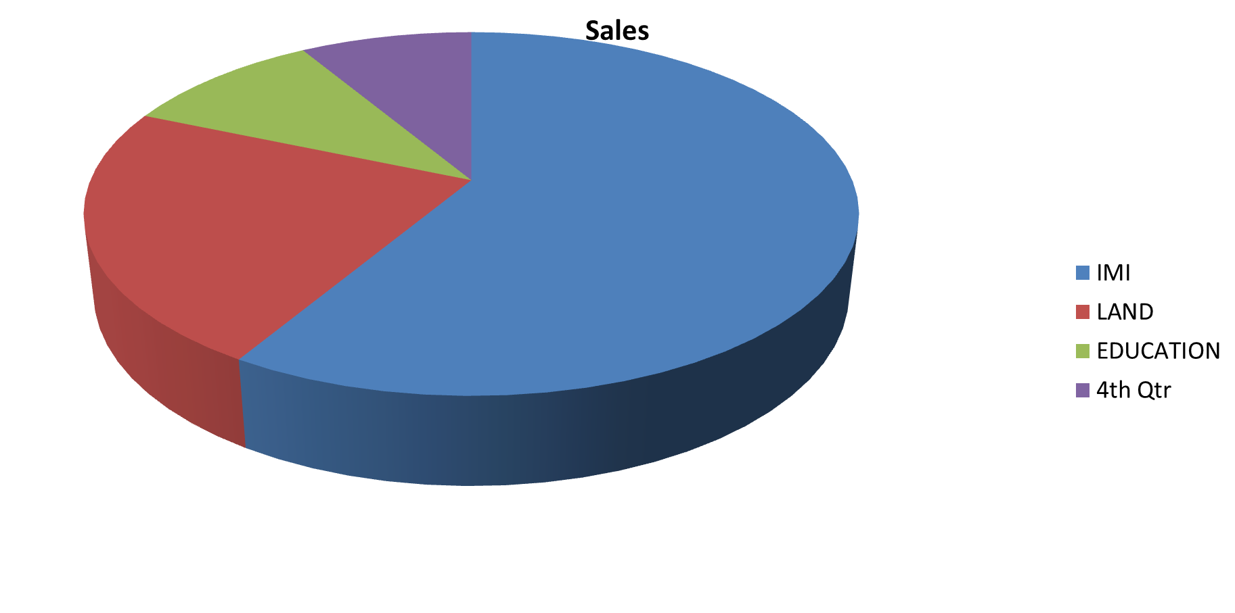


Effects of Microfinance Institutions on Poverty Alleviation and Economic Development: A Case Study in Barishal City
INTRODUCTION
poverty is a threat to peach and results in denial of all human rights. Micro-credit program has been argued to be potentially effective as a tool for poverty alleviation. The purpose of this paper is to introduce practical evidence about microfinance institution in poverty alleviation. A survey research method has been adopted to examine impact of micro finance institutions in poverty reduction.
The research instruments had both qualitative and quantitative questionnaire items. The main data collection tool was the questionnaire which was used to collect data from the households who are involved or non-involved with microfinance institution. Qualitative data generates from interviews was categories into them from study data. Correlation and regression statistical ways were employed in establishing relationship among variable.
METHODOLOGY
RESULTS
Effects of Microfinance Institutions on Poverty Alleviation and Economic Development: A Case Study in Barishal City. The tools and techniques used to analyzed the data were mostly statistical and econometrical. The data were mostly statistical and econometrical. Multicollinearity was analyzed through a correlation matrix indicating whether there are high significant correlation coefficients between the independent variable. The Regression model is
IMI =β0+β1EL+β2NEM+β3ACL +β4AFA+ µ
InvolvementwithMI | Coef. |  | St.Err. | t-value |  | p-value | [95% Conf |  | Interval] |  | Sig
Educationlevel | .489 |  | .124 | 3.95 |  | 0 | .243 |  | .735 |  | ***
Maritalstatus | -.796 |  | .155 | -5.15 |  | 0 | -1.103 |  | -.489 |  | ***
Numberofearningmem~r | -.189 |  | .19 | -0.99 |  | .323 | -.567 |  | .189
Amountofcultivable~d | .163 |  | .162 | 1.00 |  | .319 | -.16 |  | .485
Amountofloamsize | -.582 |  | .109 | -5.33 |  | 0 | -.799 |  | -.365 |  | ***
Amountoffixedasset | -.65 |  | .173 | -3.76 |  | 0 | -.993 |  | -.307 |  | ***
Constant | 2.787 |  | .435 | 6.40 |  | 0 | 1.922 |  | 3.651 |  | ***
Mean dependent var |  | 1.550 |  |  | SD dependent var |  |  | 0.575
R-squared |  | 0.377 |  |  | Number of obs |  |  | 100
F-test |  | 9.365 |  |  | Prob > F |  |  | 0.000
Akaike crit. (AIC) |  | 138.899 |  |  | Bayesian crit. (BIC) |  |  | 157.135
*** p<.01, ** p<.05, * p<.1

