Slide 1
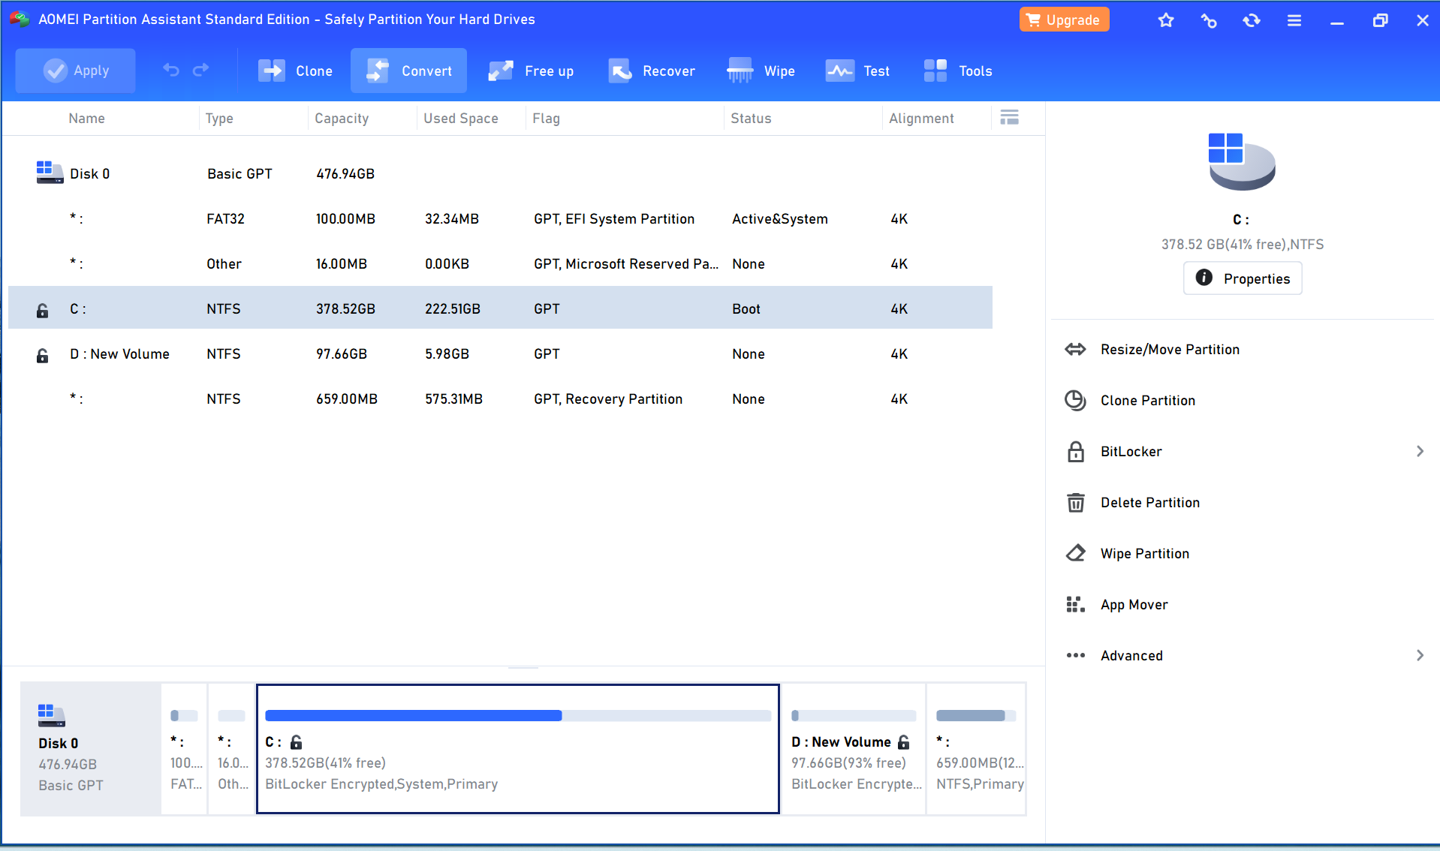
Cloning Disk C to Disk D with AOMEI Partition Assistant
Download and Install AOMEI Partition Assistant
Download AOMEI Partition Assistant website https://www.diskpart.com/download-home.html
Install the software following the on-screen prompts
Launch AOMEI Partition Assistant

Slide 2
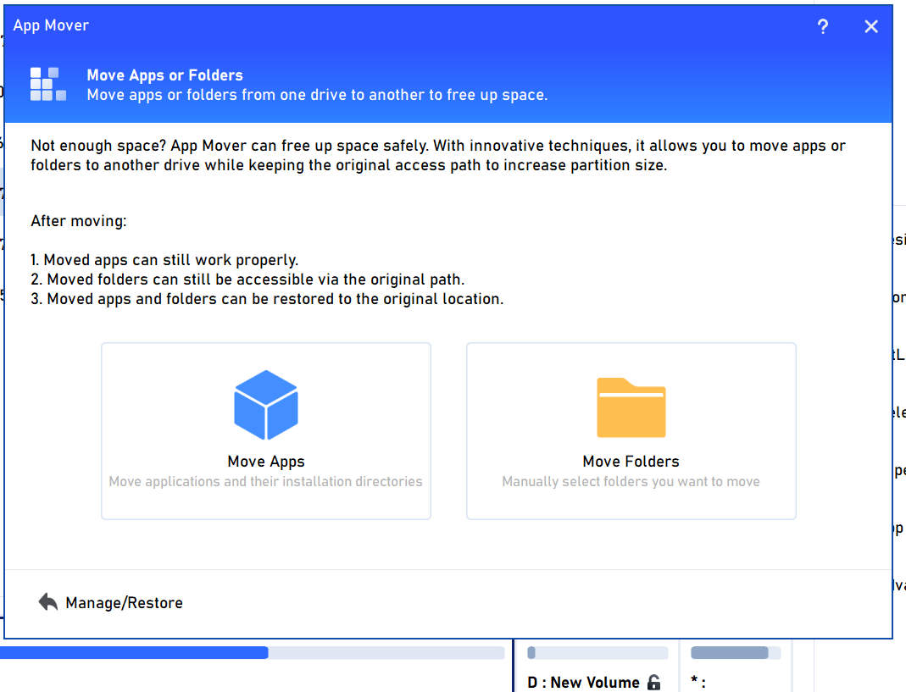
Locating Disk C and App Mover
In the main interface, locate Disk C (the full partition) on the left pane
Right-click on Disk C to reveal a context menu
Select "App Mover" from the context menu options

Slide 3
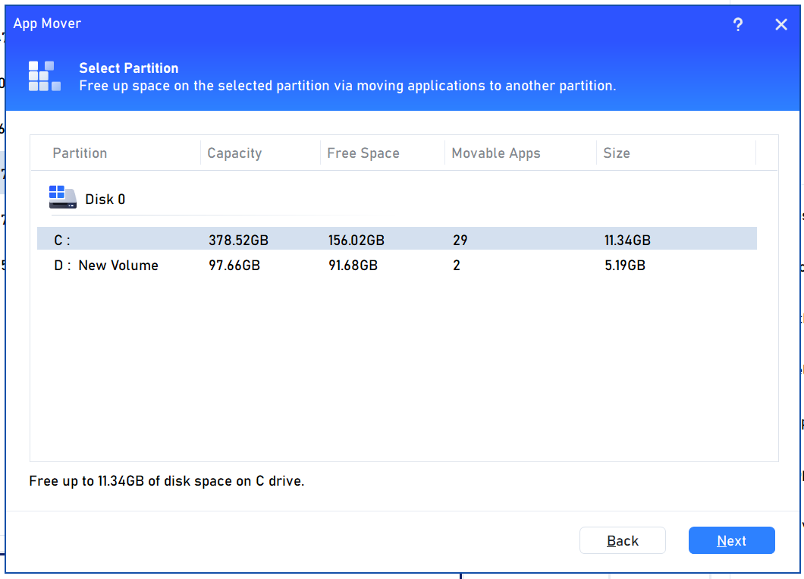
Selecting the Destination and Programs
In the "App Mover" window, choose Disk D (the destination partition) from the dropdown menu
The window will display a list of detected programs currently installed on Disk C
Select the specific programs you want to migrate to Disk D (consider free space limitations on D)

Slide 4
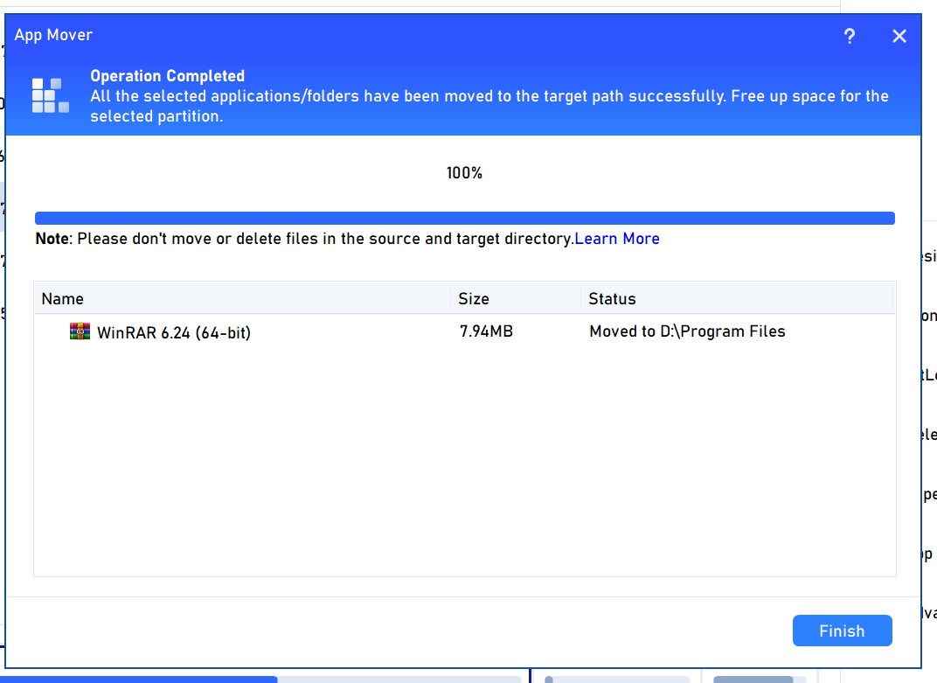
Completing the App Move and Enjoying More Disk C Space!
Double-check the source (Disk C) and destination (Disk D) partitions for accuracy
Click the "Start Move" button to begin the process
The process might take a while depending on the number of programs being moved
AOMEI Partition Assistant will notify you upon completion

