Slide 1
Configuring a Firewall in Linux
Prepared by
Sumayya Farheen

Slide 2
What is a Firewall?
In Linux, a firewall is a software component that serves as a barrier between a trusted internal network (such as your computer or a local network) and untrusted external networks (like the internet).
Its primary function is to monitor and control incoming and outgoing network traffic based on predetermined security rules.

Slide 3
Types of Firewalls in Linux:
In Linux, there are primarily two types of firewalls that are commonly used:
Packet Filtering Firewall
Proxy Firewall

Slide 4
Packet Filtering Firewall:
iptables (Netfilter): This is the traditional packet filtering firewall in Linux. It operates at the network packet level, examining packets and deciding whether to accept, drop, or forward them based on defined rules.
nftables: A modern replacement for iptables, nftables provides a more efficient and flexible framework for packet filtering and network address translation (NAT) in Linux.

Slide 5
Proxy Firewall:
Squid Proxy: While primarily known as a web proxy server, Squid can also function as a proxy firewall by controlling and filtering traffic based on application-layer protocols (e.g., HTTP, HTTPS).
Privoxy: Another proxy server that can act as a firewall by filtering and modifying web page data before it reaches the client.

Slide 6
Comparison:
Packet Filtering Firewall
Proxy Firewall
Operates at the network layer (OSI Layer 3) and sometimes at the transport layer (OSI Layer 4).
Typically used for controlling network traffic based on IP addresses, ports, and protocols.
More suitable for enforcing basic network security policies such as access control and traffic filtering.
Operates at the application layer (OSI Layer 7).
Filters traffic based on higher-layer protocols (e.g., HTTP, FTP) and can inspect and modify application data.
Provides more granular control over user activities and content filtering but may introduce higher latency due to additional processing.

Slide 7
Firewall Terminology
Firewall terminology in Linux includes a variety of terms and concepts used to describe different aspects of firewall configuration, operation, and management.
Here are some key terms commonly associated with firewalls in Linux:

Slide 8
In Linux, firewall terminology generally revolves around the tools and concepts used to manage network security. Here are some key terms and concepts related to firewalls in Linux:
Chain: A series of rules that are applied to network traffic.
Rule: A specific instruction that defines what action to take on a packet. (allow, deny, forward)
Target: The final destination of a packet. (ACCEPT, REJECT, DROP)
Interface: A network interface (eth0, wlan0) that receives or sends packets.
Port: A number that simplifies specific services. (22 for SSH (Secure Shell) protocol)

Slide 9
Protocol: Refers to a set of rules and standards that devices use to communicate with each other over a network. ( HTTP, FTP)
Source: The origin of packet. ( IP address, network range)
Destination: The intended recipient of a packet. (IP address, network range)
Zone: A logical division of a network. (e.g: public, private, DMZ)
Service: A specific application or protocol. ( SSH, HTTP, FTP)
Packet: A single unit of network data.
Filter: To examine and control network traffic based on specific criteria.
Network Address Translation: Modifying source or destination IP addresses.
Masquerade: Hiding private IP addresses behind a public IP address.

Slide 10
IP Address (Internet Protocol Address):
In simple terms, an IP address in Linux (and generally in networking) is a unique identifier assigned to each device connected to a network. It allows devices to communicate with each other by specifying the source and destination of data packets.
Serves for two main reasons:
Unique Identifier: An IP address serves as a unique address for devices, much like a postal address for homes. It distinguishes one device from another on a network.
Format: IP addresses are typically written as four sets of numbers separated by dots (e.g., 192.168.1.1). Each set, called an octet, ranges from 0 to 255 and represents part of the address.

Slide 11
Types of IP Addresses:
In Linux, like in any networking environment, there are several types of IP addresses that serve different purposes. Here are the main types of IP addresses commonly used:
Public IP Address:
A public IP address is assigned to a device directly accessible over the Internet. It uniquely identifies the device on the global Internet.
Private IP Address:
Private IP addresses are used within a private network (e.g., a home or office network) and are not directly reachable from the Internet.
Loopback IP Address:
The loopback address is used by a device to refer to itself.

Slide 12
Dynamic IP Address:
A dynamic IP address is assigned to a device by a DHCP (Dynamic Host Configuration Protocol) server.
Static IP Address:
A static IP address is manually configured on a device and remains fixed unless manually changed.
Virtual IP Address:
Virtual IP addresses are additional IP addresses assigned to a network interface.
They can be used for load balancing, failover, or other network configurations where multiple IP addresses are needed on a single physical interface.

Slide 13
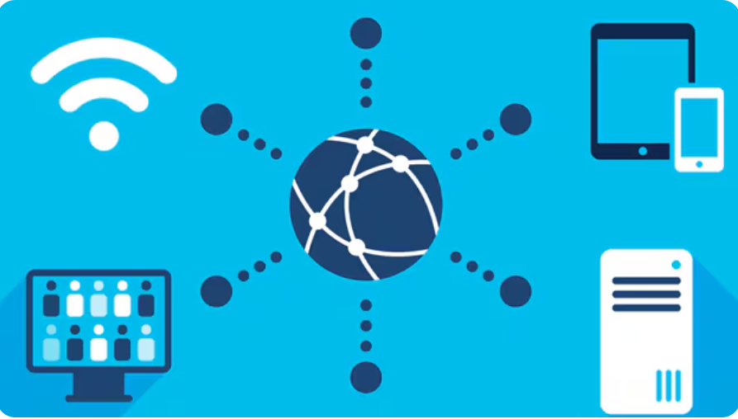
Local Area Network (LAN):
A local area network (LAN) is a collection of devices connected together in one physical location, such as a building, office, or home.
A LAN can be small or large, ranging from a home network with one user to an enterprise network with thousands of users and devices in an office or school.

Slide 14
Different types of LANs
In general, there are two types of LANs: client/server LANs and peer-to-peer LANs.
A client/server LAN consists of several devices (the clients) connected to a central server.
The server manages file storage, application access, device access, and network traffic.
A client can be any connected device that runs or accesses applications or the Internet.
The clients connect to the server either with cables or through wireless connections.

Slide 15
A peer-to-peer LAN doesn't have a central server and cannot handle heavy workloads like a client/server LAN can, and so they're typically smaller.
On a peer-to-peer LAN, each device shares equally in the functioning of the network.
The devices share resources and data through wired or wireless connections to a switch or router. Most home networks are peer-to-peer.

Slide 16
Wide-Area Network (WAN)
A wide-area network (WAN) is the technology that connects your offices, data centers, cloud applications, and cloud storage together.
It is called a wide-area network because it spans beyond a single building or large campus to include multiple locations spread across a specific geographic area, or even the world.
For example, businesses with many international branch offices use a WAN to connect office networks together.
The world’s largest WAN is the internet because it is a collection of many international networks that connect to each other.

Slide 17
Internet Traffic Type:
Internet traffic types refer to the categorization of data flows that traverse networks and the internet.
These types are classified based on the nature of the data, its purpose, and how it is handled by network devices and protocols. Here are some common types of internet traffic:
HTTP (Hypertext Transfer Protocol):
HTTP traffic is used for transmitting web pages and other resources over the internet.
It operates over TCP (Transmission Control Protocol) on port 80 (or port 443 for HTTPS, which is HTTP over SSL/TLS).

Slide 18
HTTPS (Hypertext Transfer Protocol Secure):
HTTPS is the secure version of HTTP, encrypting data using SSL/TLS (Secure Sockets Layer/Transport Layer Security). It ensures confidentiality and integrity of data transmitted between clients (browsers) and servers.
FTP (File Transfer Protocol):
FTP is used for transferring files between computers on a network. It operates over TCP on port 21 (control connection) and port 20 (data connection). FTP can be insecure (FTP) or secured with SSL/TLS (FTPS).
DNS (Domain Name System):
DNS traffic resolves domain names (e.g., www.example.com) to IP addresses. It uses UDP (User Datagram Protocol) on port 53 for queries and responses, facilitating the translation of human-readable domain names into machine-readable IP addresses.

Slide 19
SMTP (Simple Mail Transfer Protocol):
SMTP is used for sending email between servers. It operates over TCP on port 25 (unencrypted) or port 465/587 (encrypted with SSL/TLS). SMTP handles outgoing email from clients to servers and server-to-server communication.
POP3 (Post Office Protocol version 3) and IMAP (Internet Message Access Protocol):
POP3 and IMAP are protocols used by email clients to retrieve emails from a mail server. POP3 typically operates on port 110 (unencrypted) or port 995 (encrypted with SSL/TLS), while IMAP operates on port 143 (unencrypted) or port 993 (encrypted with SSL/TLS).

Slide 20
VoIP (Voice over IP):
VoIP traffic carries voice communications over IP networks, allowing for voice calls and multimedia sessions. It can use various protocols like SIP (Session Initiation Protocol) and RTP (Real-time Transport Protocol).
P2P (Peer-to-Peer):
P2P traffic involves direct communication between devices on a network without passing through a central server.
VPN (Virtual Private Network):
VPN traffic encapsulates and encrypts data, creating a secure tunnel over the internet between a client and a VPN server.

Slide 21
IP Header
In Linux networking, the IP header refers to the part of the IP packet that contains crucial information about the packet itself.
This header is added to the front of the data payload as the packet moves through the network stack.
The IP header is essential for routing and delivering packets across different networks and devices.
Here are the key components typically found in the IP header:
Version: Specifies the version of the IP protocol being used (IPv4 or IPv6).

Slide 22
Header Length: Indicates the length of the IP header in 32-bit words. This helps in locating where the data payload starts.
Total Length: Specifies the total length of the IP packet (header + data payload) in bytes.
Identification: A unique identifier assigned by the sender to aid in reassembling fragmented packets at the destination.
Protocol: Specifies the protocol used in the data payload (e.g., TCP, UDP, ICMP).
Source IP Address: The IP address of the sender (source) of the packet.
Destination IP Address: The IP address of the intended recipient (destination) of the packet.

Slide 23
TCP Header
In Linux networking, the TCP header is part of the Transmission Control Protocol (TCP) packet structure.
TCP is a core protocol in the TCP/IP suite, providing reliable, connection-oriented communication between devices over IP networks.
The TCP header contains essential information for managing the transmission of data segments between hosts.
Here are the key components typically found in the TCP header:
Source Port: A 16-bit field specifying the port number of the sending application.
Destination Port: A 16-bit field specifying the port number of the receiving application.

Slide 24
Sequence Number: A 32-bit field identifying the sequence number of the first data byte in this segment's data stream.
Acknowledgment Number: A 32-bit field used to acknowledge receipt of data. It contains the sequence number of the next byte expected from the other end.
Data Offset: A 4-bit field indicating the length of the TCP header in 32-bit words (minimum value of 5, maximum 15). This field also specifies where the data begins.
Reserved: A 6-bit field reserved for future use. It should be set to zero.
Checksum: A 16-bit field used for error-checking the header and data.

Slide 25
Flags:
URG (Urgent): Indicates urgent data is present in the packet.
ACK (Acknowledgment): Indicates the acknowledgment number is valid.
PSH (Push): Indicates the receiver should pass data to the application as soon as possible.
RST (Reset): Indicates the connection should be reset.
SYN (Synchronize): Initiates a connection.
FIN (Finish): Terminates a connection.
Options (Optional): Variable-length field used for additional functionality or features, such as timestamp, window scaling, selective acknowledgment (SACK), etc.

