Slide 1

Presentation Team Imputation
By: Ramon, Michael, Jesús, Albert, Adrien & Juliën

Slide 2
Table of contents
Pipeline
Imputation Methods
Neural Networks
Research paper

Slide 3
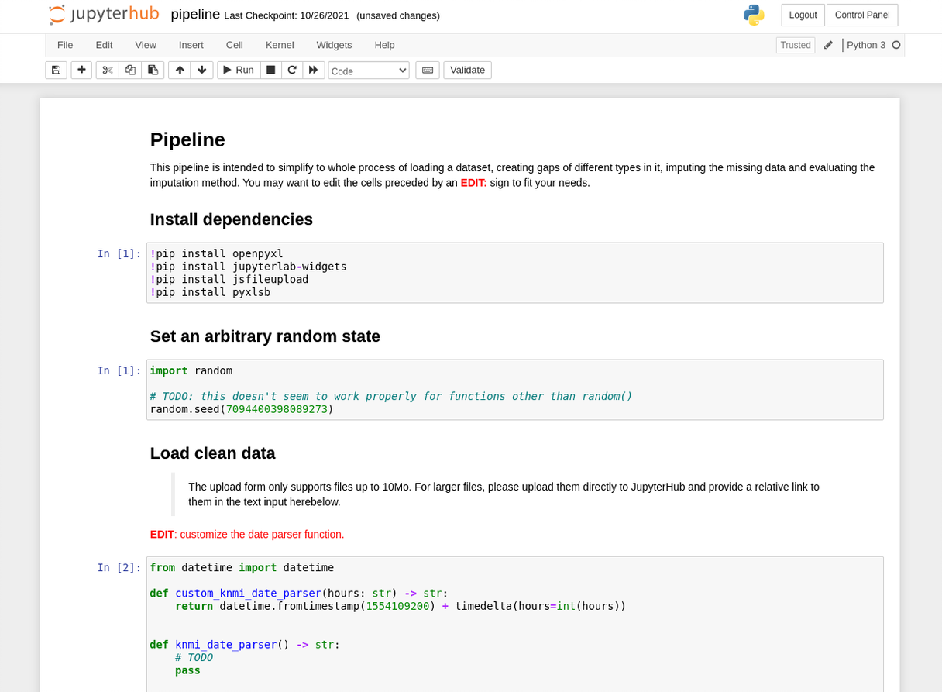
Pipeline
Uniform workflow
File statistics
Gap creation
Multiple imputation methods
Evaluation

Slide 4
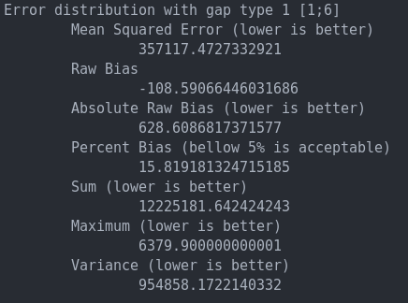
Evaluation methods
Bias
Sum of error
Distribution of error
Maximum error
Kurtosis : measures "tailedness"
Skewness: measures asymmetry in probability distribution
Pipeline evaluation metrics for Hot Deck with random donor pool.
Notes:
Links: https://blog.devgenius.io/skewness-and-kurtosis-in-data-science-aa795ba4b453 & https://keydifferences.com/differences-between-skewness-and-kurtosis.html
Skewness can also tell us about the value of mean, median and mode

Slide 5
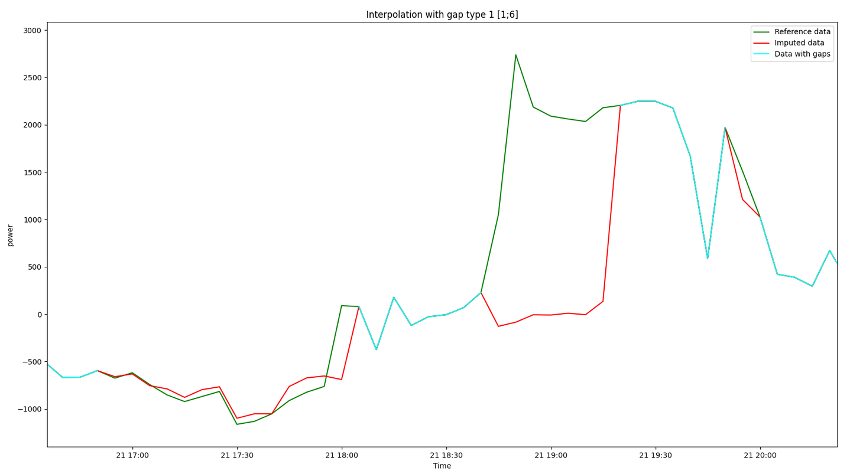

Imputation methods
Mode , Median & Mean
KNN Nearest Neighbour
Hot deck
Donor pool selection
Hot deck imputation result with a random donor

Slide 6
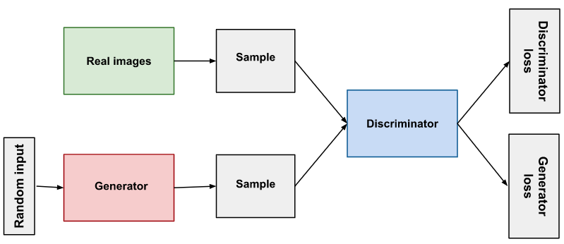
Neural Networks
Recurrent Neural Networks
GAN
Convolutional Neural Networks

Slide 7
Research (paper)
Worked on introduction for official paper
CLIMA conference

Slide 8
What we will be working on
Evaluation metrics in pipeline
Other imputation methods
Neural networks
Research paper
Focus right now: data collection

Slide 9
Questions & Feedback
Questions we have for you:
Notes:
https://stefvanbuuren.name/fimd/sec-evaluation.html

