Slide 1

Presentation Team Imputation​
BY: RAMON, MICHAEL, JESÚS, ALBERT, ADRIEN & JULIËN

Slide 2
Table of contents
Improvements to pipeline
Imputation by Regression
Imputation by Hot Deck
Neural networks
Research paper

Slide 3
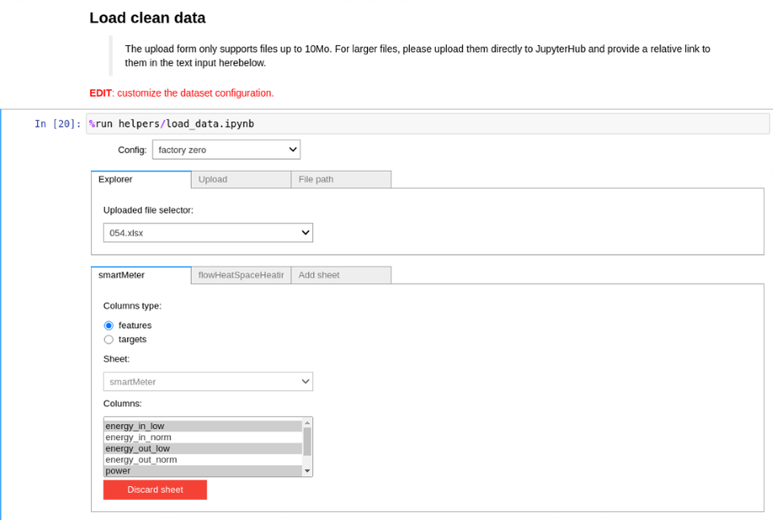
Improvements to pipeline
Improved data loading:
Multiple features
Multiple targets

Slide 4
Imputation by regression
Deterministic Regression
Stochastic Regression
On pipeline no satisfactory results
Difference
Deterministic: fully determined by parameters
Stochastic: adds randomness by probability distribution

Slide 5
Imputation by Hot Deck
What is hot deck?
Vectorization
Precision

Slide 6
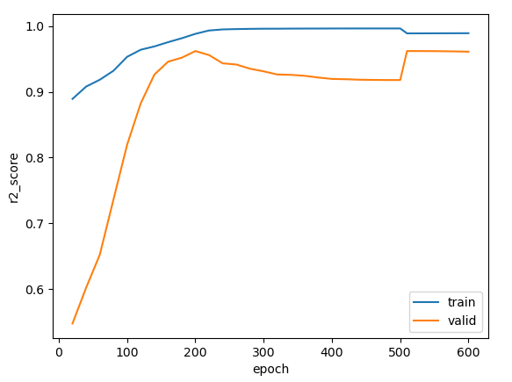
Neural Networks
Recurrent Neural Networks practice with lectures data
Optimizing hyperparameters using genetic algorithm
0.85 -> 0.963 r2_score (40 generations 21,500 genomes)

Slide 7
Research (Paper)
Introduction
Methodology
More in depth research for:
Hot Deck Imputation
Recurrent Neural Networks
Other methods optimized for time series data

Slide 8
What we will be working on?
Improving Hot Deck
Using RNN on houses data
Other "easier" models
More focus on paper
From data collection to data evaluation
No new big methods

Slide 9
Questions & Feedback
Questions:
Are there any other imputation methods for time series data we should try to implement?
Notes:
https://stefvanbuuren.name/fimd/sec-evaluation.html

