Slide 1
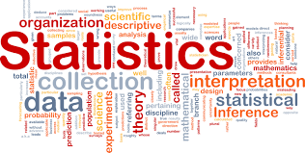

Slide 2
Statistics
Statistics is the discipline that concerns the collection, organization, analysis, interpretation and presentation of data.

Slide 3
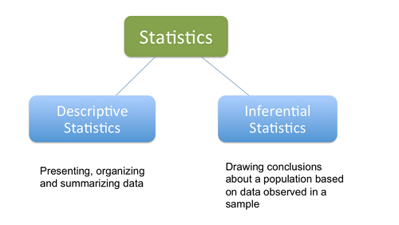
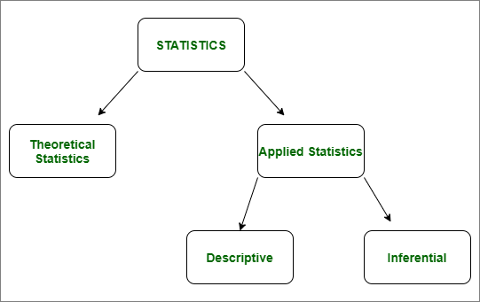
Statistics Major Categories

Slide 4
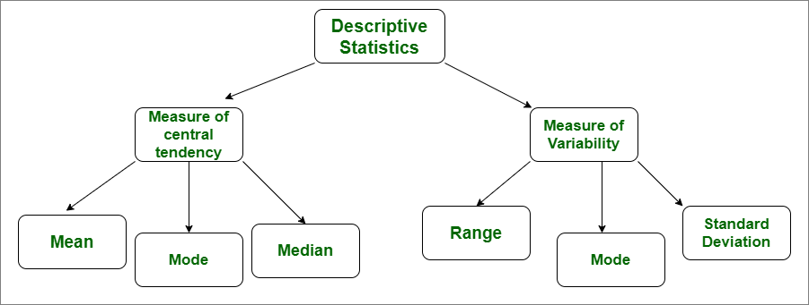
Descriptive Statistics
Descriptive statistics is a way to organise, represent and describe a collection of data using tables, graphs, and summary measures.

Slide 5
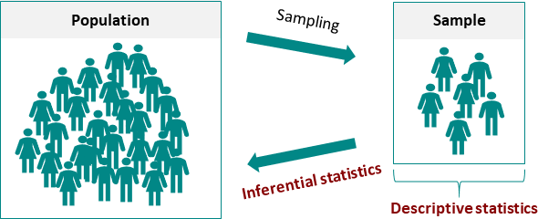
Inferential statistics
Interpret the meaning of Descriptive statistics or the meaning of the collected data.
Inferential Statistics is a method which allows us to use information collected from a sample to make decisions.
Predictions or inferences from a population. It grants us permission to give statements which goes beyond the available data or information. (Assumptions)

Slide 6
Mean, Median, Mode
The mean is the average of a data set.
The mode is the most common number in a data set.
The median is the middle of the set of numbers.

Slide 7
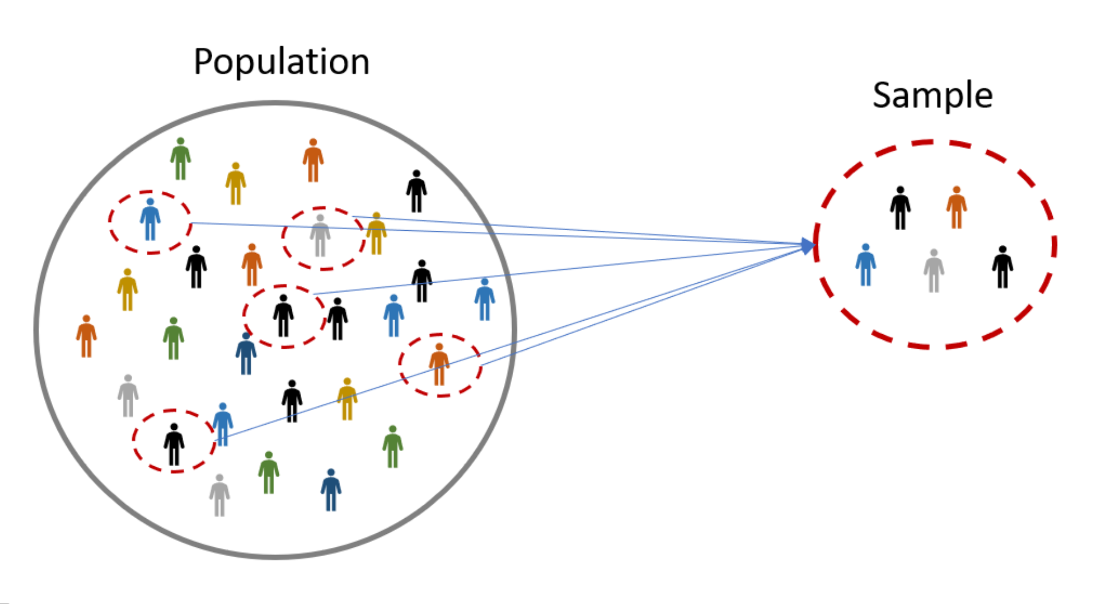
Population And Sample
A population is the entire group that you want to draw conclusions about.
A sample is the specific group that you will collect data from.
The size of the sample is always less than the total size of the population.

Slide 8
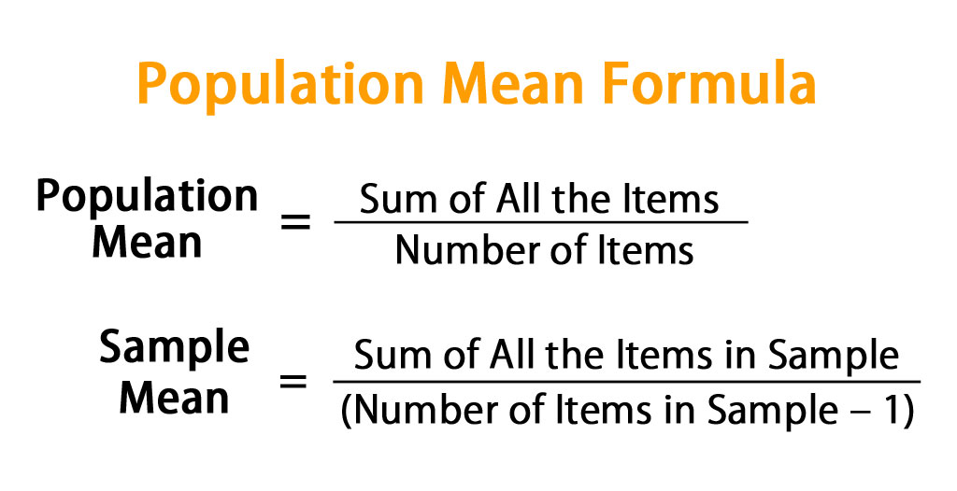
Population Sample Means

Slide 9
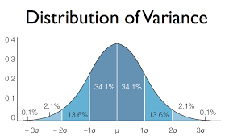
Variance
In probability theory and statistics
Variance is the measures how far a set of numbers is spread out from their average value.

Slide 10
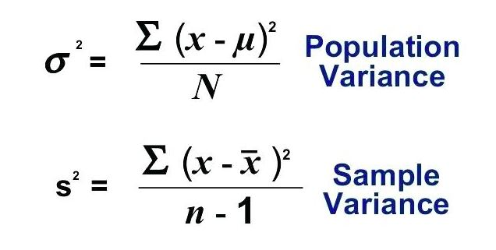
Variance: Sample | Population

Slide 11
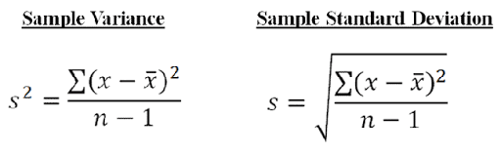
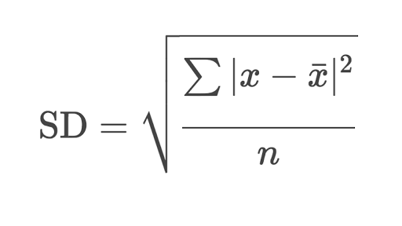
Standard Deviation (Square root of varience)
x bar is the mean of sample
n is the sample population

Slide 12
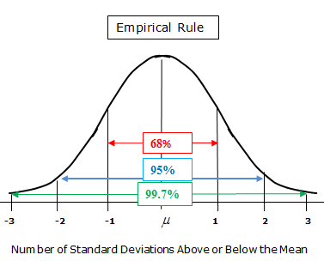
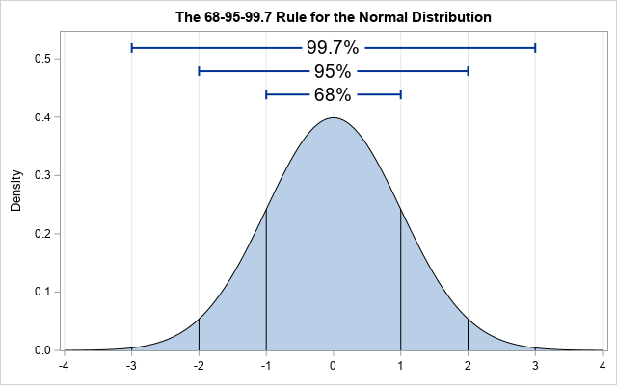
Gaussian Distribution | Normal Distribution

Slide 13
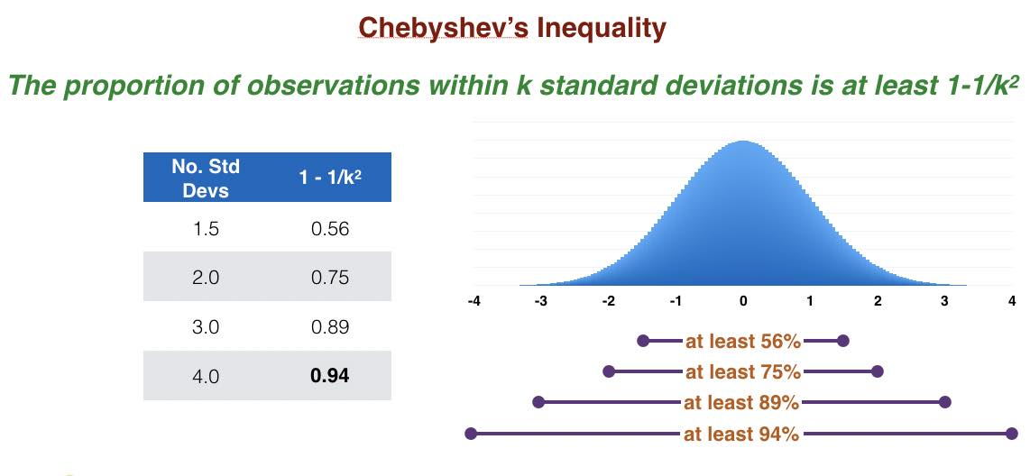

Chebyshev's Inequality

Slide 14
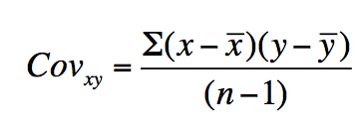
Covarience
Gives you direction if 2 features are related positively or negatively.
Do not tells you the strength of this relation.
x bar| y bar= mean of x | y

Slide 15
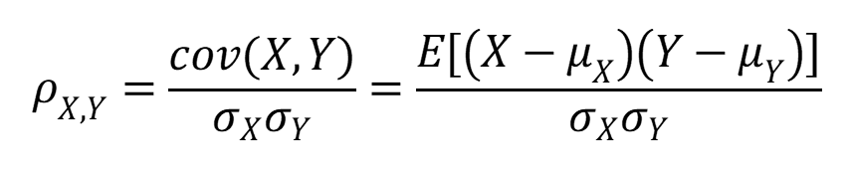
Pearson Correlation Coefficient Formula
Gives you direction, if the relation between two features is possitive or negative.
Also tells you its strength.
E-epsalon symbol

Slide 16
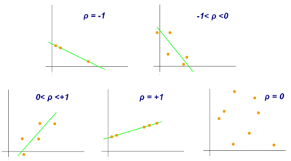
Pearson Correlation Coefficient Formula

Slide 17
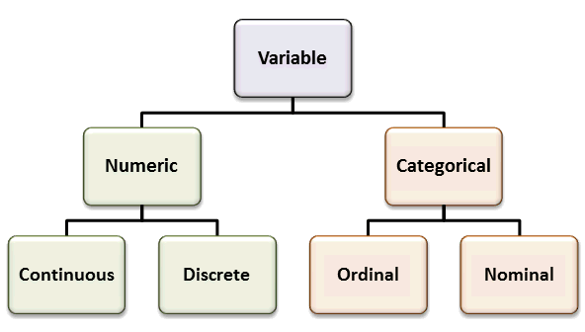
Variable In Statistics
Continuous: 1.2,2.3,3.4
Discrete: 2, 3, 4
Ordinal: Some order PhD,M.tech,B.E.
Nominal: A ,B,C ,X,Y,Z

Slide 18
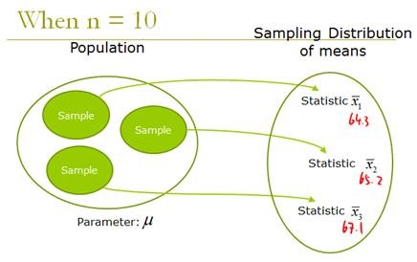
Central Limit Theorem
The central limit theorem states that if you have a population with mean μ and standard deviation σ and take sufficiently large random samples from the population with replacement , then the distribution of the sample means will be approximately normally distributed.
If sample >= 30%

Slide 19
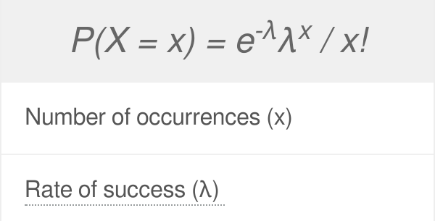
Poisson distribution
Poisson distribution shows how many times an event is likely to occur within a specified period of time.
Count as whole not as fractions(decimal).

Slide 20
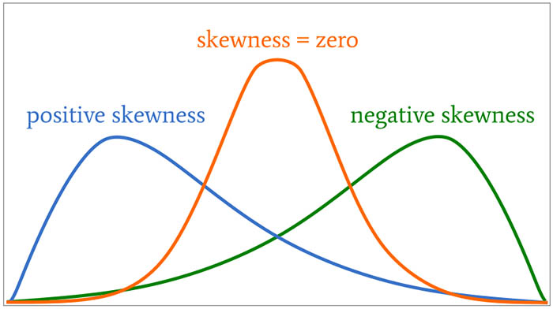
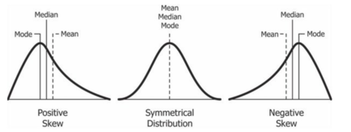
Skewness

Slide 21
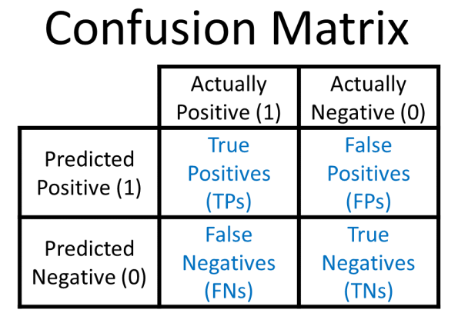
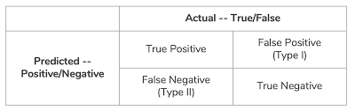
Hypothesis Building and Testing
1. Make an initial assumption. (H0) Null Hypothesis.
Collect Data or Gather Evidence.
Reject or Fail to reject H0 Null Hypothesis.
H1 is Alternate Hypothesis

Slide 22
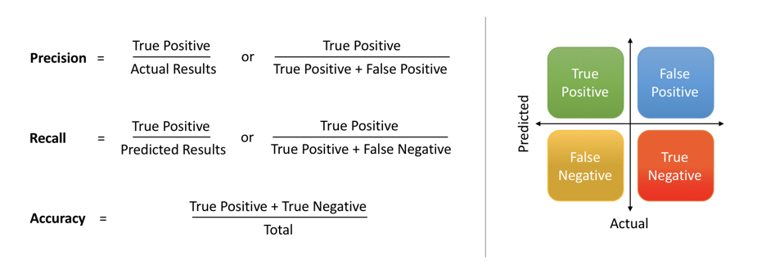
Precision and Recall
Precision
Precision attempts to answer the following question:
What proportion of positive identifications was actually correct?
Recall
Recall attempts to answer the following question:
What proportion of actual positives was identified correctly?
ACCURACY= Correct/ Total

Slide 23
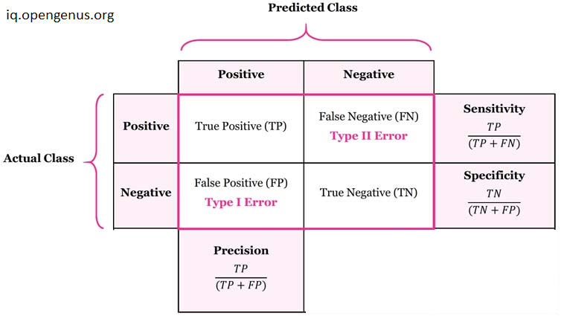
Specificity and Sensitivity | Recall
Metrix and formulas
What Is Sensitivity. Sensitivity is a measure of the proportion of actual positive cases that got predicted as positive (or true positive). Sensitivity is also termed as Recall.
What Is Specificity? Specificity is defined as the proportion of actual negatives, which got predicted as the negative (or true negative). This implies that there will be another proportion of actual negative, which got predicted as positive and could be termed as false positives.

Slide 24
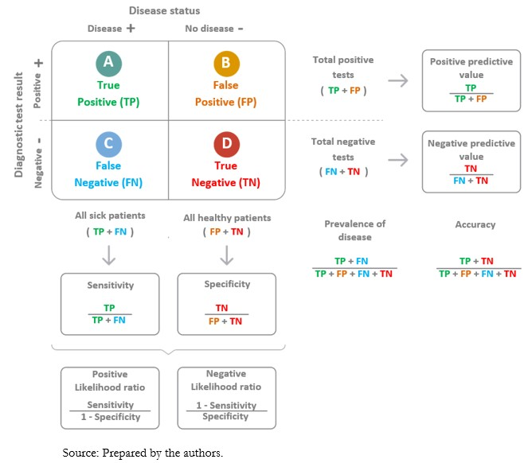

Slide 25
ROC and AUC

Slide 26
Is recall and sensitivity same in machine learning?
Is recall and sensitivity same in machine learning?
Recall or Sensitivity is the Ratio of true positives to total (actual) positives in the data. Recall and Sensitivity are one and the same.

Slide 27
P-value
P Value is the probablity value of null hypothesis to be true.
Eg:
p=0.05
5/100 times H0 will be true.
p=0.1
10/100 times H0 will be true.
p=0.3
30/100 times H0 will be true.
p=0.05
If i repeat this experiment 100 time 5 time H0 will be true.
If significance value is .5 then we reject the null hypothesis.
=> p<.5 reject H0.

Slide 28



Slide 29
End

