Slide 1
Machine Learning
Machine learning (ML) is a type of artificial intelligence (AI) that allows software applications to become more accurate at predicting outcomes without being explicitly programmed to do so. Machine learning algorithms use historical data as input to predict new output values.

Slide 2
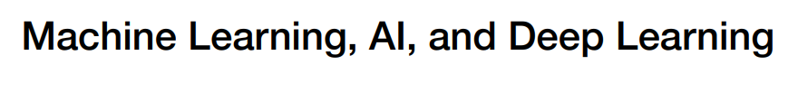
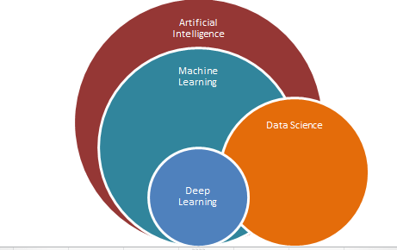
NLP

Slide 3
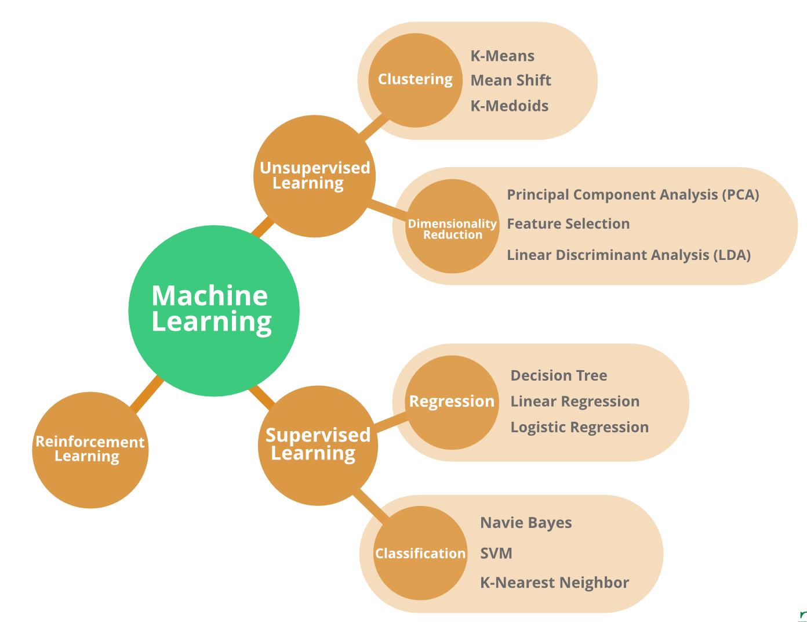
Types Of Machine Learning

Slide 4
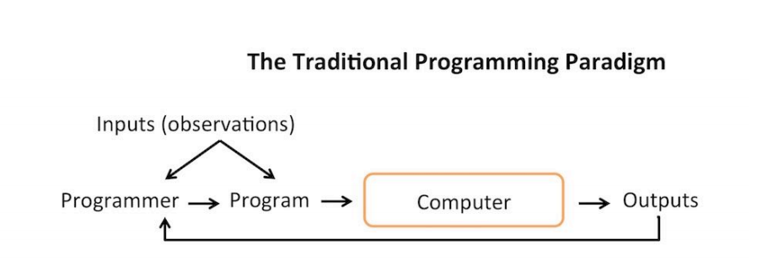

Slide 5
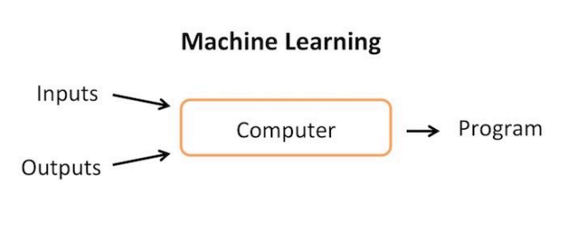

Slide 6
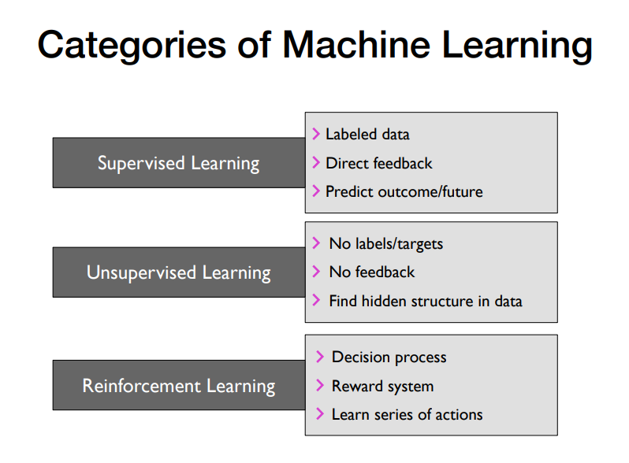

Slide 7
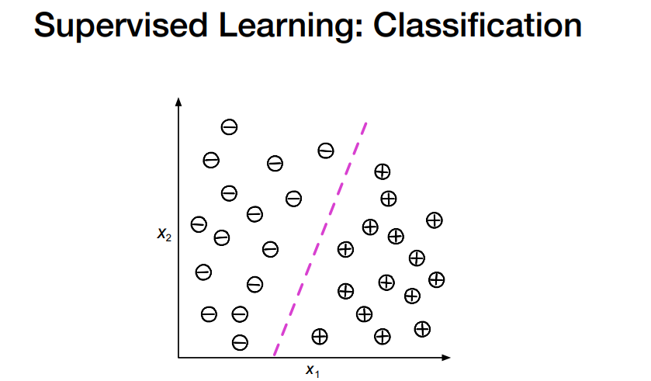

Slide 8
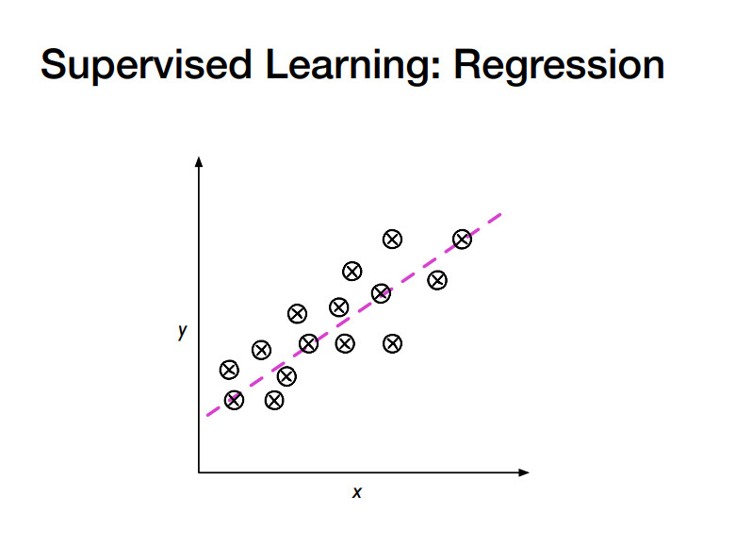

Slide 9
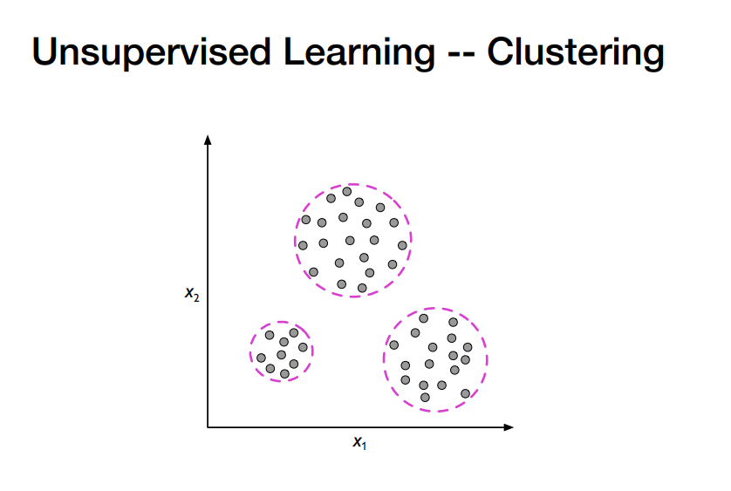

Slide 10
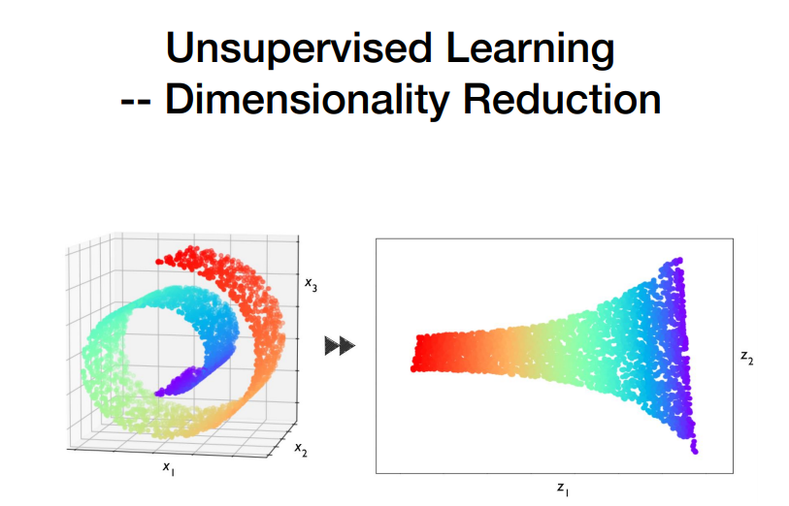

Slide 11
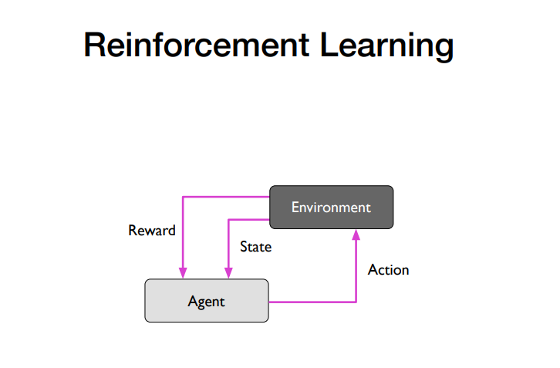

Slide 12
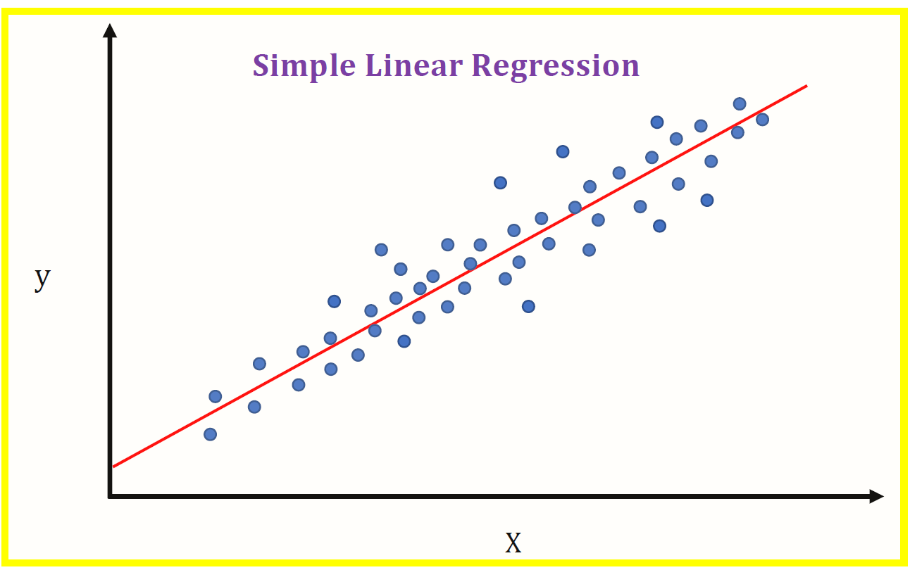

Slide 13
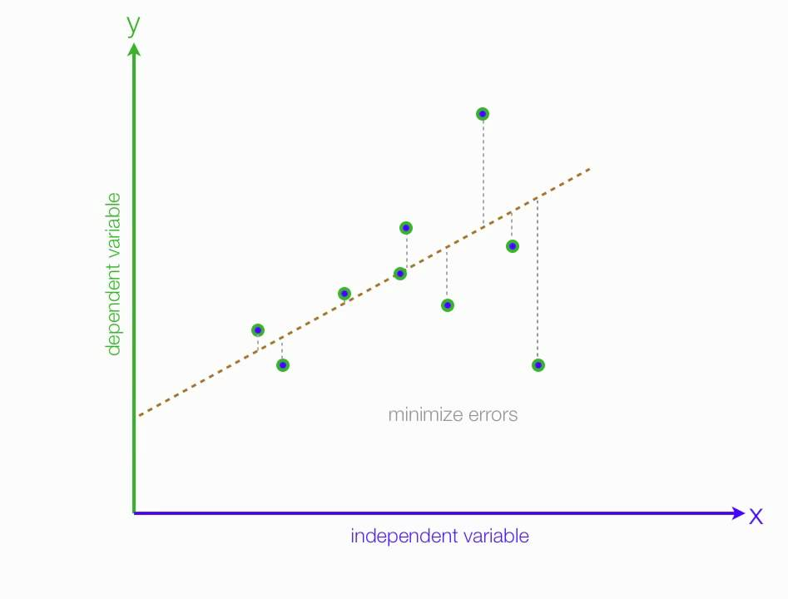
Residue | Total Error

Slide 14
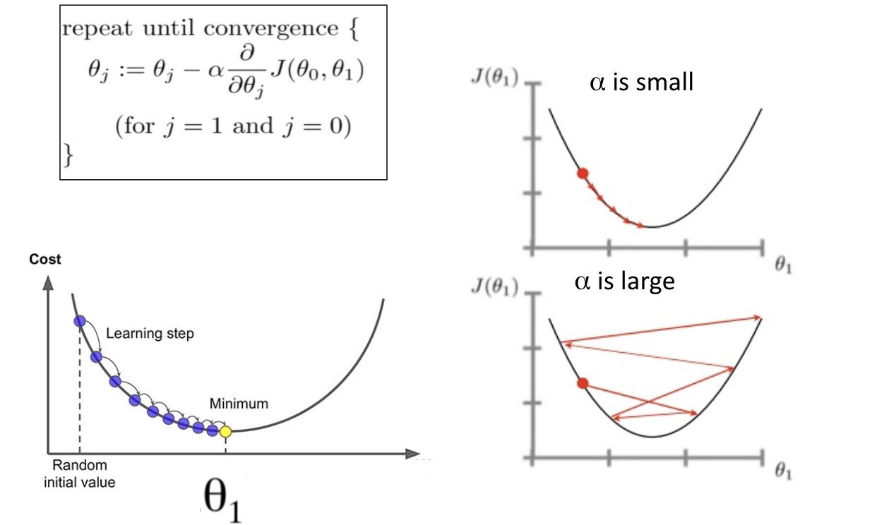
Convergence Theory In Machine Learning Formula

Slide 15
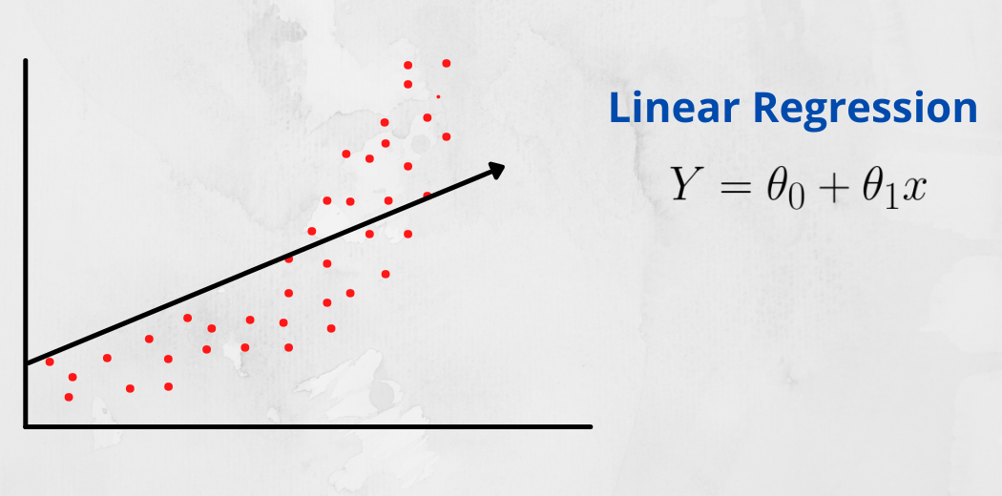
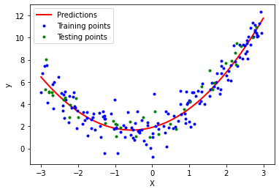
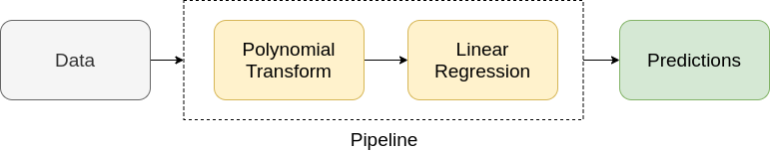
Polynomial Regression
If we have non-linear data then Linear regression will not capable to draw a best-fit line and It fails in such conditions.
Before feeding data to a mode in preprocessing stage we convert the input variables into polynomial terms using some degree.
y = a0 + a1x1 + a2x12 + … + anx1n

Slide 16
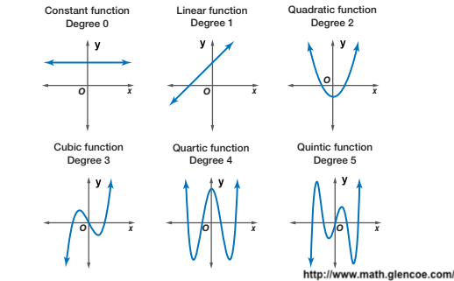
Degree
The 1-degree polynomial is a simple linear regression; therefore, the value of degree must be greater than 1. With the increasing degree of the polynomial, the complexity of the model also increases.
Degree Polynomial Name
Degree 0 Constant Polynomial
Degree 1 Linear Polynomial
Degree 2 Quadratic Polynomial
Degree 3 Cubic Polynomial

Slide 17
What will happen when you fit degree 4 polynomial in linear regression?
ANS: Since is more degree 4 will be more complex(overfit the data) than the degree 3 model so it will again perfectly fit the data. In such case training error will be zero but test error may not be zero.
Degree Polynomial Name
Degree 0 Constant Polynomial
Degree 1 Linear Polynomial
Degree 2 Quadratic Polynomial
Degree 3 Cubic Polynomial
Degree 4 – quartic (or, if all terms have even degree, biquadratic)
Degree 5 – quintic.
Degree 6 – sextic (or, less commonly, hexic)
Degree 7 – septic (or, less commonly, heptic)

Slide 18
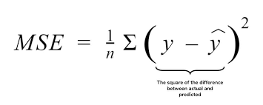
MSE=Mean Squared Error

Slide 19
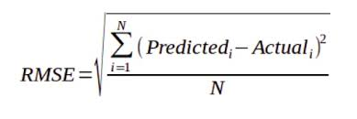
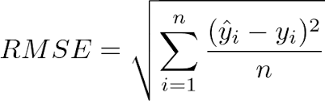
Root-Mean-Square Error (RMSE)
Root Mean Square Error (RMSE) is the standard deviation of the residuals (prediction errors).
Residuals are a measure of how far from the regression line data points are; RMSE is a measure of how spread out these residuals are.
In other words, it tells you how concentrated the data is around the line of best fit.

Slide 20
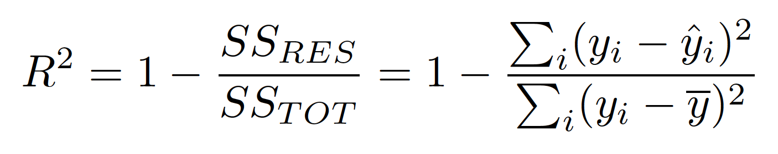
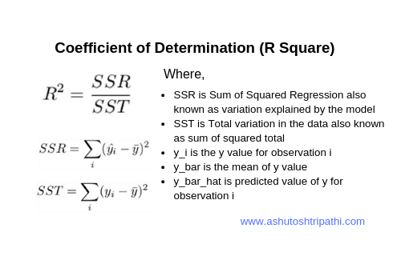
R Square:
R-squared = Explained variation / Total variation
R-squared is always between 0 and 100%:
0% indicates that the model explains none of the variability of the response data around its mean.
100% indicates that the model explains all the variability of the response data around its mean.
In general, the higher the R-squared, the better the model fits your data.R-squared values range from 0 to 1 and are commonly stated as percentages from 0% to 100%.

Slide 21
R2 VS Adjusted R2
Every time you add a independent variable to a model, the R-squared increases, even if the independent variable is insignificant. It never declines. Whereas Adjusted R-squared increases only when independent variable is significant and affects dependent variable.
Adjusted r-squared can be negative when r-squared is close to zero.
Adjusted r-squared value always be less than or equal to r-squared value.

Slide 22
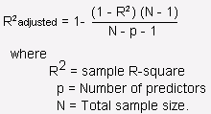
Adjusted R2
Ordinary Least Squares (OLS) Model
import statsmodels.formula.api as sm
X_opt = Independent Features
Y1 = Target
regressor_OLS =
sm.OLS(endog = Y1, exog = X_opt).fit()
regressor_OLS.summary()

Slide 23
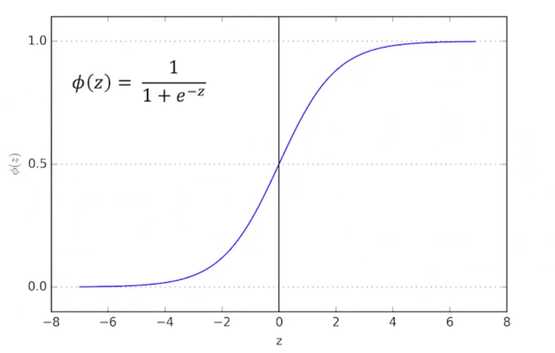
Logistic Regression | Sigmoid Function

Slide 24
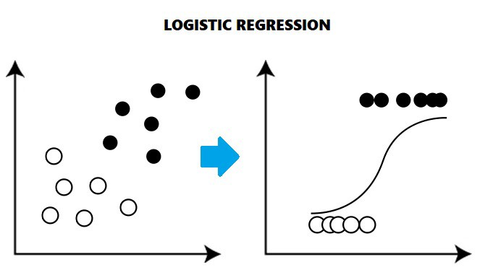

Slide 25
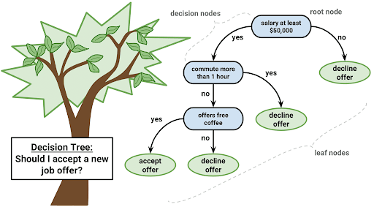
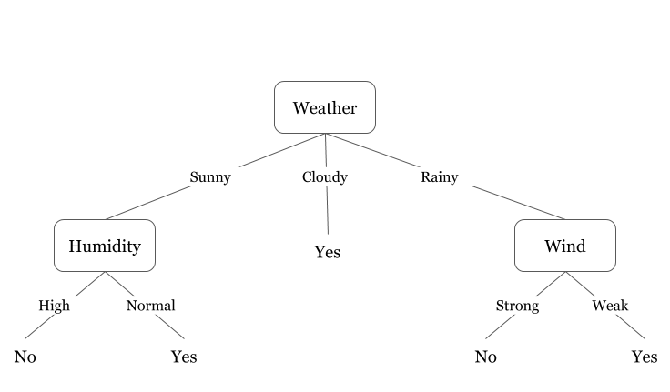
Decision Tree

Slide 26
Entropy
Entropy:
Measure of the randomness in the information being processed.
The higher the entropy, the harder it is to draw any conclusions from that information.

Slide 27
Information Gain
Information Gain
When we use a node in a decision tree to partition the training instances into smaller subsets the entropy changes.
Information gain is a measure of this change in entropy.
(Randomness of data)

Slide 28
Gini Index
Gini Index, also known as Gini impurity, calculates the amount of probability of a specific feature that is classified incorrectly when selected randomly.
If all the elements are linked with a single class then it can be called pure.
Gini Index is a metric to measure how often a randomly chosen element would be incorrectly identified.
It means an attribute with lower Gini index should be preferred.

Slide 29
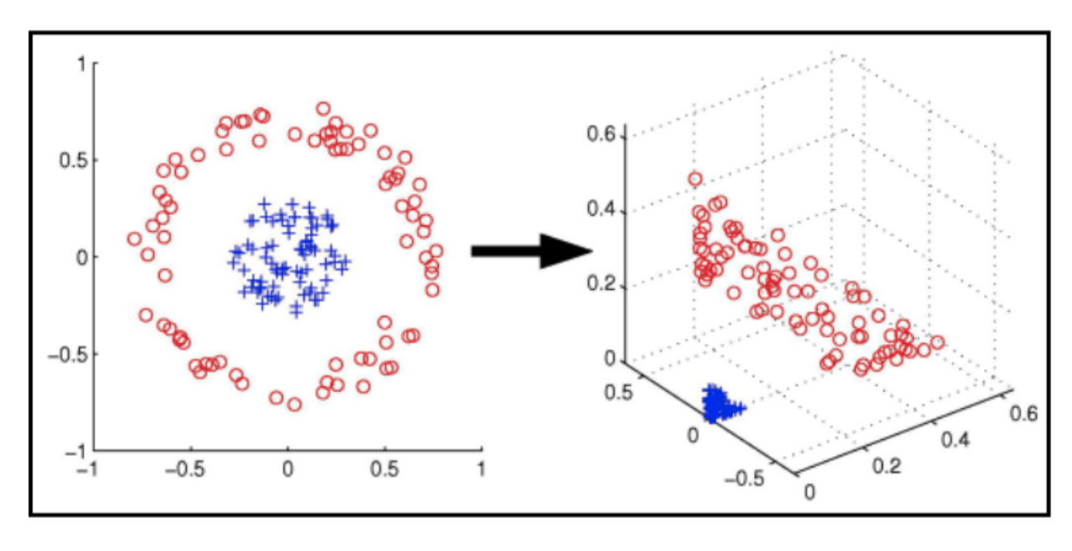
SVM : Support Vector Machines

Slide 30
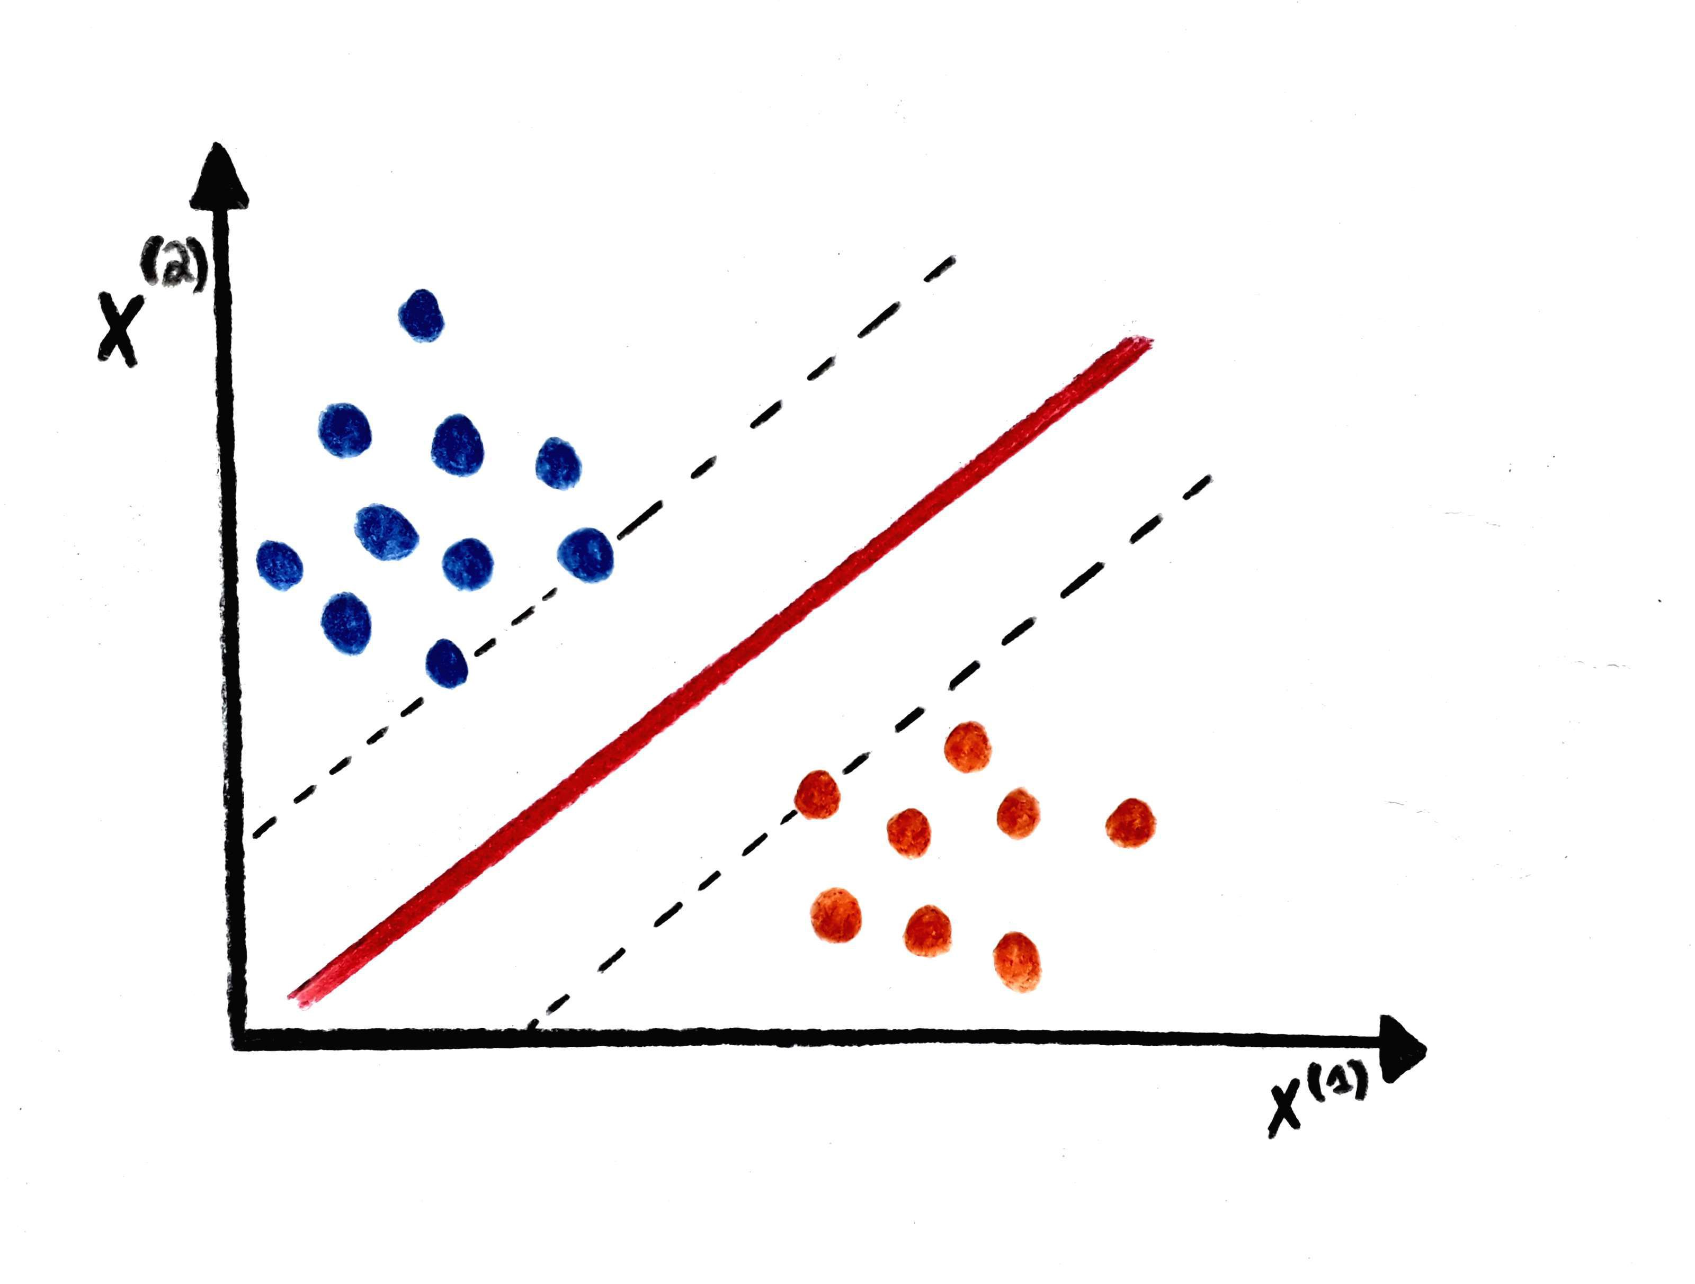
SVM : Support Vector Machines

Slide 31
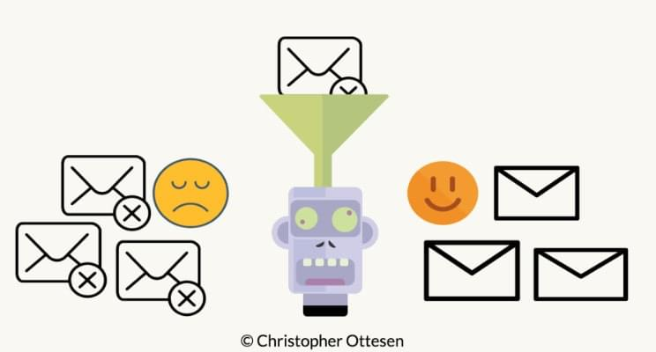
Naive Bayes
Naive Bayes classifier assumes that the presence (or absence) of a particular feature of a class is unrelated to the presence (or absence) of any other feature, given the class variable. Basically, it's "naive" because it makes assumptions that may or may not turn out to be correct.

Slide 32
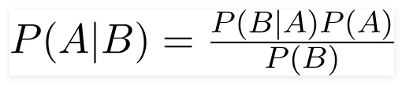
Bayes Theorem: For Naive Bayes Classifier
Using Bayes theorem,
We can find the probability of A happening, given that B has occurred.
Here, B is the evidence and A is the hypothesis.
The assumption made here is that the predictors/features are independent.
That is presence of one particular feature does not affect the other. Hence it is called naive.

Slide 33
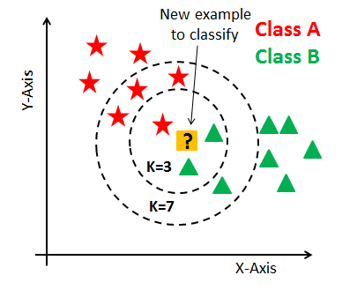
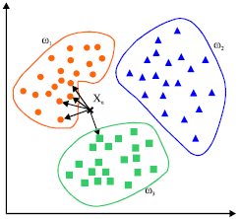
K-Nearest Neighbors algorithm KNN

Slide 34
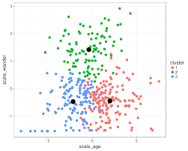
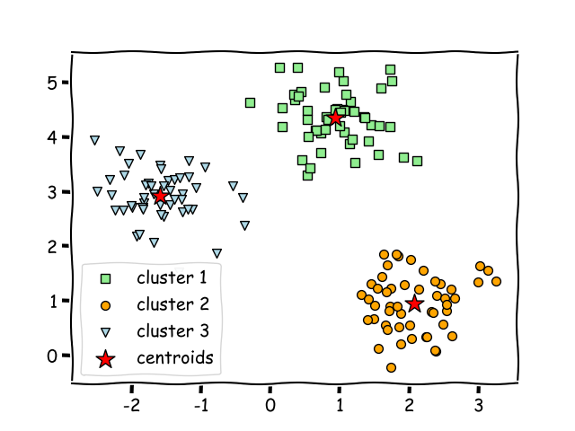
K Mean

Slide 35
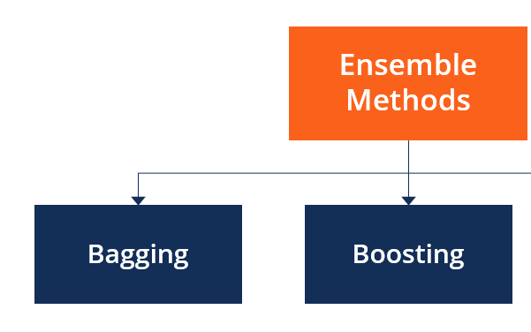

Slide 36
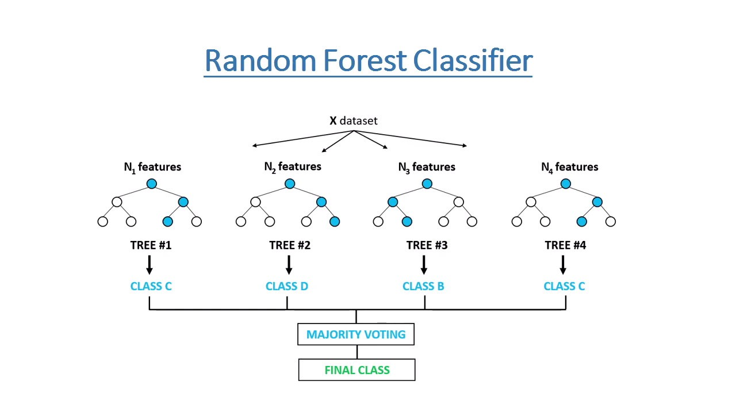
Random Forest Classifier

Slide 37
When my random forest Overfitting?
It can easily overfit to noise in the data.
The Random Forest with only one tree will overfit to data as well because it is the same as a single decision tree.
When we add trees to the Random Forest then the tendency to overfitting should decrease (thanks to bagging and random feature selection).

Slide 38
All DT as base model
Regulization
Samples
Voting at the end for output

Slide 39
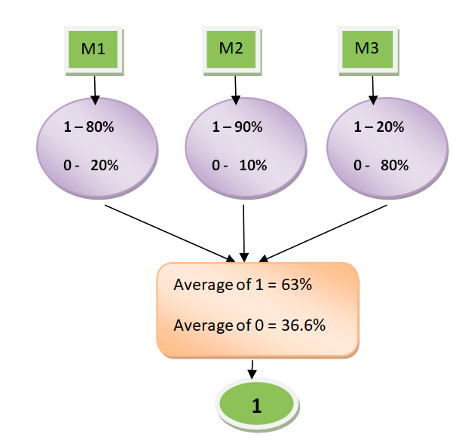
Voting Classifier
Hard Voting: In hard voting, the predicted output class is a class with the highest majority of votes.
Soft Voting: In soft voting, the output class is the prediction based on the average of probability given to that class.

Slide 40
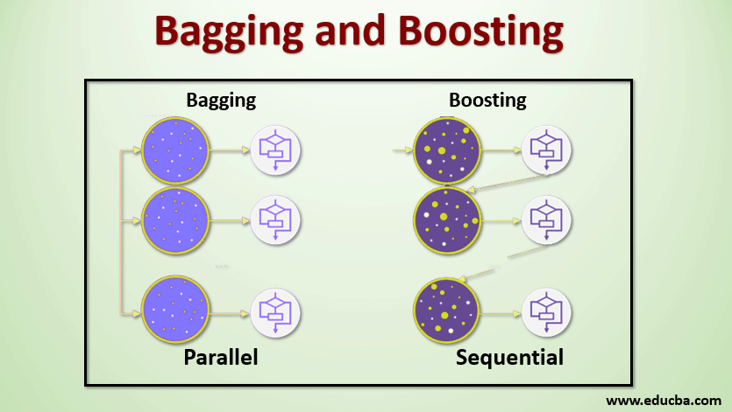
Boosting Algorithem
Taking weak learner togather and combine their output for more accurate result making a strong model.
Boosting and Baging both are Ensemble Learning.

Slide 41
Types of Boosting Algorithm
AdaBoost (Adaptive Boosting) algorithm
Gradient Boosting algorithm
XG Boost algorithm

Slide 42
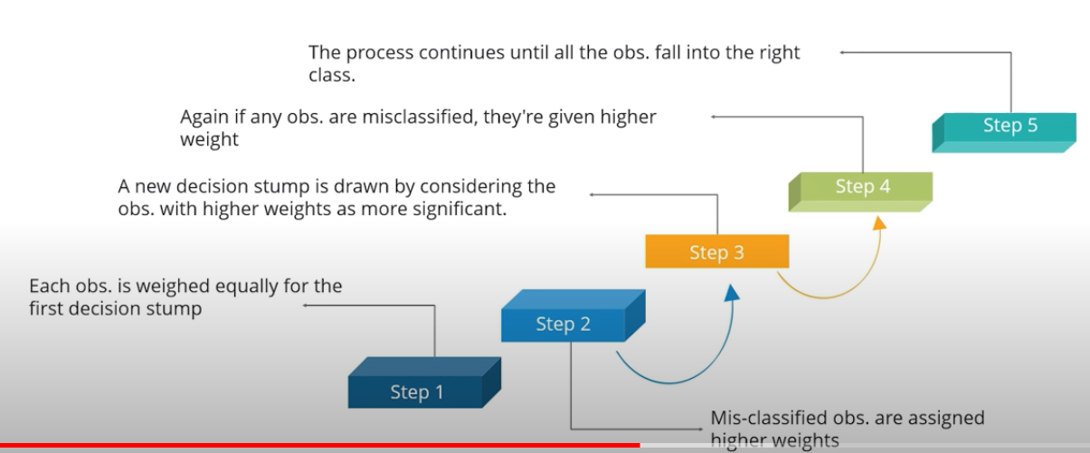
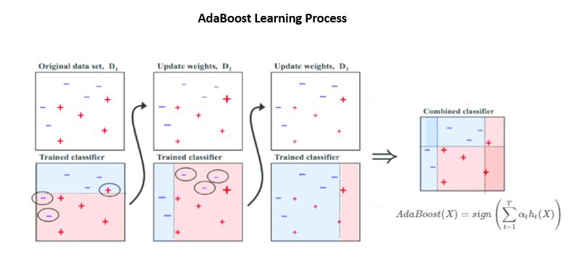
AdaBoost (Adaptive Boosting) Algorithm
Used for both classification and regression. But most commonly used as a classifier.
Weak classifier combined to one strong.

Slide 43
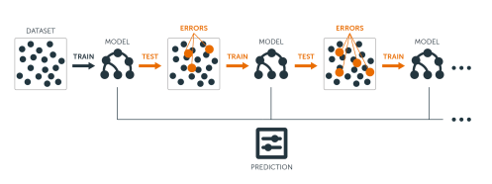
Gradient Boosting
It is also a sequential ensumble method.
Focus on reducing the loss function.
We dont increase weight here.
Base learner are genrated in such a way that the present learner is stronger then the previous one.
Each time a new model is added that regularize the previous model hence improving the loss function.

Slide 44
XGBoost | eXtreme Gradient Boosting.
Parallelization of tree construction using all of your CPU cores during training.
Distributed Computing for training very large models using a cluster of machines.
Out-of-Core Computing for very large datasets that don’t fit into memory.
Cache Optimization of data structures and algorithm to make best use of hardware.
Gradient Boosting was very slow in computing.
It use all base model parallelly.
Distributed computing is used.
Out of core computing.
Cache Optimization.
Execution Speed Improves.
Model Performance Improves.
It is actually a frame work that support multiple languages.
Using regulization by default.
Internally a DT model.
Auto pruning : Tree dont grow below a certain level.So bias and varience is taken care off.
Miss values are handled if they are still there.

Slide 45
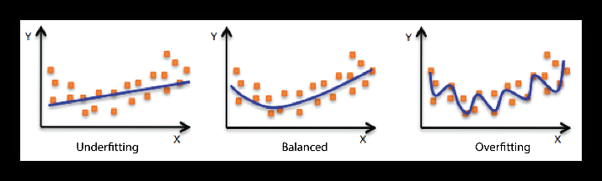
Over Fiting And Under Fitting
Under Fitting= Training error and testing error HIGH
Over Fitting = Training error LOW but testing error HIGH

Slide 46
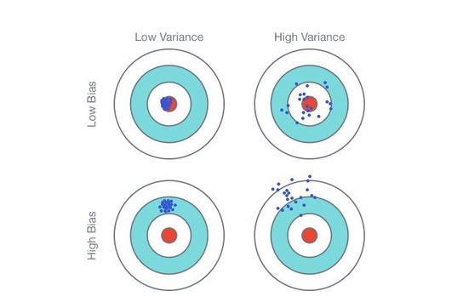
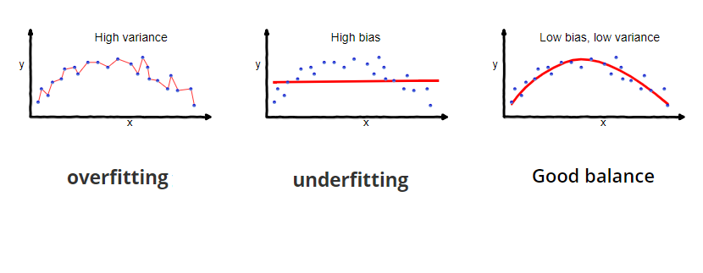
Variance And Bias
Bias is training time error
Variance is testing time error

Slide 47
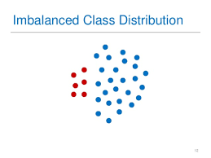
Imbalance Class Distribution

Slide 48
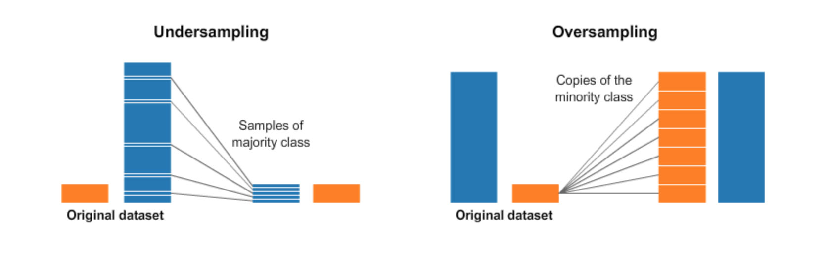
Over Sampling And Under Sampling

Slide 49
Repository
UCI Machine Learning Repository
https://archive.ics.uci.edu/ml/index.php
Kaggle
https://www.kaggle.com/

Slide 50
Principal Component Analysis or PCA
PCA is a dimensionality-reduction method that is often used to reduce the dimensionality of large data sets.
It transform a large set of variables into a smaller one that still contains most of the information in the large set.
Reduce the number of variables of a data set, while preserving as much information as possible.

Slide 51

STANDARDIZATION Scale
A variable that ranges between 0 and 100 will dominate over a variable that ranges between 0 and 1.
Put all on the same scale

Slide 52

Normalization
The goal of normalization is to change the values of numeric columns in the dataset to use a common scale, without distorting differences in the ranges of values or losing information.

Slide 53
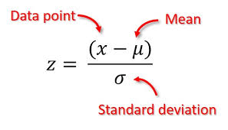
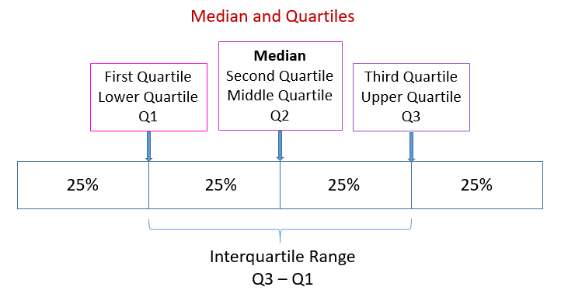

Outlier Detection
Z-Score
IQR
Scatter Plot
Box Plot

Slide 54
Methods
Z- Score
IQR
Box Plot
Scatter Plot

Slide 55

Z-Score
A z-score is the number of standard deviations from the mean value of the reference population.

Slide 56

Interquartile range (IQR)
The IQR describes the middle 50% of values when ordered from lowest to highest.
To find the interquartile range (IQR), ​first find the median (middle value) of the lower and upper half of the data.
These values are quartile 1 (Q1) and quartile 3 (Q3). The IQR is the difference between Q3 and Q1.

Slide 57

IQR for outliner detection

Slide 58


BOX PLOT

Slide 59


Scatter Plot

Slide 60

Lable Encoding
For Ordinal Data.
Eg:
Phd > M.Tech > B.E.

Slide 61

One Hot Encoding

Slide 62

CLUSTER
Clustering is a type of unsupervised machine learning technique where the goal is to group a set of data points into clusters or groups, so that:
Data points in the same cluster are more similar to each other than to those in other clusters.
Data points in different clusters are more dissimilar.
The aim is to find natural groupings or patterns in the data without predefined labels or categories.
Key Characteristics of Clustering:
Unsupervised: No labeled data is required.
Similarity-based: Points in the same cluster are similar (based on distance, feature similarity, etc.).
Exploratory: Used to discover hidden patterns in data.
Common Clustering Algorithms:
K-means: Partitions data into K clusters by minimizing the variance within each cluster.
DBSCAN: Forms clusters based on density, useful for finding arbitrarily shaped clusters.
Mean Shift: Moves "windows" around the data to find dense areas and form clusters.
Hierarchical: Builds a tree of clusters, useful for nested groupings.
Applications of Clustering:
Customer segmentation in marketing.
Image recognition and object detection.
Document classification.
Anomaly detection.
In short, clustering is about grouping similar items together to uncover inherent structures in the data

Slide 63
K-means
K-means is a popular unsupervised clustering algorithm that partitions data into K clusters based on feature similarity.
Steps of K-means Algorithm:
Choose the number of clusters (K): You decide how many clusters you want to form in advance. The value of K is a hyperparameter and must be specified before running the algorithm.
Initialize the centroids: Randomly select K data points from the dataset as the initial cluster centers (called centroids).
Assign data points to the nearest centroid: Each data point is assigned to the closest centroid, based on a distance metric (typically Euclidean distance). This step forms K clusters.
Update the centroids: Once all points are assigned to a cluster, compute the new centroid for each cluster. The centroid is the mean of all the points within the cluster.
Repeat: Reassign the data points to the new centroids and update the centroids again. Repeat this process until the centroids stop changing (i.e., they converge) or a specified number of iterations is reached.
Final Clusters: Once the centroids stabilize, the algorithm terminates, and the final clusters are formed.
Key Concepts:
Centroids: The center of a cluster, calculated as the mean of all points in the cluster.
Distance Metric: Euclidean distance, used to measure how far data points are from the centroids.
Convergence: The algorithm stops when the centroids no longer move significantly between iterations, or after a fixed number of iterations.
Visual Example:
Imagine you have a 2D dataset. K-means will:
Start by randomly picking K points as cluster centers.
Assign each data point to the nearest centroid.
Recalculate the centroid of each cluster based on the assigned points.
Repeat this until the centroids stop changing, resulting in distinct clusters.

Slide 64
Mean Shift
Mean Shift works and how it forms clusters:
1. Start with Data Points:
You have a set of data points (say N points).
2. Place Windows on Points:
Each data point gets its own window (kernel), starting at its position.
The number of windows is equal to the number of data points.
3. Shift the Window:
For each window, compute the mean of all points inside the window.
Move the window center to this mean. Repeat until the window stabilizes (i.e., stops moving).
4. Convergence:
After several iterations, each window converges to a local density peak (the highest concentration of nearby points).
5. Form Clusters:
Points that converge to the same mean (or nearby) are grouped into the same cluster.
Clusters are formed around the regions where the data points "bunch up."
6. Final Clusters:
The algorithm produces clusters based on the density peaks, and each cluster center corresponds to a converged window.
Key Points:
Number of clusters depends on the data and the bandwidth parameter (larger bandwidth = fewer clusters, smaller bandwidth = more clusters).

Slide 65
Hierarchical Clustering
Hierarchical Clustering is another popular unsupervised clustering algorithm that builds a hierarchy of clusters, often represented as a dendrogram (a tree-like diagram). Unlike K-means, hierarchical clustering doesn't require you to specify the number of clusters in advance. It can either work by bottom-up or top-down approaches.
Two Types of Hierarchical Clustering:
Agglomerative (Bottom-Up): Starts with each data point as its own cluster and progressively merges the closest clusters.
Divisive (Top-Down): Starts with all points in one large cluster and progressively splits the clusters.
Agglomerative clustering is the most commonly used type of hierarchical clustering, so we'll focus on that.
Steps of Agglomerative Hierarchical Clustering:
Start with individual data points as clusters: Each data point is considered its own cluster.
Compute the similarity (distance) between all pairs of clusters:
This is typically done using a distance metric, such as Euclidean distance or Manhattan distance.
Several linkage methods can be used to calculate the distance between clusters (more on that below).
Merge the closest clusters: Identify the two closest clusters and merge them into one cluster.
Repeat: Continue to merge the closest clusters until all points are in a single cluster or until the desired number of clusters is achieved.
Build the dendrogram: The process of merging clusters is visualized in a dendrogram. Each merge is represented as a branch, with the distance between merged clusters indicated by the vertical axis.
Linkage Methods (to calculate distance between clusters):
Single Linkage: The distance between two clusters is the shortest distance between points in the clusters (i.e., nearest neighbors).
Complete Linkage: The distance between two clusters is the longest distance between points in the clusters (i.e., farthest neighbors).
Average Linkage: The distance between two clusters is the average distance between all pairs of points from each cluster.
Ward’s Method: This minimizes the total within-cluster variance and is often preferred because it tends to create compact, spherical clusters.
Dendrogram:
A dendrogram is a tree-like diagram used to represent the arrangement of clusters. The height of the branches indicates the distance at which clusters are merged.
How to Choose the Number of Clusters:
You can cut the dendrogram at a certain level to decide the number of clusters.
The "elbow" method: Look for the point where the distance between clusters increases significantly — this might suggest a good place to cut the tree.

Slide 66
DBSCAN (Density-Based Spatial Clustering of Applications with Noise)
DBSCAN (Density-Based Spatial Clustering of Applications with Noise) is a powerful clustering algorithm that identifies clusters of data points based on their density. Unlike K-means, DBSCAN can discover clusters of arbitrary shapes and is good at handling outliers (points that don't belong to any cluster).
Key Concepts of DBSCAN:
Core Points: Points that have at least minPts points within a given epsilon (ε) radius.
Border Points: Points that are not core points but are within the ε radius of a core point.
Noise Points: Points that do not belong to any cluster (points that are neither core nor border points).
Two Key Parameters:
Epsilon (ε): The maximum distance between two points for one to be considered as a neighbor of the other. Essentially, it defines the neighborhood of a point.
minPts: The minimum number of points required to form a dense region (a cluster). A core point must have at least minPts points within its ε radius, including itself.
How DBSCAN Works (Step-by-Step):
Start with an arbitrary point: Pick a random point in the dataset that hasn't been visited yet.
Check if it's a core point: If the point has minPts points within its ε radius, it becomes a core point, and a new cluster starts.
Expand the cluster: All points within the ε radius of the core point (including border points) are added to the cluster.
Check neighboring points: For each new point added to the cluster, repeat the process: check if it has minPts neighbors and expand the cluster if necessary.
Mark noise: If a point doesn’t meet the core point criteria (doesn't have enough neighbors), it’s marked as noise (outlier).
Repeat for all points: The algorithm moves to the next unvisited point and repeats the process until all points are either part of a cluster or marked as noise.

Slide 67
Clustering Metrics
silhouette_score
What it does: Measures how well each data point lies within its cluster.
Input: Features (X) and cluster labels.
Output: A score between -1 and 1.
1: Perfect clustering.
0: Overlapping clusters.
-1: Incorrect clustering.
davies_bouldin_score
What it does: Evaluates the average similarity ratio between clusters.
Input: Features (X) and cluster labels. vOutput: A score where lower is better.
calinski_harabasz_score
What it does: Measures the ratio of cluster separation to cluster compactness.
Input: Features (X) and cluster labels.
Output: A score where higher is better.
mutual_info_score
What it does: Measures the mutual information between true and predicted cluster labels (how much knowing one label helps predict the other).
Input: True labels and predicted labels.
Output: Non-negative score (higher is better).
adjusted_rand_score
What it does: Compares predicted clusters with true clusters, adjusted for chance.
Input: True labels and predicted labels.
Output: Score between -1 and 1.
1: Perfect match

Slide 68


