Slide 1
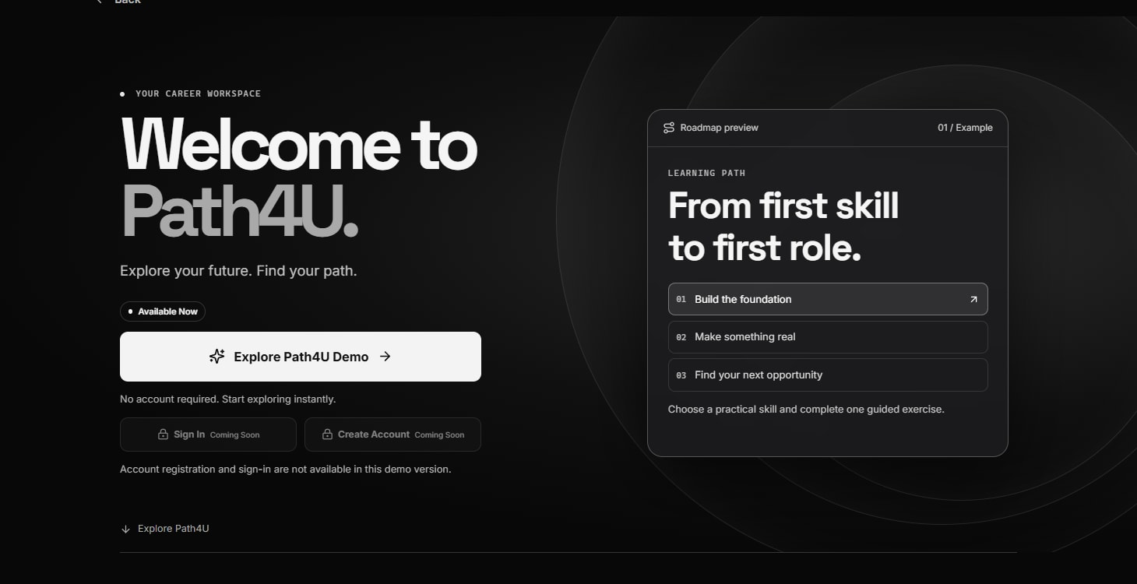
Path4U
Your Future. Your Direction.
TEAM SOUL
Sumed Satpathy
Shayan Tanveer Khan
Syed Md Takiuddin Ali
Notes:
We are team SOUL: Sumed Satpathy, Shayan Tanveer Khan and Syed Md Takiuddin Ali. Path4U helps students and early-career professionals choose a direction and turn it into a practical next step. We connect opportunity discovery, learning plans and preparation in one workspace. Today we will show the actual guest experience and clearly identify which newer AI improvements are on Preview.
Sources: User-supplied team names; public welcome screen; public/mark.svg.
Public demo: https://path4u.vercel.app. Source snapshot: f39d7be. Latest AI/quota improvements remain on the protected Preview; Production is an earlier build.

Slide 2
The problem
02
Unclear career direction
Scattered learning resources
A goal needs a manageable first step.
Useful courses need context and a schedule.
Hard-to-compare opportunities
Skills that are hard to present
Relevance, sources and requirements matter.
Applications need clear evidence of experience.
Notes:
A student can know they want a technology career without knowing what to study next. Learning resources are scattered, opportunity listings need careful checking, and turning skills into a clear application takes another set of tools. Path4U addresses this connected workflow. These are the needs our product is designed around, not claims based on an invented survey.
Sources: User brief and README problem statement. No survey statistics or market-size claims.
Public demo: https://path4u.vercel.app. Source snapshot: f39d7be. Latest AI/quota improvements remain on the protected Preview; Production is an earlier build.

Slide 3
Our solution
03
One platform to discover opportunities, build skills,
plan careers and prepare for employment.
Discover
Plan
Practice
Prepare
Find relevant opportunities
Set a learning goal
Follow milestones
Present your skills
Notes:
Our value proposition is one platform to discover opportunities, build skills, plan careers and prepare for employment. The user starts with something relevant, chooses a learning goal and time budget, follows observable milestones, and prepares material they can review. The user remains in control of saving work and submitting through official channels. We do not automatically apply to LinkedIn jobs.
Sources: README feature descriptions; src/Discover.tsx, src/Learning.tsx, src/ResumeStudio.tsx.
Public demo: https://path4u.vercel.app. Source snapshot: f39d7be. Latest AI/quota improvements remain on the protected Preview; Production is an earlier build.

Slide 4
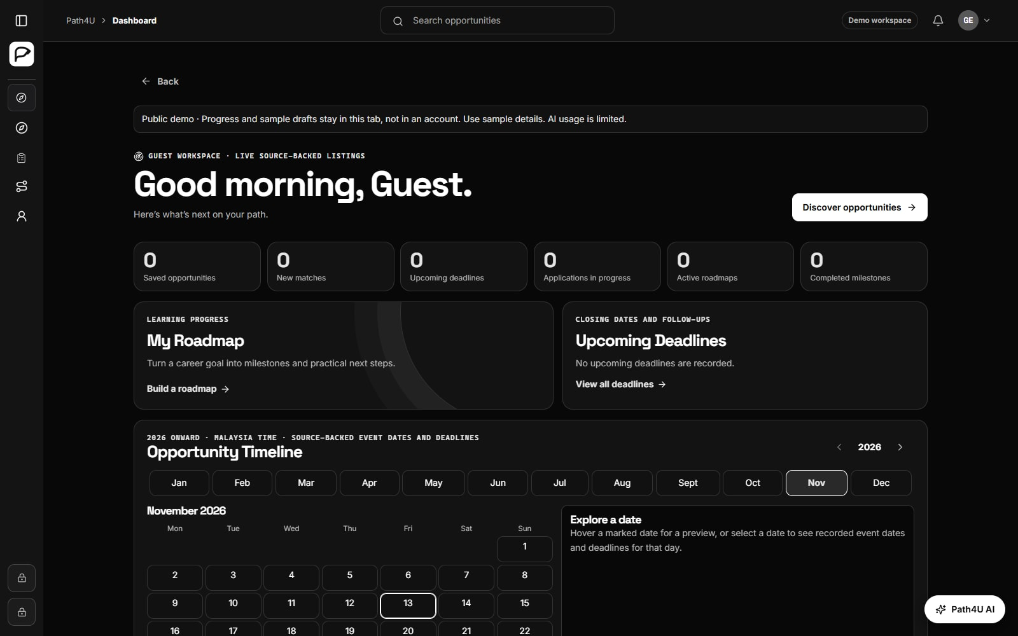
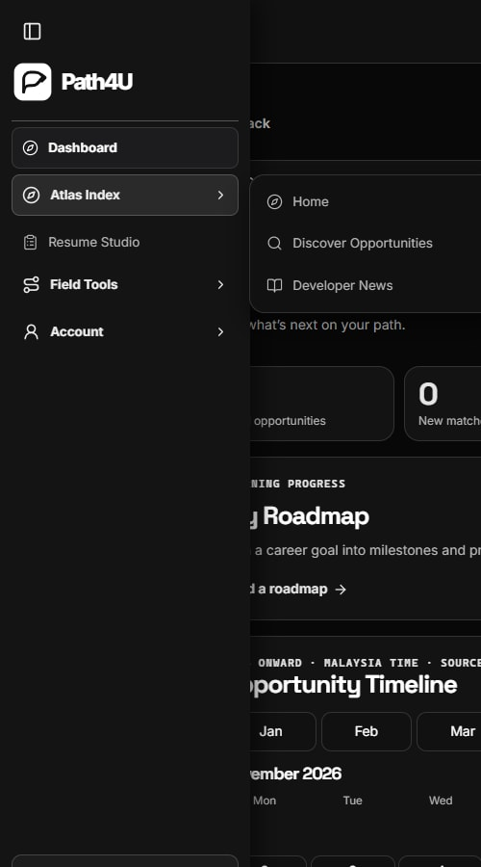
Platform overview
04
Guest dashboard and hover, keyboard or touch navigation
Notes:
The dashboard keeps saved work and learning progress visible. The sidebar expands on pointer entry, while touch and keyboard users can open the same destinations. Atlas Index groups discovery and saved opportunities. Field Tools holds the learning and preparation tools. The public release is guest-first, with account actions marked Coming Soon. Guest work stays in this browser tab.
Sources: Current Production dashboard and Atlas Index captures, 13 November 2026; src/Shell.tsx and src/Dashboard.tsx.
Public demo: https://path4u.vercel.app. Source snapshot: f39d7be. Latest AI/quota improvements remain on the protected Preview; Production is an earlier build.

Slide 5
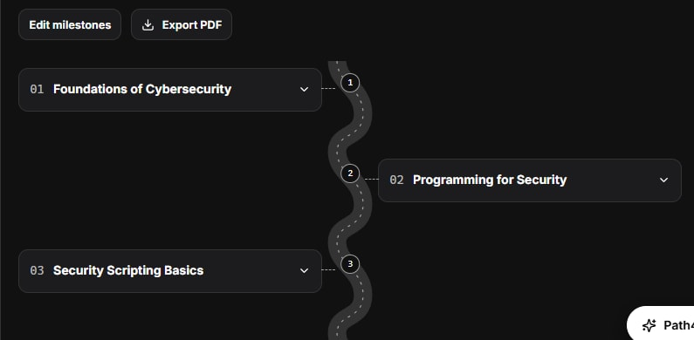
Personalized AI roadmaps
05
Goal, level and study time
Milestones with projects
and learning resources
Explicit save and
progress tracking
Saved flowchart view
Editable mind-map branches
Live AI improvements shown from the tested protected Preview
Notes:
Users choose a career goal, starting level, duration and weekly hours. The server validates generated phases against that time budget and returns lessons, projects, completion criteria and resource links. Users explicitly save a plan and track progress. A saved plan also has a flowchart view, so changing the view does not require another generation. Editable mind maps are implemented, with genuine Gemini branch generation verified on the newer protected Preview.
Sources: server/roadmaps.mjs; src/Learning.tsx; actual live Gemini Preview capture from docs/video.
Public demo: https://path4u.vercel.app. Source snapshot: f39d7be. Latest AI/quota improvements remain on the protected Preview; Production is an earlier build.

Slide 6
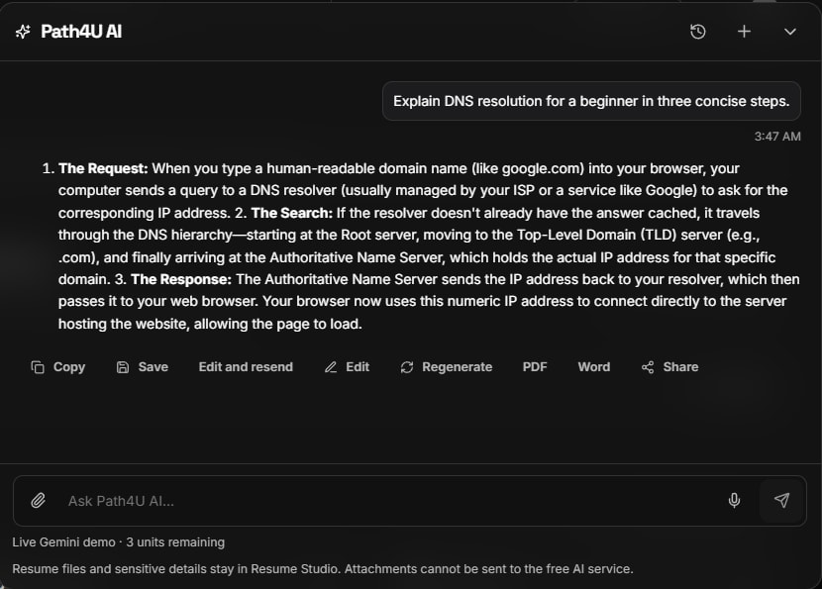
Path4U AI assistant
06
Technology explanations
Career and study-plan help
Original-provider course links
Live Gemini Preview capture. Paid web research remains disabled.
Notes:
Path4U sends a non-sensitive question through the server to Gemini. The example explains DNS resolution for a beginner. The assistant can support career and technology guidance and learning-plan requests. Course recommendations use original-provider directory links. Quotas and provider errors remain visible. Paid web grounding is disabled in this release, so we do not claim that this demonstration performed live web research.
Sources: server/liveDemo.mjs, server/integrations.mjs and real nonblank Gemini Preview response.
Public demo: https://path4u.vercel.app. Source snapshot: f39d7be. Latest AI/quota improvements remain on the protected Preview; Production is an earlier build.

Slide 7
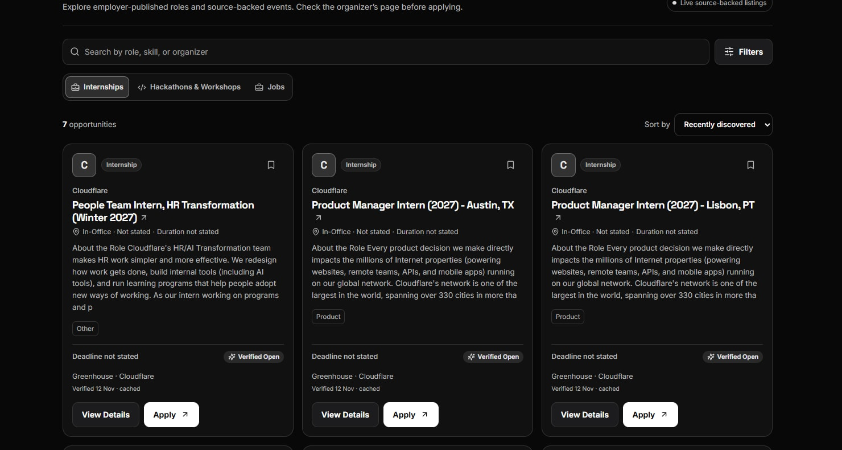
Discover opportunities
07
Internships
Hackathons & workshops
Jobs
Location and skill filters
Original application links
Source and freshness labels
Unknown deadlines stay unknown. Confirm availability at the source.
Notes:
The catalog separates internships, hackathons and workshops, and jobs. Users can search by role or skill terms and filter by location. Listings retain original links and source labels. A missing deadline stays unknown instead of becoming an invented closing date. Availability can change at the organizer, so the user should check the source before applying. The brands visible in listings are sources, not claimed partnerships.
Sources: Current Production Discover capture; src/Discover.tsx and server/feed.mjs.
Public demo: https://path4u.vercel.app. Source snapshot: f39d7be. Latest AI/quota improvements remain on the protected Preview; Production is an earlier build.

Slide 8
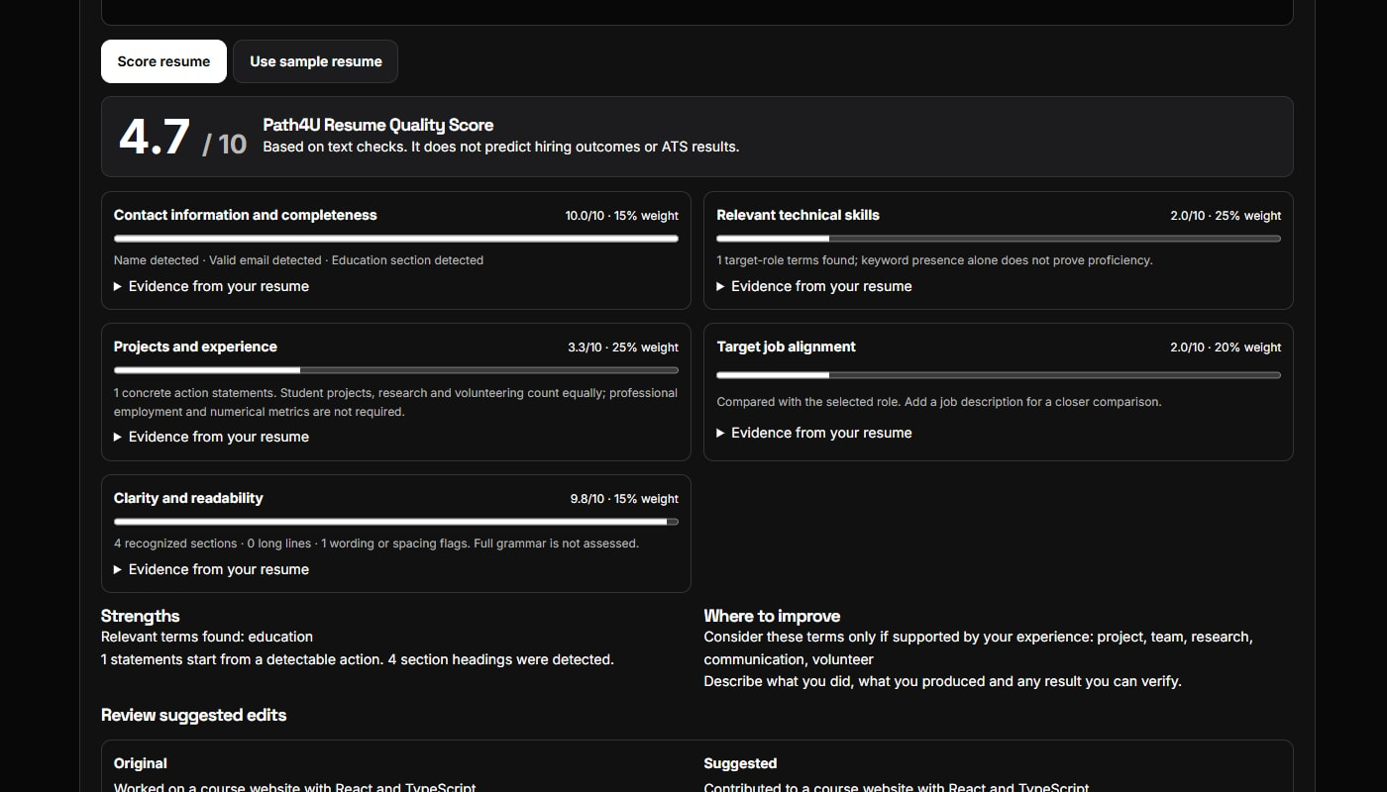
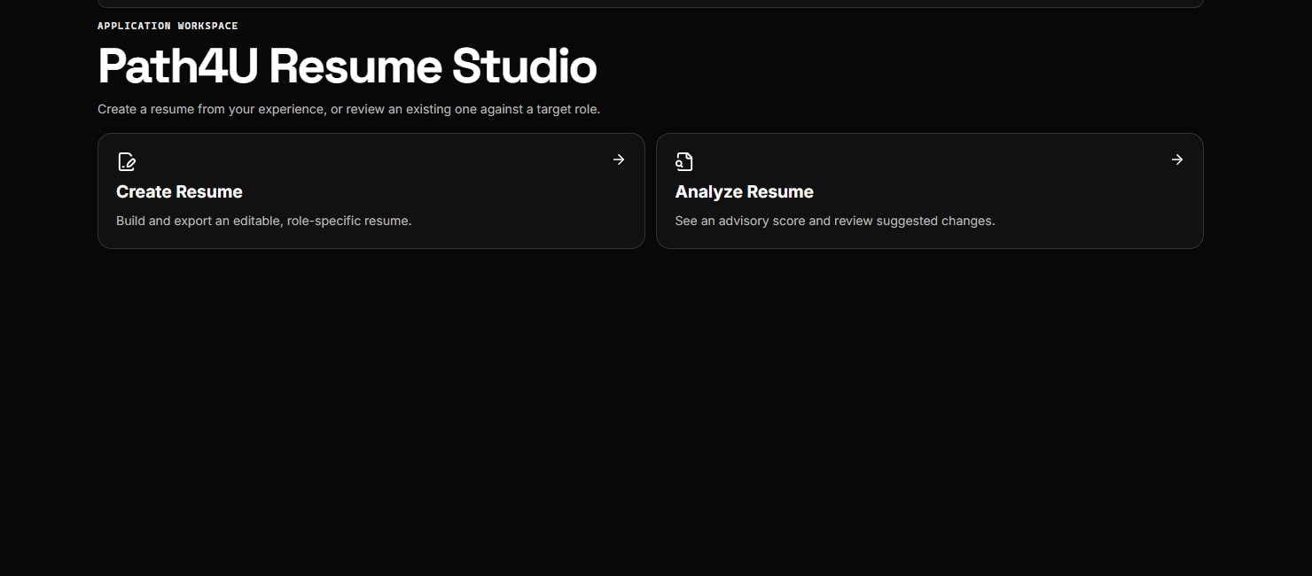
Resume Studio & Rater
08
Build with validation
Review an explained quality rubric
Professional formatting and editable exports
Actionable suggestions from observable text
Fictional sample data. Local quality evaluation does not predict hiring outcomes.
Notes:
Resume Studio supports creating a resume, validating required inputs, formatting drafts and exporting documents. The local rater explains its quality rubric and gives actionable suggestions supported by the supplied text. The screenshot uses the built-in fictional sample. This is a heuristic quality evaluation, not an official ATS score or a hiring prediction. Private resume text is not sent to the free Gemini service.
Sources: Current Production Resume Studio and local fictional sample evaluation; shared/resumeValidation.mjs and shared/resume.mjs.
Public demo: https://path4u.vercel.app. Source snapshot: f39d7be. Latest AI/quota improvements remain on the protected Preview; Production is an earlier build.

Slide 9
Technology & innovation
09
Integrated learning and career preparation
Gemini API
React 19
TypeScript + Vite
Vercel
Node API
User
Approved data sources
Guest progress stays in this tab.
Server checks govern live AI requests.
Supabase
Data + durable quotas
Public account actions remain Coming Soon
Notes:
The frontend uses React, TypeScript and Vite. Vercel hosts the frontend and Node API. The API coordinates Gemini, approved opportunity sources and Supabase. The newer durable AI path reserves quota before provider calls. Guest progress remains in tab storage, while retained account features use the existing ownership checks. The engineering contribution is joining these steps through a modular, reviewable workflow. Public account access remains disabled, and we do not claim production maturity beyond the demonstrated release.
Sources: package.json, vercel.json, api/index.mjs, server/index.mjs, server/aiQuota.mjs and Supabase migrations.
Public demo: https://path4u.vercel.app. Source snapshot: f39d7be. Latest AI/quota improvements remain on the protected Preview; Production is an earlier build.

Slide 10

Impact & live demo
10
Your journey starts
with a direction.
Students, graduates and early-career professionals
Now: discovery, learning plans and resume tools
Next: verified account access and approved integrations
Explore Path4U
path4u.vercel.app
TEAM SOUL
Notes:
Path4U is for students, graduates and early-career professionals who want a clear next step. The current guest experience connects source-backed discovery, learning plans and local resume preparation. Future development includes enabling verified account access after its remaining checks and adding approved integrations. The QR code opens the actual public Production demo, which is an earlier build than the protected AI/quota Preview. Please explore Path4U and ask us about the implemented workflow.
Sources: Verified public website https://path4u.vercel.app; user brief; docs/HACKATHON_SUBMISSION.md.
Public demo: https://path4u.vercel.app. Source snapshot: f39d7be. Latest AI/quota improvements remain on the protected Preview; Production is an earlier build.

