Slide 1


Team
Carbifier
-Sumedh Sawant

Slide 2

My App

Slide 3
Contents
Aim
Problem Statement
Workflow
Architecture Diagram
Future Plans
Concusion

Slide 4
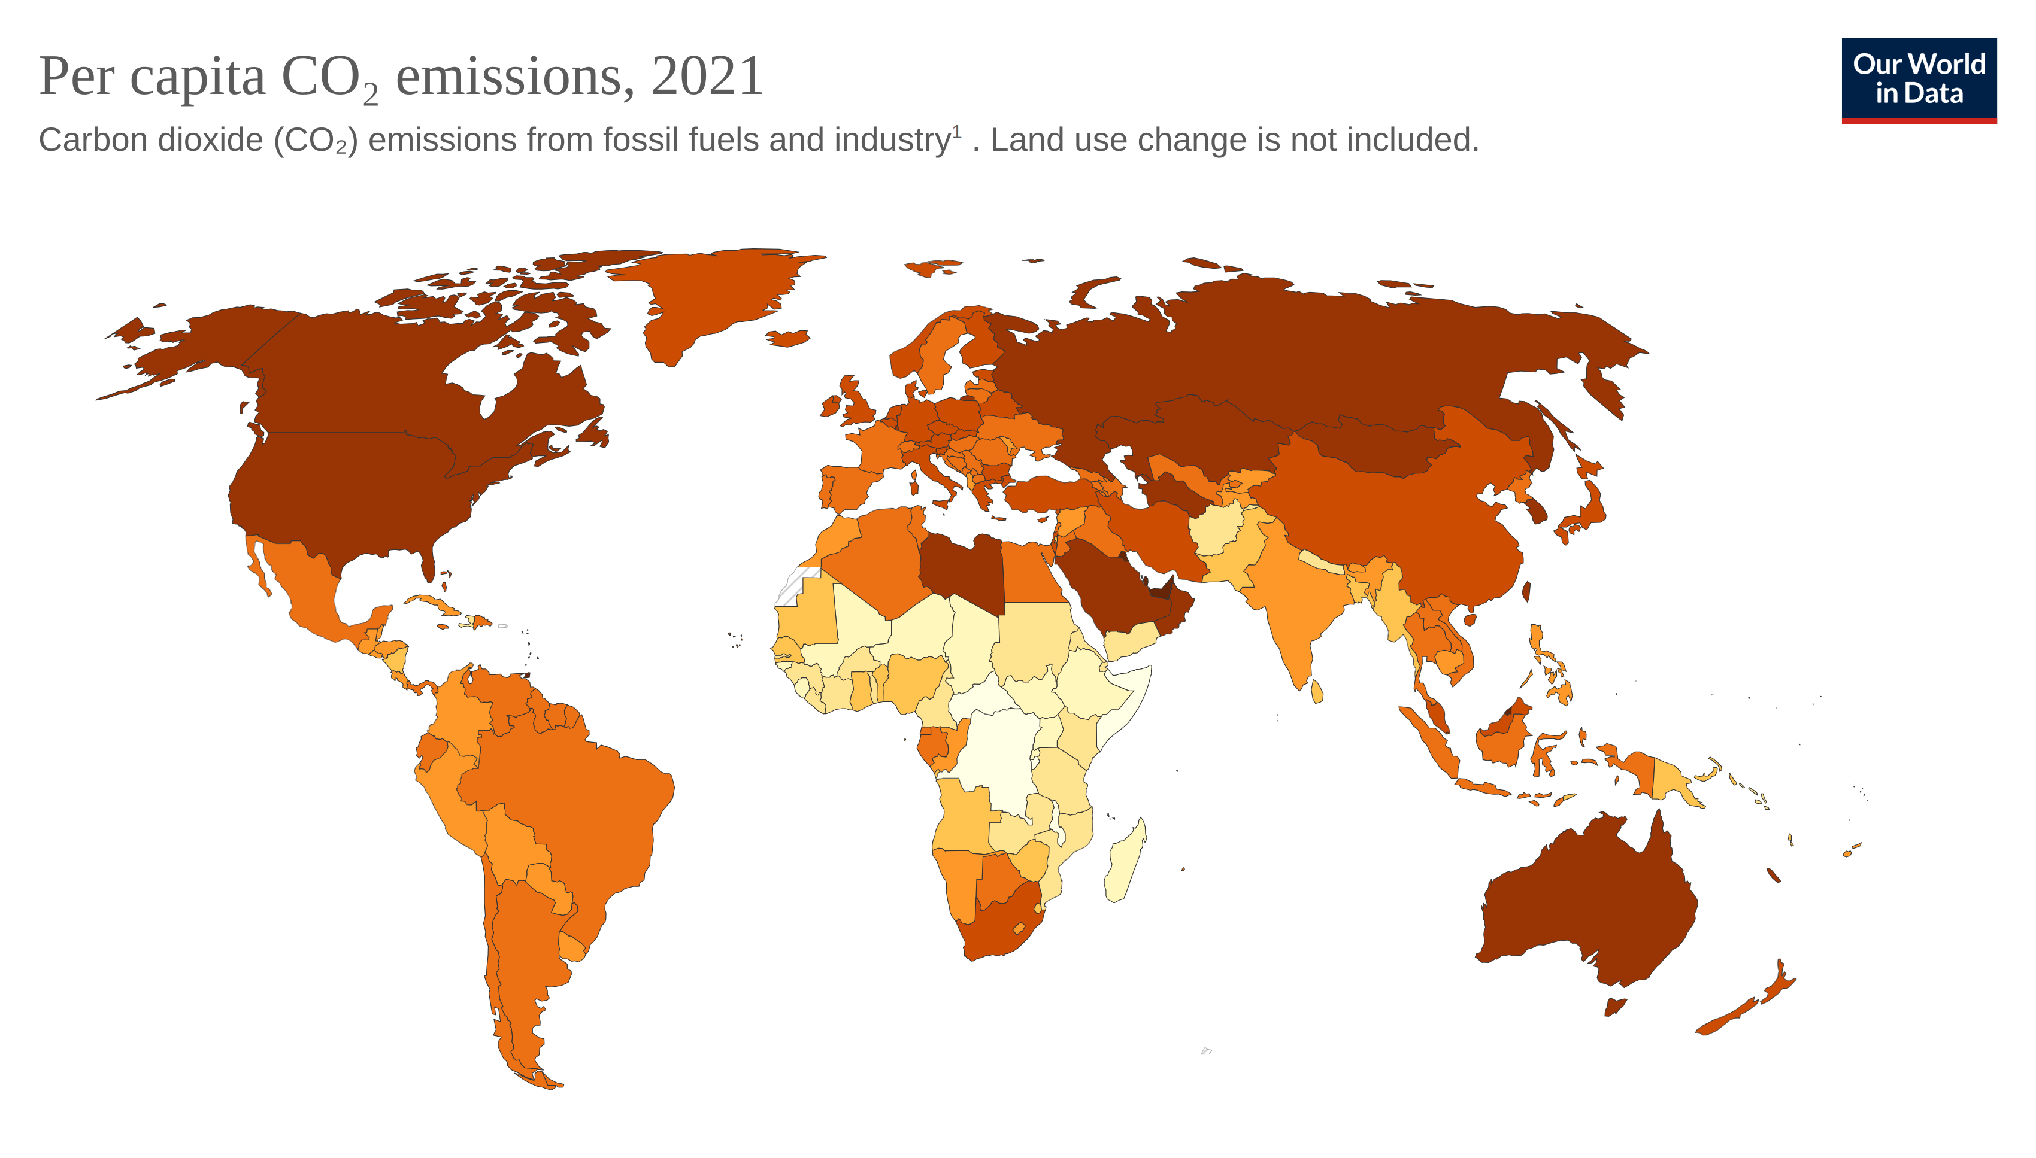
Carbon Emission Map

Slide 5

Our Aim
Every year, around 9 million people die due to carbon emissions caused by several factors such as burning of fossil fuels.
A total of 37 Billion Metric Tonnes of CO2 is released into our atmosphere every year with around 40% of them being from India and China.
In order to curb the rate of carbon emissions, I have developed CredifyME to help users track, calculate and reduce their carbon footprint and get CARBON CREDITS at certain achievable goals

Slide 6
Problem Statement
A website that tracks and calculates the carbon footprint of the user from their monthly electricity usage.
Upon having a limited/Safe value of footprints , the user is awarded CARBON CREDITS that are displayed publicly on their profile.

Slide 7
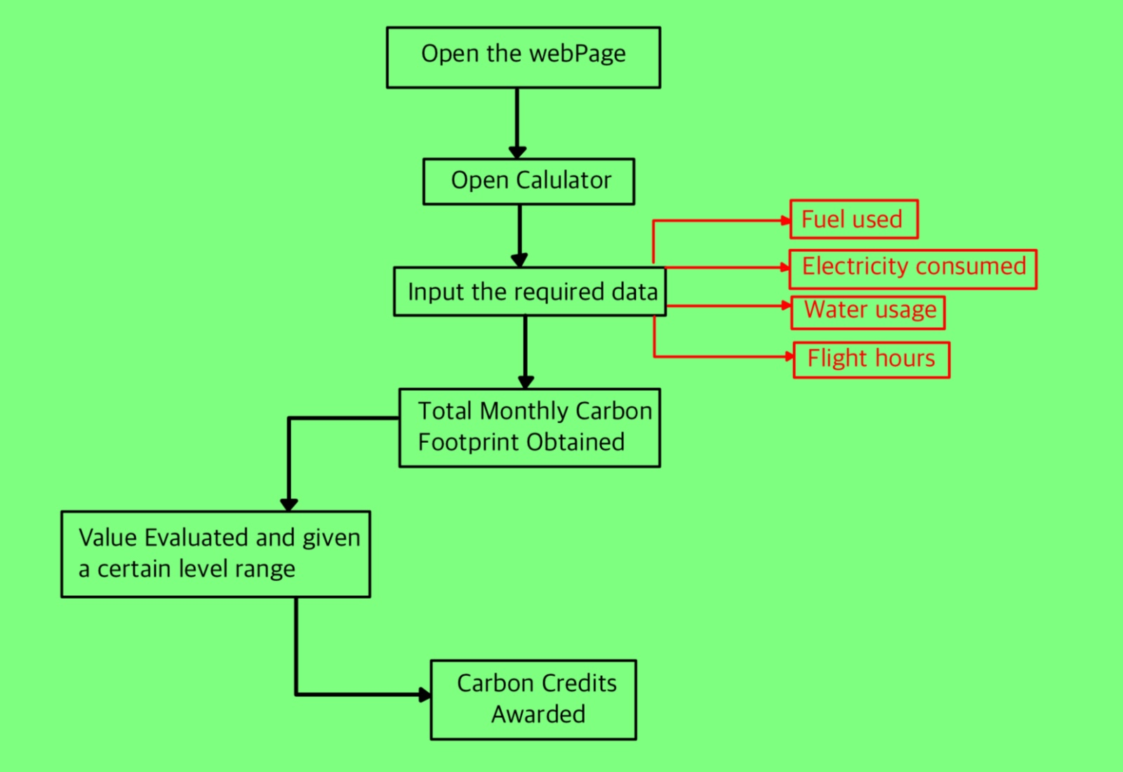
Workflow of the App

Slide 8
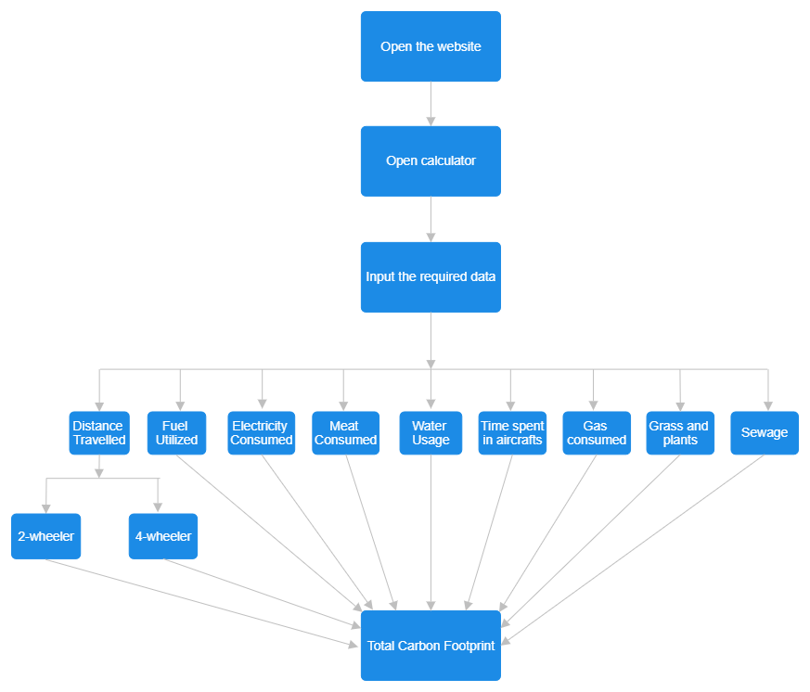
Architecture Diagram

Slide 9
Future Plans
Decentralise the Carbon Credits , via Ethereum blockchain
Credits can be exchanged with discount coupons that can be used in the future
We can also expand as further we can calculate carbon footprints for Industries and Buildings

Slide 10
Why credifyMe?
Easy to use GUI
Accurate calculations
Helps manage carbon emissions and to limit them
Non-Profit initiative
We’ll also provide personalised insights and tips provided according to each user’s unique needs
One-stop destination for all eco-friendly activities
Credit system helps build a community of like-minded people striving towards a green future
Potential to provide certain benefits to user choosing to limit their carbon footprint i.e those with high credits, via future collaborations with other companies
Can be a huge asset towards sustainable development when used on a larger scale

