Slide 1

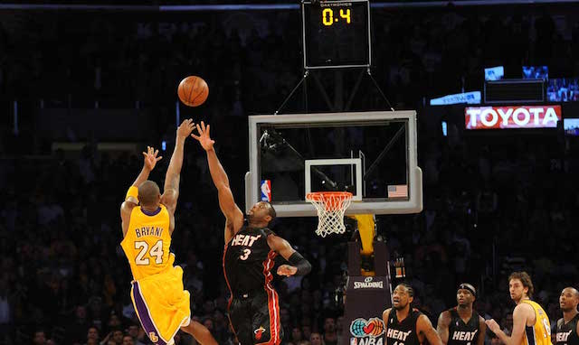
Monte Carlo Simulation
Basketball

Slide 2
The Problem Statement
There is less than 30s left on the clock, and the team is down by 3 points, Is it better to attempt a hard 3-pointer or an easy 2-pointer and get another possession (Fouling the opponent so that they are forced to make a free throw).

Slide 3
Variables involved
Home teams:
2-pt conversion rate
3-pt conversion rate
Offensive rebound and Defensive rebound
Opponent:
2-pt conversion rate
3-pt conversion rate
Offensive rebound and Defensive rebound
Free throw conversion rate
Free throw rebound rate
Time to shoot and Time to foul

Slide 4
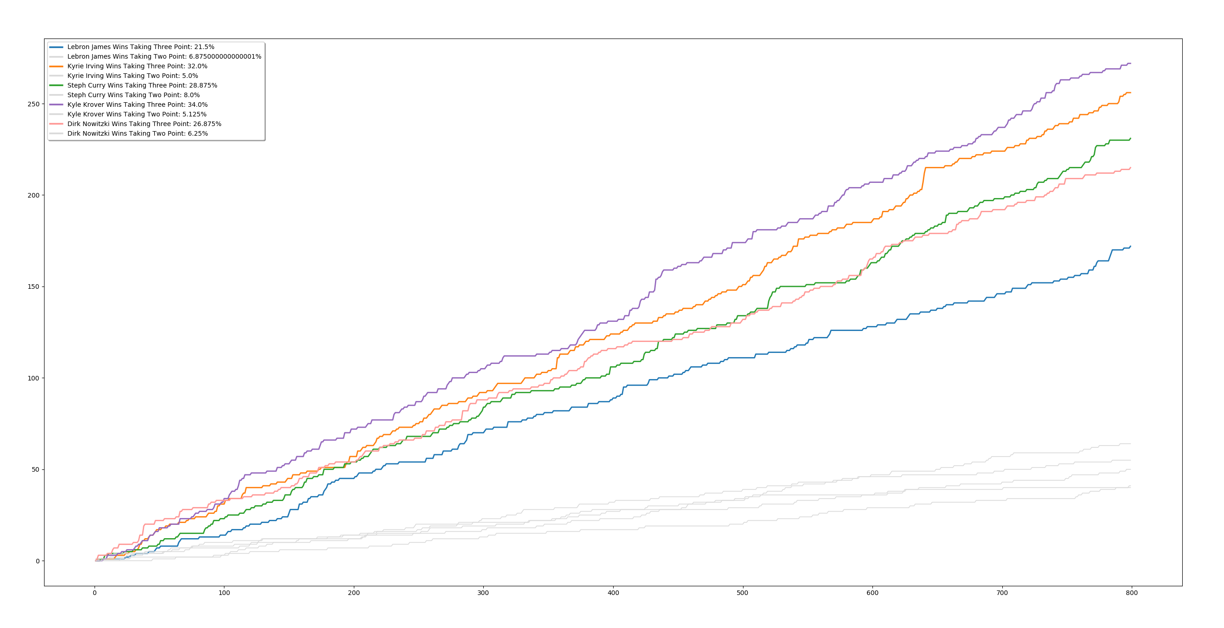
Result

