Slide 1

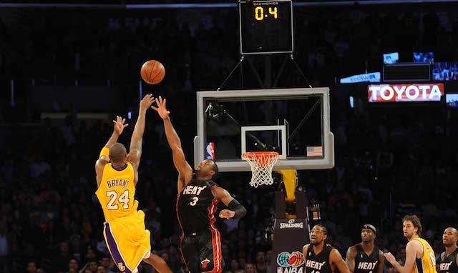
Monte Carlo Simulation
Basketball

Slide 2
The Problem Statement
There is less than 30s left on the clock, and the team is down by 3 points, Is it better to attempt a hard 3-pointer or an easy 2-pointer and get another possession (Fouling the opponent so that they are forced to make a free throw).

Slide 3
Variables involved
Home teams:
  2-pt conversion rate
  3-pt conversion rate
  Offensive rebound and Defensive rebound
Opponent:
  2-pt conversion rate
  3-pt conversion rate
  Offensive rebound and Defensive rebound
  Free throw conversion rate
  Free throw rebound rate
Time to shoot and Time to foul

Slide 4
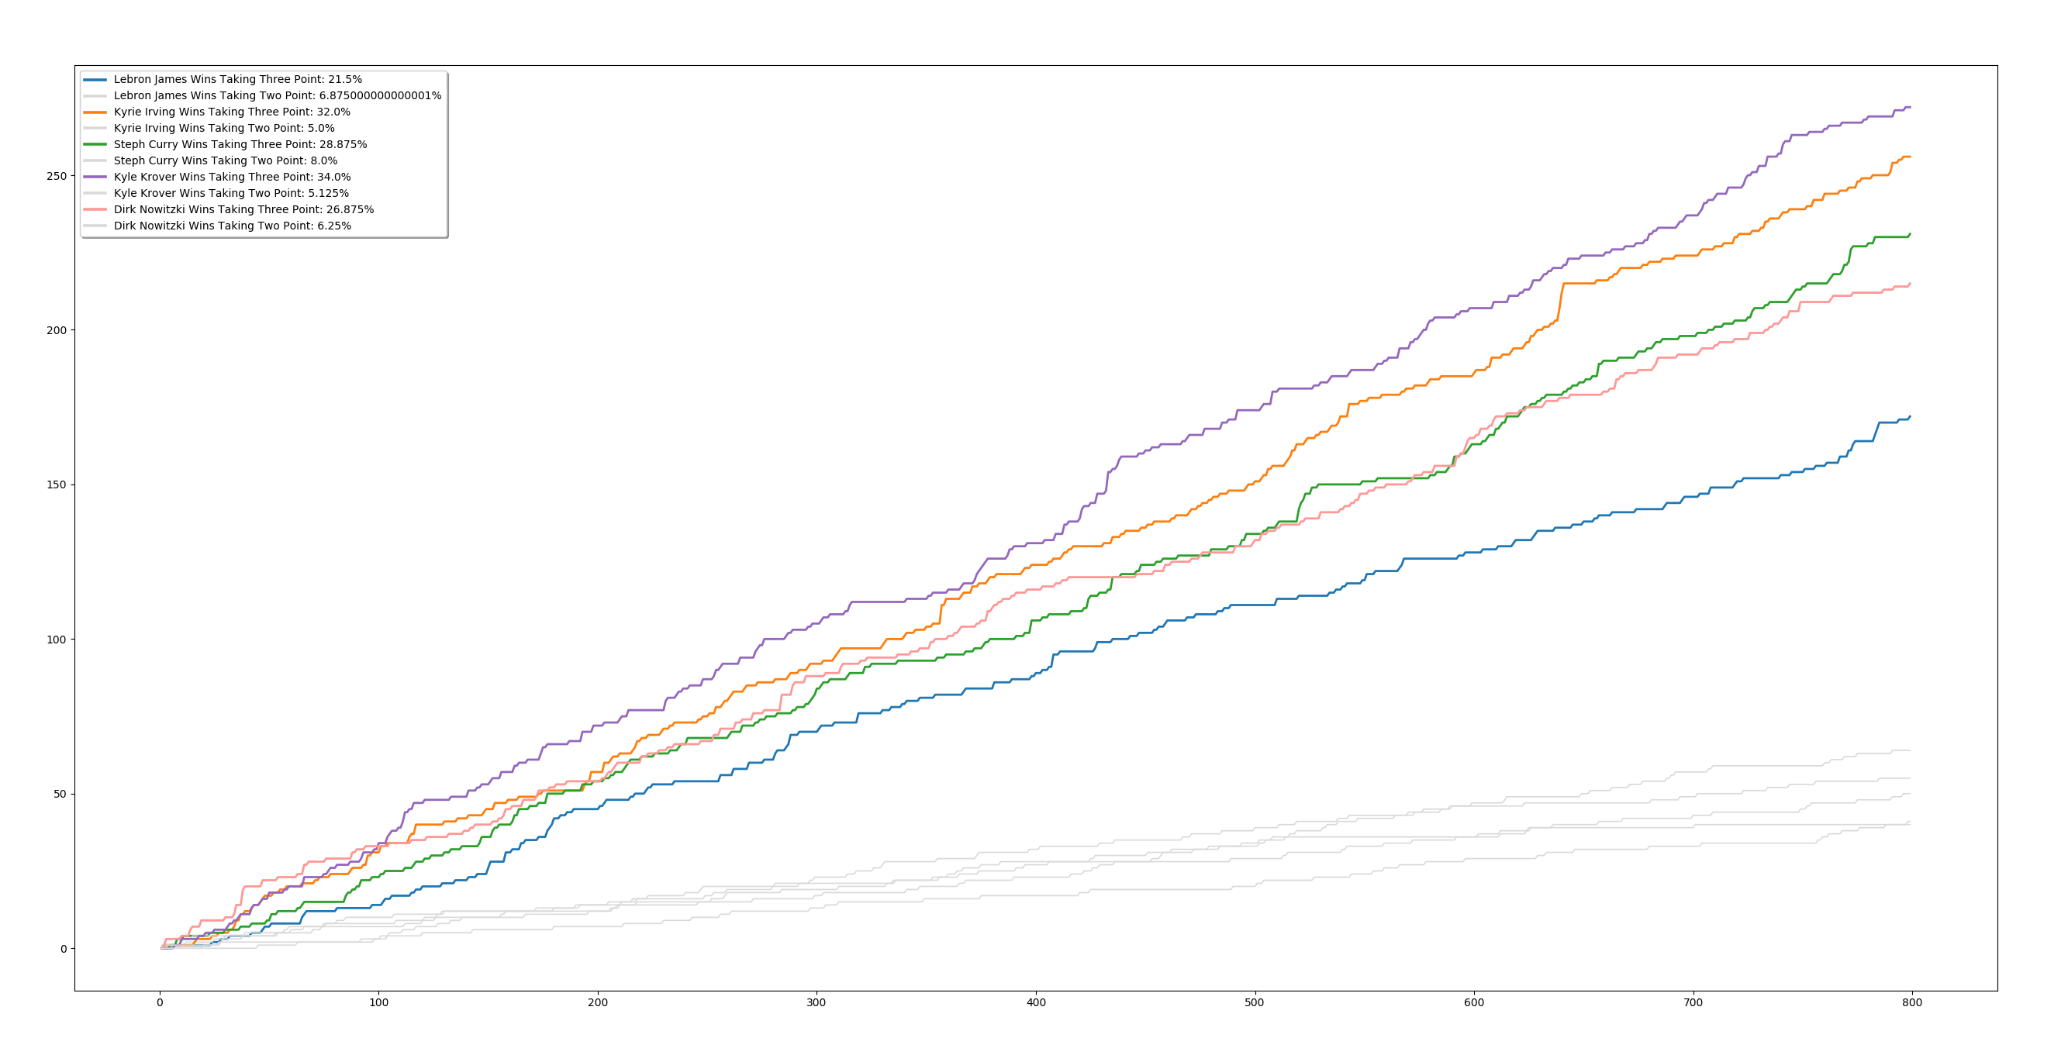
Result

