Slide 1
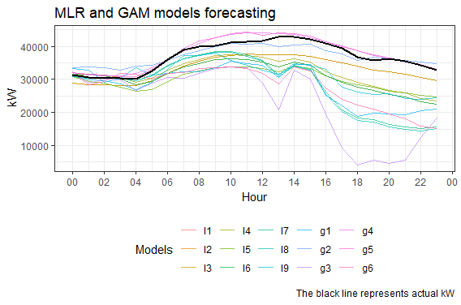
Multivariate Short Term Load Forecasting using Machine Learning Methods
Background and Motivation
Methods
Assumptions
Current forecsting methods heavily rely on rules pertaining to different days of the week and hours of the day
Do not always perform as expected, requires manual estimation to be added as an adjustment
Relies on individuals with heavy market knowledge
We start of with simple linear regression and proceed towards multivariate regression model
Implement Ensembled prediction models.
Create a Neural Network based LSTM or a RNN to create a long range forecast and aggregate down
Models perform better if there are no missing or unreported load values, proper imputation techniques to be developed if missing values discovered
Relies on a promising forecast of weather and other independent variables
Innovation
Validate
Machine Learning Methods allow for rapid prototyping of different models and to apply the most the apt amongst them.
Heavy Duty Neural Network can be applied if the complexity of the forecast or if long range forecasts are required
Can be applied on almost any programming language with some basic statistical knowledge
The current models developed use a test set that has accurate weather data, it would be interesting to apply this to a current weather forecast.
Additional tuning of the parameters may be required when forecasting real-time.

