Slide 1

Slide 1
CRIME ANALYSIS IN PHILADELPHIA
Name – Sumedha N/A
Program – MS Business Analytics

Slide 2
OVERVIEW
The primary objective is to uncover patterns, trends, and correlations within the crime data, focusing on various factors such as the timing of crimes, weather conditions, unemployment rates, and geographic distribution.
Understand the underlying factors contributing to crime in Philadelphia..
Identify potential hotspots and temporal patterns that could assist in crime prevention.
Explore the impact of socio-economic variables, such as unemployment rates, on crime frequencies.
Enhance public safety through data-driven insights and recommendations.
Understand the distribution and frequency of various types of crimes.
Analyze crime trends over time and correlate them with weather patterns and unemployment rates.
2

Slide 3
TARGET AUDIENCE
Real Estate Developers and Investors: Insight into crime rates and trends can influence decisions about property development, investments, and marketing strategies for residential and commercial properties.
Public Health Officials: Understanding the correlation between crime and socio-economic factors can help public health professionals develop programs that address mental health, substance abuse, and other health-related issues contributing to crime rates.
Technology and Data Analytics Companies: Companies specializing in data analytics, predictive modeling, and public safety technologies might be interested in the methodologies and tools used in the project for potential collaborations or product development.
Community Organizations and NGOs: Groups focused on community development, crime prevention, and youth engagement programs can use the insights to tailor their initiatives, apply for grants, and collaborate with law enforcement for community policing efforts.
Media and Journalists: Reporters covering local news, crime, and public safety can use the findings to inform their reporting, create stories that highlight key issues and solutions, and bring public attention to efforts aimed at reducing crime and enhancing community well-being.
3

Slide 4
Slide 1
DATASET DESCRIPTION
I took the data from : https://data.phila.gov/visualizations/crime-incidents
It has 21 columns and around 2.5M rows.

Slide 5
DATASET DESCRIPTION
1.⁠ ⁠crime_type: Indicates the category or specific nature of the crime reported.
2.⁠ point_x: Represents the longitude coordinate where the crime occurred.
3.⁠ ⁠point_y: Represents the latitude coordinate where the crime occurred.
4.⁠ ⁠Year: The year in which the crime was reported.
5.⁠ ⁠Month: The month of the year when the crime was reported.
6.⁠ ⁠Day: The day of the month on which the crime occurred.
7.⁠ Hour: The hour of the day (in 24-hour format) when the crime was reported.
8.⁠ Minute: The minute within the hour when the crime was reported.
9.⁠ ⁠Weekday: The day of the week when the crime occurred.
10. IsWeekend: A binary indicator (yes/no) of whether the crime occurred on a weekend.
4

Slide 6
DATASET DESCRIPTION
11. street_name: The name of the street where the crime took place.
12. ⁠block_number: The block number on the street where the crime occurred, which can help in pinpointing the location.
13.⁠ ⁠distance_to_nearest_police_station: The distance from the crime scene to the nearest police station, typically in meters or kilometers.
14.⁠ ⁠temperature_2m_max (°F): The maximum temperature at 2 meters above ground level on the day of the crime, in degrees Fahrenheit.
15.⁠ ⁠temperature_2m_min (°F): The minimum temperature at 2 meters above ground level on the day of the crime, in degrees Fahrenheit.
16.⁠ ⁠temperature_2m_mean (°F): The average temperature at 2 meters above ground level on the day of the crime, in degrees Fahrenheit.
17.⁠ precipitation_sum (mm): The total precipitation in millimeters for the day when the crime was reported.
18.⁠ precipitation_hours (h): The number of hours during which precipitation occurred on the day of the crime.
19.⁠ Unemployment Rate of a Population: The unemployment rate in the area where the crime occurred, which could be a factor in the frequency or type of crime.
5

Slide 7
ANALYTICAL APPROACH
Searched dataset
Performed Exploratory Data Analysis
Cleaned the imbalance dataset
Preprocessed the dataset
Applied machine learning algorithms
6

Slide 8
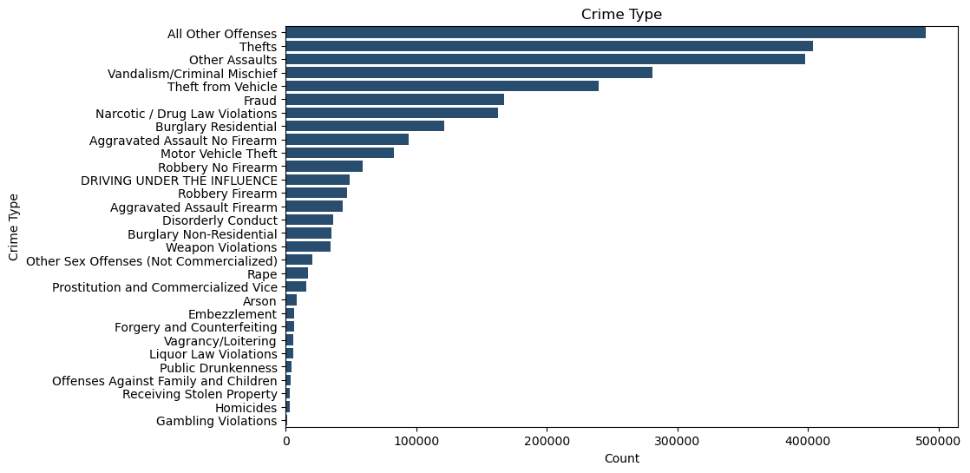
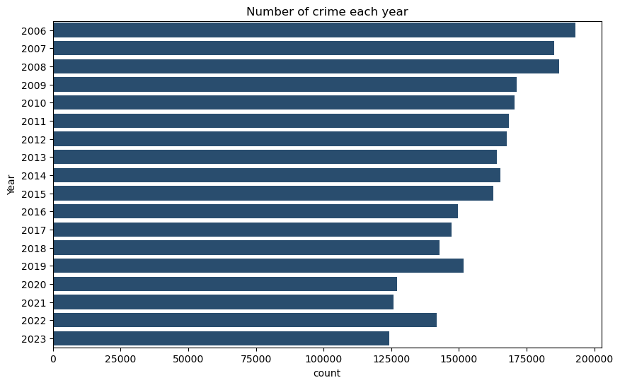
Slide 2
DATA DRIVEN
7

Slide 9
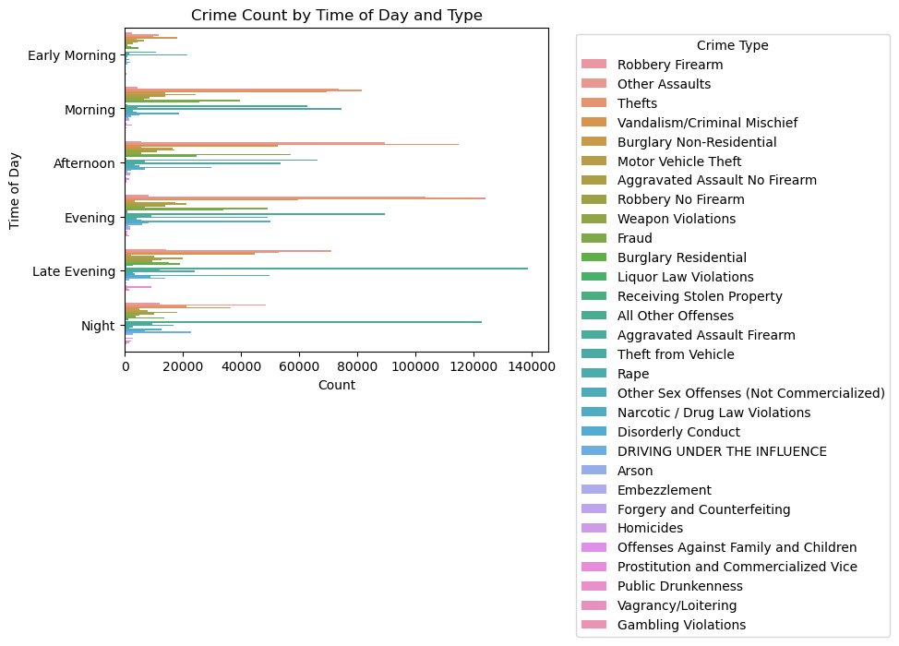
Slide 2
DATA DRIVEN
8

Slide 10
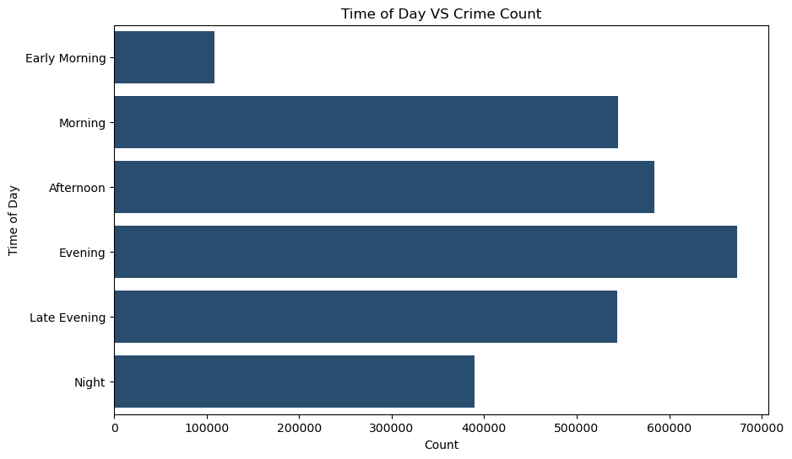
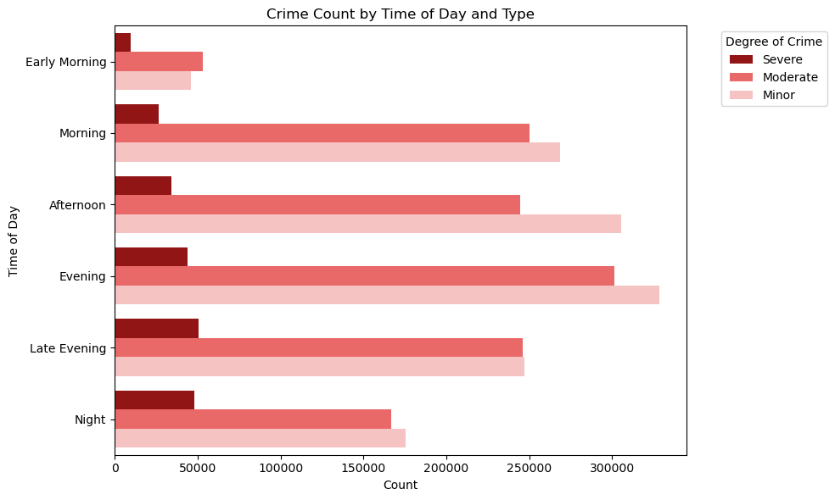
Slide 2
DATA DRIVEN
9

Slide 11
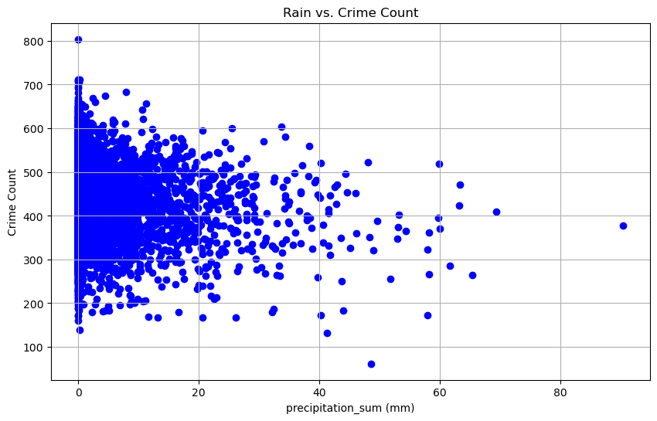
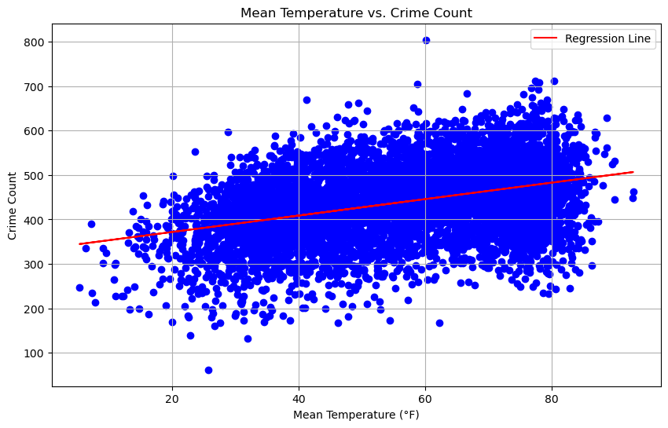
Slide 2
DATA DRIVEN
10

Slide 12

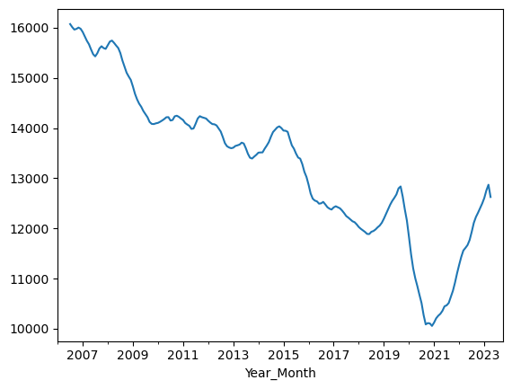
Slide 10
Year to Month
11

Slide 13
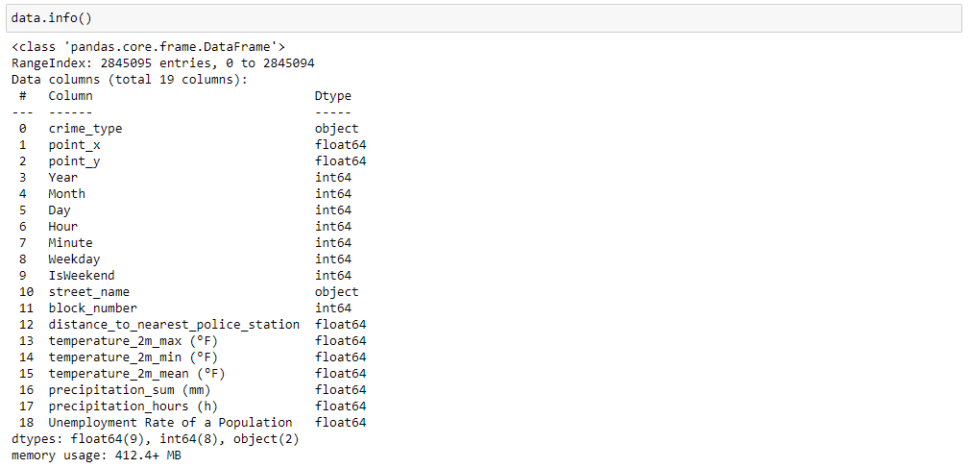
DATA DRIVEN

Slide 14
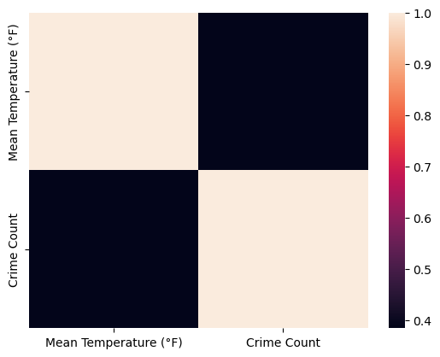
Slide 10
11

Slide 15
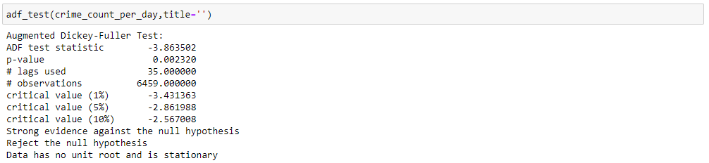
Augmented Dickey-Fuller (ADF) test

Slide 16
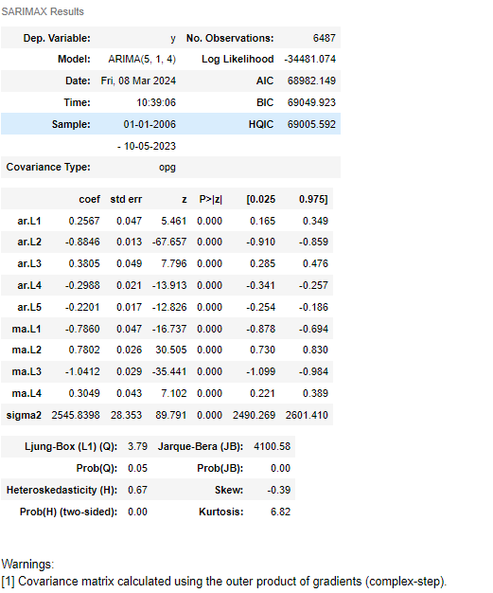
Forecasting Crime Trends: ARIMA Model Analysis with Optimized Order (5,1,4)

Slide 17
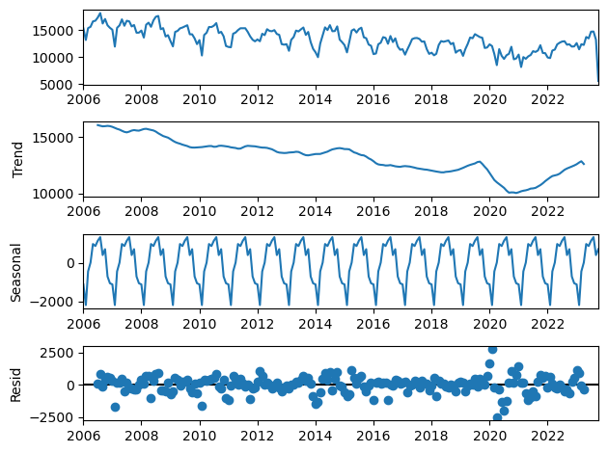
Decomposing Crime Data: Unveiling Seasonal Trends and Irregular Patterns

Slide 18
Limitations and Exceptions
Data Quality and Completeness: The analysis is as good as the data. Any missing, inaccurate, or biased data can lead to flawed insights. Incomplete crime reports or misclassification of crimes can impact the results.
Historical Data Constraints: The project's predictive power is limited by the historical scope of the data. If significant societal changes have occurred that affect crime (like a pandemic or economic crisis), the historical data might not capture these effects.
Scope of Available Data: The dataset may not include all relevant variables that impact crime rates, such as detailed demographic information, law enforcement practices, or cultural factors.
Assumption of Stationarity: Many statistical models, including ARIMA, assume data stationarity. If the crime data are non-stationary and this isn't adequately addressed, the model predictions could be unreliable.
Model Overfitting: There is a risk of overfitting the statistical models to the historical data, which would make them less generalizable and accurate in predicting future events.
External Validity: The findings and predictive models based on Philadelphia's data might not be generalizable to other cities with different socio-economic dynamics and crime patterns.
Causation vs. Correlation: The project may identify correlations between variables and crime rates, but these do not necessarily imply causation, which could lead to incorrect conclusions about what influences crime.
Privacy and Ethical Considerations: The project must navigate the ethical landscape of working with sensitive data, ensuring that privacy is maintained and the analysis does not lead to biased conclusions that could negatively affect certain populations.
Real-Time Data Analysis: The project may not account for real-time data analysis, which can be crucial for timely crime prevention and resource allocation.
Interdisciplinary Limitations: Crime is a complex, multifaceted issue that intersects with psychology, sociology, economics, and more. A purely data-driven approach may overlook these nuances that are hard to quantify.
3

Slide 19
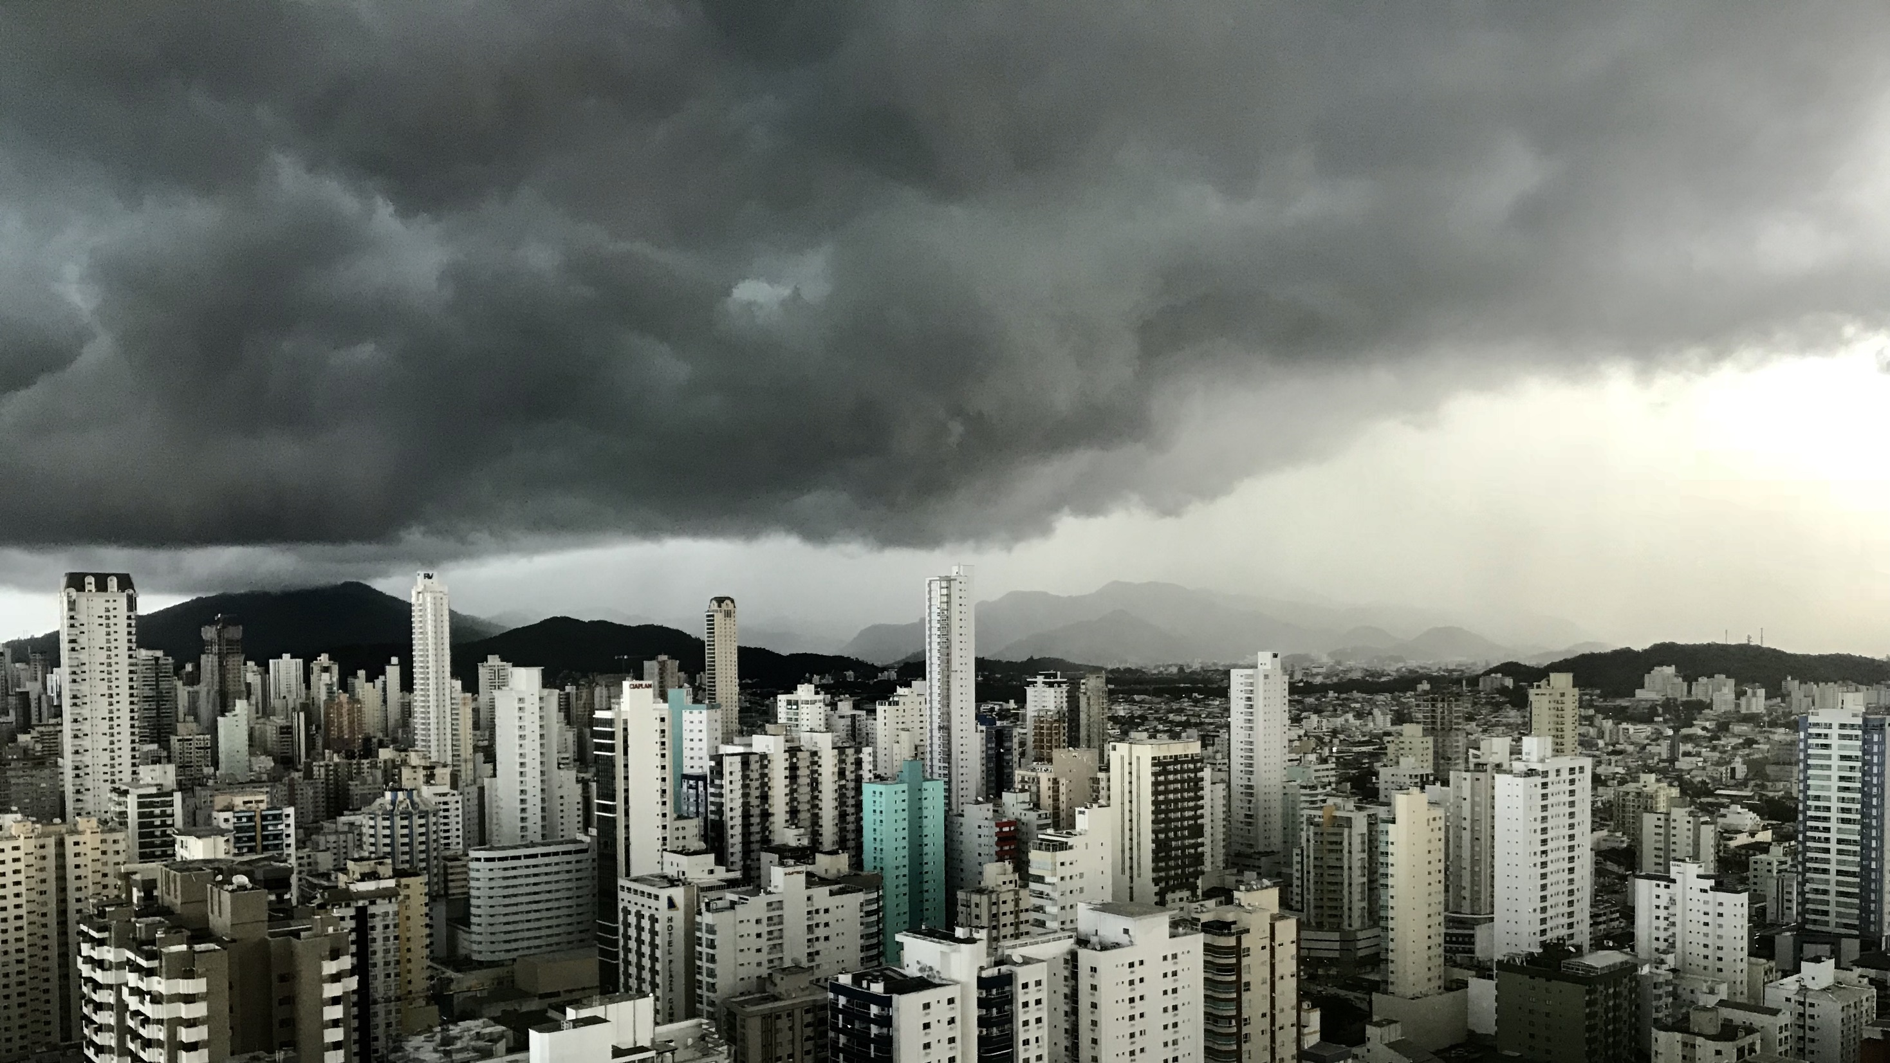
Slide 11
THANK YOU

