Slide 1

Diabetes Readmission Prediction
By:- Prashant Mourya
Sumedha Sirikonda
Bindu Priya G
Shreya Gavasane
Himanshu Ghritalhare
Shirley Simone
Tugce Erenler

Slide 2

Agenda
Introduction
Project outline
Data Description
Hypothesis
Methodology
Discussions and Results
Conclusions

Slide 3
Introduction
What Is Readmission Rate
A hospitalization that occurs within 30 days after a discharge
Why Is Readmission Important
Reduce cost of care and medical disputes
Improve patients’ safety and health
Our Goal
Predict if a patient with diabetes will be readmitted to the hospital within 30 days.

Slide 4
Project Outline
Background: Alarmingly high risk of readmissions in the US
Goal: Predict if a patient with diabetes will be readmitted to the hospital within 30 days.
Methods: K-nearest neighbors, Logistic regression, Naive Bayes, Decision tree, Random forest, Gradient boosting classifier
Results: Emergency readmissions occur most frequently and Gradient boosting hisad the highest accuracy model for the classification problem.
Conclusions: Effective prediction on readmissions helps health care systems to identify and target patients at the highest risk for readmission

Slide 5
Data Description
Attribute | Description
Admission type | patient's admission type: emergency, urgent, elective, newborn, not available, etc.
Time in hospital | Integer number of days between admission and discharge
Number of lab procedures | Number of lab tests performed during the encounter
Number of outpatient visits | Number of outpatient visits of the patient in the year preceding the encounter
Number of emergency visits | Number of emergency visits of the patient in the year preceding the encounter
Number of inpatient visits | Number of inpatient visits of the patient in the year preceding the encounter
Number of diagnoses | Number of diagnoses entered to the system
A1c test result | The range of the result or if the test was not taken
Diabetes medications | Whether there was any diabetic medication prescribed or not
Readmitted | Days to inpatient readmission
Main attributes :
Data source: UCI Machine Learning Repository, https://archive.ics.uci.edu/ml/datasets/Diabetes+130-US+hospitals+for+years+1999-2008
The dataset represents 10 years (1999- 2008) of clinical care at 130 US hospitals and integrated delivery networks. It includes 101,766 instances and 55 features representing patient and hospital outcomes.

Slide 6
Hypothesis
Recurrent, unplanned readmissions to the hospital which happen when patients return shortly after discharge and are readmitted for the same or a related condition

Slide 7




Data Pre-Processing Feature Scaling Building training/validation/test samples Model selection Model evaluation
Methodology

Slide 8
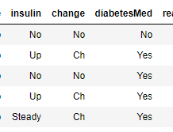
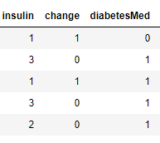
Data Pre-Processing
8
Remove irrelevant variables (EX:encounter_id','patient_nbr','payer_code)
Replace unknown value such as ‘?’ by calculating its weight in the dataframe
Convert Numerical data to Categorical Data
Re-categorize Readmission group from 3 groups (<30, >30 days and No) to 2 groups (Readmission <30 days >30 days and No)
Numerical
Categorical

Slide 9
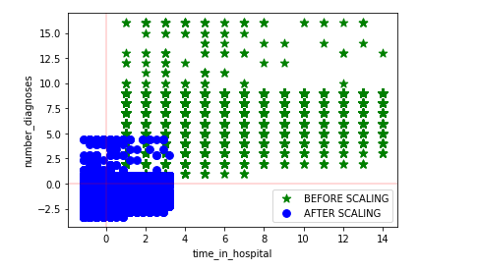
Feature Scaling
Standardized to have zero mean and unit variance
Picking cols with correlation greater than 0.2
Data is standardized to zero mean and unit variance so that there isn't much difference in values of different features
By standardizing, feature values are equally distributed along a Standard Normal Distribution Curve

Slide 10
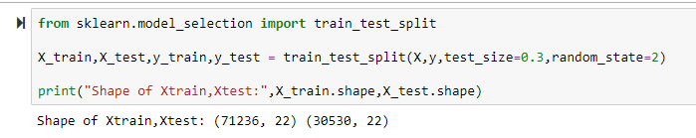
Building training/validation/test samples
Partition: 70% on Training; 30% on Testing

Slide 11
Model Selection
Feature Engineering
Hyperparameter tuning

Slide 12
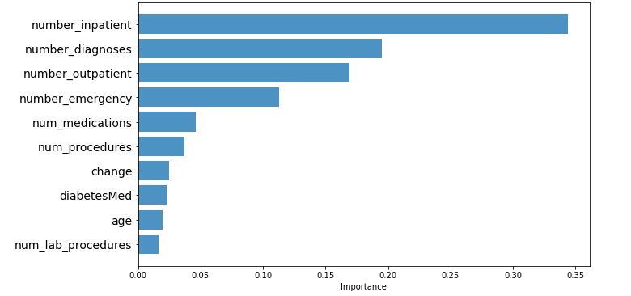
Feature Engineering

Slide 13
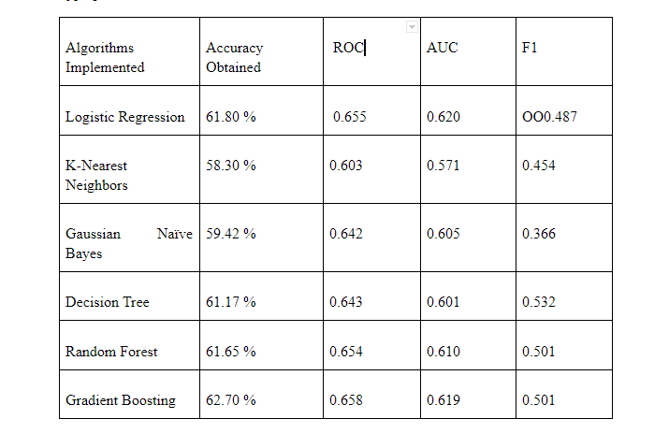
ML models in Analysis:
Models used in our Analysis:
Logistic Regression
K-Nearest neighbors
Gaussian Naive Bayes
Random Forest Classifier
Decision Tree Classifier
Gradient Boosting Classifier

Slide 14
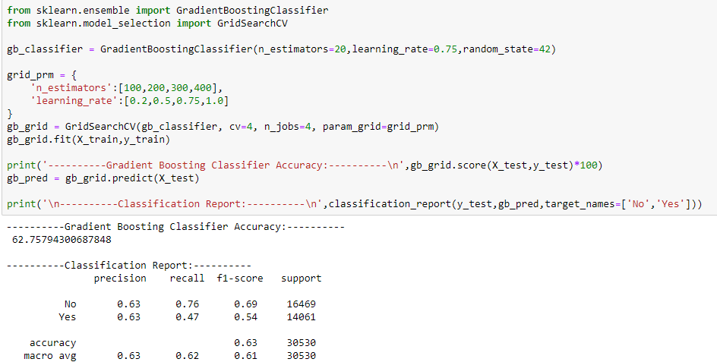
Hyperparameter Tuning

Slide 15
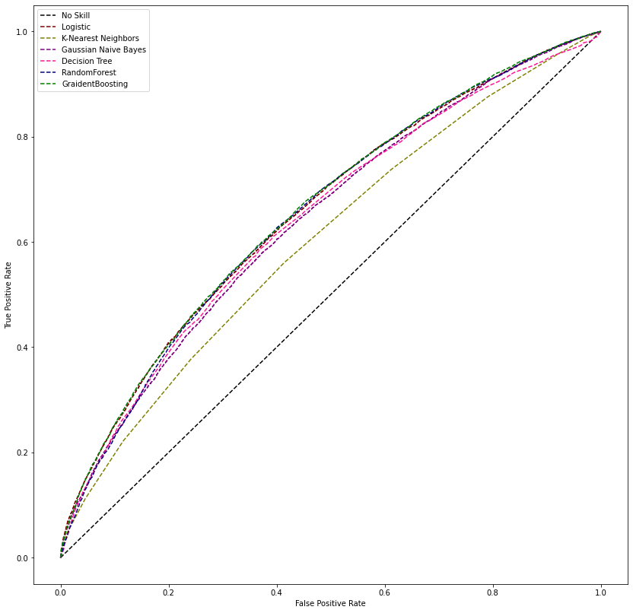
AUC-ROC Curve

Slide 16
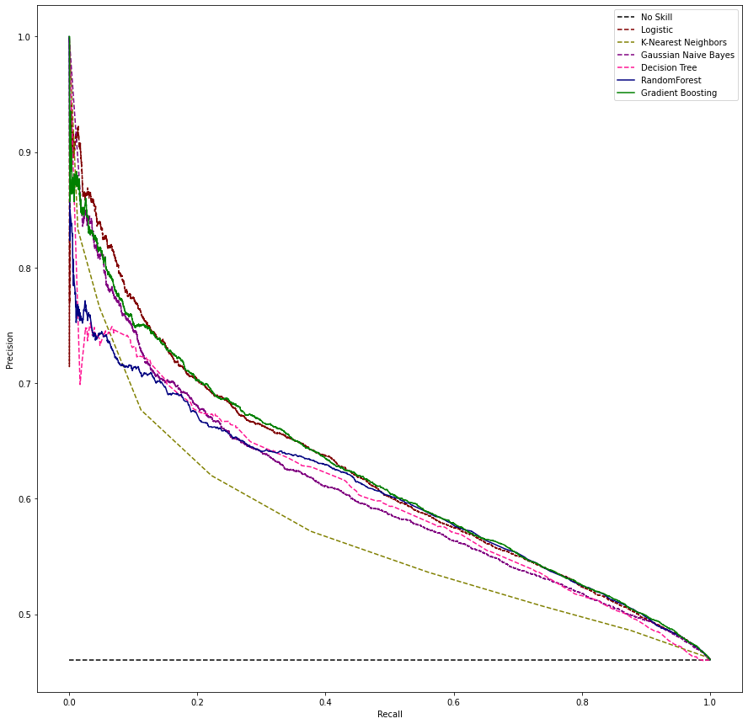
AUC-PR Curve

Slide 17
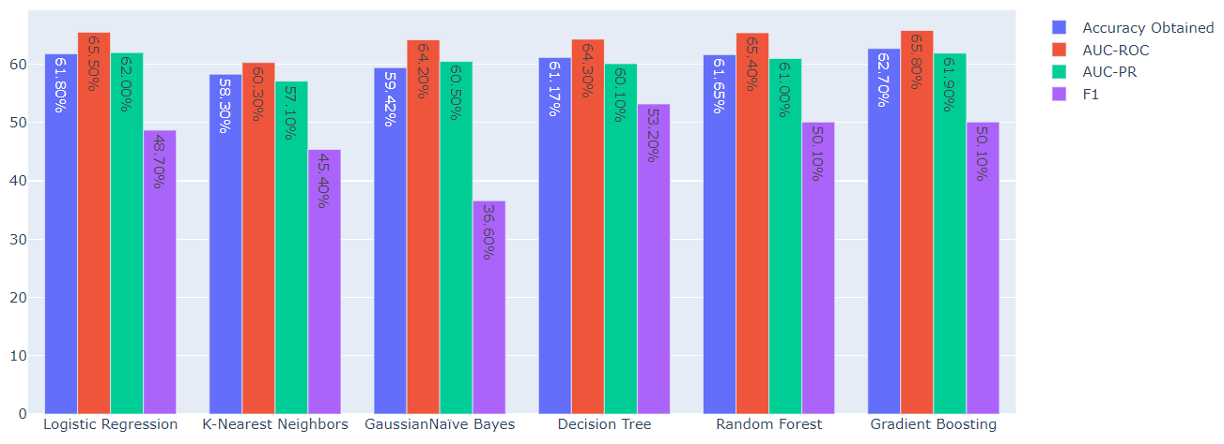
Model Evaluation

Slide 18
Conclusion
Learnings from the project
Goal achieved
Future Work and suggestions

Slide 19
Questions?

Slide 20
Thank you

