Slide 1
Heart Disease Prediction Hackathon
predict whether a patient is at risk of heart disease
Sumedha Ghildiyal

Slide 2
Dataset overview
Source: train.csv and test.csv (provided for project)
Size:
Training dataset: Contains features + target label(Heart_Disease)
Test dataset: Contains same features (without target)
Data Type: Mixed data-both categorical and numerical columns
• Used for a binary classification task
Objective
To build an accurate machine-learning model that predicts the target variable (0/1) based on patient related features.
The Goal is to:
• Understand data patterns
• Clean and preprocess the dataset
• Train different ML models (Logistic Regression, Random Forest)
• Identify the best-performing model

Slide 3
Data Understanding & Cleaning
Key Insights from EDA:
• Dataset contains both categorical and numerical columns
• Categorical columns need conversion to numeric form
• Different columns have different value ranges , scaling is needed
• No major outliers affecting model performance
Data Preprocessing Steps:
Label Encoding:
All categorical columns were label encoded so ML models can read them.
Saved encoders and applied the same encoding on test data.
Feature Scaling:
Used StandardScaler to scale training and test datasets for models like Logistic Regression and Random Forest.
Train–Test Split:
Split data into X_train, X_test, y_train, y_test to evaluate model.

Slide 4
Approach
Overall work flow
Load train.csv and test.csv : training dataset had 14 columns 820 rows.
Identify categorical and numerical columns: 2 categorical columns i.e Gender and chest_pain_type
Handle missing values: there were no missing values in the dataset
Apply Label Encoding on categorical features to convert categorical data into a numerical format(0,1,2…)
Apply Scaling to numerical features: Used standard scalar
Split data into train–test sets so the model could learn on one part and be tested on another.
Train models :we used two models Logistic Regression as a simple baseline model, and Random Forest for better accuracy and feature importance.
The models were trained on the processed training data and then tested on the test data to measure how well they performed
Evaluated the results using accuracy, classification report, and ROC-AUC score to understand the model’s effectiveness.

Slide 5
Results and Insights
Model Performance Summary:
We tested two machine learning models: Random Forest and Logistic Regression to predict heart disease
Random Forest performed the best with 98% accuracy. It correctly identified almost all patients with and without heart disease.
Its ROC-AUC score was 0.996, which means the model is extremely good at separating the two classes
Logistic Regression gave 84% accuracy, which is good but not as high as Random Forest.
Its ROC-AUC score was 0.93, meaning it still performed well but was less powerful compared to Random Forest.

Slide 6
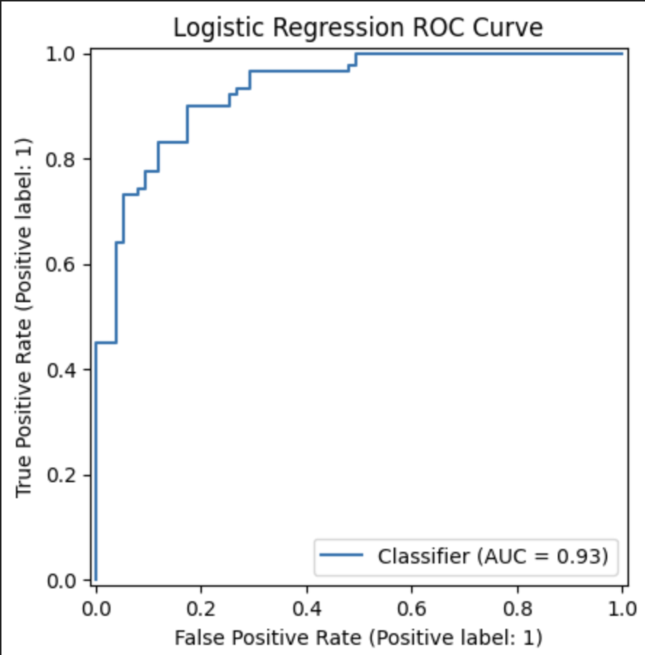
Results : Logistic regression
The curve is close to the top-left corner, which means:
High True Positive Rate (it catches most positive cases)
Low False Positive Rate (it makes few wrong predictions)
Logistic regression model is very strong and reliable.
It can correctly detect heart disease cases most of the time, and it does not make many mistakes.

Slide 7
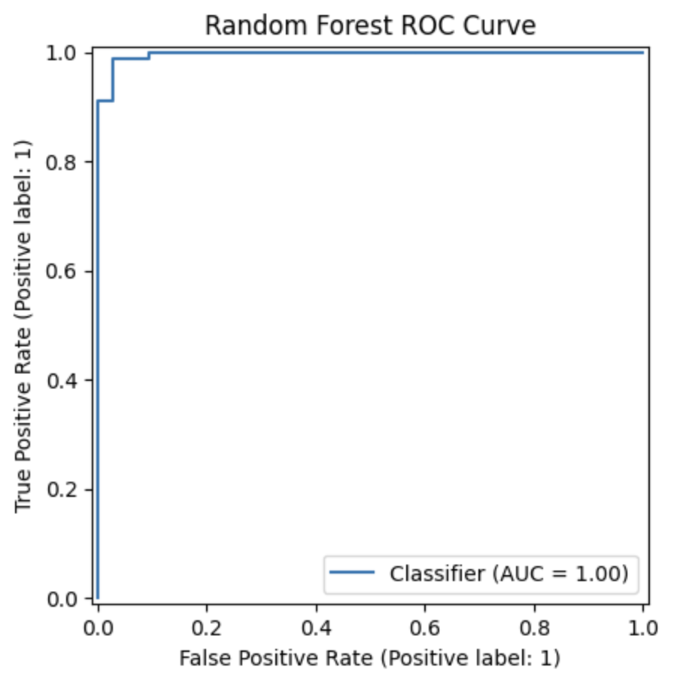
Random forest
AUC = 1.00, which is the perfect score.
The ROC curve is touching the top-left corner, which means:100% True Positive Rate , 0% False Positive Rate

Slide 8
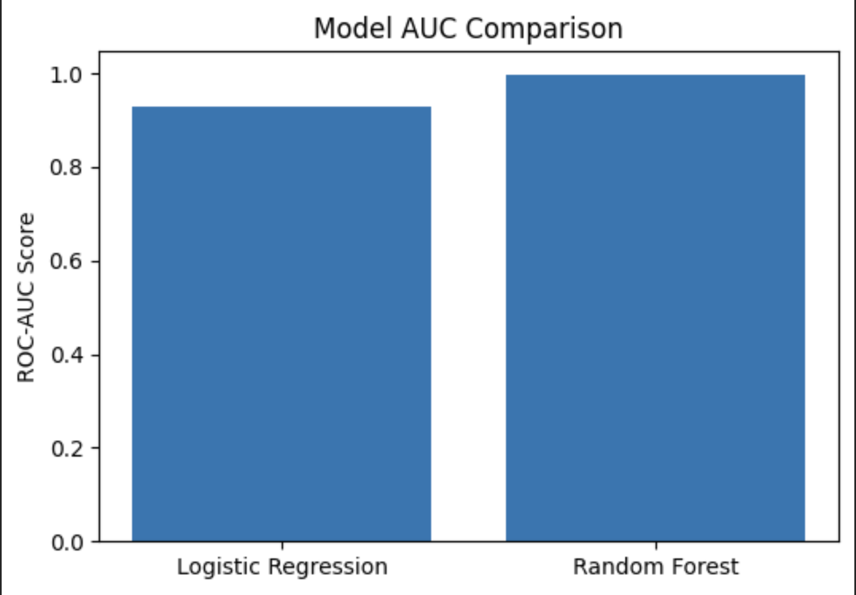
Comparison
Random Forest is better because it has a higher AUC score.It can separate positive and negative cases more accurately.
Logistic Regression is good, but Random Forest is almost perfect.
Choose Random Forest for prediction.It gives better performance, higher accuracy, and stronger classification.

Slide 9
Challenges
Faced installation errors while importing XGBoost and LightGBM, which made it difficult to use them.
Because of these issues, I decided to stick to Logistic Regression and Random Forest.
These two models were easier to run and still gave very good accuracy, so they were suitable for the project.

Slide 10
Learning & Next Step
Learnings
• Label Encoding and Scaling can change model performance.
• Tree-based models like Random Forest work very well for structured data.
• Metrics like ROC-AUC and F1 give a clearer picture than accuracy.
Future Improvements
• hyperparameter tuning for better performance.
• Use cross-validation for more stable results.
• Experiment with models like XGBoost, LGBM and CatBoost.

