Slide 1

THERMALGUARD
Industrial Thermal Intelligence & Fire Safety
Isolating electrical micro-hotspots at the edge before insulation breakdown causes ignition.
🔥 Spatial Thermal Array
768-Pixel MLX90640 Matrix
⚡ Zero-Delay Interlock
Hardware Relay Trip
💻 Operations Console
React 19 + REST Telemetry
Notes:
[⏱ 0:00 - 0:08 | TITLE SLIDE]
PRESENTER SPEAKS:
"This is ThermalGuard—an end-to-end industrial thermal intelligence and fire safety system. It isolates electrical micro-hotspots at the edge before insulation breakdown causes catastrophic fire ignition."

Slide 2
THE CHALLENGE & INNOVATION
Why ThermalGuard?
❌ The Problem: Reactive Safety
• Traditional smoke/flame alarms activate ONLY AFTER combustion begins.
• Electrical micro-hotspots build up silently inside switchgear & transformers.
• Overheating degrades wire insulation, causing arc flashes, fires & costly outages.
✅ The Solution: Proactive Thermal Intelligence
• Continuous spatial thermal array monitoring (768 infrared pixels).
• Multi-sensor fusion combining IR thermal canvas, line current & climate.
• Autonomous hardware trip interlock cuts power before ignition occurs.
768-Pixel Grid
MLX90640 Thermal Matrix
< 1s Interlock
Instant Relay Trip Response
100% Edge Autonomous
Zero-Cloud Trip Reliance
Notes:
[⏱ 0:08 - 0:20 | PROBLEM & SOLUTION]
PRESENTER SPEAKS:
"Industrial fires start quietly. Traditional alarms warn you only AFTER combustion starts. ThermalGuard continuously fuses spatial thermal imaging with real-time load telemetry to auto-trip power interlocks before ignition can occur."

Slide 3
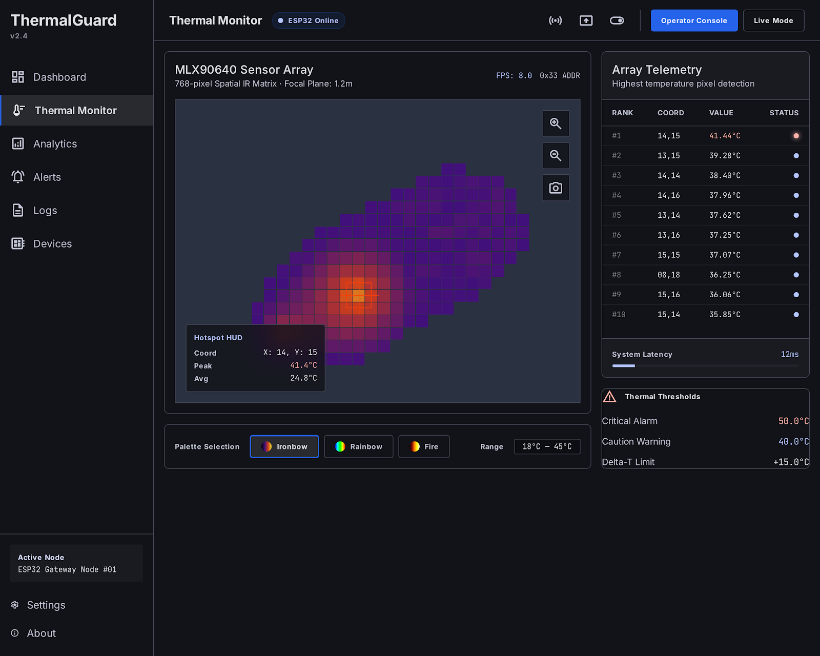
SYSTEM ARCHITECTURE
Hardware Edge Node & Web Operations Console
🔌 Edge Hardware Node (ESP32)
• ESP32 Dual-Core MCU (240MHz) with REST API Server
• MLX90640 32x24 Spatial Thermal Camera (I2C 400kHz)
• ACS712 Line Current Telemetry + DHT11 Climate Sensor
• Hardwired Safety Relay Interlock (GPIO 18) & Buzzer Alarm
💻 Operations Console (React 19)
• Modern React 19 + Vite + Framer Motion UI Design
• Spatial Heatmap rendering & real-time load curves
• Fault-tolerant Telemetry Polling & Live/Demo Mode Switcher
• Fullscreen Presentation Mode (Hotkey 'F') for visual demos
Notes:
[⏱ 0:20 - 0:38 | ARCHITECTURE & DEMO]
PRESENTER SPEAKS:
"Our system pairs an ESP32 edge microcontroller with a 768-pixel thermal matrix and load sensor. The ESP32 drives local hardware relays directly while serving real-time REST telemetry to our React 19 operations dashboard."

Slide 4
CORE CAPABILITIES
End-to-End Safety & Intelligence
🔥 Spatial Hotspot Isolation
32x24 IR array canvas pinpoints hot spots with micro-degree precision, mapping thermal gradients across high-voltage gear.
⚡ Autonomous Relay Trip
Zero-cloud reliance. The ESP32 edge logic trips the hardware power relay in milliseconds upon threshold breach.
📊 Operations Web Console
React 19 dashboard featuring real-time heatmaps, environmental charts, current load telemetry, and hardware controls.
🏭 Modular Grid Scalability
REST JSON API architecture ready for multi-substation monitoring, MQTT streaming, and predictive TinyML forecasting.
Notes:
[⏱ 0:38 - 0:50 | CAPABILITIES]
PRESENTER SPEAKS:
"ThermalGuard combines spatial hotspot pinpointing, zero-latency local trip interlocks, an intuitive web interface, and scalable grid topology for plant-wide deployment."

Slide 5
SUMMARY & IMPACT
ThermalGuard: Proactive Thermal Intelligence
Proactive Fire Safety for Industrial Infrastructure
• Proactive Prevention: Detects micro-hotspots BEFORE smoke or ignition occurs, safeguarding equipment & uptime.
• Edge Reliability: Autonomous ESP32 interlock guarantees emergency power trips even during network disconnects.
• Turnkey Visibility: React 19 operations console provides plant operators with real-time thermal & load intelligence.
• Grid Infrastructure Ready: Modular architecture structured for substation expansion, cloud sync & predictive ML.
Prevent Catastrophic Electrical Fires with ThermalGuard
Repository: ThermalGuard | ESP32 Edge Node + React 19 Operations Web Console
Notes:
[⏱ 0:50 - 1:00 | CONCLUSION]
PRESENTER SPEAKS:
"To wrap up: ThermalGuard replaces reactive fire alarms with proactive edge intelligence—protecting industrial assets, reducing downtime, and saving lives. Thank you!"

