Slide 1

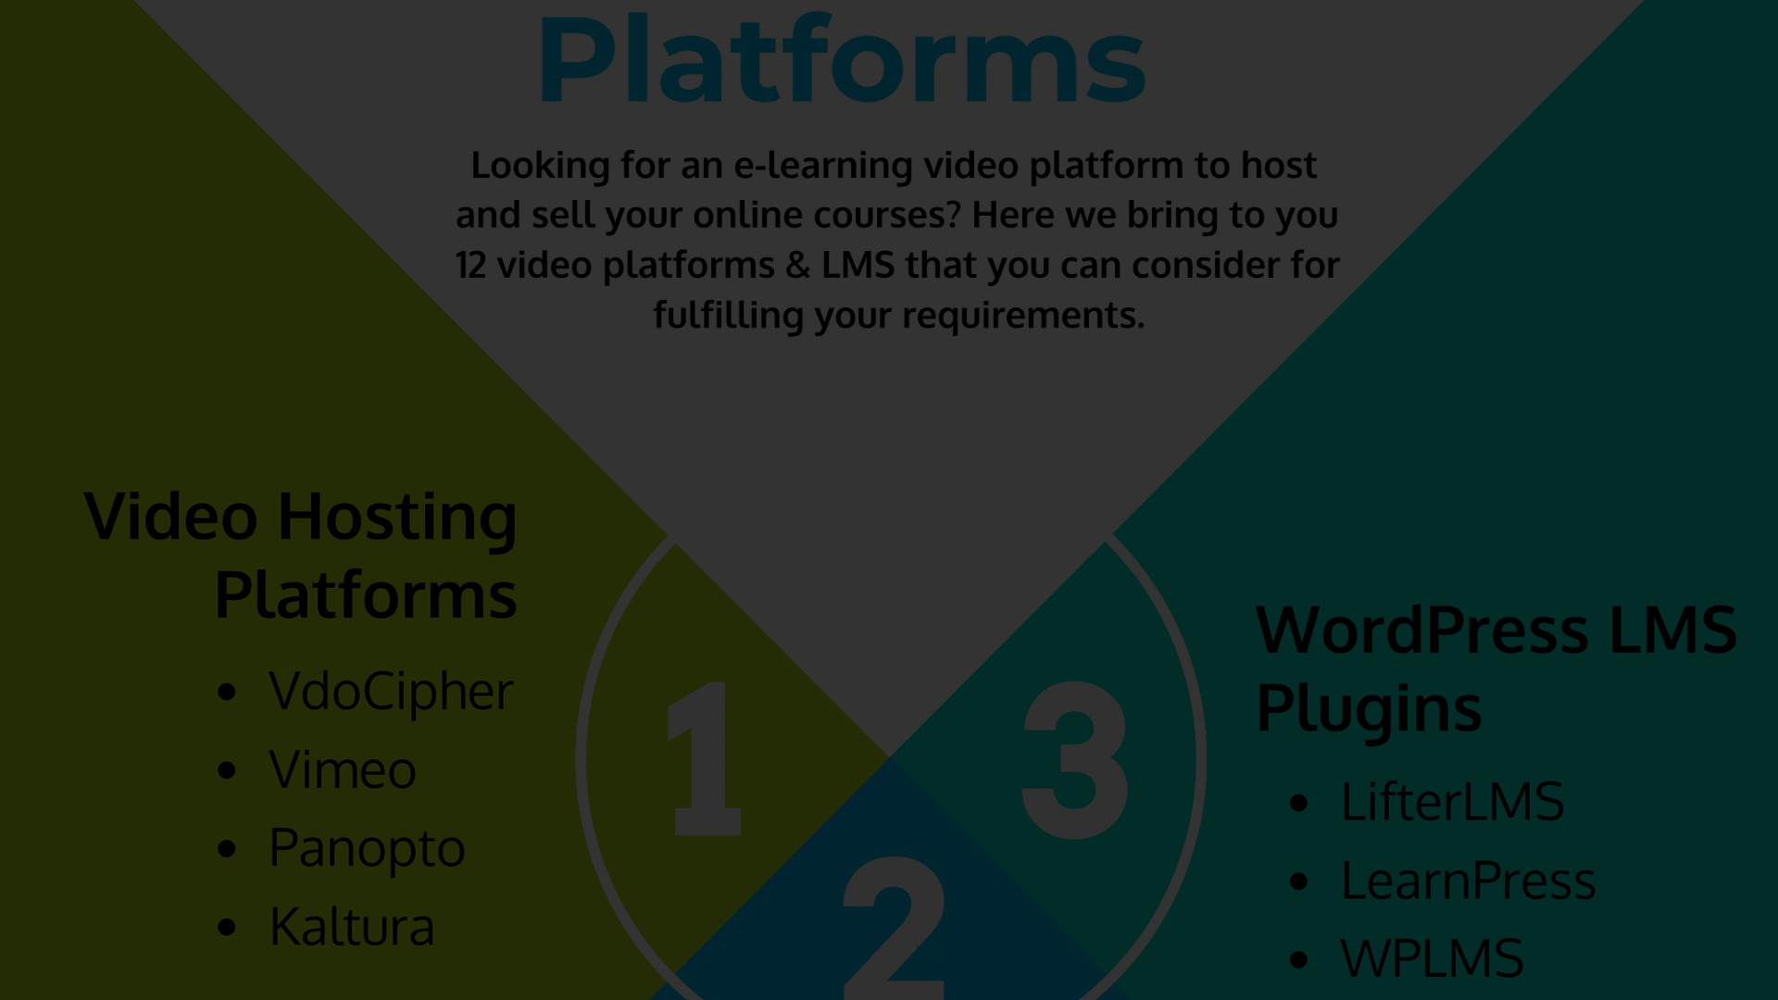


Building an Online Learning Platform
Empower educators and engage learners with our comprehensive online learning platform, designed to elevate the e-learning experience.

Slide 2
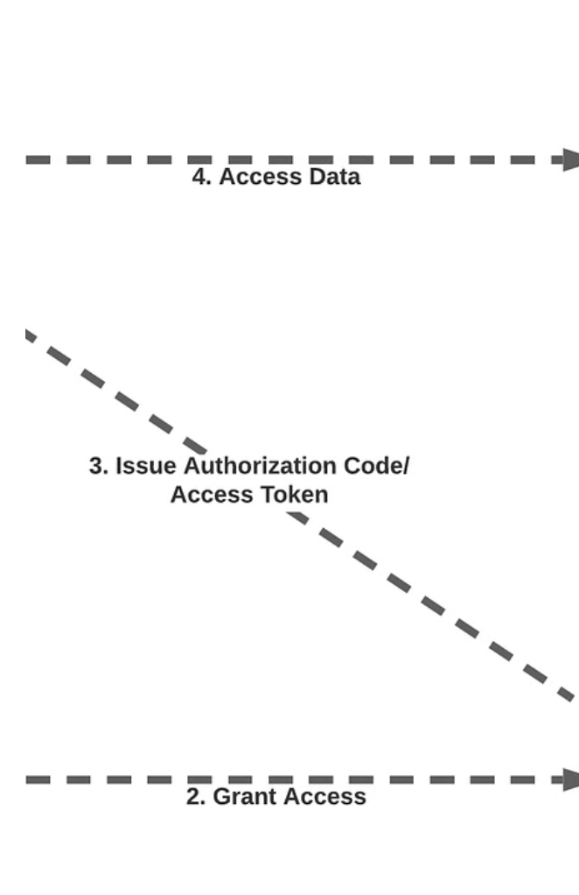
User Authentication and Profile Management
Enhanced User Experience

Slide 3
Course Creation and Management
Instructor Empowerment
Empower instructors with the capability to craft and oversee courses, from uploading video lectures to managing course materials, assignments, and quizzes. Categorize courses based on subject, difficulty level, and duration for a structured learning experience.

Slide 4

Interactive Quizzes and Assessments
1
Engaging Learning
Create interactive quizzes with multiple-choice, true/false, and open-ended questions. Automatic grading and feedback provide timely assessment, while progress tracking enables learners to monitor their quiz scores and performance over time.

Slide 5

Video Lectures and Content Delivery
On-Demand Learning
Deliver video lectures and multimedia content seamlessly. Features include streaming flexibility, enabling learners to pause, rewind, and review content at their own pace, ensuring a fluid and adaptive learning environment.

Slide 6
Progress Tracking and Performance Analytics
Monitor Progress
Completion Status
Performance Analytics
Identify Learning Outcomes

Slide 7

Learner Engagement and Insight
Interactive Learning
Foster collaboration and interaction among learners through discussion forums, peer review, and group projects, enhancing engagement and knowledge sharing.

Slide 8

Scalability and Performance
Scalable Design
Develop a robust infrastructure that ensures the platform's performance and scalability, catering to a growing user base without compromising user experience.

