Slide 1



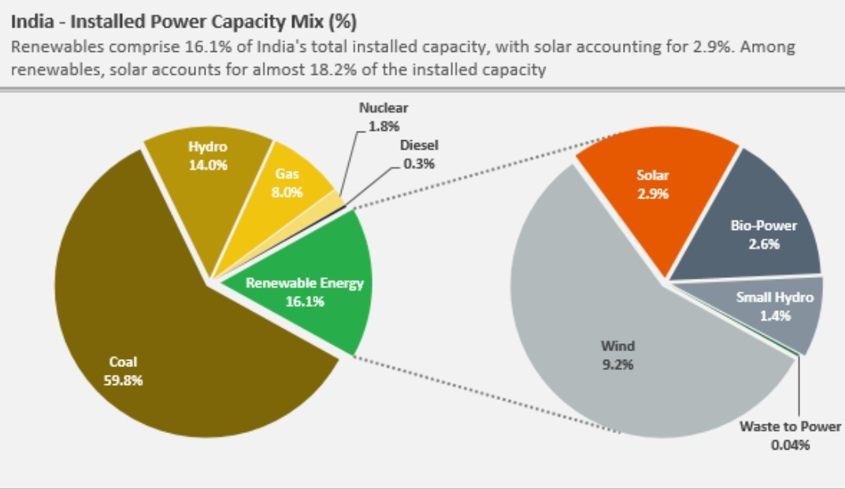

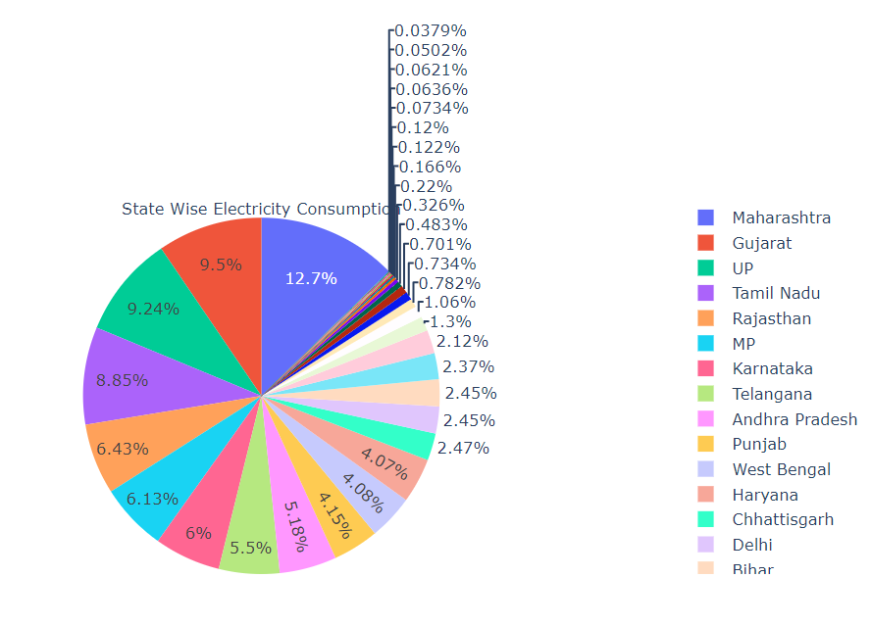
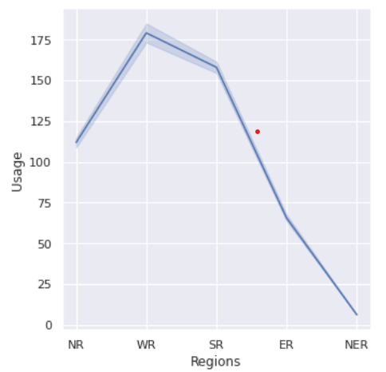
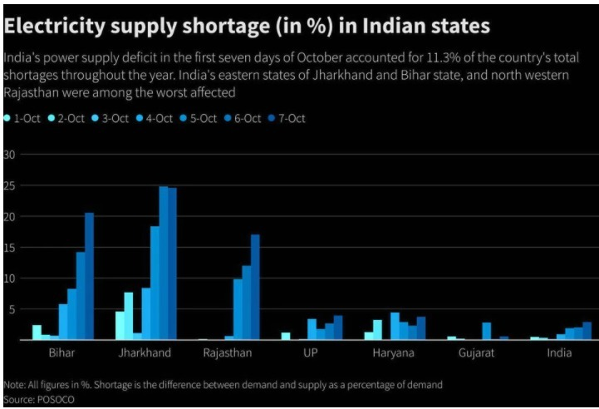
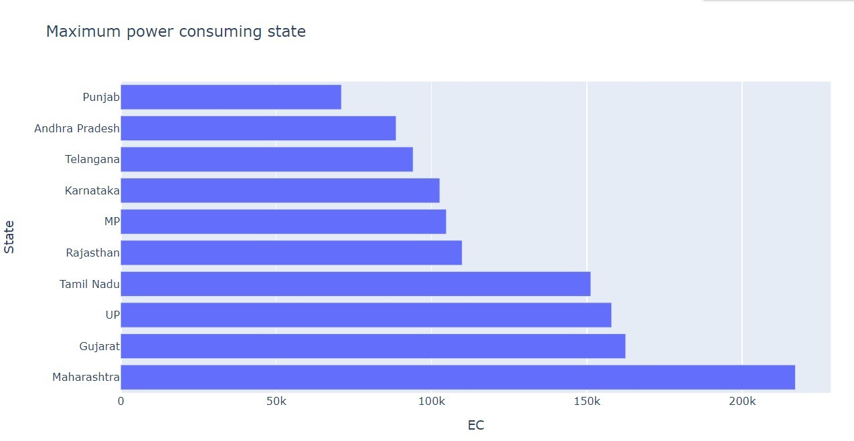
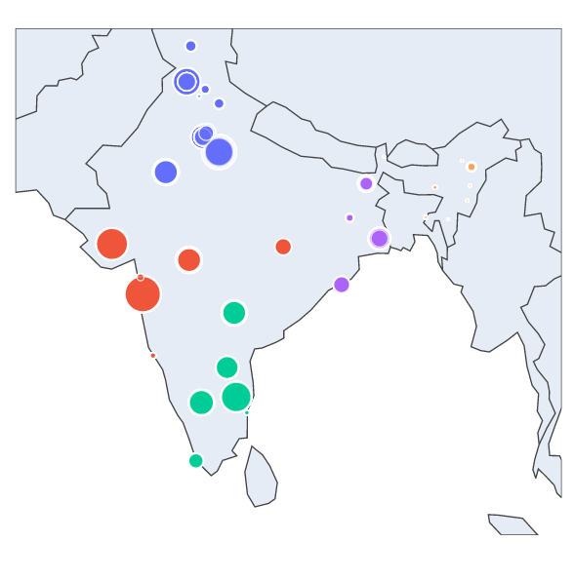
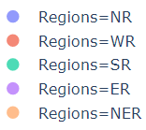
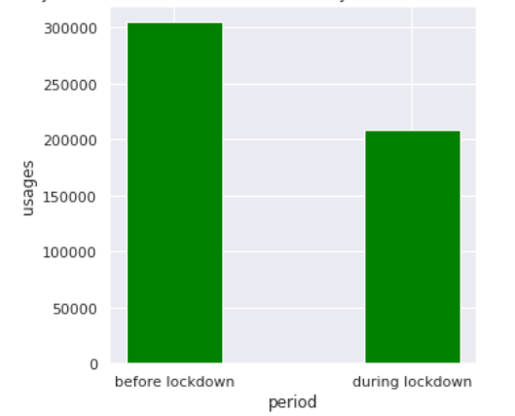
Understanding Power Consumption in Indian States
TRACK NAME:
Analytics Using Python
TEAM NAME:
Team S-A-A-B
TEAM GROUP PIC :
PROBLEM STATEMENT
1)What are the states that consume the most and the least amount of electricity.
2)What was the effect of
Lockdown on the electricity consumption in India.
STAKEHOLDER MAP
GRAPHS
SECONDARY RESEARCH
1) Studying electricity consumption across various regions in India based on references from data analysis
INSIGHTS
1)Western region of India consumed the most amount of electricity.
2) Maharashtra and Sikkim are the highest and lowest consuming states.
2)The comparison of consumption patterns in the period March-May for 2019 and 2020 shows that there was approximately 31.47%
reduction in total consumption
across India due to lockdown.
WAY AHEAD ?
India’s power consumption deficit in the eastern region is due to supply shortage of electricity.
Going ahead, there is a latent need of investment for energy infrastructure in eastern region.
PROTOTYPE – IMAGES, SCREENSHOT
SOLUTION
The analysis shows that although the consumption reduced during the Lockdown Period, it also increased drastically as the restrictions were removed. To meet the demand of ever-increasing electricity the stakeholders and the government should consider shifting their focus from Coal to other Renewable sources.

