Slide 1
Big Data Architecture and Governance Individual Project – Coca Cola
Sumeet Gaglani

Slide 2
Company Name: Coca Cola
Industry: Beverage
History/Background:
Coca-Cola history began in 1886 when the curiosity of an Atlanta pharmacist, Dr. John , led him to create a distinctive tasting soft drink that could be sold at soda fountains. He created a flavored syrup, took it to his neighborhood pharmacy, where it was mixed with carbonated water and deemed “excellent” by those who sampled it. Dr. John partner and bookkeeper, Frank M. Robinson, is credited with naming the beverage “Coca‑Cola” as well as designing the trademarked, distinct script, still used today.
Prior to his death in 1888, just two years after creating what was to become the world’s #1-selling sparkling beverage, Dr. Pemberton sold portions of his business to various parties, with the majority of the interest sold to Atlanta businessman, Asa G. Candler. Under Mr. Candler’s leadership, distribution of Coca‑Cola expanded to soda fountains beyond Atlanta. In 1894, impressed by the growing demand for Coca‑Cola and the desire to make the beverage portable, Joseph Biedenharn installed bottling machinery in the rear of his Mississippi soda fountain, becoming the first to put Coca‑Cola in bottles. Large scale bottling was made possible just five years later, when in 1899, three enterprising businessmen in Chattanooga, Tennessee secured exclusive rights to bottle and sell Coca‑Cola.

Slide 3
Organization Issues
Project: Analytics for Revenue diversification
Coca-Cola and Pepsi have diversified their beverage product lineups in response to these trends. They've invested heavily in tea, juice, and bottled water, which has helped offset declines in their core soda businesses.
But Pepsi went a step further. The company has become a powerful force in the snack foods business, with popular brands such as Lays, Doritos, Tostitos, Cheetos, and Quaker Oats, among others.
Pepsi is the larger business in terms of revenue($64.42 billion), with nearly twice as much as Coca-Cola($33.92 billion)
Big data can be used to analyze Coca Cola historical revenue streams and cost structures to identify weaknesses and make improvement on their current products. Big data can also be used for Market analysis to identify emerging trends in products and services that the association will include in the market to increase their revenue from multiple products.
Project: Big Data Analytics to Drive Customer Loyalty
Michelle Obama, is on a campaign against obesity, urging Americans to drink more water. Former Mayor Michael R. Bloomberg tried to ban sales of giant-size high-sugar soft drinks in New York City. And this week, the Food and Drug Administration proposed new foo labels that would more prominently display grams of added sugar, including the high-fructose corn syrup used in Coca-Cola. The company reported declining sales of soda in the critical North American market along with disappointing sales growth globally, alarming investors. Shares fell over 4 percent on the news, the most in seven months. So far this year, Coke shares have dropped nearly 7 percent.
Coca cola should emphasize on quality rather than the quantity of beverage served using. Using big data and social media like facebook, twitter, instagram they can advertise their upgraded products containing low sugar content. Big Data can access information like the sex, location and social data of every customer and allow marketers to send different offers to each individual based on his or her interests.

Slide 4
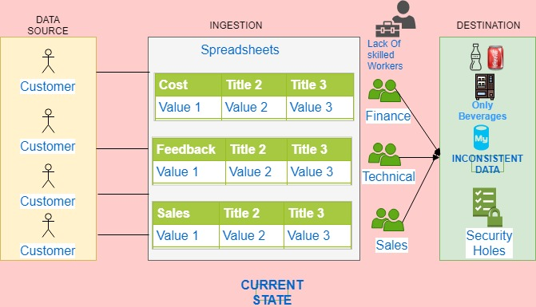
Project: Analytics for Revenue diversification

Slide 5
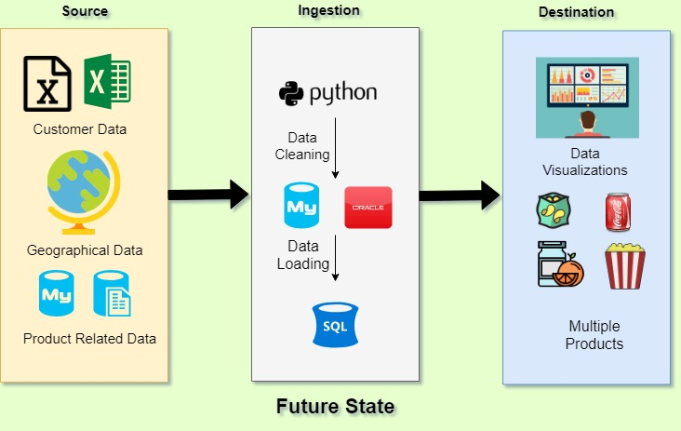

Slide 6
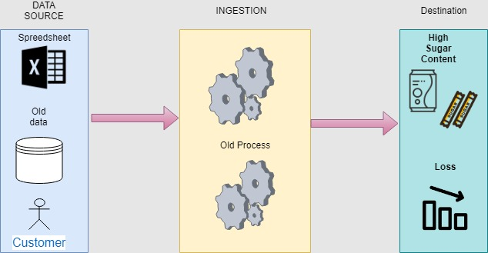
Project: Big Data Analytics to Drive Customer Loyalty
CURRENT STATE

Slide 7
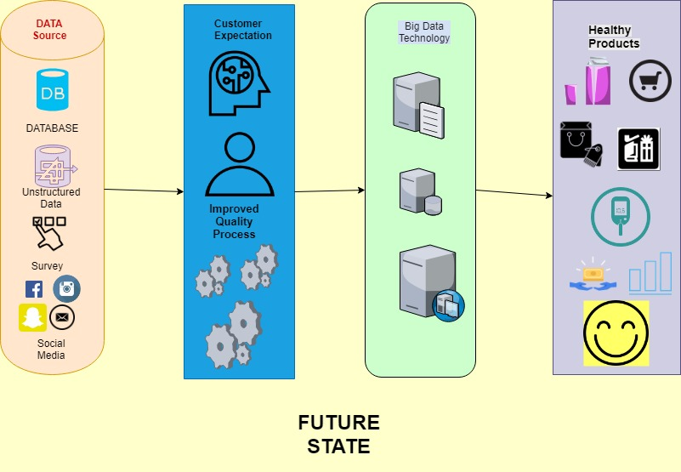

Slide 8
Comparision
FACTORS | Analytics for Revenue diversification | Big Data Analytics to Drive Customer Loyalty
Budget | More cost is required to implement | Less cost is required for implementation
Products | Multiple new and Healthier Project | Only Healthy Products
Time | More time completion | Less time for completion
Risk & Issues | If customers are not satisfied with new products it will be a great loss for company. | Since the target is to produce new healthy beverage the risk on implementing would be less
Strength | Brand Name, More new Products | Brand name
Weakness | Data collected across continents should be accurate | Need to reformulate the existing product which would be time consuming
Stakeholders | KFC,McDonald | KFC,McDonald
ROI | The ROI would be great once the products are able to generate revenue from multiple source | ROI would be less since it has only one new healthy beverage to sell

Slide 9
Select Project
Analytics for Revenue diversification
Reasons
1. Healthier products can be produced too not in just beverage but also food products.
2. Larger scope in ROI and more profitable
3. It just not replaces the old products but also improves the process work flow starting from collecting the data to delivering multiple products.
4. More skilled employees would be added in the team.
5. Will increase the number of stakeholders.

Slide 10
Functional Requirements
Data Visualization: Processed and cleaned data will be available for researchers and developers. Data needs to be presented in dashboard that is easily understandable across all beneficiaries and stakeholders. Considering a baseline functionality, statistical and integrated information requires further analysis from data scientists. However, for the project, as a best practice functionality, we will need high quality Business Intelligence tool with company since wide visibility is a must.
Batch Processing: As the data sets are large since it is from different part of the world, often a big data solution must process data files using running batch jobs to filter, aggregate, and prepare the data for analysis. Usually these jobs involve reading source files, processing them, and writing the output to new files. As for the project, as a best practice functionality, it is important to process large volumes of data to get more detailed insights as well as to get fast analytics results.
Enterprise Datawarhouse : Data for batch processing operations is typically stored in a distributed location that can hold data in various formats. This kind of store is often called a data marts. For the project, as a best practice functionality, we will integrate the system that would allow storage of a virtually unlimited amount of data, efficiently dealing with a range of different data models, support both structured and unstructured data
Robust Framework & Orchestration: Any kind of Big Data frameworks is designed to cope with the problems of Variety, Volume and Velocity. Key features allow for iterative processing, storage and data ingestion. For the project, as a best practice functionality, the framework should allow repeated data processing operations, encapsulated in workflows, that transform source data, move data between multiple sources and load the processed data into an analytical data store to a report or dashboard generating tool.

Slide 11
Non Functional Requirements
Performance – This requirement ensures optimal performance for the Big data solution, by considering the following:
Data Acquisition
Storage
Data Processing
Reliability – The solution should ensure that the system should continue to work correctly (performing the correct function at the desired level of performance) even in the face of adversity Maintainability - Over time, many different people will work on the system and they should all be able to work on it productively by ensuring that:
Monitoring the health of the system periodically
Keeping software and platforms up to date, including security patches
Establishing good practices and tools for deployment, and configuration management
Cloud Support & Elasticity – This requirement ensures that the solution should be capable to move the architecture into the cloud to take advantage of the many benefits associated with its economies of scale. Elasticity is a cloud property which enables a framework to scale here and there as per request..
Flow Control – This requirement ensure that the solution is capable of handling scenarios where the data source is emitting records faster than system can consume by providing strategies like dropping records and sampling.

Slide 12
Non Functional Requirements
Interoperability: The key thought for any big data solution will be whether the solution would work with numerous platforms or not. Considering a baseline functionality, the requirement would be to build a closed analytics application, that is built for one infrastructure platform. However, for the business opportunity as a best practice usefulness, an investigation arrangement that would interface with any of the significant stages is suggested thinking about a future verification execution.

Slide 13
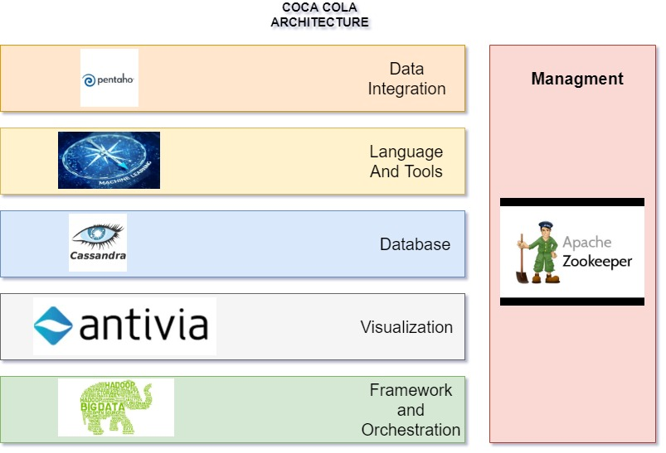
Architecture

Slide 14
Reason for Selecting tools in Architecture

Slide 15
Reasons
Data Integration: PENTAHO
The data which is collected from various data source, spreadsheets, customer feedback/survey must be integrated and stored in single database so that the process carries on according to the project flow.
Pentaho has about 35 optimized data connectors such as SAP HANA connector, Microsoft Excel, SQL Lite, SQL Server, and Salesforce.com etc. which helps us to connect to our data easily without any addon or third-party connectors.
The data integration to handle the large flux of the data would be “Pentaho Data Integration”
Pentaho Kettle does not require the data to be stored in single data base or single source, it can work the same way even if the data is spread across.
The installation is fast and easy.
When attempting to process the vast amounts of data collected on a daily basis for reporting, it is critical to have a Data Integration solution that is not only easy to use but easily extendable.
Language And Tool: MACHINE LEARNING
In order to make predictions and decisions of launching the products we can use algorithms like tensor flow and random forest. The research for products for its taste, logistics, price according to demographics enables an advanced level for reaching out for customer satisfaction. The goal is to understand the impact of the launching multiple products for revenue across continents.

Slide 16
Reasons
Database: CASSANDRA
Apache Cassandra is a free and open-source, distributed, wide column store, NoSQL database management system designed to handle large amounts of data across many commodity servers.
Provides high availability with no single point of failure.
Cassandra offers robust support for clusters spanning multiple datacenters across different location, with asynchronous master less replication allowing low latency operations everyone who uses it.
Visualization: ANTIVIA
In Antivia no coding skills are required when you utilize DecisionPoint Enterprise, an Antivia that lets us design interactive dashboards for different analysis like sales analysis, inventory analysis and rejects analysis.
We can also work directly with your existing data without changing or altering underlying data structures. Reuse existing queries to get up and running right away.
Other features of Antivia include the ability to share data sets for consistency, merge multiple data sources from different geographical location, refresh data in real-time, balance large volumes of data with fast response times and work in conjunction with Big Data databases.

Slide 17
Reasons
Framework and Orchestration: HADOOP
Orchestration is the automated arrangement, coordination and management of the computer systems. Middleware and services, this will help us to automate things so that it will reduce the burden on the project team members who can decide the strategy on the output dashboard or invest their time on the planning.
The framework is secured and scalable and has the various data encryption as a add on.
Its fast, scalable, flexible and resilient to failure.

Slide 18
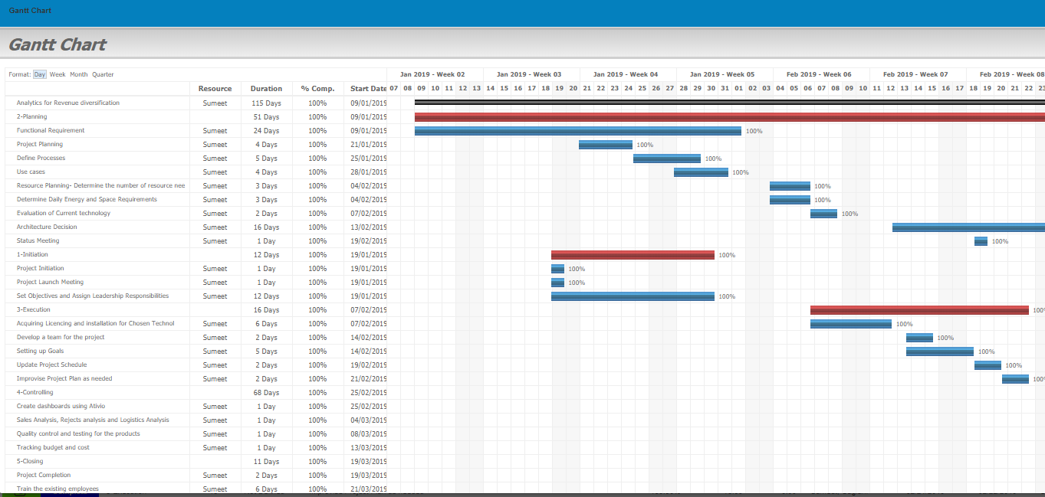
PROJECT PLAN

Slide 19
OTHER FACTORS
RISK
Setting up logistics and effectively supplying products according to city: This task would be heavy on the pockets of project sponsor. If the products which are supplied do not meet the customer expectation it will be a great loss for the company.
ISSUES
Collecting data across the continents: There would be a lot of data inconsistency since data would be gathered by different teams in different location.
DATA COLLECTION
The source for collecting data is from the Internet or devices used by the users to get trending food items they are searching for.
Customer feedback would be a vital data source for meeting up their expectation

Slide 20
OTHER FACTORS
SECURITY
In core Hadoop technology the HFDS has directories called encryption zones. When data is written to Hadoop it is automatically encrypted (with a user-selected algorithm) and assigned to an encryption zone. Encryption is file specific, not zone specific. That means each file within the zone is encrypted with its own unique data encryption key (DEK). Clients decrypt data from HFDS uses an encrypted data encryption key (EDEK), then use the DEK to read and write data. Encryption zones and DEK encryption occurs between the file system and database levels of the architecture.
Encryption keys need to be managed, which is the job of the Hadoop Key Management Server, or KMS. The KMS generates encryption keys, manages access to stored keys and manages encryption and decryption on HDFS clients. KMS is a Java web application with both client and server components that communicate with each other using HTTP and REST API. Security in KMS includes HTTPS secure transport and support for HTTP SPNEGO Kerboros authentication.
SCALABILITY
A system is said to be scalable if it can increase its workload and throughput when additional resources are added. Developing a comprehensive scalable data platform is key to continuing the projects development.. Scaling up or Vertical scaling is process in which you add new resources like memory or CPU to improve system performance. Scaling out or Horizontal scaling is the process of adding more hardware to a system.

Slide 21
OTHER FACTORS
MANAGEMENT
Manageability is brought about by using Apache ZooKeeper. ZooKeeper is a distributed application providing services for managing a distributed application. In the project, ZooKeeper helps to coordinate and manage shared data with robust synchronization techniques. Some common services provided by the ZooKeeper are Naming service, Configuration management, Cluster management, Locking and synchronization service and reliable data registry. ZooKeeper uses a custom messaging protocol, which ensures that the local replicas never diverge. It also provides high performance by its reads outnumber writes, which is a typical showcase for a coordination service. It is also able to sustain a high throughput even when a server node which performs automatic recovery fails. One main highlight of this is that, no transaction is left partial, rather, it succeeds completely or fails completely which avoids any data corruption in the process.

